Slide 1
Lot
…Failure to think beyond the here and now

Slide 2
Layout by Charlie H. Campbell

Slide 3
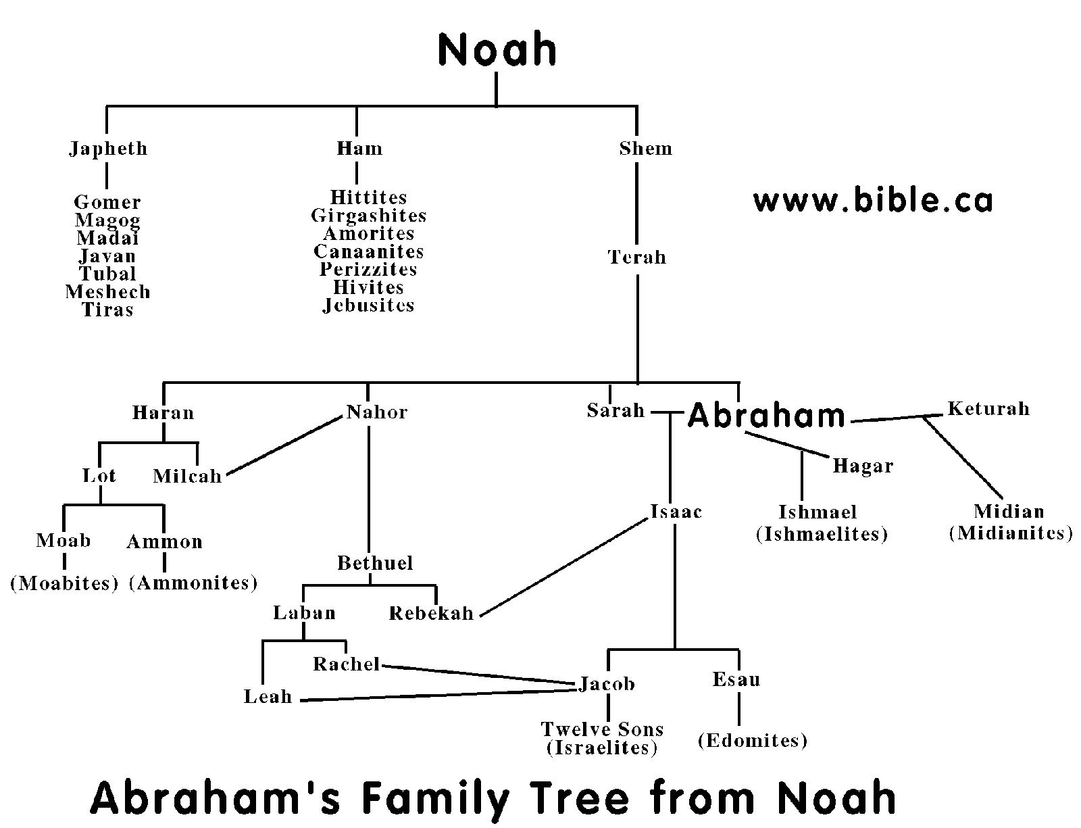

Slide 4
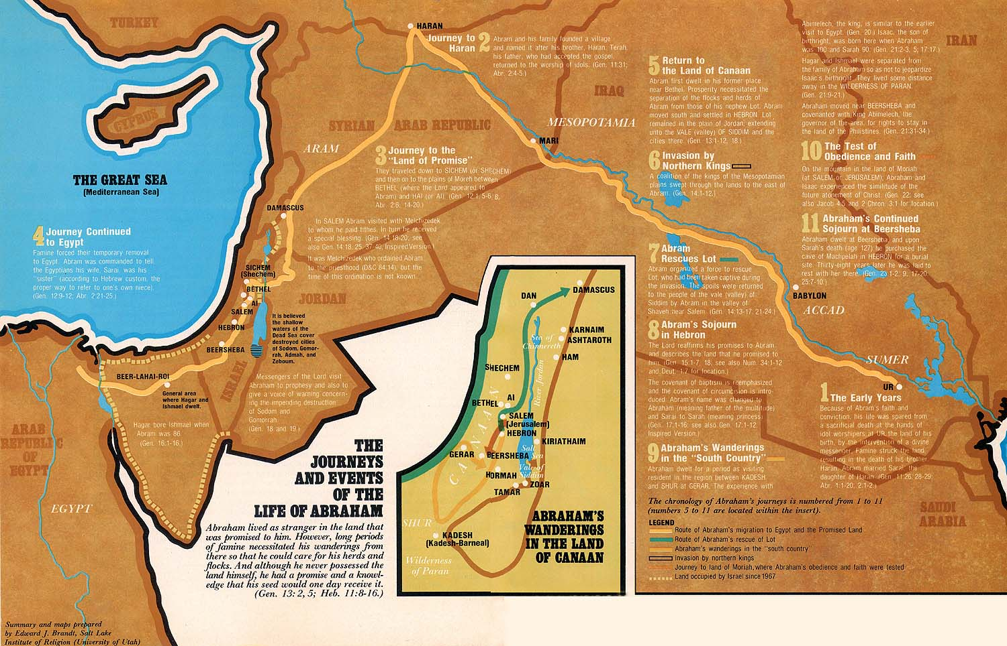

Slide 5
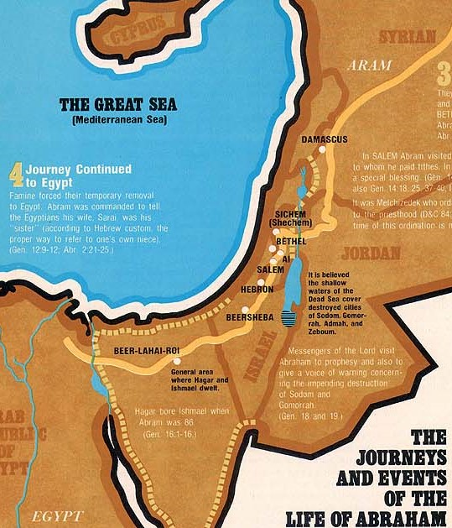

Slide 6


Slide 7
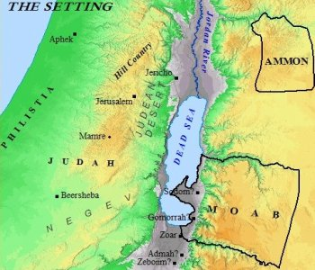

Slide 8
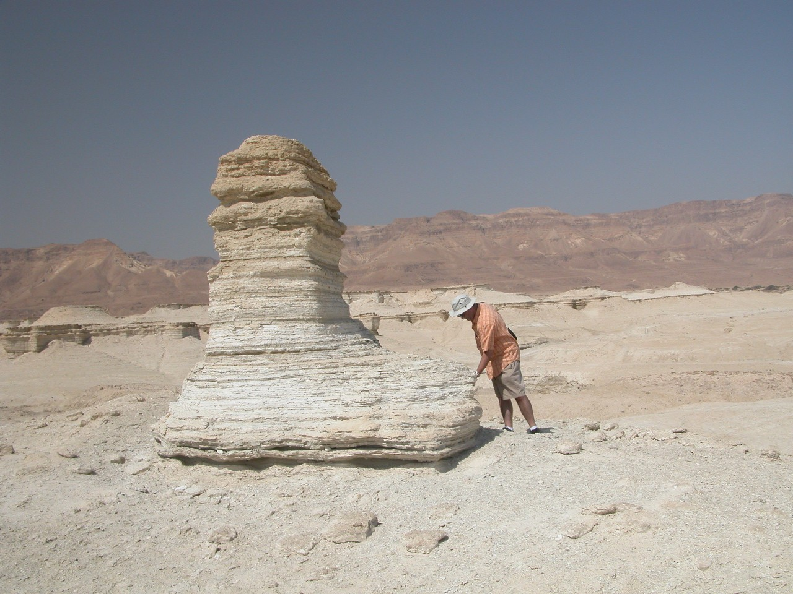
A Pillar of Salt

