Slide 1
Next Week
Stephen
  Acts 6
  Acts 7

Slide 2
Phinehas
Characters that Build Character

Slide 3
Phinehas
fin’ e- as
Mouth of Brass
Son of Eleazar, grandson of Aaron

Slide 4
History Ties
Wilderness Wandering
Last encampment before going into Canaan - Shittim
Moses stepping down and Joshua taking command of Israel
Balak and Balaam
  Numbers 22
Conquest of Canaan

Slide 5
Main Events
Baal Worship at Peor/Shittim
  Numbers 25:6-18
  Plague that killed 24,000
Vengenace in Midian
  Numbers 31
  Balaam killed and women?
Altar of Witness
  Joshua 22: 10-34

Slide 6
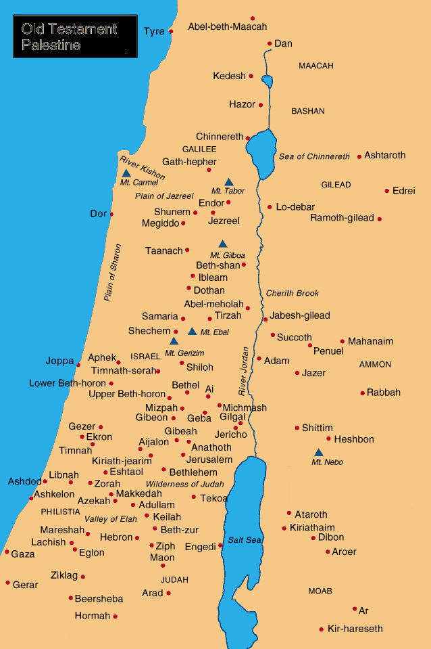

Slide 7
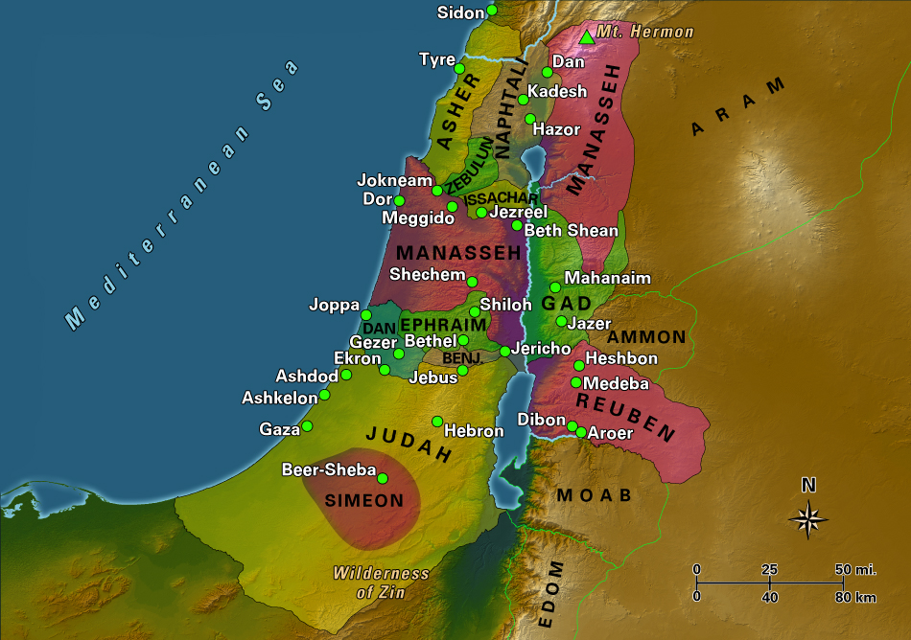

Slide 8
Phinehas Character Traits
Zeal
  What kind of Zeal do you have
  Midian was stealing the hearts of Israel causing them to sin against God
Leader
Take Action
  Are you confident enough to take action against those destroying causing the congregation/the body to die.

