Slide 2
called to BECOME
2 Peter 1.4

Slide 3
always in Control
2 Peter 1.6

Slide 4
“Now for this very reason also, applying all diligence, in your faith supply moral excellence, and in your moral excellence, knowledge, and in your knowledge, self-control, and in your self-control, perseverance, and in your perseverance, godliness, and in your godliness, brotherly kindness, and in your brotherly kindness, love.”
2 Peter 1:5–7
always in Control
2 Peter 1.6

Slide 5
“Now for this very reason also, applying all diligence, in your faith supply moral excellence, and in your moral excellence, knowledge, and in your knowledge, self-control, and in your self-control, perseverance, and in your perseverance, godliness, and in your godliness, brotherly kindness, and in your brotherly kindness, love.”
2 Peter 1:5–7
always in Control
2 Peter 1.6

Slide 6
Bringing Into Control…
Our eyes (Job 31.1; Matt 5.27-28)
Our ears (Isaiah 33.15)
Our tongues (James 3.6-12)
Our thoughts (Philippians 4.8)
always in Control
2 Peter 1.6

Slide 7
Gaining Control
Remember your reward is on the line (1Corinthians 9.25)
always in Control
2 Peter 1.6

Slide 8
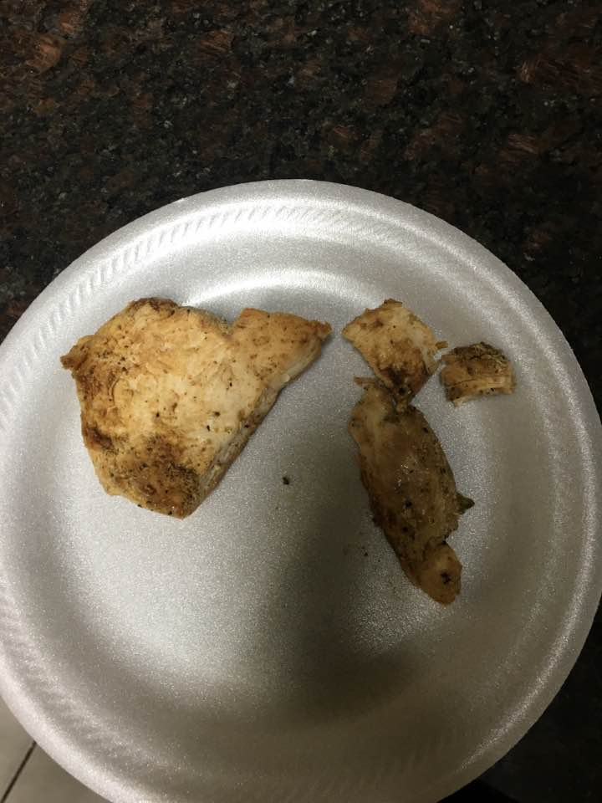
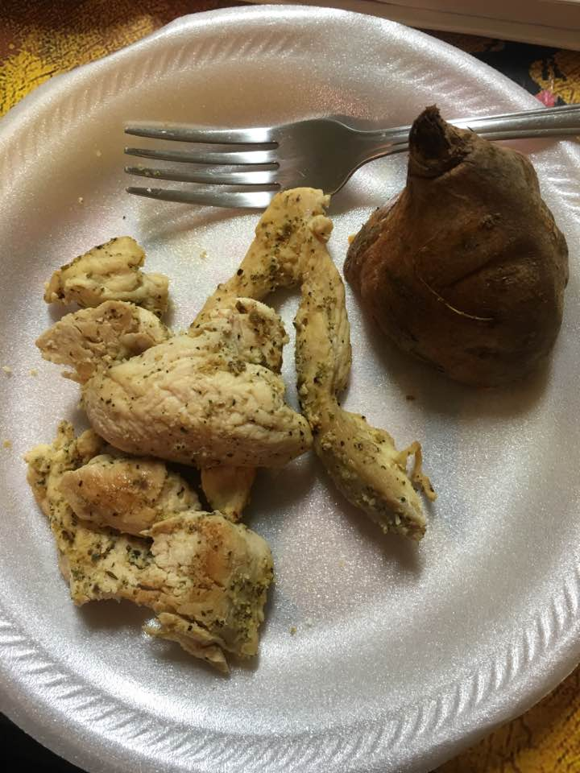
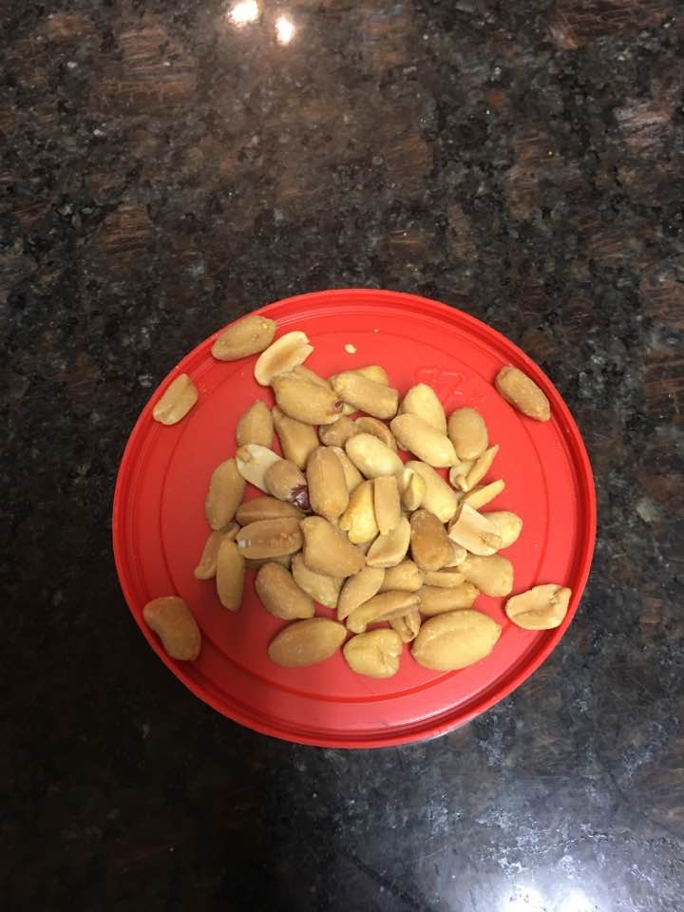
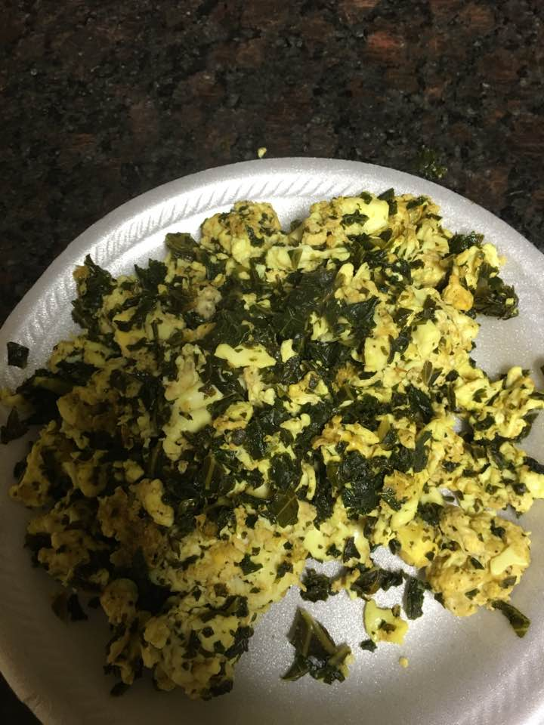

Slide 9
Gaining Control
Remember your reward is on the line (1Corinthians 9.25)
It’s a daily discipline (1Corinthians 9.27)
Avoid the situations where you may lose control (2Timothy 2.22)
Replace bad practices with good ones (1Timothy 6.11)
Pray (2Thessalonians 1.11)
If you stumble, repent and start again (1John 1.8-9)
always in Control
2 Peter 1.6

