Slide 2
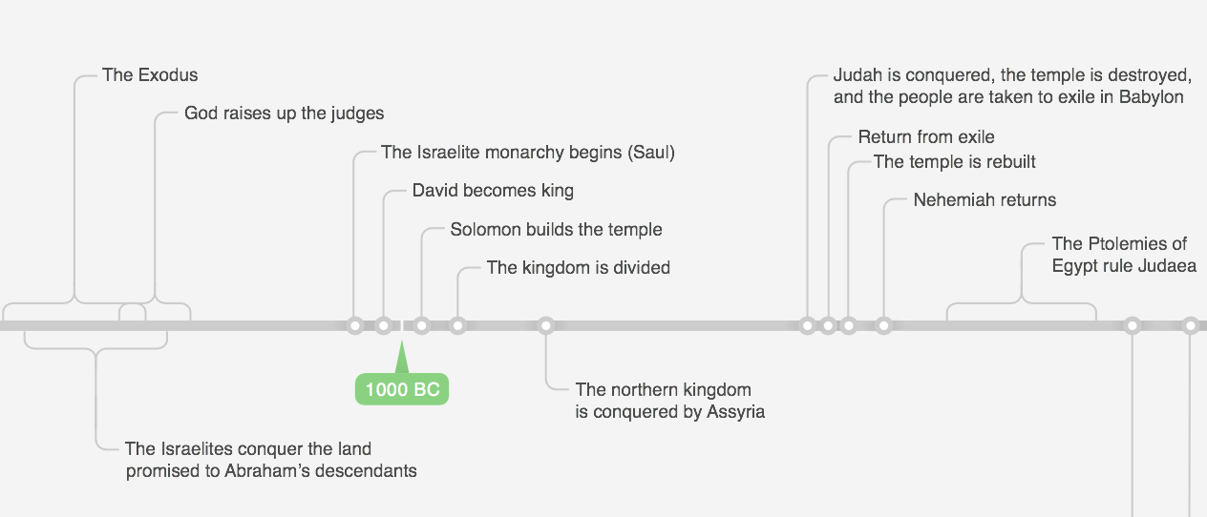
Deut. 28 1400 BC
Isaiah 44 700 BC
Ezra 536 BC

Slide 4
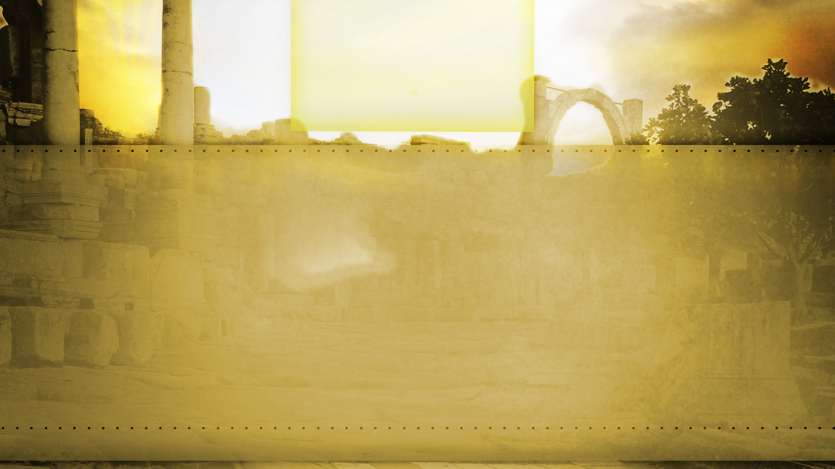
Why Israel Was Failing
Because of external obstacles (Ezra 4.1-5, 24)
Because they were discouraged (Ezra 3.12-13; Haggai 2.3)
Because they were preoccupied with their own interests (Haggai 1.2-4)

Slide 5
Finish The Mission!
So that God would be pleased (Haggai 1.8)
So that God would be glorified (Haggai 1.8)
So that God would be with them (Haggai 1.13)

Slide 6
Finish The Mission!
“Then Zerubbabel the son of Shealtiel, and Joshua the son of Jehozadak, the high priest, with all the remnant of the people, obeyed the voice of the Lord their God and the words of Haggai the prophet, as the Lord their God had sent him. And the people showed reverence for the Lord.” (Haggai 1:12, NASB95)

