Slide 1
Nabal and Abigail
Characters that Build Character

Slide 2
Polar Opposites
Nabal
Fool
1Sam.25:3 Harsh and badly behaved
Abigail
Discerning and beautiful

Slide 3
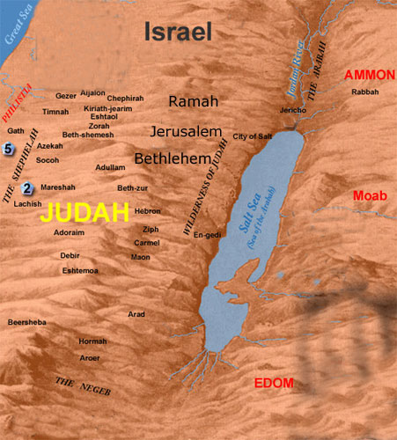

Slide 4
Themes 1 Samuel 25
Nabal’s Foolishness
Abigail’s Wisdom
David’s let’s the Lord deliver justice

Slide 5
Nabal
Very Rich
3000 Sheep
1000 Goats
Beautiful and Discerning wife
Foolish Attitude
False sense of Power
Vs 14.. Nabal railed at them

Slide 6
Abigail
Made haste
200 loaves, two skins of wine, five sheep already prepared, five seahs of grain, hundred clusters of raisins, two hundred cakes of figs.
Hurried
Lord restrained you from bloodguilt and from saving with your own hand
Vs 30-31. “working salvation himself”
Vs 36 Abigail’s wisdom on discussing issues with Nabal

Slide 7
Summary
Phinehas
Mighty Men
Stephen
Mordecai
Abigail
Jael
Individual Action
Decisive Conviction
Pure Hearts

