Slide 1
Mordecai

Slide 2
Mordecai Facts
Jew from the tribe of Benjamin
lived in Susa, the capital of Persia
he had been taken captive by Nebuchadnezzar
acted as a father to Esther who was his uncles daughter—first cousin

Slide 4
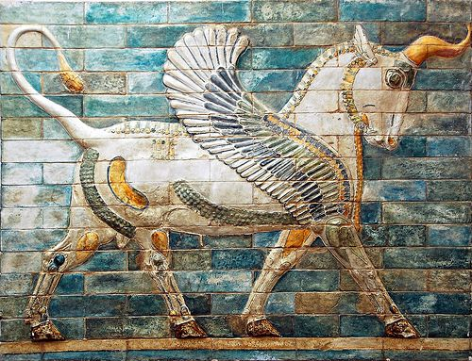

Slide 6
Facts about the book of Esther
Mordecai possibly the author of Esther- Esther 9:20-22
The book of Esther was most likely written between B.C. 460 and 331, after the reign of Xerxes I but prior to Alexander the Great's rise to power.
The book of Esther was written to the Jewish people to record the origins of the Feast of Lots, or Purim.
The story takes place during the reign of King Xerxes I of Persia, primarily in the king's palace in Susa, the capital of the Persian Empire.

Slide 7
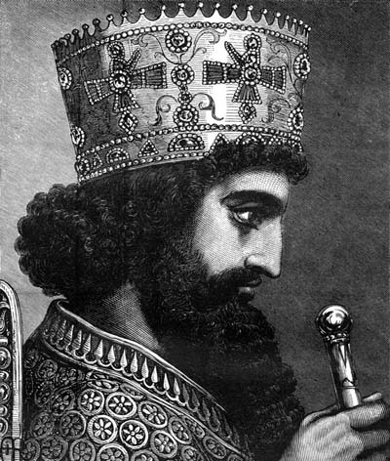
King Xerxes I & Esther

Slide 8
The Gallows
In the work of the Greek historian Herodotus, impalement is regularly presented as a Persian punishment. Given the setting of Esther, it thus seems likely that the manner of punishment for Haman was in fact impalement.

Slide 9
Pride cometh before the fall
Vashti, Hamman, and King Xerxes
“pride cometh before the fall (Prov 11:2)
God will resist the proud person and only then will He give grace to those who humble themselves (James 4:6).
“Before a downfall the heart is haughty” (Prov 18:12a).

Slide 10
For such a time as this
“Do not think to yourself that in the king’s palace you will escape any more than all the other Jews. For if you keep silent at this time, relief and deliverance will rise for the Jews from another place, but you and your father’s house will perish and who knows whether you have not come to the kingdom for such a time as this” (Esther 4:13-14)

