Slide 4
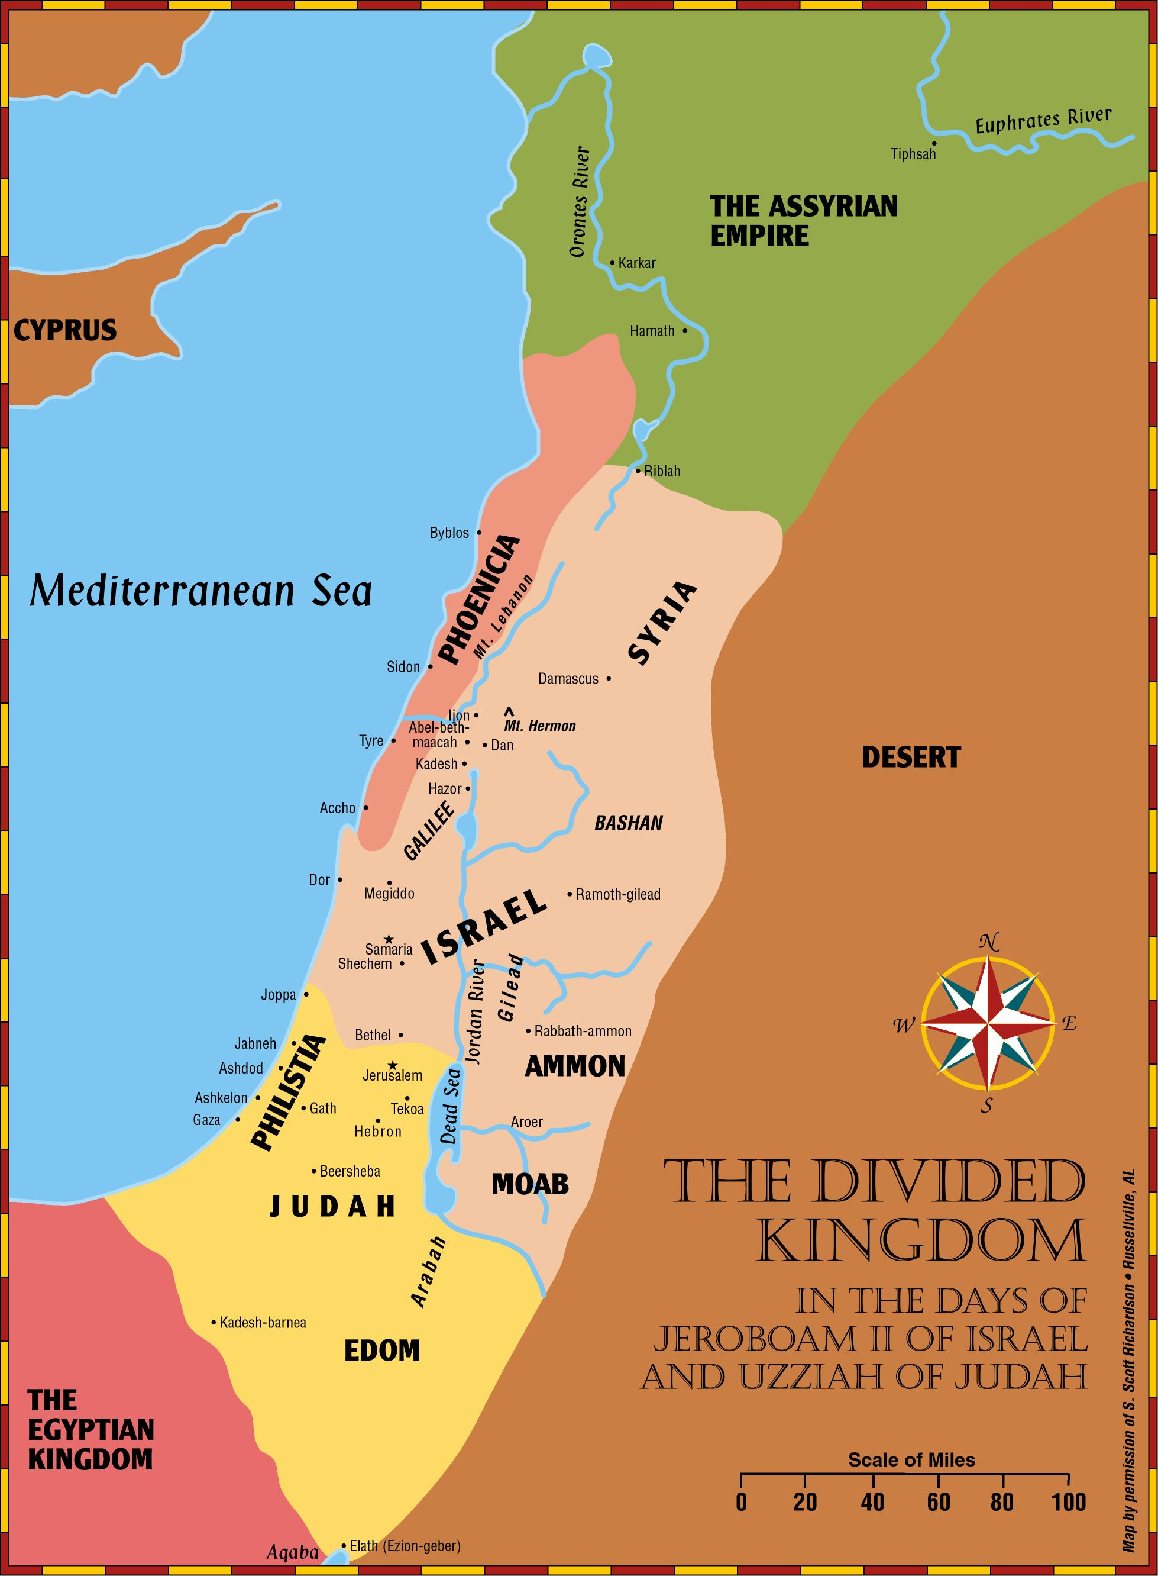

Slide 5
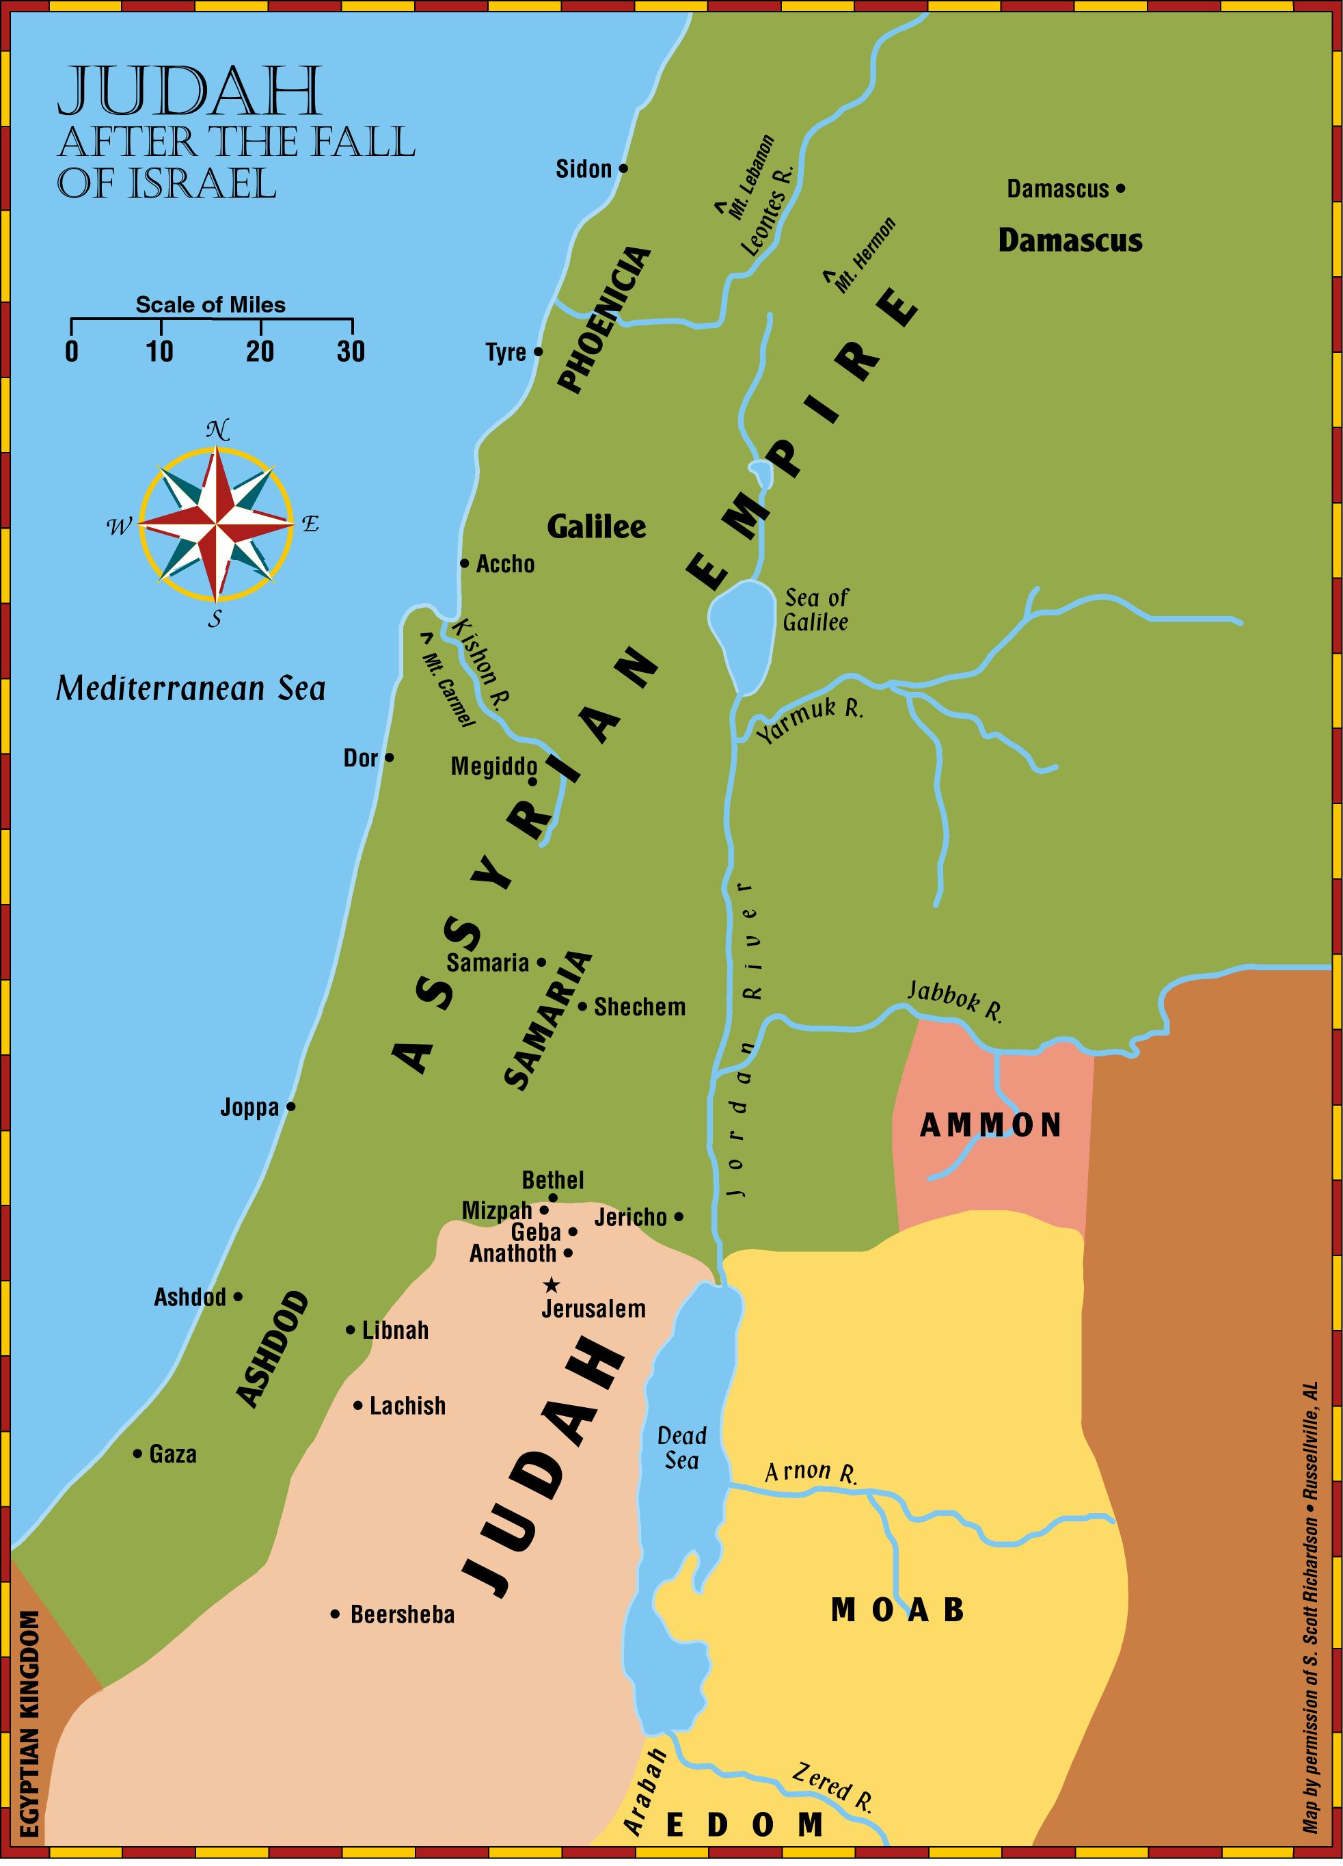

Slide 6
Moresheth

Slide 7
“Micah of Moresheth prophesied in the days of Hezekiah king of Judah; and he spoke to all the people of Judah, saying, ‘Thus the Lord of hosts has said, “Zion will be plowed as a field, And Jerusalem will become ruins, And the mountain of the house as the high places of a forest.”’”
(Jeremiah 26:18, NASB95)

Slide 8
Three cycles of judgment & hope
Israel & Judah punished, but Jacob will be gathered (Micah 1-2)
Jerusalem & her leaders destroyed, but God’s Kingdom established under the Shepherd-King (Micah 3-5)
God’s indictment of His people, but the hope of the righteous (Micah 6-7)
the book of Micah

Slide 9
Our Glorious Reality (Micah 4-5)
What The Lord Requires (Micah 6.8)
The Righteous Response To A Sinful World (Micah 7)
the book of Micah

