Slide 2
John the Baptist
Who are you?

Slide 3
John the Baptist

Slide 4
John the Baptist

Slide 5
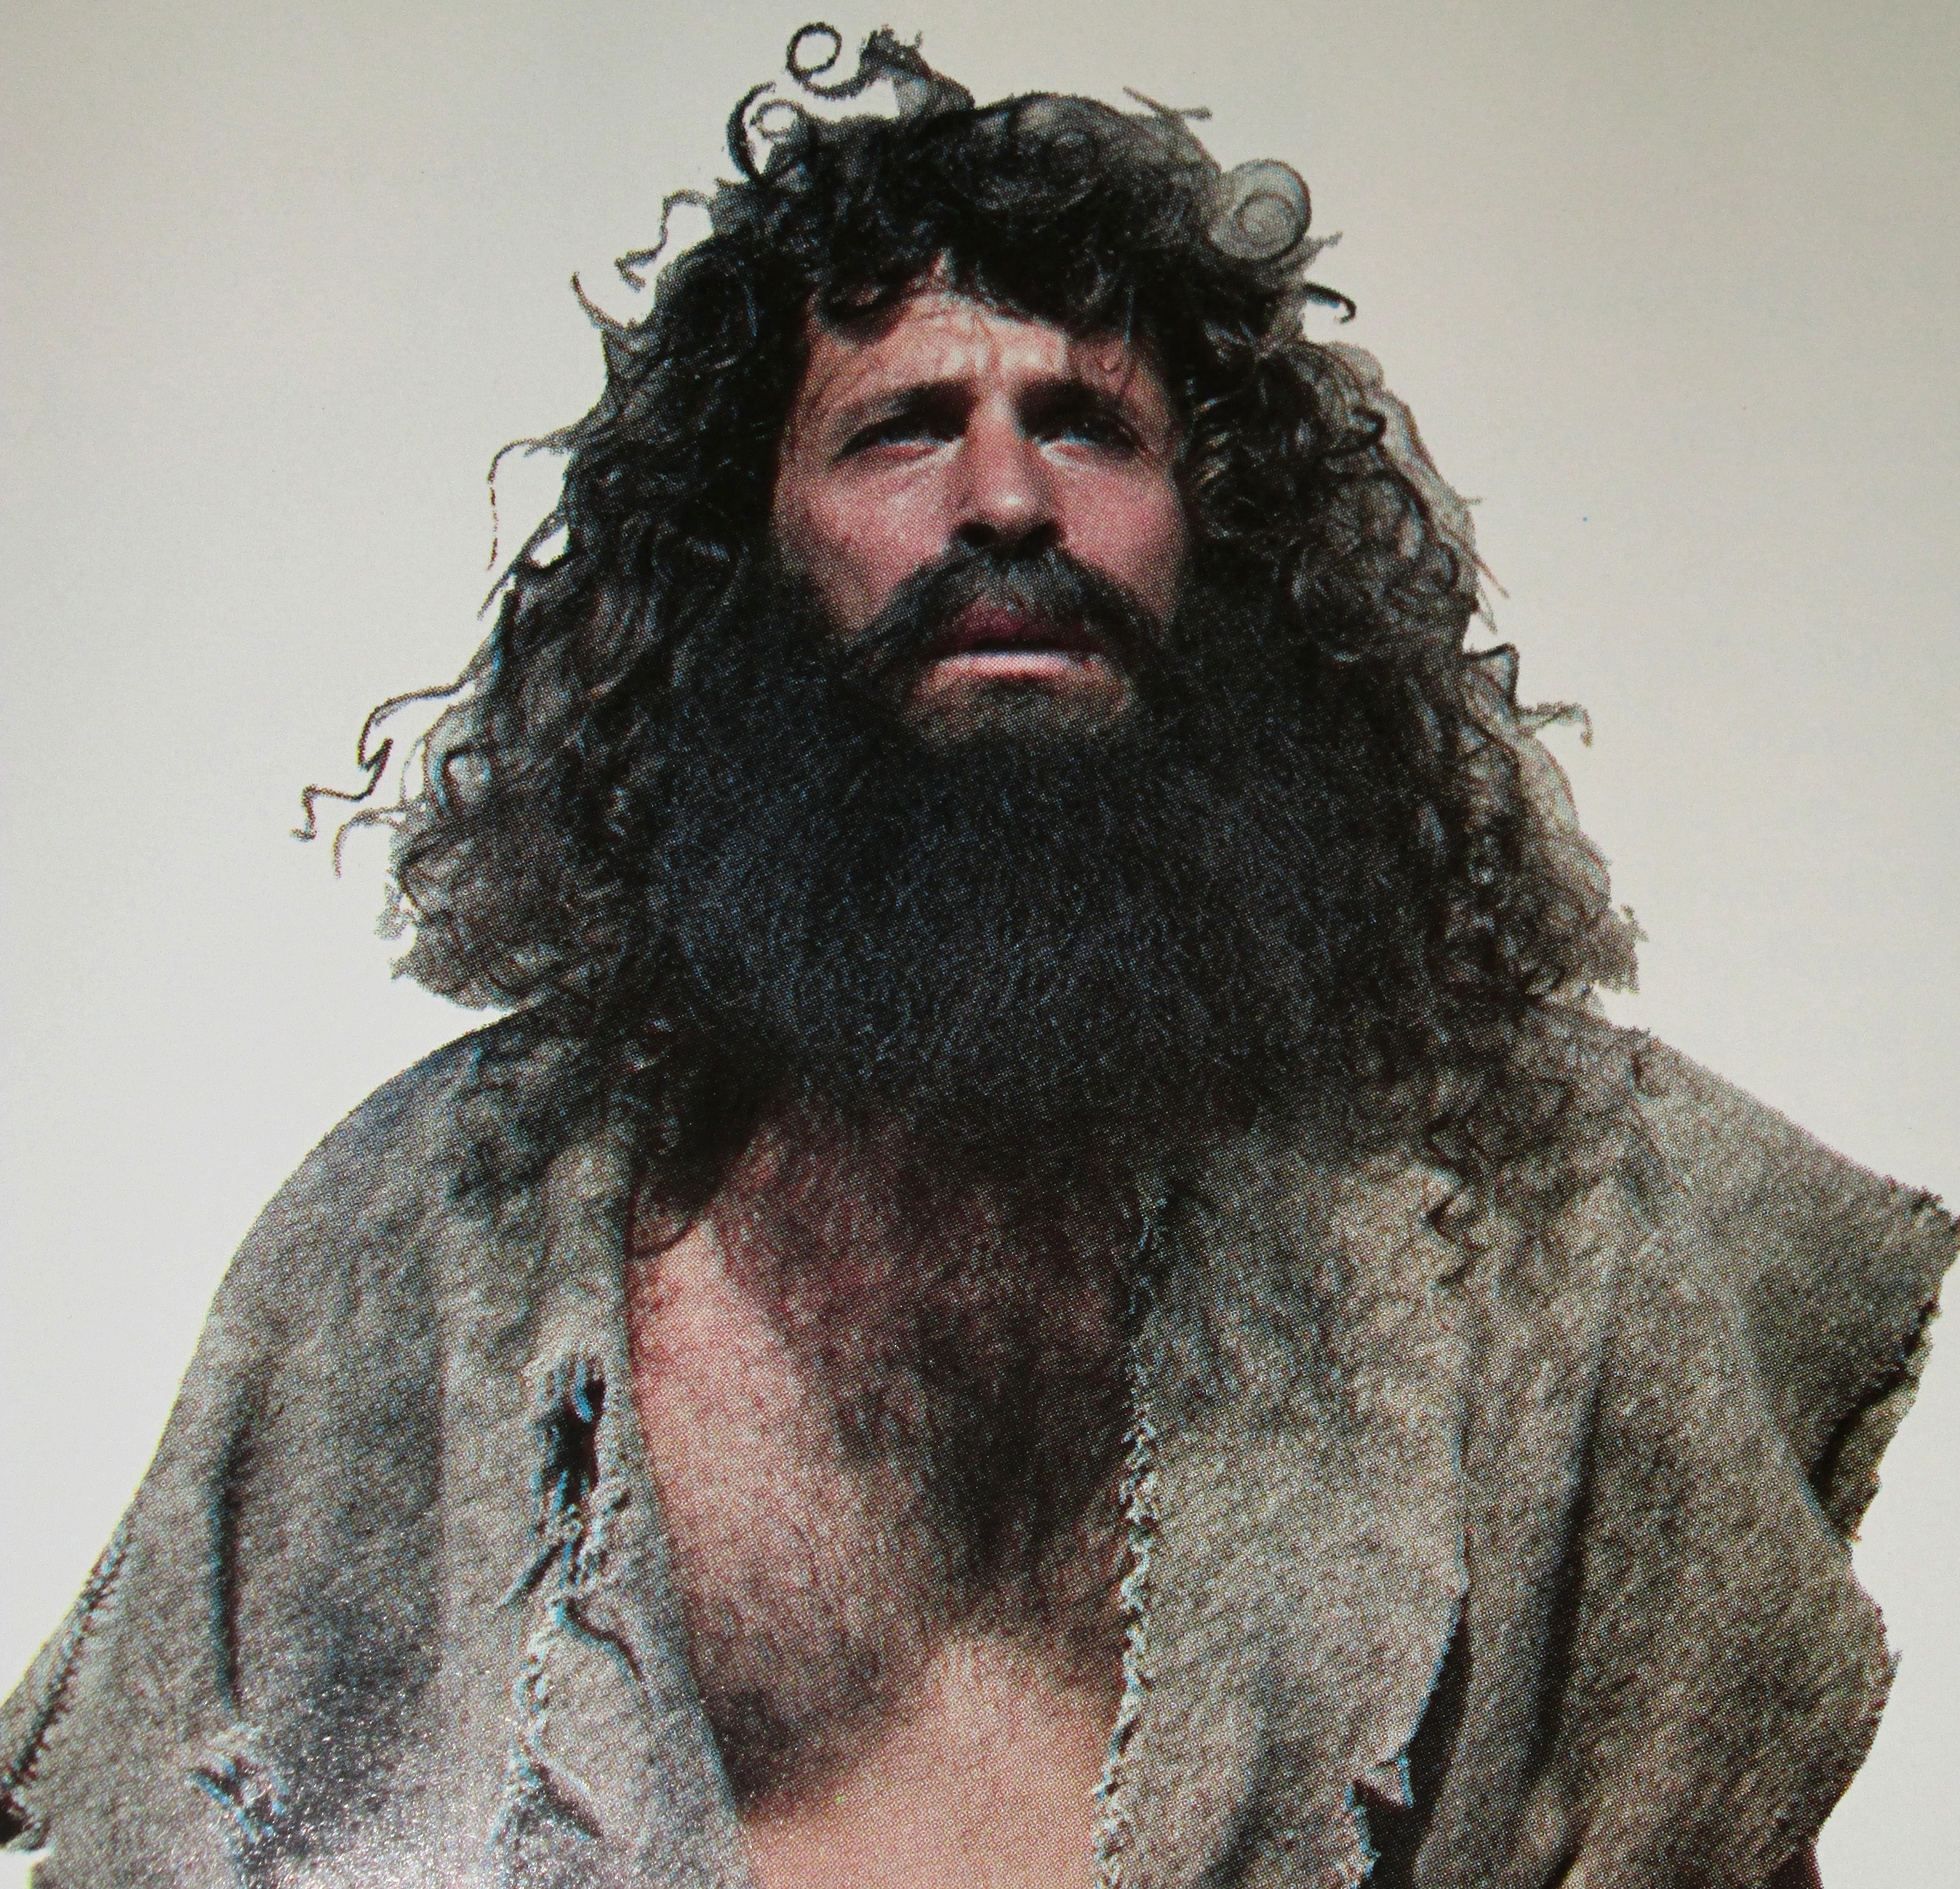

Slide 6
John the Baptist
Did he start the church?

Slide 7
John the Baptist’s Role
Subordinate to Christ
A Ministry of Reconciliation

Slide 8
Isaiah 40:3-5 - A voice cries: “In the wilderness prepare the way of the Lord; make straight in the desert a highway for our God. Every valley shall be lifted up, and every mountain and hill be made low; the uneven ground shall become level, and the rough places a plain. And the glory of the Lord shall be revealed, and all flesh shall see it together, for the mouth of the Lord has spoken.”

Slide 9
Malachi 4:5,6 - “Behold, I will send you Elijah the prophet before the great and awesome day of the Lord comes. And he will turn the hearts of fathers to their children and the hearts of children to their fathers, lest I come and strike the land with a decree of utter destruction.”

Slide 10
Mt. 11:13-15 - “For all the Prophets and the Law prophesied until John, and if you are willing to accept it, he is Elijah who is to come. He who has ears to hear, let him hear.”

Slide 11
Lessons Learned from John the Baptist
Humility
“I am not the Christ”
“I am not Elijah”
”I am not the prophet”
“I am the voice of one crying in the wilderness make straight the way of the Lord, as said Isaiah the prophet.”

Slide 12
Lessons Learned from John the Baptist
Humility
“I am not the Christ”
“I am not Elijah”
”I am not the prophet”
“I am the voice of one crying in the wilderness make straight the way of the Lord, as said Isaiah the prophet.”

Slide 13
Lessons Learned from John the Baptist
Humility
Uncompromising condemnation of sin
Disinterest in material things

Slide 14
John the Baptist
“I tell you, among those born of women none is greater than John.”

