Slide 2
Planting of Tottlebank Church (Winstanley – p. 22)
Camelford and Sawrey organized a congregation of Tottlebank. The Five-mile Act of 1665 prohibited any ejected minister from going within five miles of any corporate town or his former parish, unless he took an oath that he would not seek any change of government either in church or state. Sutherland concludes that “the situation of Tottlebank, over five miles from Stavely and over five miles from the market town of Ulverston, suggests that it was chosen originally to avoid penalties under the Act”.
Original Minute-book
The original Minute-book of this historic occasion is now preserved in the library of Regent Park College, Oxford University, where it can be consulted. Here is how it begins:
“This booke is for the use of that Church of Christ in Broughton,
Ffurnessfells and Cartmell whereof Mr. Gabriel Camelford is teaching elder, 18th day of the sixth month called August 1669. A Church of Christ was founded in order and faith drawn together in the fellowship and order of the Gospel of Jesus Christ.”

Slide 3
Tottlebank – 1669
Eight men are named as being present “at the home of William Rawlinge of Tottlebank.” At first all meetings of this congregation would have to be in the homes of members because prior to 1689 the erection of places of worship by Nonconformists was illegal.
Distinguishing Marks
William Robinson wrote concerning Tottlebank: “It is interesting to note that the church had the following marks usually associated with the Reformation of the Campbells:
1. It was named ‘The Church of Christ’.
2. Only Believers’ Baptism by immersion was practiced.
3. The Lord’s Supper was the chief service of worship each Sunday and only baptized communicants were allowed.
4. The government was congregational and there was liberty of ministry. Elders and deacons were ordained and one elder served as a Teaching Elder, and supported by the church”.

Slide 4
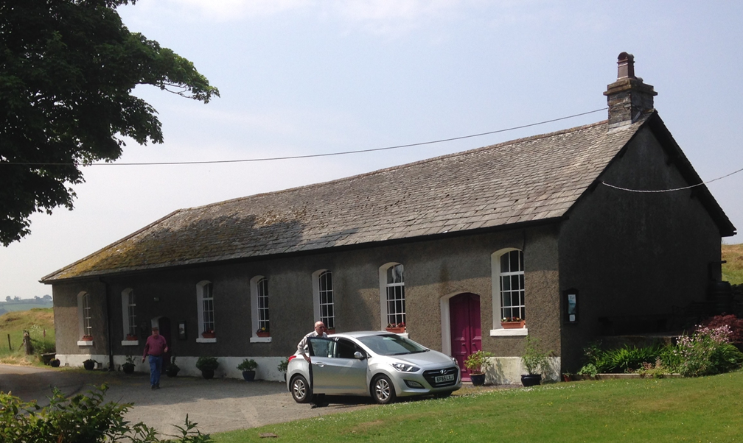

Slide 5
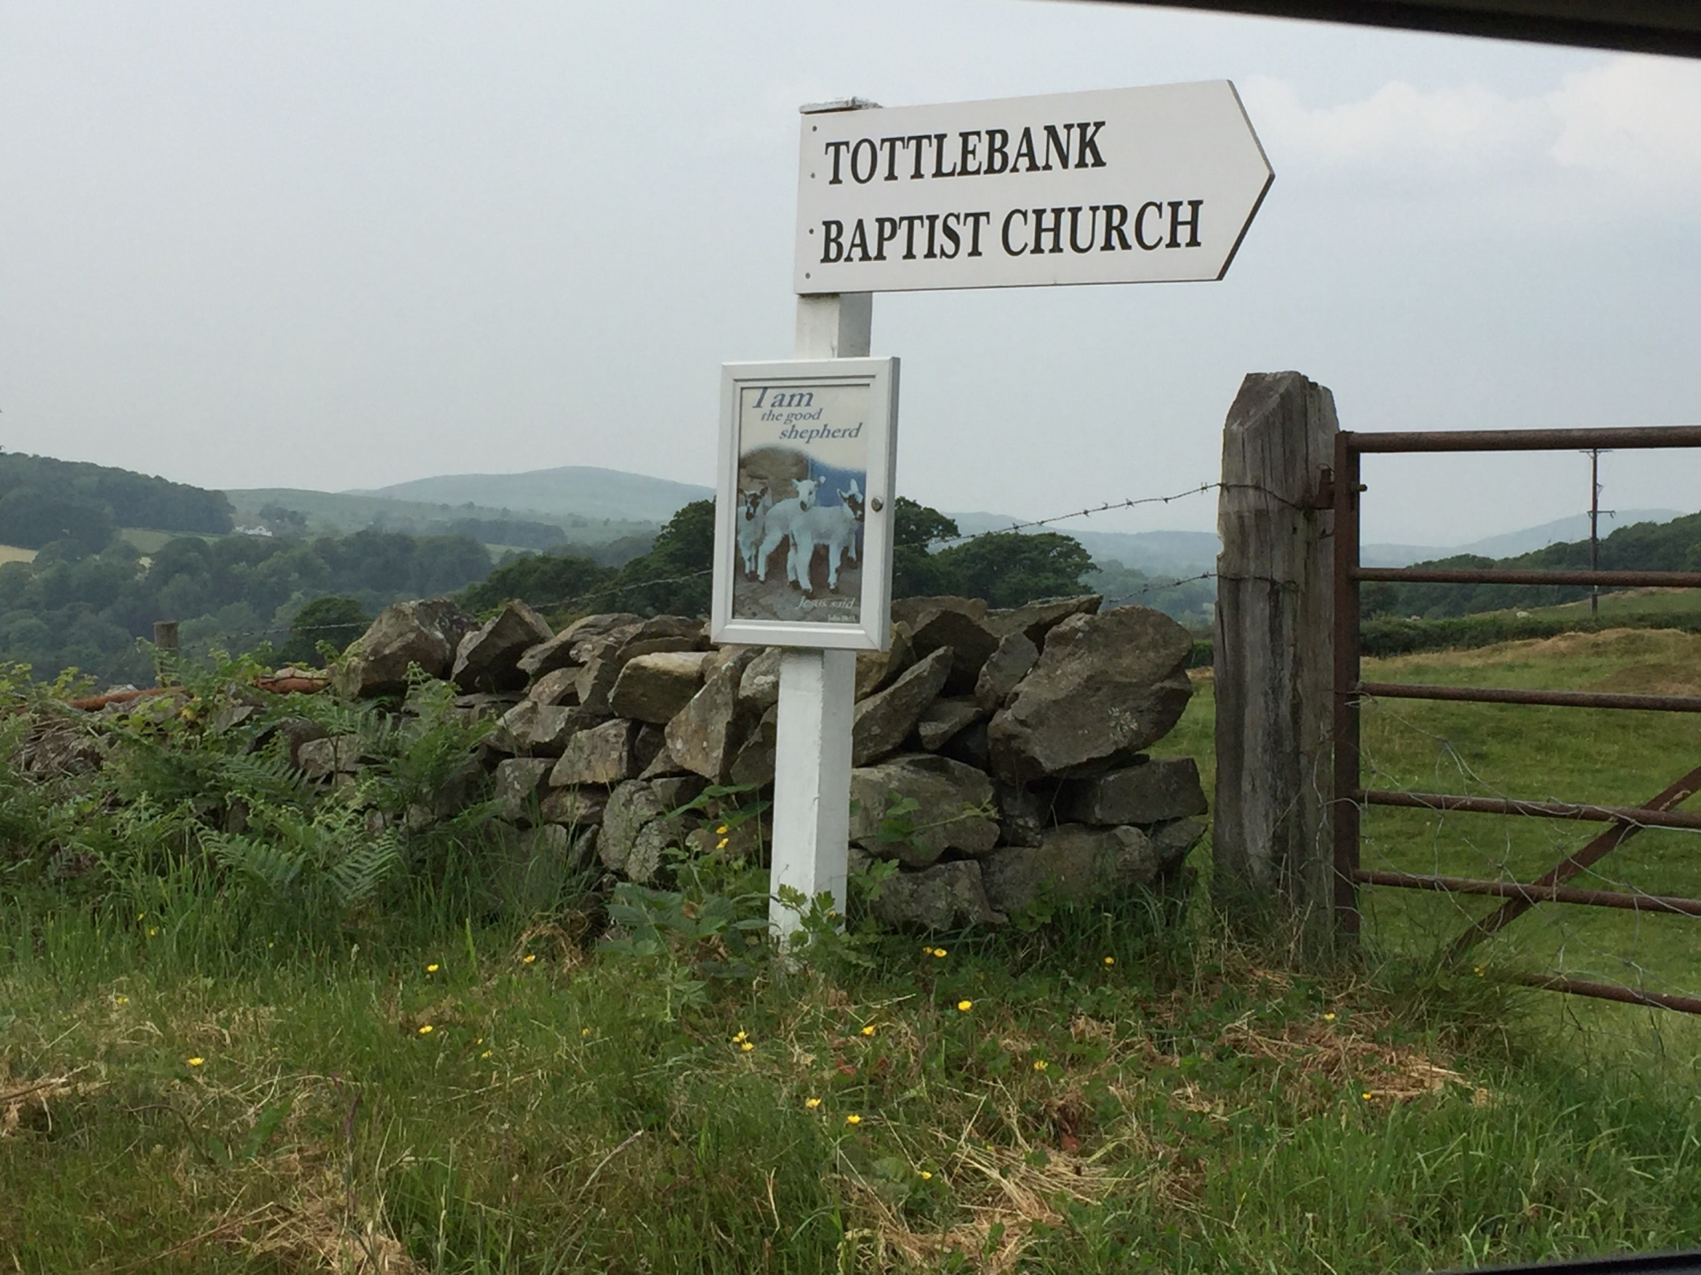

Slide 6
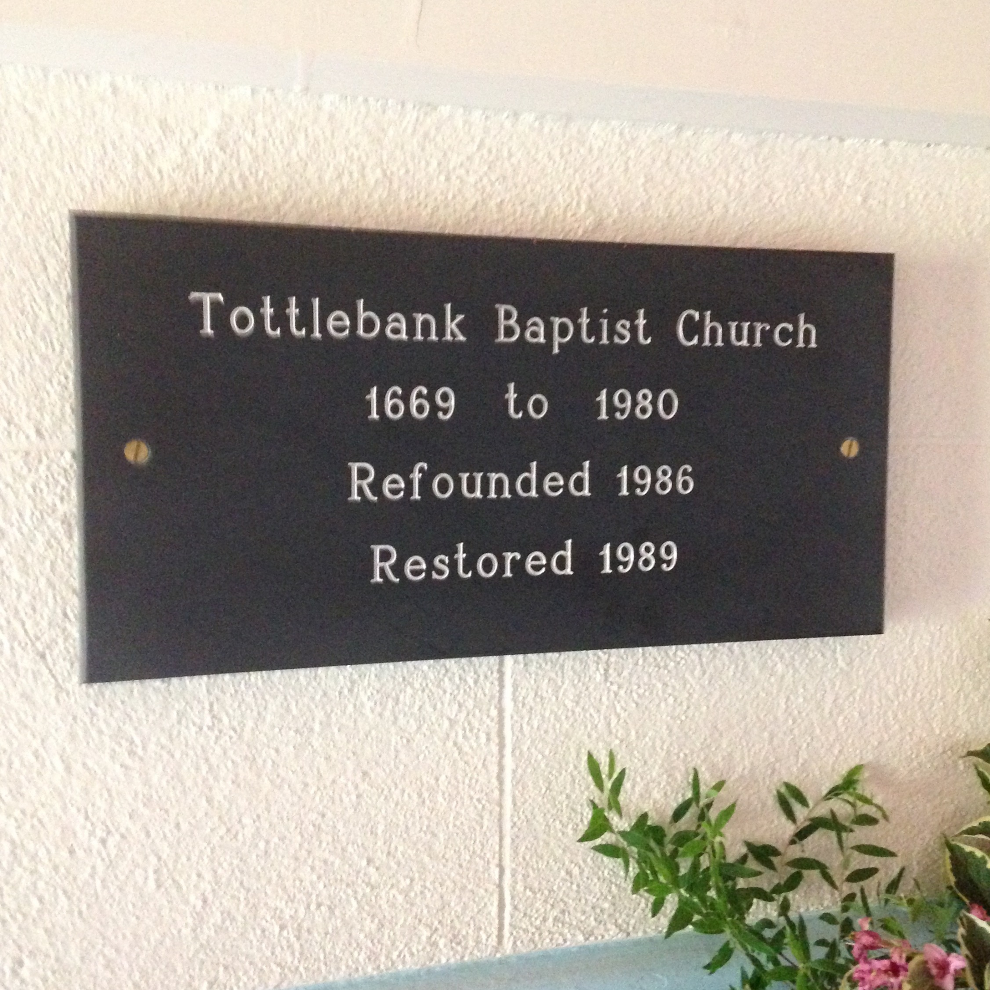

Slide 7
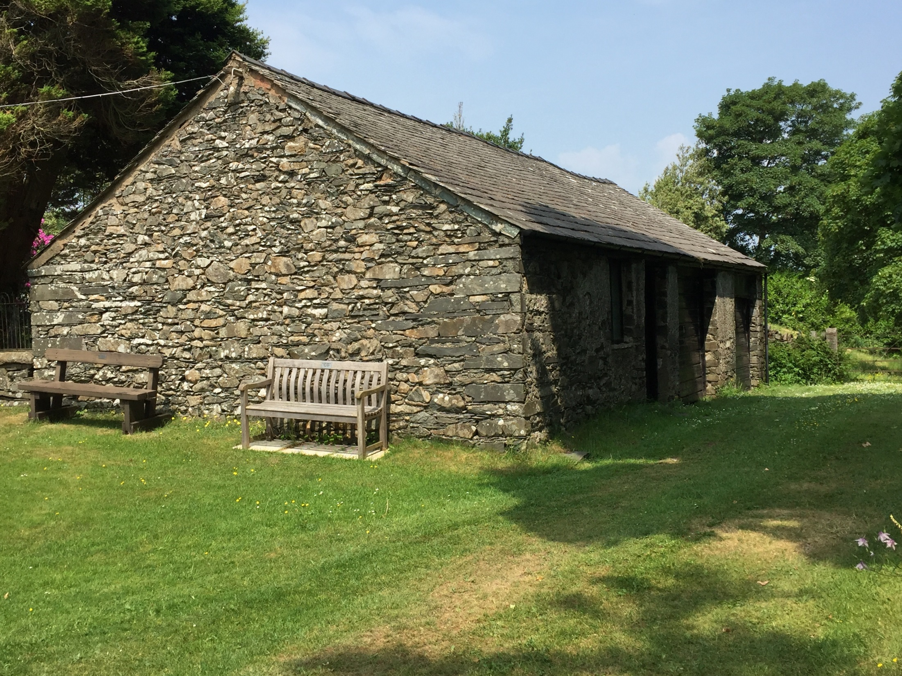

Slide 9
The Middle Period 1848-1914 (John Renwick, p. 109 ff)
In any movement, the initial stages are usually vibrant and exciting. Staying the course is more difficult. It takes tenacity and perseverance. In the early years of the Restoration Movement William Thompson noted that the efforts of the evangelists were spread too thin and that more ministers of the Word were needed. The only way that the young churches saw to remedy this situation was to pool their resources. At first this was tried nationally and then at a district level. Evangelists were supported by groups of churches and they would divide their time among them, ministering to each in turn. This seemed like a good arrangement but in later years proved a dangerous concept as all sorts of supra-congregational committees evolved to take care of the business of the church. This jeopardized the New Testament principle of congregational autonomy. Matters that should have rested with elders and members of local churches were taken out of their hands. They were then dealt with by a multiplicity of select groups that functioned above the level of the local churches.

Slide 10
The Middle Period 1848-1914 (John Renwick, p. 109 ff)
In any movement, the initial stages are usually vibrant and exciting. Staying the course is more difficult. It takes tenacity and perseverance. In the early years of the Restoration Movement William Thompson noted that the efforts of the evangelists were spread too thin and that more ministers of the Word were needed. The only way that the young churches saw to remedy this situation was to pool their resources. At first this was tried nationally and then at a district level. Evangelists were supported by groups of churches and they would divide their time among them, ministering to each in turn. This seemed like a good arrangement but in later years proved a dangerous concept as all sorts of supra-congregational committees evolved to take care of the business of the church. This jeopardized the New Testament principle of congregational autonomy. Matters that should have rested with elders and members of local churches were taken out of their hands. They were then dealt with by a multiplicity of select groups that functioned above the level of the local churches.

Slide 11
The Middle Period 1848-1914 (John Renwick, p. 109 ff)
In any movement, the initial stages are usually vibrant and exciting. Staying the course is more difficult. It takes tenacity and perseverance. In the early years of the Restoration Movement William Thompson noted that the efforts of the evangelists were spread too thin and that more ministers of the Word were needed. The only way that the young churches saw to remedy this situation was to pool their resources. At first this was tried nationally and then at a district level. Evangelists were supported by groups of churches and they would divide their time among them, ministering to each in turn. This seemed like a good arrangement but in later years proved a dangerous concept as all sorts of supra-congregational committees evolved to take care of the business of the church. This jeopardized the New Testament principle of congregational autonomy. Matters that should have rested with elders and members of local churches were taken out of their hands. They were then dealt with by a multiplicity of select groups that functioned above the level of the local churches.

Slide 12
Page 152-153 (Frank Worgan)
The ‘Evangelistic Committee’ which was formed as the result of the Chester Conference (1847) proved to be the first of many other committees, for once the practice had been introduced and a precedent set, committees multiplied quickly, created in order to manage a wide range of church activities. This misguided proliferation of church officials culminated in the creation of a ‘Central Council’, which had its own ‘Sub-committee of the Central Council’, and a ‘President of Conference’ was elected annually.
The yearbook of 1933, which was the year when British Churches reported their highest membership, lists a staggering twenty-two Committees and Councils. How true it is that from little acorns mighty oaks do grow!
(This is the same time period when Alexander Campbell was promoting the formation of the Missionary Society in the U.S. to do work for the churches.)

Slide 13
Brother Campbell’s proposal, though accepted, created some surprise, since, it was known that, in the early days, when he produced “ The Christian Baptist”, he had expressed his very positive opposition to the creation and support of Missionary, Bible and Education Societies, declaring that they:
“robbed the Church of its glory and exalted the inventions of men
above the wisdom of God” He further wrote, that the early Christians “dared not transfer to such societies a cent or a prayer”! He declared that “in their
church capacity alone they moved.”
He had, it seems, changed his mind about such extra-organisation, since he had earlier also expressed disapproval of other expedients, intended to help in the spread of the Gospel.
We may imagine that they were even more surprised when on October 24th, 1849, he became the first ‘President’ of the newly created “American Christian Missionary Society.” The society was to elect twenty Vice-presidents, fourteen Managers and ten Foreign Managers. What scriptural justification could be produced for this organization is impossible to imagine. The strongest argument produced in support of this arrangement claimed that it was:
‘a plan for evangelizing the world, governed by the principle of expediency’.

Slide 14
Page 238 (Frank Worgan)
From that 1930 single seed, sown in 1861, there eventually grew a tree in whose many branches all kinds of birds made their nests!
The Growth of Unscriptural Organization
In the forty years from the 1847 Chester Conference to the year 1887 there had been added to the “General Evangelistic Committee” only three other committees. These were a “Training Committee”, a “Publishing Committee” and a “Sunday School Committee”, and in that year – 1887 – there existed 135 congregations, with a total of 8,306 members. But when we examine the annually produced statistics, we subsequently find that, after reaching the peak figures of 1930, church membership and the number of congregations had fallen drastically and continued to fall. Not so the number of officials!

Slide 15
Page 238
The Year Book for 1946 records that an impressive corps of special Church representatives had been appointed. These were
To the British Council of Churches, (Principal W. Robinson).
To the Free Church Federal Council, (J. W. Black, W. Mander, along with the
Chairman and the General Secretary of the Conference).
A Fraternal Delegate to the Baptist Union Assembly. (C. K. Green).
To the British Conference of Missionary Societies, (H. Philpott).
To the Youth Department of the British Council of Churches, (L. Colver).
To the Youth Committee of the Free Church Federal Council, (K. J. Simmnett).
To ‘Hold Conversations with Representatives of the Baptist Union’,
)W. J. Clague, W. Black, J.P. LL. D. W. Robinson M.A. D.D, A. C. Walters,
M.A., Ph D. and W. Mander, B.A.)

Slide 16
Page 238
An examination of the ‘Year Books’ reveals that by 1947 Committees had proliferated at such a rate that there had been created,
The Emergency Committee,
The Home Missions Committee;
The Missionary Committee,
The Sunday school and Youth Committee,
The Publishing Committee,
The Training Committee,
The Union Committee,
The Social Questions Committee,
The Nominations Committee,
The Press Committee,
The Women’s Committee,
The Chapel Building Committee,
The Chapel Building Trustees,
The Historical Committee,
The Board of Endowment Trustees,
The Commission on the Ministry.
The Churches of Christ Foreign Missions Property Society Ltd.

Slide 18
Page 178 (Frank Worgan)
‘Prophets of Liberalism’
The two American preachers mainly responsible for the trouble which arose were the afore-mentioned J. H. Garrison and a certain W. T. Moore.
According to Earl I. West, author of the highly regarded history of the Restoration movement, entitled: “The Search for the Ancient Order”, these two men were the leaders of “The Prophets of Liberalism” in the Church in the United States. When he listed the names of those advocating liberalism in that country, he concluded with the names of Garrison and Moore and stated:
“In lasting influence the latter two are far more significant than
the others.”
“Before considering the liberal movement that arose in the church
It is well to consider its two greatest promoters – J. H. Garrison
and W. T. Moore”?

Slide 19
(Heritage & Destiny, Winfred Garrison, pp. 37-38)
If anyone else were listing the fathers of the latter half of the nineteenth century, he would doubtless mention J. H. Garrison at this point. Since he was my father, I can only hint at what I would say about him if he were not. As editor for forty years and editor emeritus and regular contributor for almost twenty more, he made The Christian-Evangelist the principal journalistic influence toward liberty and unity among Disciples themselves: liberty as against the dogmatic proscription of variant theological views, and unity in fellowship among all Christians and in the promotion of the brotherhood’s common enterprises of evangelism, missionary expansion, and education. He was perhaps foremoset among those who led Disciples to enter, at first hesitantly and then wholeheartedly, into the ecumenical movement in which they now seem so completely at home. There were many other able leaders in this movement, but his influence was conspicuous because of his seniority (he was an older man than Ainslic, Philputt, Powell, or any of the dozen others who could be named in this connection), his personal prestige, and the fact that he had a newspaper for the amplification by his voice.

Slide 20
By all modern standards J. H. Garrison was a conservative in theology during the first half of his active editorial life. Later he became what he himself called a “liberal conservative.” That is to say, his personal views were moderately conservative, but he was boundlessly liberal in preserving the bonds both of personal friendship and of Christian fellowship with men whose views were either more conservative or more liberal than his own. In his early editorials (written while he was still a young man in his 30’s) he was demanding of the churches rigid conformity to the apostolic pattern in all things, though he never went so far as to rule out organs or missionary societies. Thus he attempted to carry on the “restoration” emphasis which was indeed one element of tradition derived from the founding fathers of Disciples of Christ. But gradually the unity element in the same tradition prevailed, and he came to see the incompatibility of the two, especially since the features of the primitive churches which were to be restored included a good many about which honest and intelligent differences of opinion were not only possible but actual. He became a spokesman for that more liberal strain in the Disciple tradition which sought unity among all Christians on such terms that matters of human opinion and debatable interpretations would no longer serve as barriers to keep them apart. In his last phase he came to regard the different views and practices of baptism as within the class of permissible differences by which Christians ought not to allow themselves to be divided.

Slide 21
The Middle Period 1848-1914 (John Renwick, p. 109 ff)
In any movement, the initial stages are usually vibrant and exciting. Staying the course is more difficult. It takes tenacity and perseverance. In the early years of the Restoration Movement William Thompson noted that the efforts of the evangelists were spread too thin and that more ministers of the Word were needed. The only way that the young churches saw to remedy this situation was to pool their resources. At first this was tried nationally and then at a district level. Evangelists were supported by groups of churches and they would divide their time among them, ministering to each in turn. This seemed like a good arrangement but in later years proved a dangerous concept as all sorts of supra-congregational committees evolved to take care of the business of the church. This jeopardized the New Testament principle of congregational autonomy. Matters that should have rested with elders and members of local churches were taken out of their hands. They were then dealt with by a multiplicity of select groups that functioned above the level of the local churches.

Slide 22
The Later Period 1915-1945 (Renwick)
This period saw vast and irreversible changes in the world as two great wars were fought out across the globe. The church too faced great change. Two generations of young Christian men and women had to face up to the issue of going off to war. At home, the church continued to grow. In 1890, 146 churches reported 8,985 members. In 1900, 173 churches reported 11,789 members. In 1911, 200 churches reported 14,725 members. In 1923, 201 churches reported 16,465 members. In 1939, 179 churches reported 15,229 members. This period however saw a movement back towards the denominational world. The 1914 conference agreed to join the Faith and Order Movement and sent representatives to their conference in Geneva in 1920. Publications abounded from songbooks to tracts. From 1935 the leading magazine was the Scripture Standard, the first editor being Walter Crosswaite.

Slide 23
Regarding growth of the gospel, Garrison, pp. 89ff)
Taking the 22,000 in 1832 as a base, it will be seen that the succeeding forty years the number of Disciples of Christ had been multiplied by sixteen, while the population of the United States had been multiplied by three.
In the hundred years from 1860 to 1960 their number was, approximately, multiplied by ten—in spite of the loss of an ultraconservative element now statistically separate as “Churches ofChrist” and claiming more members than Disciples of Christ and twice as many congregations.

Slide 24
Campbell and the development of the society: Garrison, p. 92)
In this changed situation he could see that it was not enough merely to reproduce as accurately as possible the polity and methods of the earliest churches. He did not abandon the restoration formula, but he dealt with it more freely and with some awareness that in the interest of efficiency in the modern world the church might need to adopt some methods for which there was no precise command in the apostolic teaching or precedent in the apostolic church. This might mean not only co-operation among the churches in spreading the gospel but also organizations, such as conventions and societies, to promote and stabilize such co-operation.

Slide 25
Campbell and the society: Garrison: p. 93
In spite of the reluctance of many and the opposition of a few, Disciples began to hold conventions and to form societies. The details have been recorded elsewhere. State conventions and state missionary societies in a few states preceded the first national convention (Cincinnati, 1849) and the organization of the American Christian Missionary Society with Alexander Campbell as its president. These societies, both state and national, actually contributed very little to the growth of the denomination during the first two or three decades of their existence. The numbers had nearly doubled in the eight years before 1840, and that was before there were any missionary societies. That doubled figure was almost tripled between 1840 and 1850, and the few fragmentary societies that existed had done practically nothing in that decade. The next decade showed an increase of more than sixty per cent, but the societies, though there were now several more of them, were still doing so little that such statistics about their work as are available seem absurd.

Slide 26
Ultimately, a division into three parts:
Churches of Christ
Christian Church (conservative)
Christian Church (Disciples of Christ)
Garrison, p. 103-104
The first and ultimately the most divisive issue had to do with the organization of missionary societies. In his Christian Baptist days Alexander Campbell had criticized the missionary societies then existing on both scriptural and practical grounds. They were not authorized in the New Testament and were therefore no part of the pattern to be restored. They were extravagant in their administration and inefficient in their operation. That was when there was no body of churches looking to him for advice as to how to carry on their promotional and missionary work. When there came to be such a group, he advised them to hold a convention and he became president of the society that convention organized. He had changed from the view that everything is forbidden that is not authorized to the view that whatever is not forbidden is permitted. There was an element among early Disciples who did not follow him in this change. The societies, both national and state, became controversial long before the issue became actually divisive.
While this issue was becoming hot, the “organ question” arose. It would have arisen sooner if organs had been available. This was an old quarrel. While Luther favored the use of the organ in worship, Calvin was as strongly antiorgan as Daniel Sommer or David Lipscomb ever was. Many of the eighteenth-century New England churches had been opposed to instrumental music, though there the instrument in question was the “bass fiddle.” The issue was more acute among Disciples because many believed that the restoration of a primitive pattern was of the essence of their distinctive plea. Many opposed the organ who supported the missionary societies, but most of these ultimately (page 104) waived their objection. The organ question by itself would never have produced an open break, but it widened the rift that was already opening. W. T. Moore called the years from 1866 to 1875 the period of controversy. It was indeed a period of very little except controversy, and the battles of those years were the more fierce because the combatants, being still within the same communion, could fight at close range. Each party could still cherish the hope of bringing the whole movement to its point of view. Actual separation began in the1880’s, and the division was made a matter of statistical record in 1906 when the federal religious census of that year listed Disciples of Christ and Churches of Christ as two distinct “denominations.”
The separation having become a fact of history, other differences developed in the spirit and ethos of the two groups and in the directions of their further change. Among other differentia of less importance, there came to be a sharp contrast between their respective attitudes toward other communions and toward co-operative work with them. It became a mark of the Churches of Christ to engage in no co-operation for any purpose with any other religious body. Disciples of Christ, on the contrary, have welcomed every opportunity for such co-operating.
Page 108
Another breach was in the making before the first one had been formally acknowledged to exist. It is hard to know how early it began to be evident that there were two types of mind even among those Disciples who agreed that missionary societies and organs were not necessarily offenses against the restoration principle.

Slide 27
Ultimately, a division into three parts:
Churches of Christ
Christian Church (conservative)
Christian Church (Disciples of Christ)
Garrison, p. 103-104
The first and ultimately the most divisive issue had to do with the organization of missionary societies. In his Christian Baptist days Alexander Campbell had criticized the missionary societies then existing on both scriptural and practical grounds. They were not authorized in the New Testament and were therefore no part of the pattern to be restored. They were extravagant in their administration and inefficient in their operation. That was when there was no body of churches looking to him for advice as to how to carry on their promotional and missionary work. When there came to be such a group, he advised them to hold a convention and he became president of the society that convention organized. He had changed from the view that everything is forbidden that is not authorized to the view that whatever is not forbidden is permitted. There was an element among early Disciples who did not follow him in this change. The societies, both national and state, became controversial long before the issue became actually divisive.
While this issue was becoming hot, the “organ question” arose. It would have arisen sooner if organs had been available. This was an old quarrel. While Luther favored the use of the organ in worship, Calvin was as strongly antiorgan as Daniel Sommer or David Lipscomb ever was. Many of the eighteenth-century New England churches had been opposed to instrumental music, though there the instrument in question was the “bass fiddle.” The issue was more acute among Disciples because many believed that the restoration of a primitive pattern was of the essence of their distinctive plea. Many opposed the organ who supported the missionary societies, but most of these ultimately (page 104) waived their objection. The organ question by itself would never have produced an open break, but it widened the rift that was already opening. W. T. Moore called the years from 1866 to 1875 the period of controversy. It was indeed a period of very little except controversy, and the battles of those years were the more fierce because the combatants, being still within the same communion, could fight at close range. Each party could still cherish the hope of bringing the whole movement to its point of view. Actual separation began in the1880’s, and the division was made a matter of statistical record in 1906 when the federal religious census of that year listed Disciples of Christ and Churches of Christ as two distinct “denominations.”
The separation having become a fact of history, other differences developed in the spirit and ethos of the two groups and in the directions of their further change. Among other differentia of less importance, there came to be a sharp contrast between their respective attitudes toward other communions and toward co-operative work with them. It became a mark of the Churches of Christ to engage in no co-operation for any purpose with any other religious body. Disciples of Christ, on the contrary, have welcomed every opportunity for such co-operating.
Page 108
Another breach was in the making before the first one had been formally acknowledged to exist. It is hard to know how early it began to be evident that there were two types of mind even among those Disciples who agreed that missionary societies and organs were not necessarily offenses against the restoration principle.

Slide 28
Ultimately, a division into three parts:
Churches of Christ
Christian Church (conservative)
Christian Church (Disciples of Christ)
Garrison, p. 103-104
The first and ultimately the most divisive issue had to do with the organization of missionary societies. In his Christian Baptist days Alexander Campbell had criticized the missionary societies then existing on both scriptural and practical grounds. They were not authorized in the New Testament and were therefore no part of the pattern to be restored. They were extravagant in their administration and inefficient in their operation. That was when there was no body of churches looking to him for advice as to how to carry on their promotional and missionary work. When there came to be such a group, he advised them to hold a convention and he became president of the society that convention organized. He had changed from the view that everything is forbidden that is not authorized to the view that whatever is not forbidden is permitted. There was an element among early Disciples who did not follow him in this change. The societies, both national and state, became controversial long before the issue became actually divisive.
While this issue was becoming hot, the “organ question” arose. It would have arisen sooner if organs had been available. This was an old quarrel. While Luther favored the use of the organ in worship, Calvin was as strongly antiorgan as Daniel Sommer or David Lipscomb ever was. Many of the eighteenth-century New England churches had been opposed to instrumental music, though there the instrument in question was the “bass fiddle.” The issue was more acute among Disciples because many believed that the restoration of a primitive pattern was of the essence of their distinctive plea. Many opposed the organ who supported the missionary societies, but most of these ultimately (page 104) waived their objection. The organ question by itself would never have produced an open break, but it widened the rift that was already opening. W. T. Moore called the years from 1866 to 1875 the period of controversy. It was indeed a period of very little except controversy, and the battles of those years were the more fierce because the combatants, being still within the same communion, could fight at close range. Each party could still cherish the hope of bringing the whole movement to its point of view. Actual separation began in the1880’s, and the division was made a matter of statistical record in 1906 when the federal religious census of that year listed Disciples of Christ and Churches of Christ as two distinct “denominations.”
The separation having become a fact of history, other differences developed in the spirit and ethos of the two groups and in the directions of their further change. Among other differentia of less importance, there came to be a sharp contrast between their respective attitudes toward other communions and toward co-operative work with them. It became a mark of the Churches of Christ to engage in no co-operation for any purpose with any other religious body. Disciples of Christ, on the contrary, have welcomed every opportunity for such co-operating.
Page 108
Another breach was in the making before the first one had been formally acknowledged to exist. It is hard to know how early it began to be evident that there were two types of mind even among those Disciples who agreed that missionary societies and organs were not necessarily offenses against the restoration principle.

Slide 29
Ultimately, a division into three parts:
Churches of Christ
Christian Church (conservative)
Christian Church (Disciples of Christ)
Garrison, p. 103-104
While this issue was becoming hot, the “organ question” arose. . . . The issue was more acute among Disciples because many believed that the restoration of a primitive pattern was of the essence of their distinctive plea. Many opposed the organ who supported the missionary societies, but most of these ultimately waived their objection.
Actual separation began in the1880’s, and the division was made a matter of statistical record in 1906 when the federal religious census of that year listed Disciples of Christ and Churches of Christ as two distinct “denominations.”

Slide 30
Ultimately, a division into three parts—three mindsets
Churches of Christ
Christian Church (conservative)
Christian Church (Disciples of Christ)
Garrison,
The separation having become a fact of history, other differences developed in the spirit and ethos of the two groups and in the directions of their further change. Among other differentia of less importance, there came to be a sharp contrast between their respective attitudes toward other communions and toward co-operative work with them. It became a mark of the Churches of Christ to engage in no co-operation for any purpose with any other religious body. Disciples of Christ, on the contrary, have welcomed every opportunity for such co-operating.
Page 108
Another breach was in the making before the first one had been formally acknowledged to exist. It is hard to know how early it began to be evident that there were two types of mind even among those Disciples who agreed that missionary societies and organs were not necessarily offenses against the restoration principle.

Slide 31
Ultimately, a division into three parts—three mindsets
Churches of Christ
Christian Church (conservative)
Christian Church (Disciples of Christ)
Garrison,
The separation having become a fact of history, other differences developed in the spirit and ethos of the two groups and in the directions of their further change. Among other differentia of less importance, there came to be a sharp contrast between their respective attitudes toward other communions and toward co-operative work with them. It became a mark of the Churches of Christ to engage in no co-operation for any purpose with any other religious body. Disciples of Christ, on the contrary, have welcomed every opportunity for such co-operating.
Page 108
Another breach was in the making before the first one had been formally acknowledged to exist. It is hard to know how early it began to be evident that there were two types of mind even among those Disciples who agreed that missionary societies and organs were not necessarily offenses against the restoration principle.

Slide 32
Current status among Christian Churches:
Conservatives: few in number, little influence
Disciples of Christ:
Ultra liberal view of Scriptures
Open membership
Ecumental

Slide 33
I Cor 9
Phil
4:15
Church
Pr
2 Cor
11:8
Churches
Pr
I Cor. 16:1-5
Churches
Needy Saints
N E E D
Pr

Slide 34
Phil
4:15
Church
Pr
No Scripture
2 Cor
11:8
Churches
Pr
I Cor. 16:1-5
Churches
Needy Saints
I Cor 9
C h u r c h e s
United Christian
Missionary Society
P C P
C P C
Pr

Slide 35
Churches of Christ in the U. S. in the 1950’s and 60’s.
Noble desire to evangelize: Herald of Truth, Broadway plan of cooperation
Today: three mindsets:
“Anti’s” who reject sponsoring church and/or support of organizations
Conservative/liberals: Hold Bible authority, justify sponsoring church and
some organization support
Main stream: Looser on Bible authority
Instrumental music
Women’s roles

Slide 36
Phil
4:15
Church
Pr
No Scripture
2 Cor
11:8
Churches
Pr
I Cor. 16:1-5
Churches
Needy Saints
I Cor 9
C h u r c h e s
Sponsoring
Church
P C P
C P C
Pr

Slide 37
The Middle Period 1848-1914 (John Renwick, p. 109 ff)
In any movement, the initial stages are usually vibrant and exciting. Staying the course is more difficult. It takes tenacity and perseverance. In the early years of the Restoration Movement William Thompson noted that the efforts of the evangelists were spread too thin and that more ministers of the Word were needed. The only way that the young churches saw to remedy this situation was to pool their resources. At first this was tried nationally and then at a district level. Evangelists were supported by groups of churches and they would divide their time among them, ministering to each in turn. This seemed like a good arrangement but in later years proved a dangerous concept as all sorts of supra-congregational committees evolved to take care of the business of the church. This jeopardized the New Testament principle of congregational autonomy. Matters that should have rested with elders and members of local churches were taken out of their hands. They were then dealt with by a multiplicity of select groups that functioned above the level of the local churches.

