Slide 2
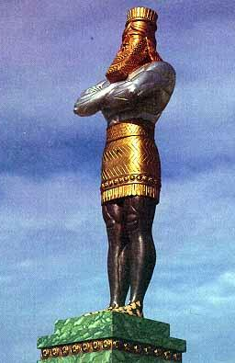
Babylon
Medo-Persia
Greece
Rome

Slide 3
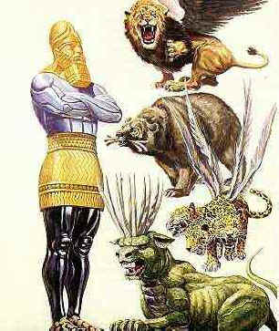
Daniel’s Visions
Daniel 8
Babylon
Babylon
Babylon
Medo-Persia
Medo-Persia
Medo-Persia
Greece
Rome
Rome
Rome

Slide 4
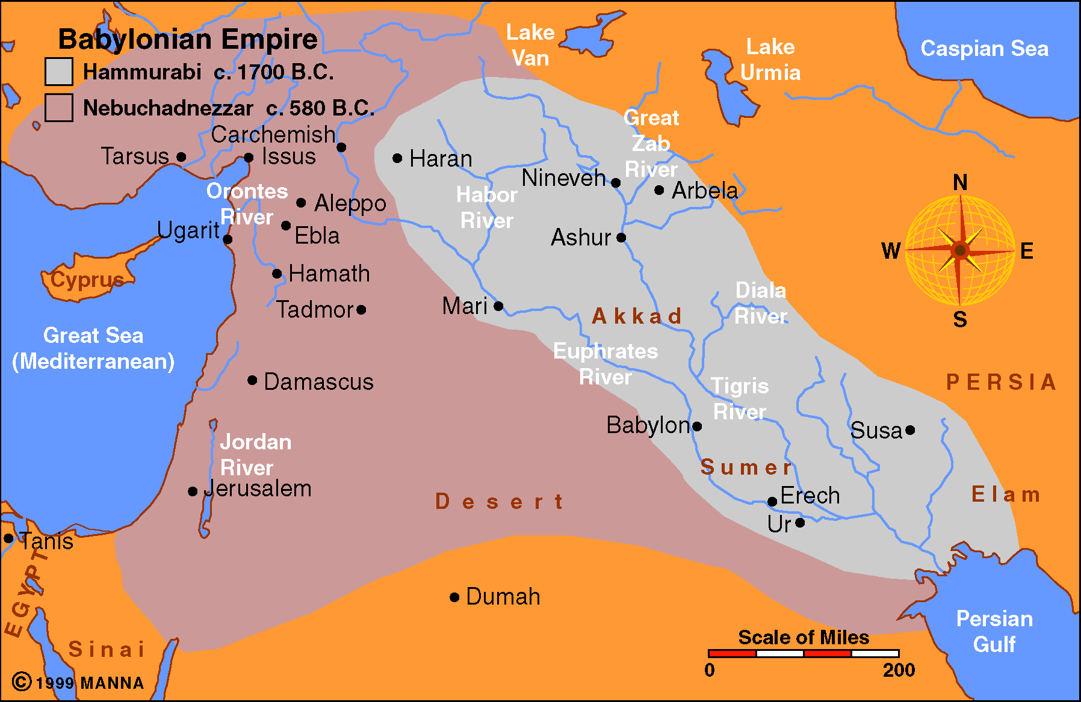

Slide 5
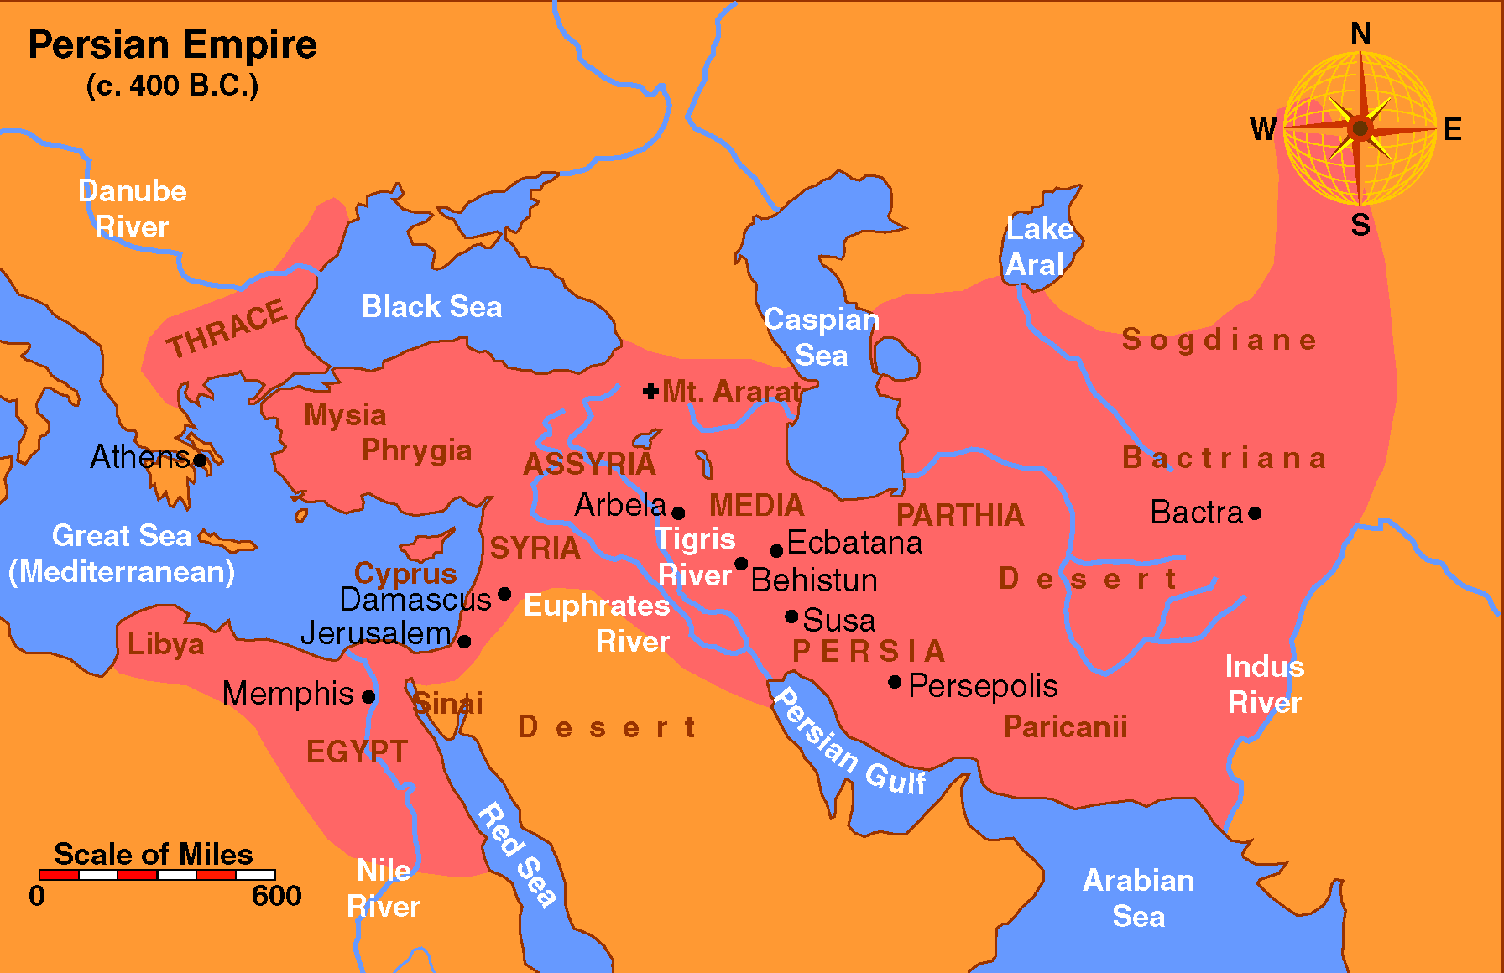

Slide 6
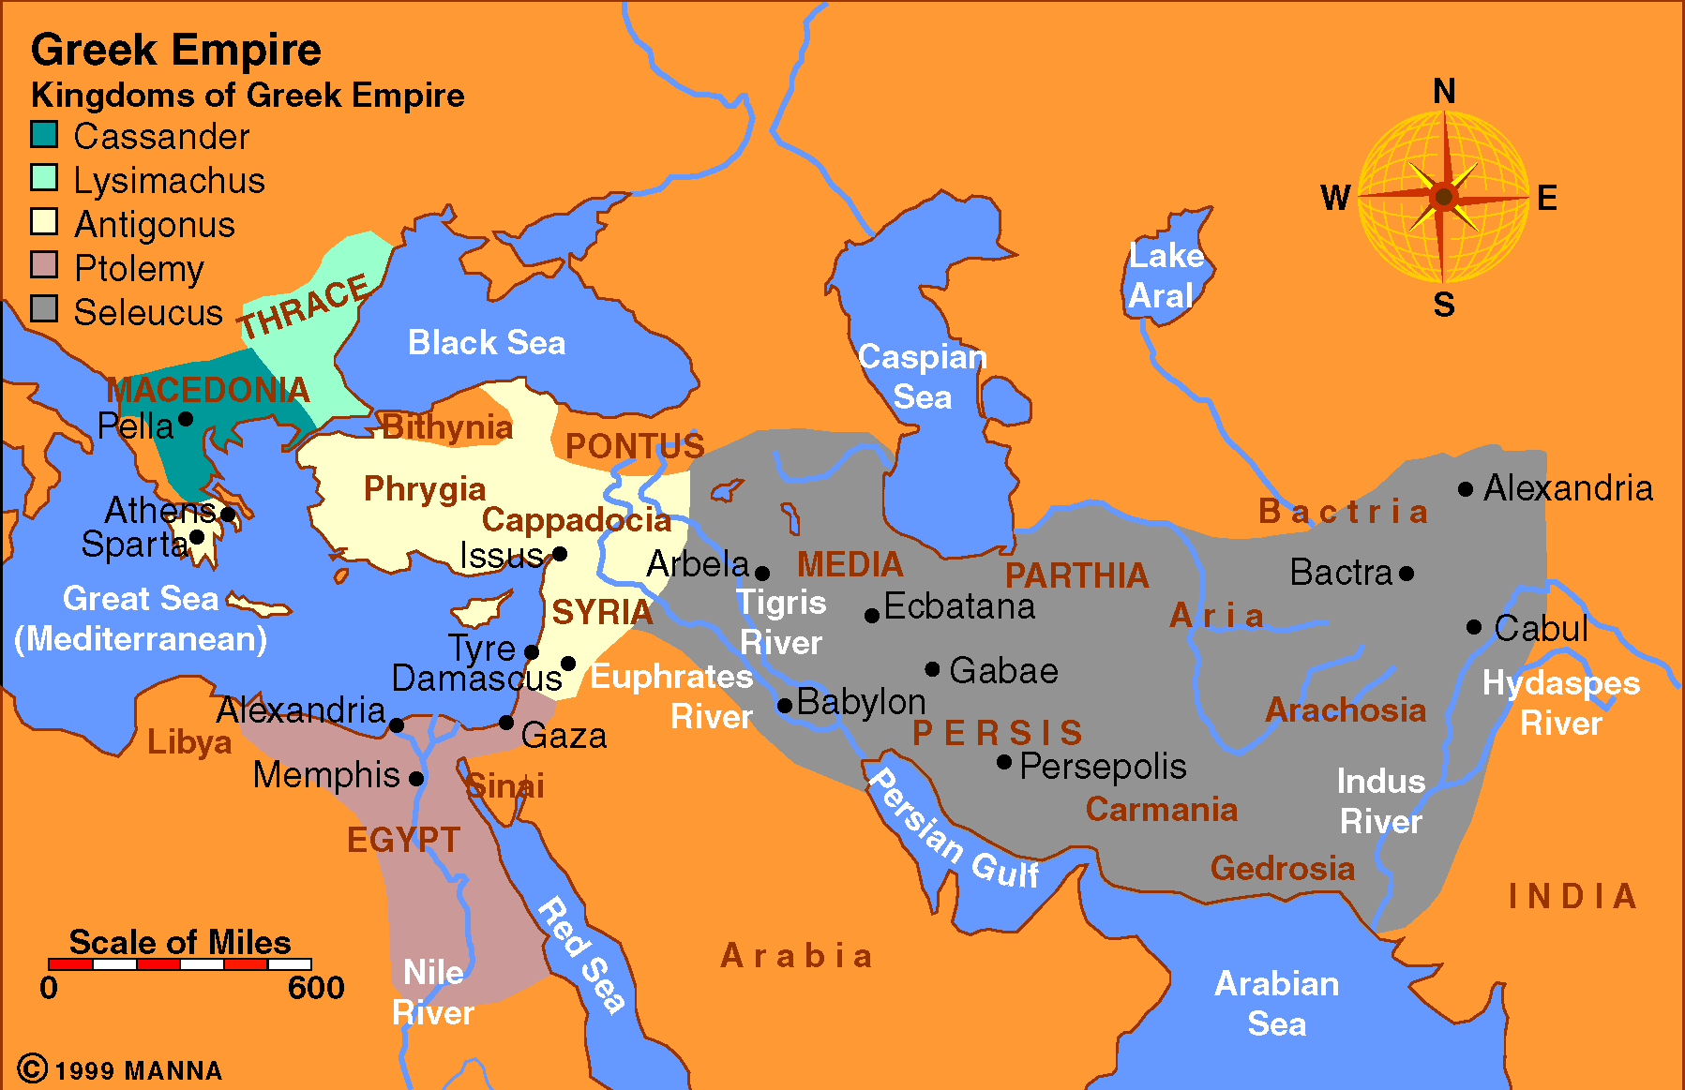

Slide 7
