Slide 2
The Authority of God’s Word

Slide 3
The Authority of His Message is Complete
Revealed by Divine Inspiration
Apostles guided in the words they spoke and wrote
This apostolic teaching was meant to guide the church

Slide 4
Example of Paul the Apostle
1st & 2nd Corinthians

Slide 5
Today’s Attitudes

Slide 6
How Do We Learn God’s Will From Scripture?
Historical Narrative & Letters illustrate truth
Historical Narrative & Letters contain commands and statements of truth
Conclusions can be drawn from inspired sources
Distinguishing between Custom and Pharisaical Tradition

Slide 7
"The whole series of the divine Scriptures is interpreted in a fourfold way. In all holy books one should ascertain what everlasting truths are therein intimated, what deeds are narrated, what future events are foretold, and what commands or counsels are there contained."

Slide 8
"The whole series of the divine Scriptures is interpreted in a fourfold way. In all holy books one should ascertain what everlasting truths are therein intimated, what deeds are narrated, what future events are foretold, and what commands or counsels are there contained."

Slide 9
"The whole series of the divine Scriptures is interpreted in a fourfold way. In all holy books one should ascertain what everlasting truths are therein intimated, what deeds are narrated, what future events are foretold, and what commands or counsels are there contained."

Slide 10
"The whole series of the divine Scriptures is interpreted in a fourfold way. In all holy books one should ascertain what everlasting truths are therein intimated, what deeds are narrated, what future events are foretold, and what commands or counsels are there contained."

Slide 11
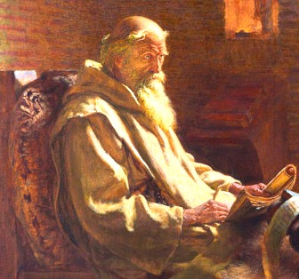
Venerable Bede (672-735 AD)
"The whole series of the divine Scriptures is interpreted in a fourfold way. In all holy books one should ascertain what everlasting truths are therein intimated, what deeds are narrated, what future events are foretold, and what commands or counsels are there contained."

Slide 12
How Do We Learn God’s Will From Scripture?
Historical Narrative & Letters illustrate truth
Historical Narrative & Letters contain commands and statements of truth
Conclusions can be drawn from inspired sources
Distinguishing between Custom and Pharisaical Tradition

Slide 13
The Authority of God’s Word

