Slide 1
God’s Covenant
Genesis 12-50

Slide 2
God’s Promises
I will give you this land
I will make of you a great nation
I will bless you and make your name great/ you will be a blessing.
I will bless those who bless you, and him who dishonors you I will curse
In you all the families of the earth shall be blessed.
Heir of the world (Rom. 4:13)

Slide 3
Genesis 15-17 (The Offspring of Abraham)
God enters a covenant with Abram’s offspring
God reveals specifics about Abram’s offspring
Sarai and Abram think the offspring will come through Hagar
Abram’s name is changed to “Abraham” (father of a multitude)
God says circumcision will be the sign of the covenant between God and Abram’s offspring
God reveals the offspring will come through Sarah
Abram and all the men of his household were circumcised that very day

Slide 4
Genesis 18:1-8

Slide 5
Treatment of Sojourners
Abraham
Lot
Sodom

Slide 6
19:1-3
The two angels came to Sodom in the evening, and Lot was sitting in the gate of Sodom. When Lot saw them, he rose to meet them and bowed himself with his face to the earth and said, “My lords, please turn aside to your servant's house and spend the night and wash your feet. Then you may rise up early and go on your way.” They said, “No; we will spend the night in the town square.” But he pressed them strongly; so they turned aside to him and entered his house. And he made them a feast and baked unleavened bread, and they ate.

Slide 7
19:4-5
But before they lay down, the men of the city, the men of Sodom, both young and old, all the people to the last man, surrounded the house. And they called to Lot, “Where are the men who came to you tonight? Bring them out to us, that we may know them.”

Slide 8
19:27-29
And Abraham went early in the morning to the place where he had stood before the Lord. And he looked down toward Sodom and Gomorrah and toward all the land of the valley, and he looked and, behold, the smoke of the land went up like the smoke of a furnace.
So it was that, when God destroyed the cities of the valley, God remembered Abraham and sent Lot out of the midst of the overthrow when he overthrew the cities in which Lot had lived.

Slide 9
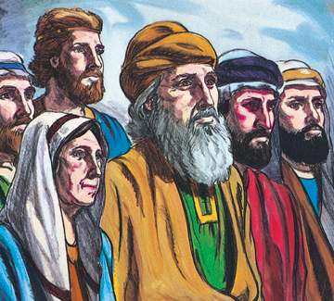
In the beginning…

Slide 10
Sodom & Gomorrah
Lot
Egypt
Israelites
Sin
Christians
“He has delivered us from the domain of darkness and transferred us to the kingdom of his beloved Son, in whom we have redemption, the forgiveness of sins.”- Col. 1:13-14
Notes:
Luke 17

Slide 11
God will protect His people as they are sojourning.
“I will bless those who bless you, and him who dishonors you I will curse” (Gen 12)
God’s people must treat sojourners well.
“I will bless you and make your name great, so that you will be a blessing.” (Gen 12)

Slide 12
Genesis 20

Slide 13
Read 21-22

