Slide 1
God’s Covenant
Genesis 12-50

Slide 2
Chapter 36: “These are the generations of Esau”
Chapter 37: “These are the generations of Jacob”

Slide 3
Ch. 37-50:
God has made promises to the offspring of Abraham
Narrative detail: Dreams, hatred, leaving Canaan, mourning, deception, imprisonment, success…
The offspring of Abraham are in danger
All people of the earth are in danger
In advance, God had provided a savior
Worldwide famine
Notes:
Typology

Slide 4
Ch. 37-50:
God has made promises to the offspring of Abraham
Narrative detail: Dreams, hatred, leaving Canaan, mourning, deception, imprisonment, success…
Notes:
Typology

Slide 5
God’s Promises
I will give you this land
I will make of you a great nation
I will bless you and make your name great/ you will be a blessing.
I will bless those who bless you, and him who dishonors you I will curse
In you all the families of the earth shall be blessed.
Heir of the world (Rom. 4:13)
Notes:
Can you trust God’s promises? Is He trustworthy?

Slide 6
Chapter 37 Dreams of Joseph
Notes:
Read aloud

Slide 7
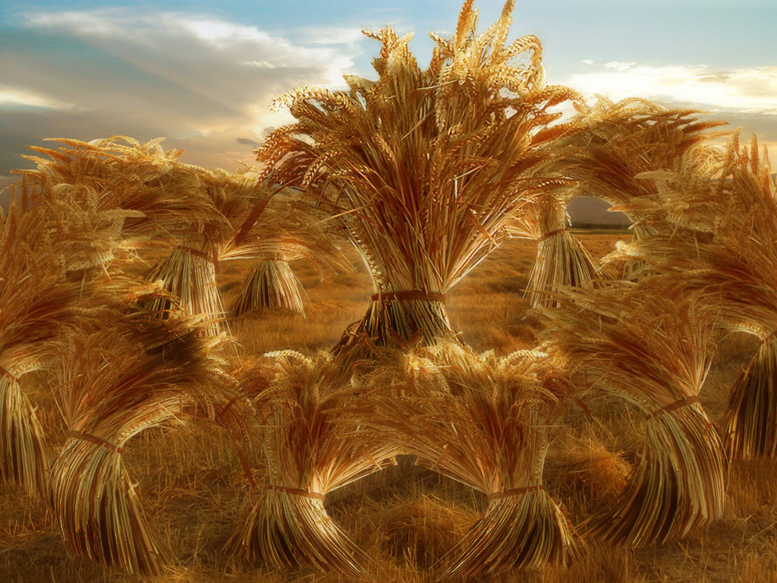

Slide 8
Chapter 37:12-36
Notes:
Read aloud

Slide 9
Abraham
Isaac
Jacob
Joseph
Judah

Slide 10
Chapter 37
Judah plans to take a son from Jacob (By deception).
A goat is used, as well as a garment.
Item is given to Jacob.
“Please examine…”/ Jacob recognizes it
Jacob loses a son.
Chapter 38
Judah loses sons.
Tamar plans to get a son from Judah (By deception).
A goat is used, as well as a garment.
Items are given to Judah.
“Please examine…”/ Judah recognizes it

Slide 11
Chapter 38
Judah gives in to sexual immorality
A garment is used for deception
Judah is shown to be unrighteous
Chapter 39
Joseph doesn’t give in to sexual immorality
A garment is used for deception
Joseph is shown to be righteous

Slide 12
38:27-30 Tamar gives birth
When the time of her labor came, there were twins in her womb. And when she was in labor, one put out a hand, and the midwife took and tied a scarlet thread on his hand, saying, “This one came out first.” But as he drew back his hand, behold, his brother came out. And she said, “What a breach you have made for yourself!” Therefore his name was called Perez. Afterward his brother came out with the scarlet thread on his hand, and his name was called Zerah.
Notes:
Zerah means dawning/ shining
Perez means breakthrough/ burst forth

Slide 13
39:2-5
The Lord was with Joseph, and he became a successful man, and he was in the house of his Egyptian master. His master saw that the Lord was with him and that the Lord caused all that he did to succeed in his hands. So Joseph found favor in his sight and attended him, and he made him overseer of his house and put him in charge of all that he had. From the time that he made him overseer in his house and over all that he had, the Lord blessed the Egyptian's house for Joseph's sake; the blessing of the Lord was on all that he had, in house and field.
“…and I will bless you and make your name great, so that you will be a blessing.” (Gen 12)

Slide 14
Notes:
Jacob’s ladder- 28:10

