Slide 2
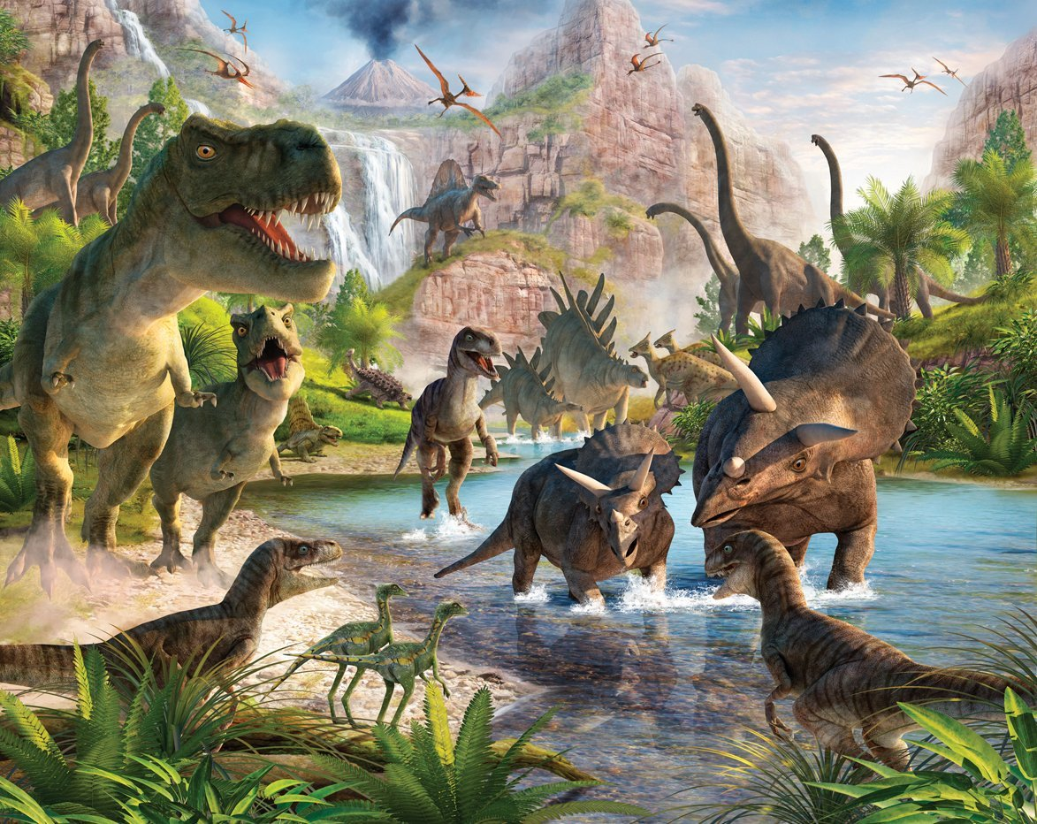

Slide 3
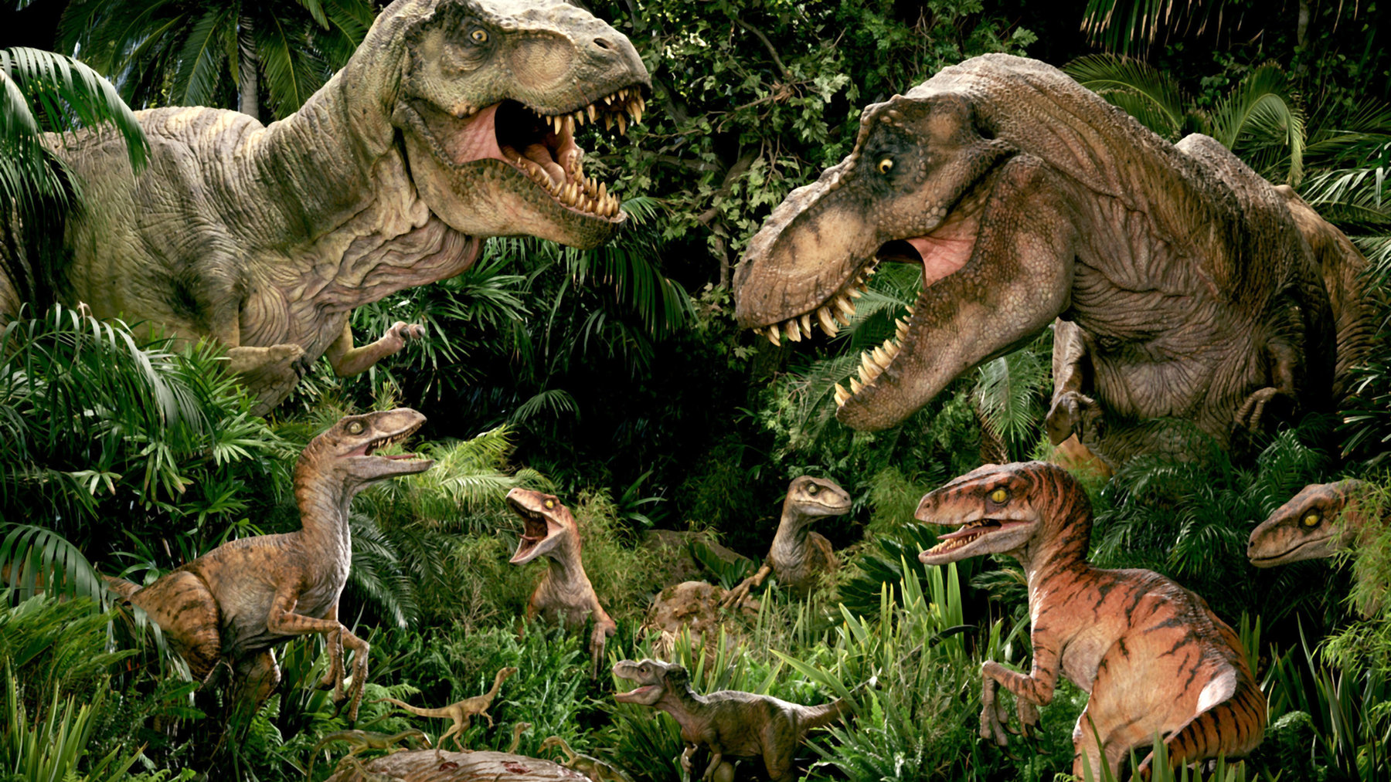
The King
Of The Dinosaurs

Slide 4
God Created Dinosaurs
The King
Of The Dinosaurs

Slide 5
God Created Dinosaurs
“Dinosaur” coined 1840
Day 5, God created water & air animals (Gen. 1:20-23)

Slide 6
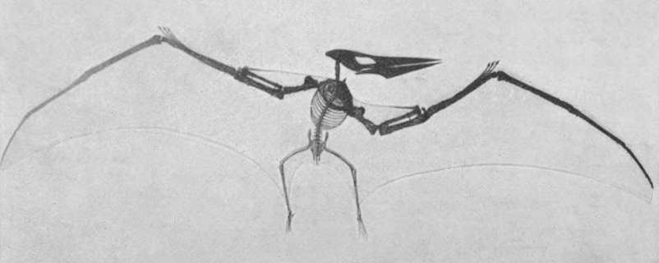
Pterosaur Fossil

Slide 7
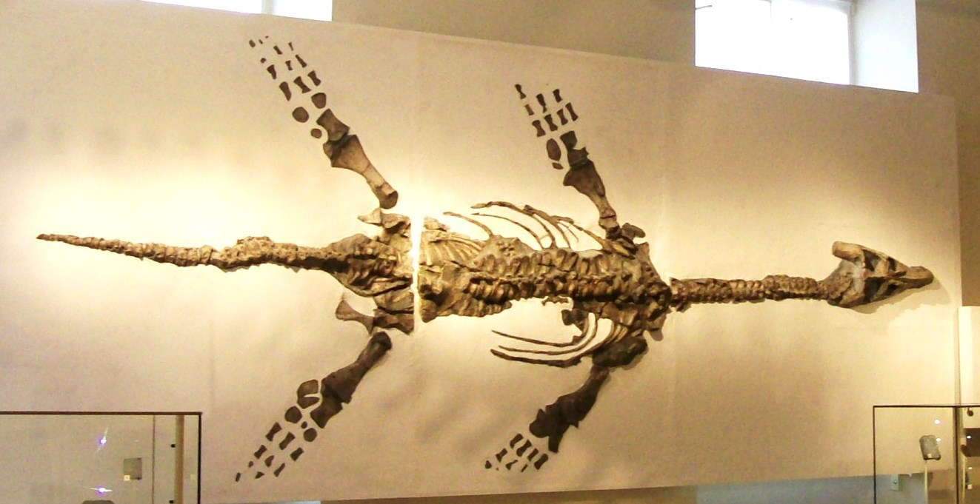
Plesiosaurus Fossil

Slide 8
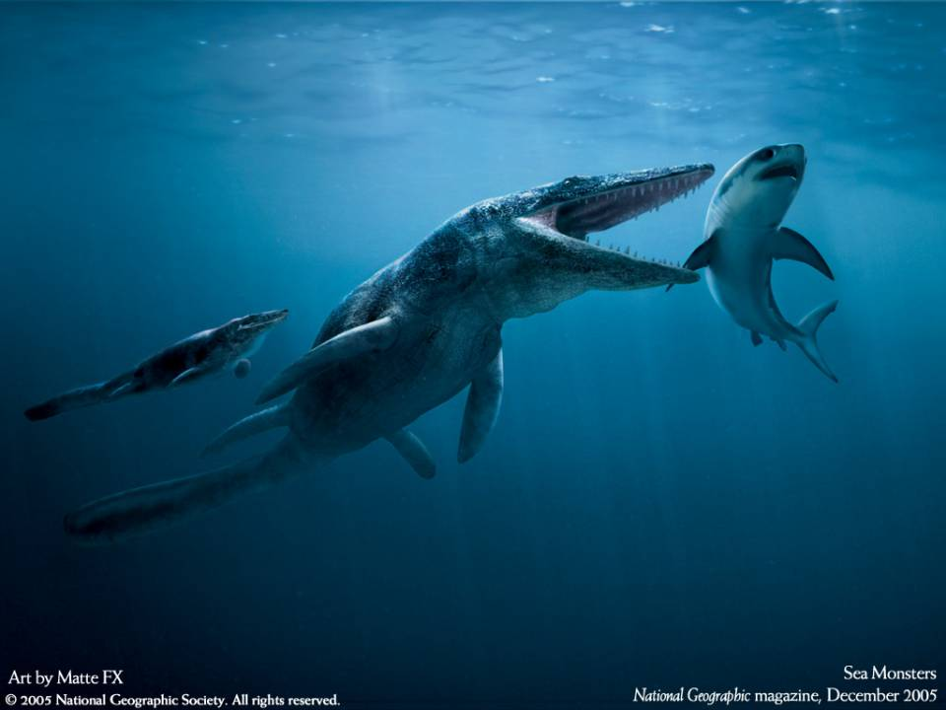
Liopleurodon

Slide 9
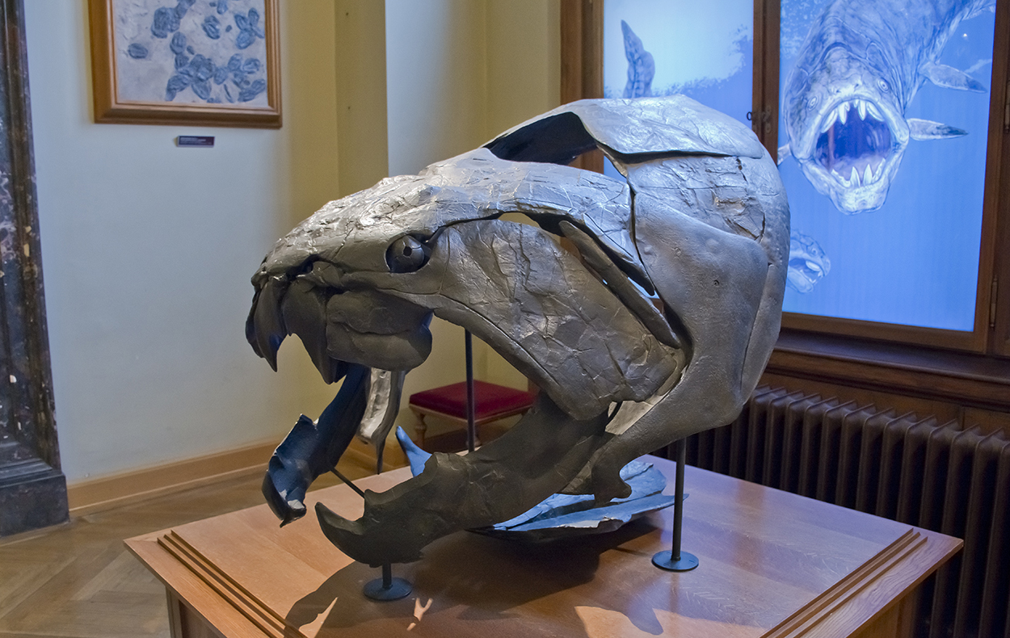
Dunkleosteus Fossil

Slide 10
God Created Dinosaurs
“Dinosaur” coined 1840
Day 5, God created water & air animals (Gen. 1:20-23)
Day 6, God created land animals (Gen. 1:24-25)

Slide 11
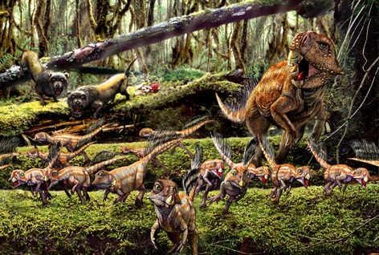
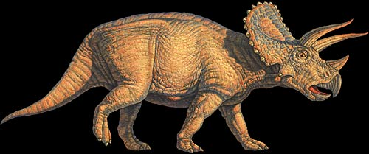
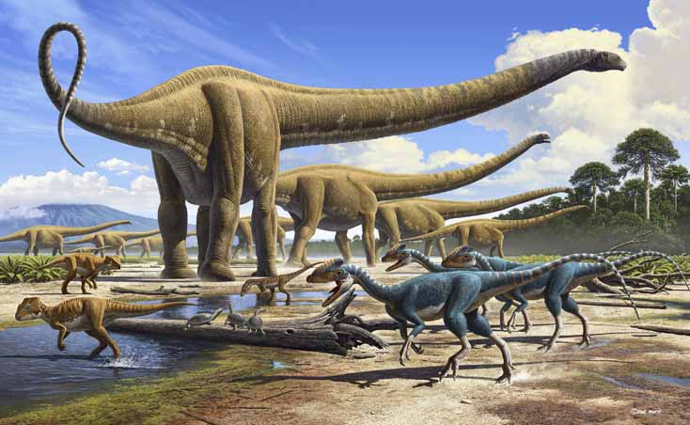
Triceratops
Psittacosaurus & Repenomamus Giganticus
Diplodocus

Slide 12
God Created Dinosaurs
The first Dinosaurs were “good” and ate vegetation (Gen. 1:30-31)

Slide 13
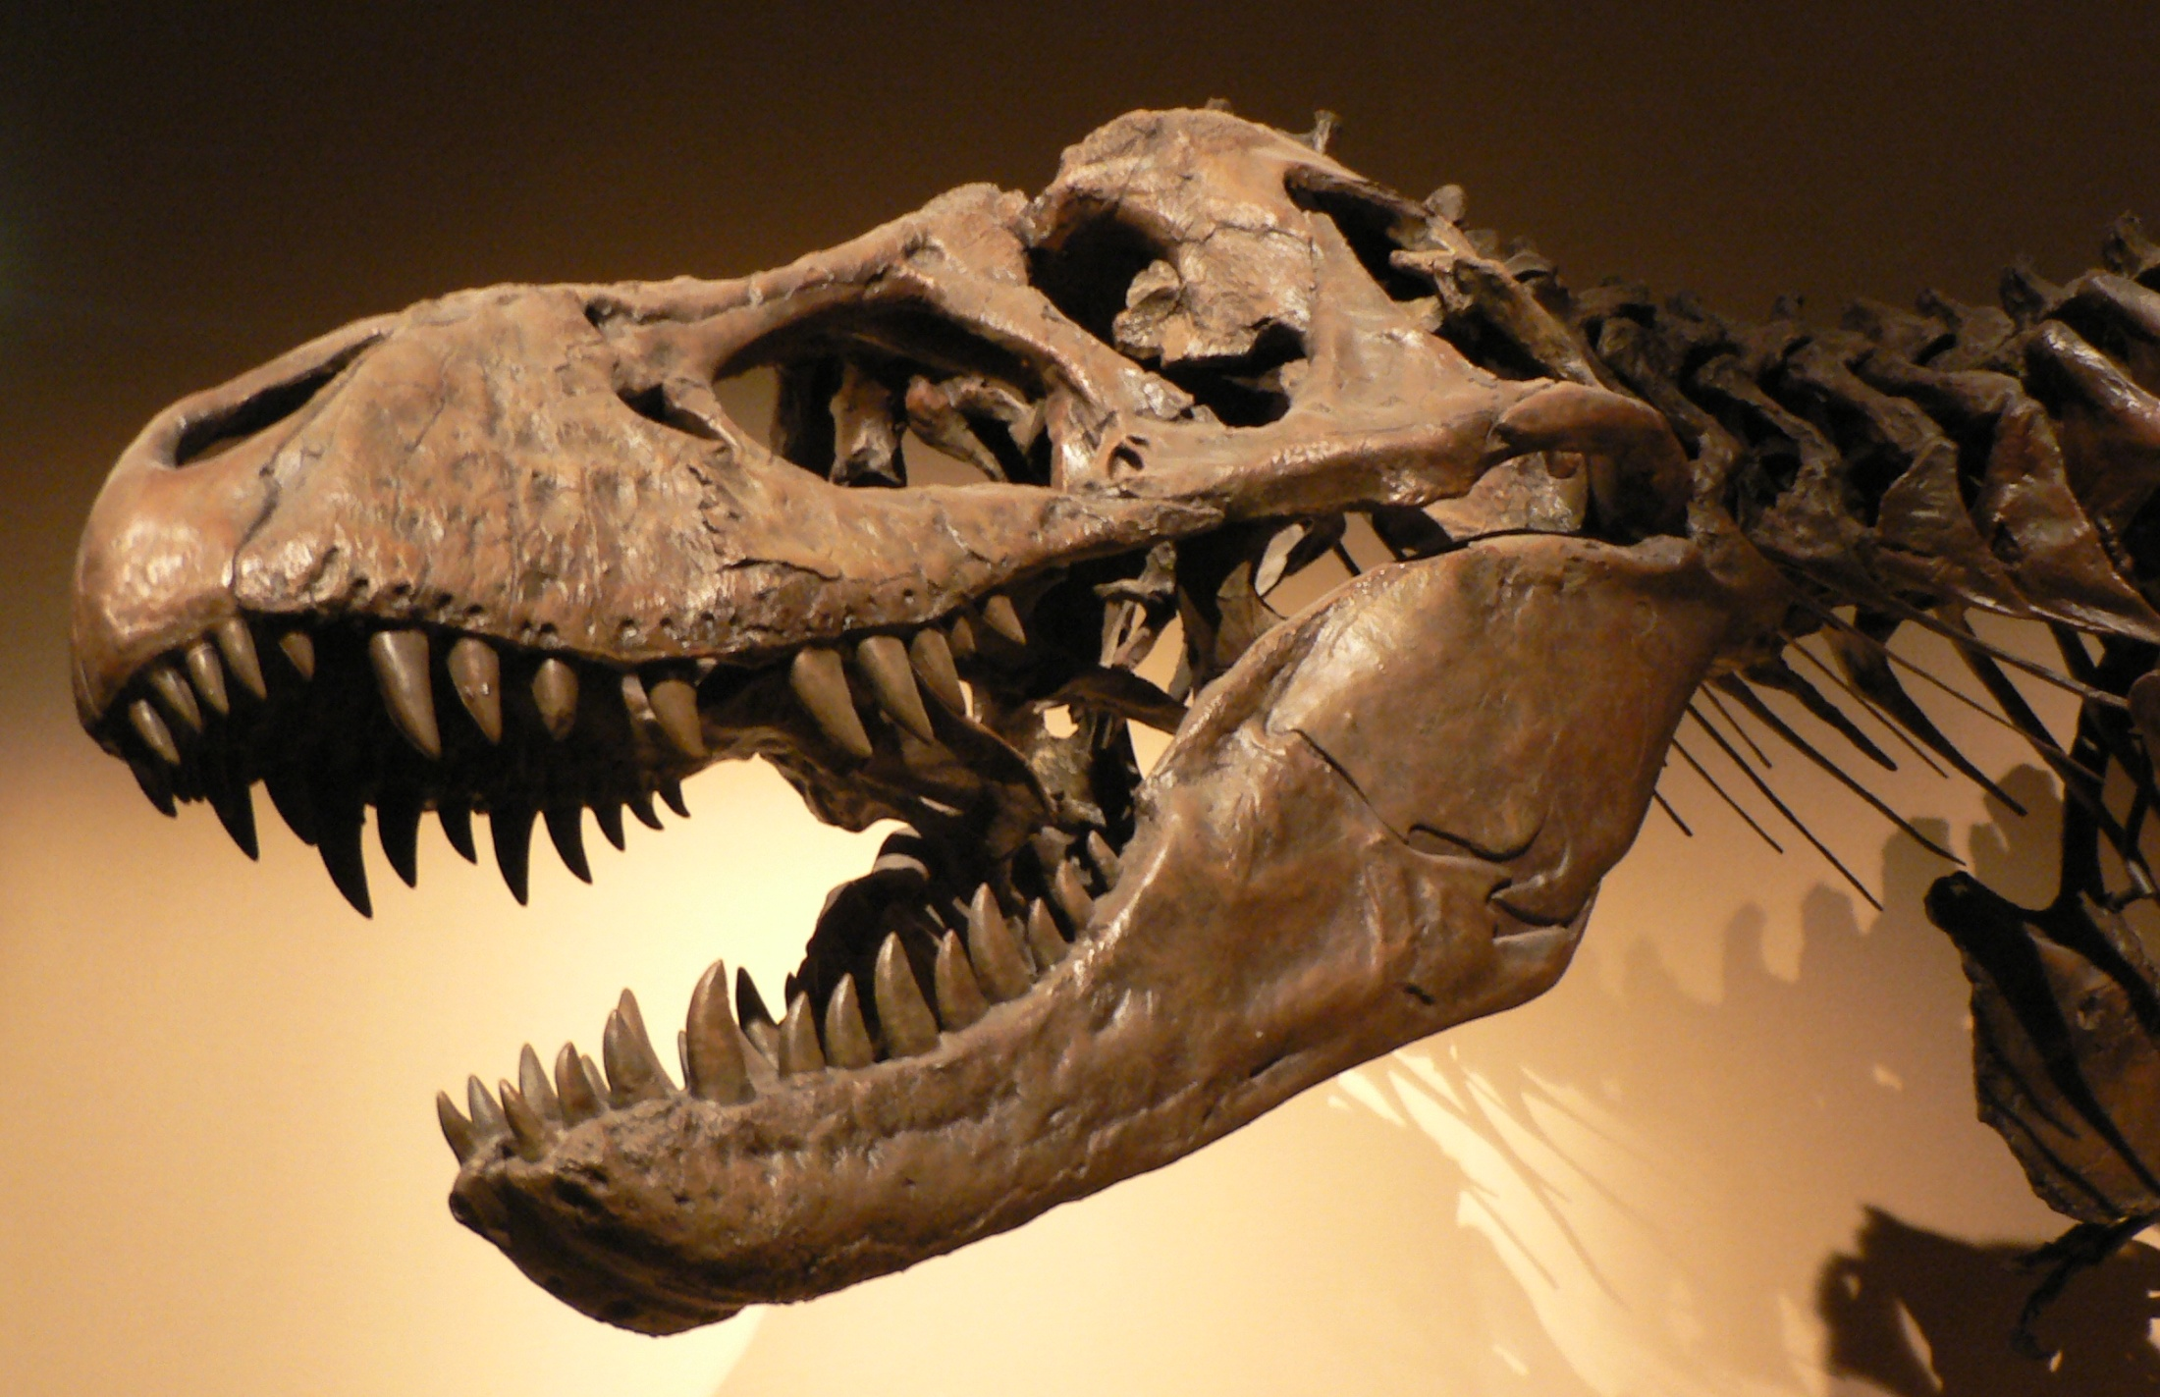

Slide 14
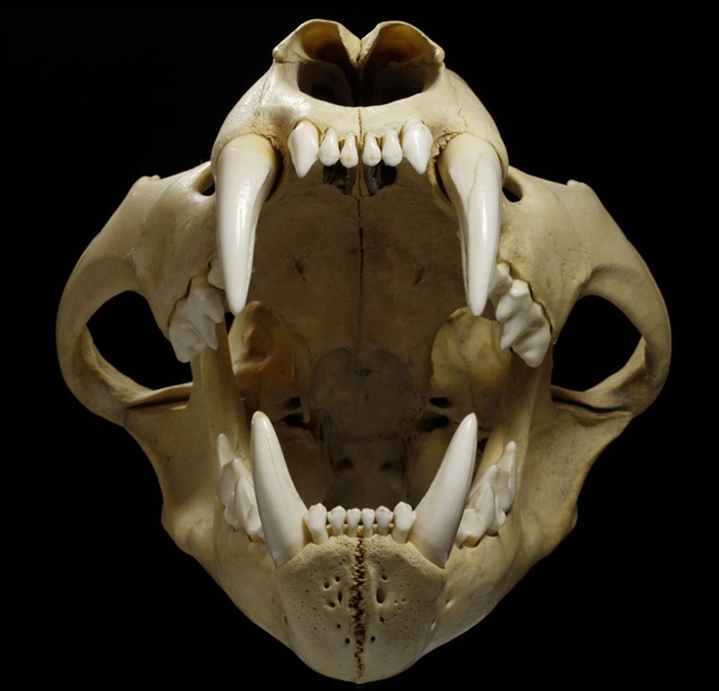

Slide 15
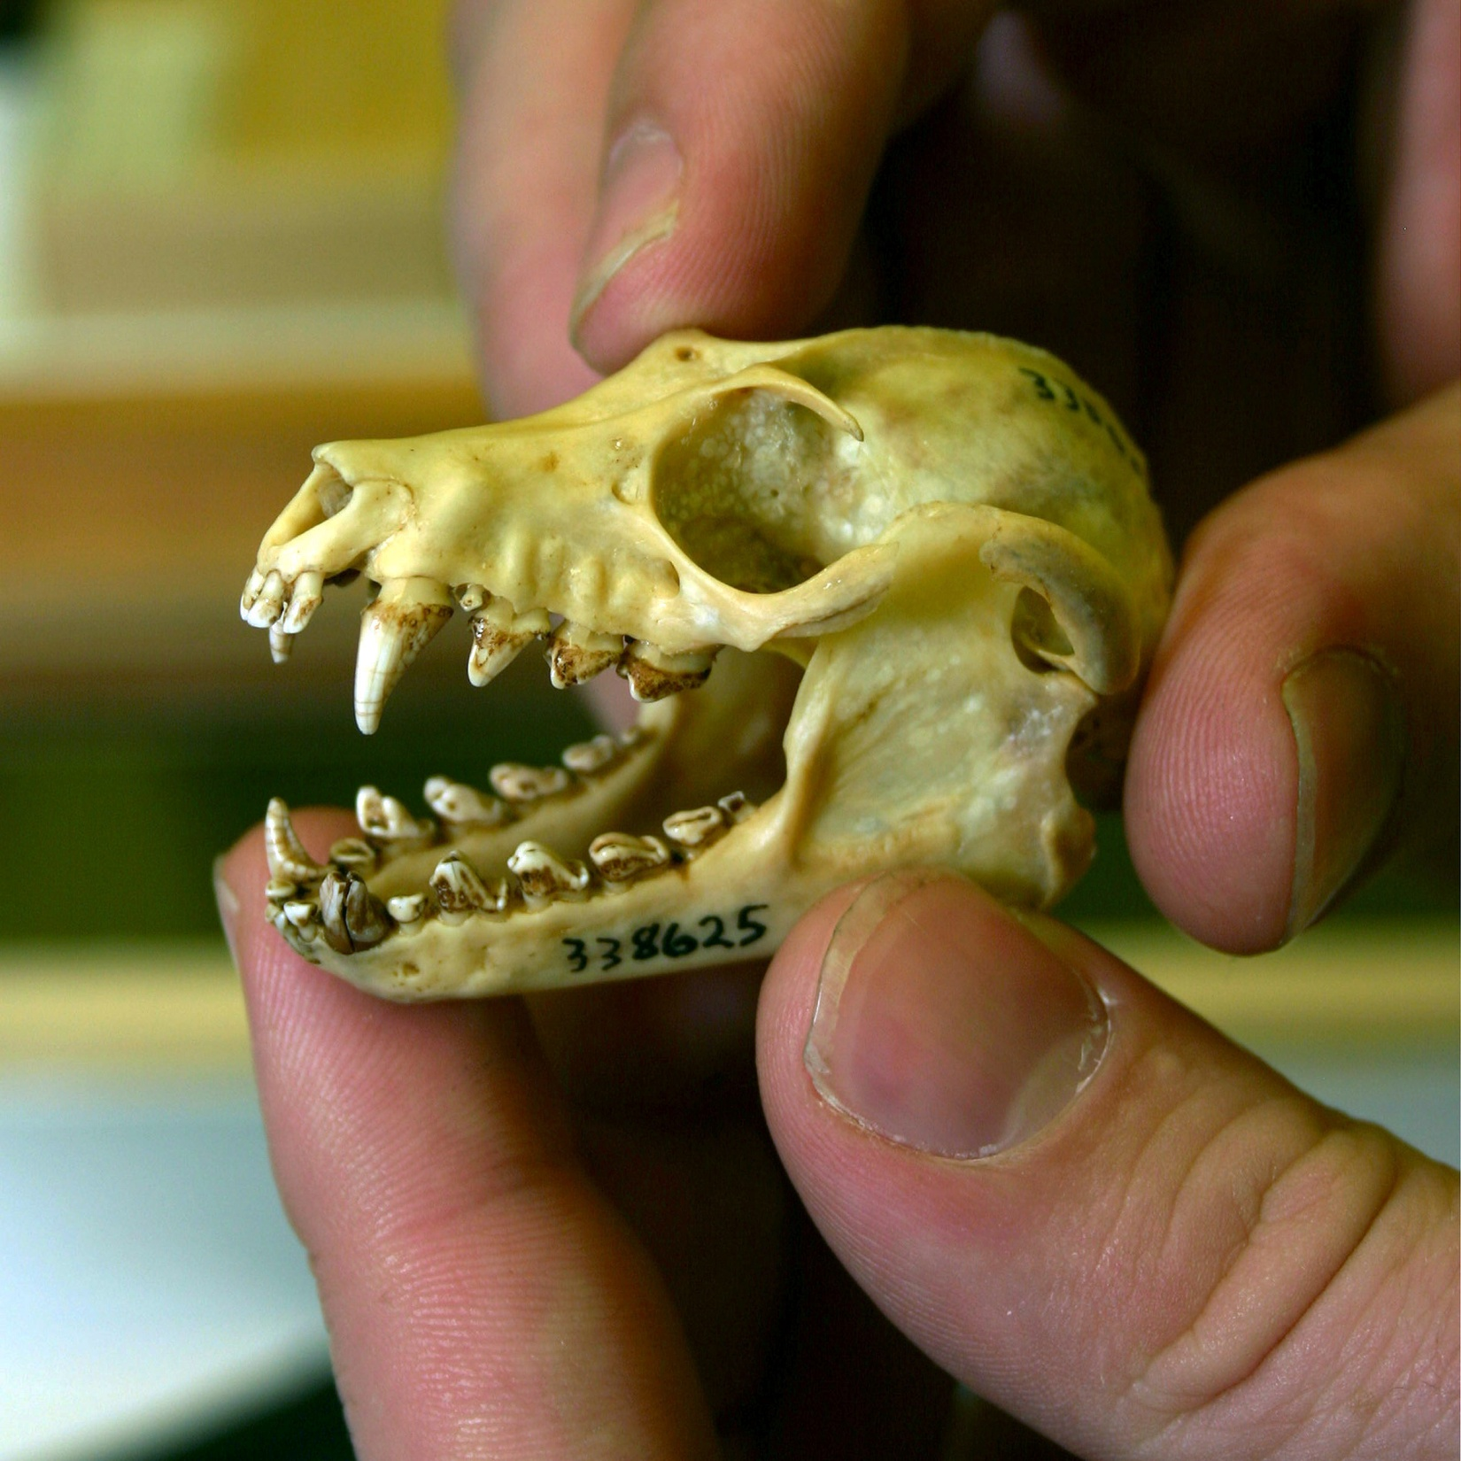

Slide 16
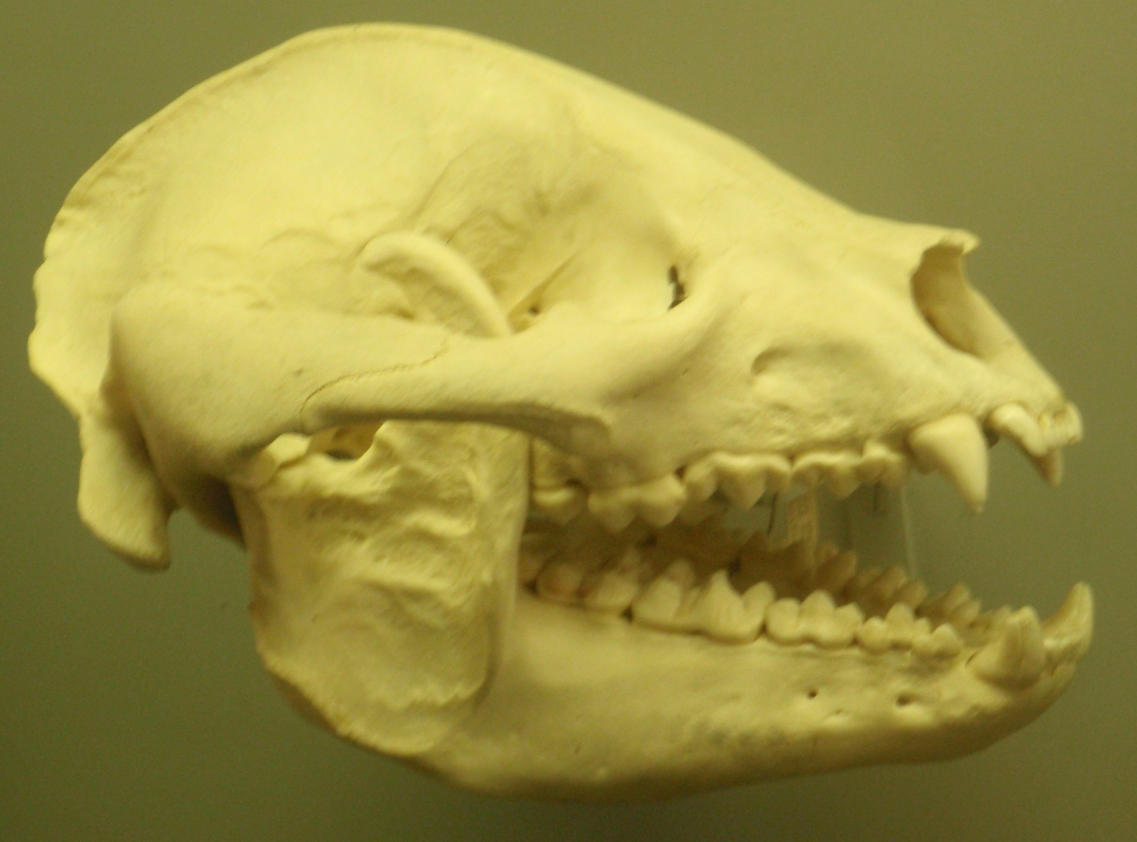

Slide 18
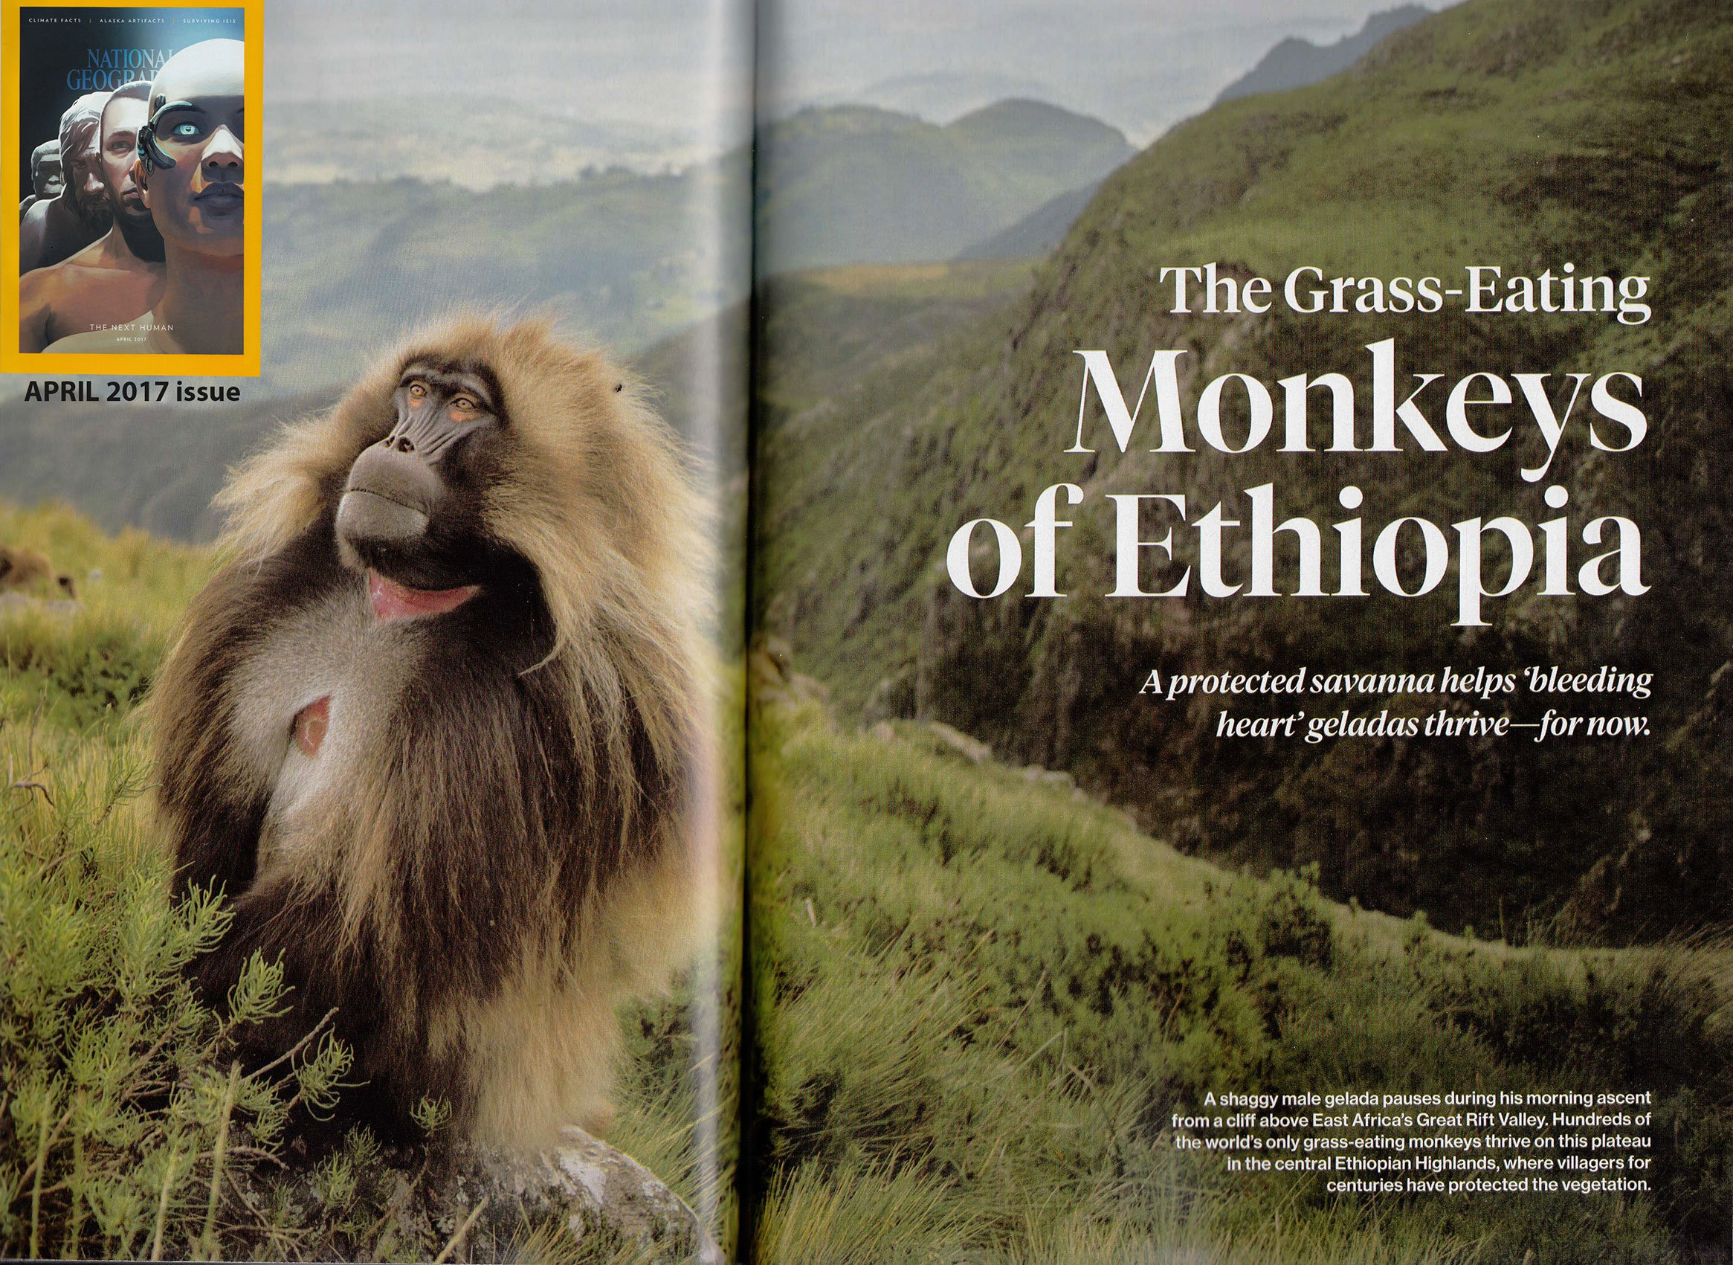

Slide 19
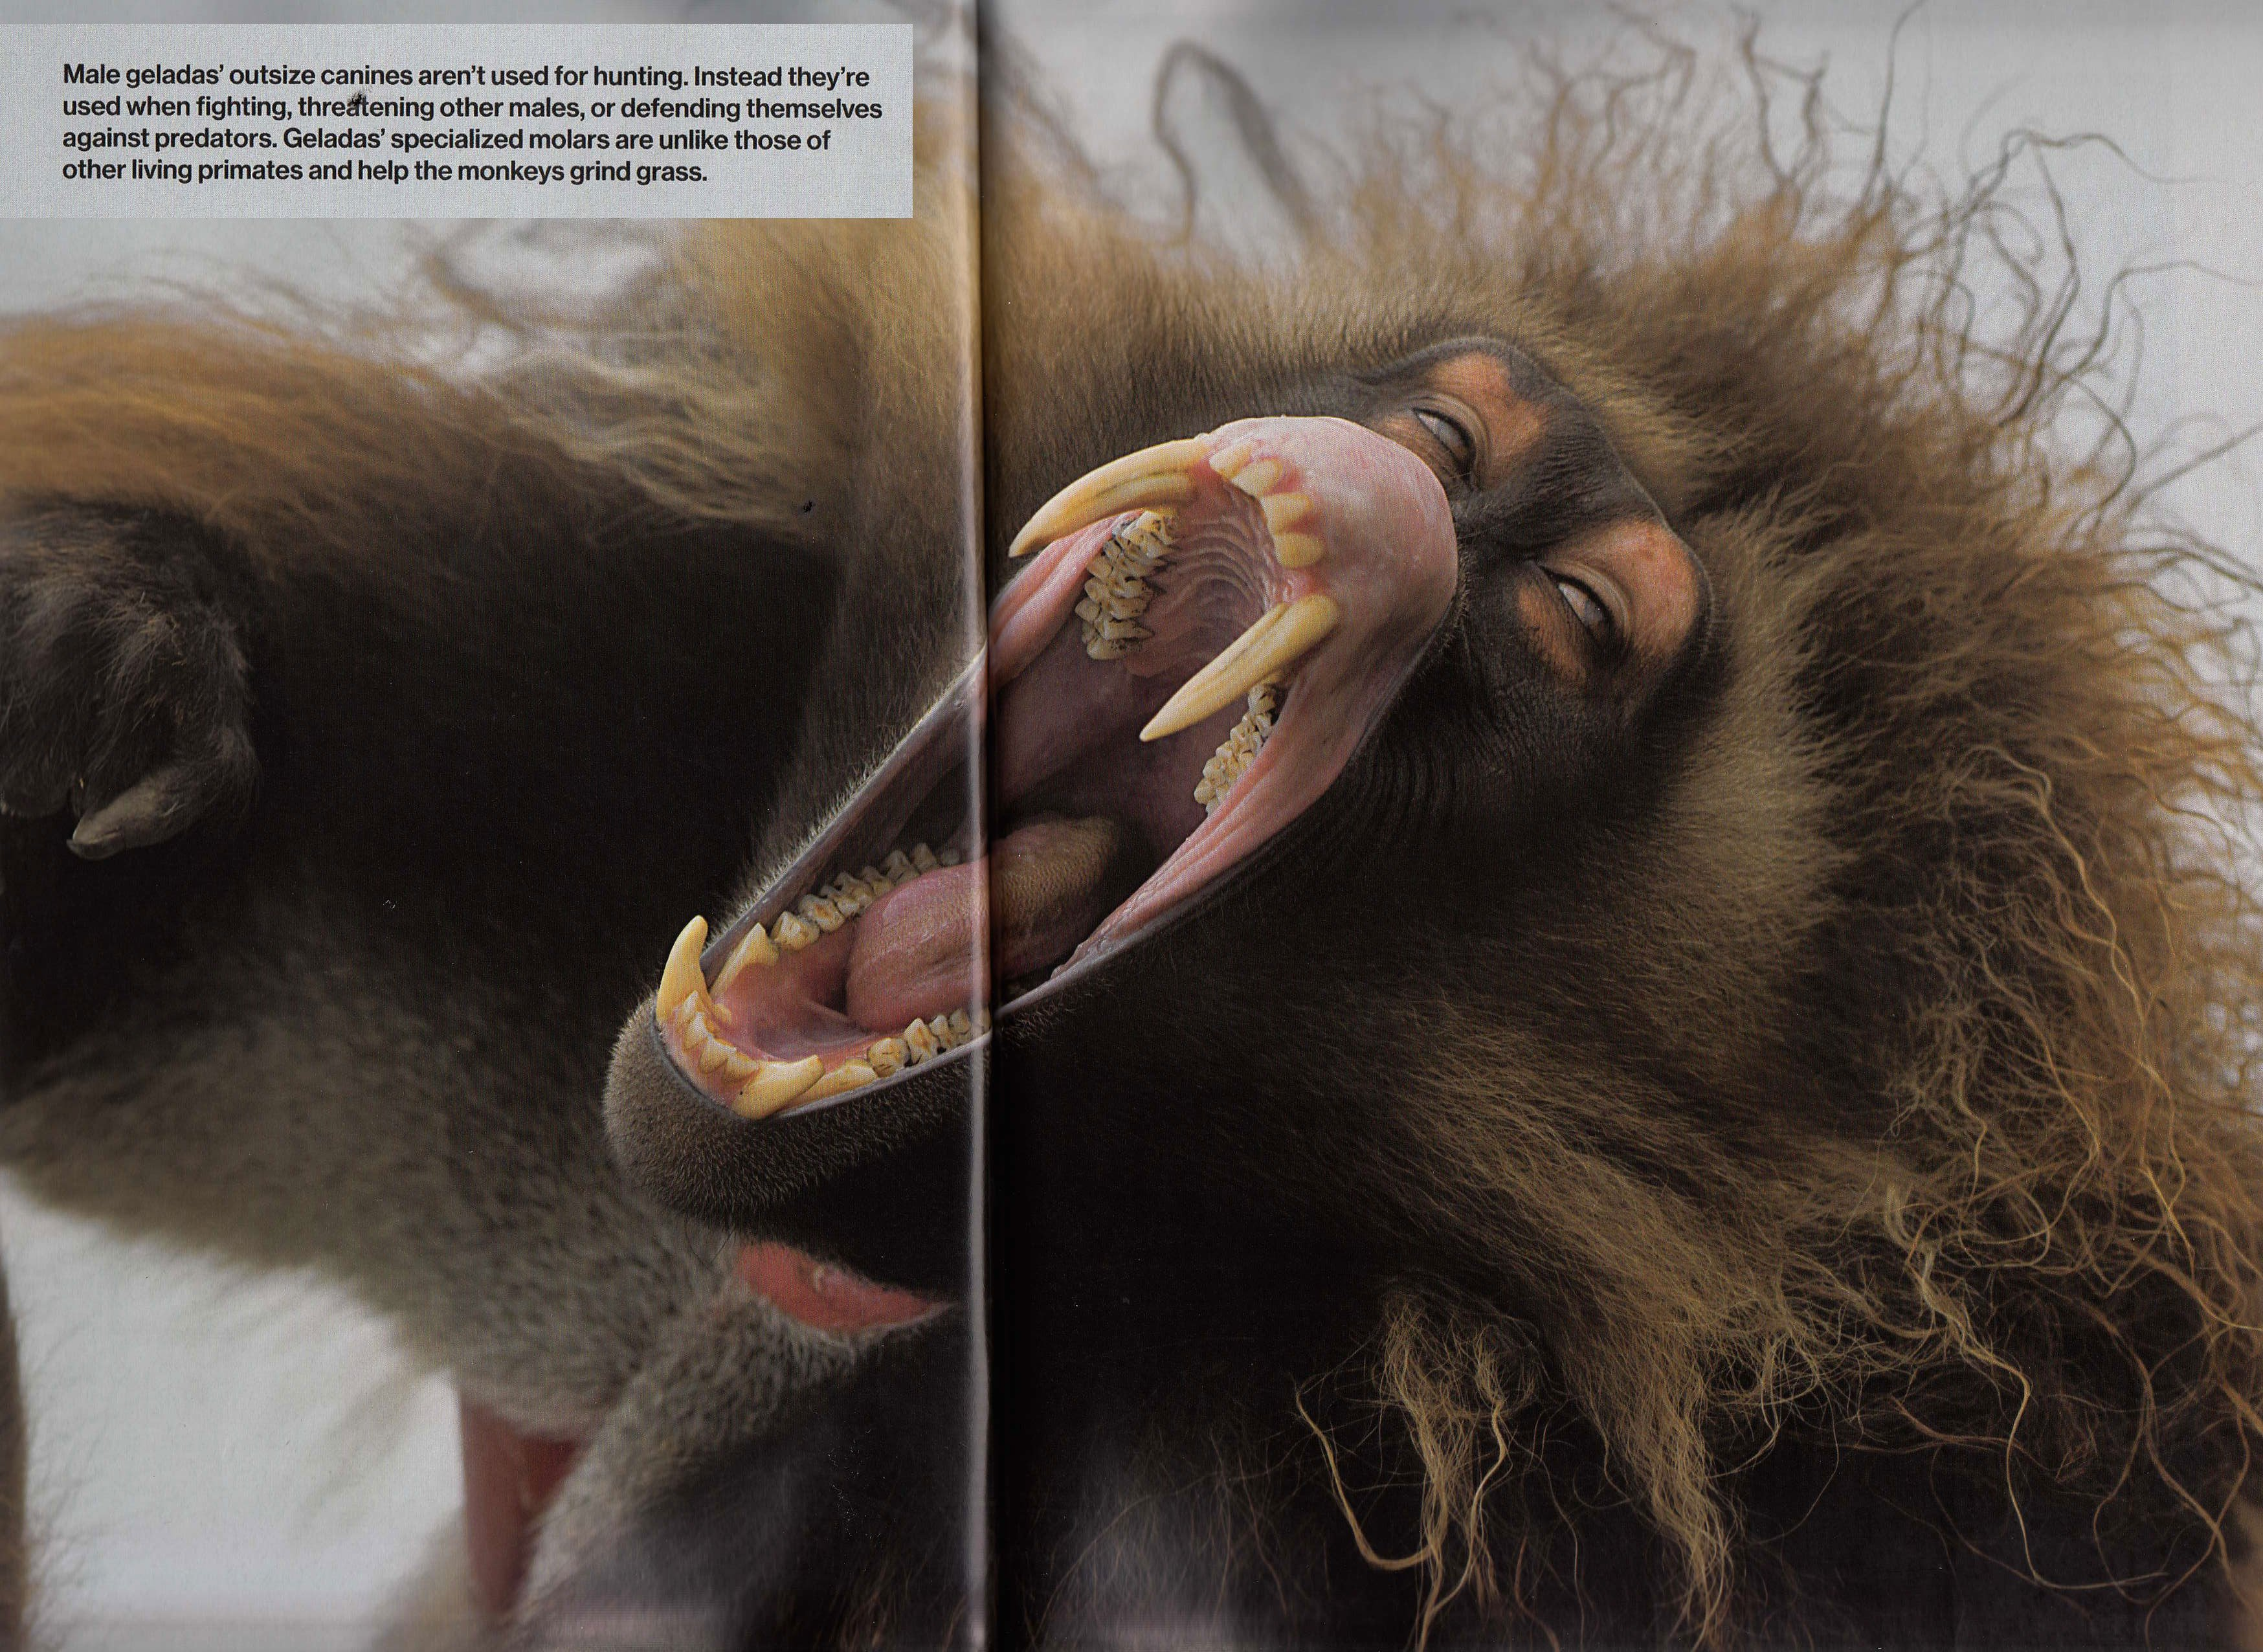

Slide 21
God Created Dinosaurs
The first Dinosaurs were “good” and ate vegetation (Gen. 1:30-31)
Day 6, God created Mankind (Gen. 1:26-28)

Slide 22
Could Mankind Truly Coexist with Dinosaurs?
The King
Of The Dinosaurs

Slide 23
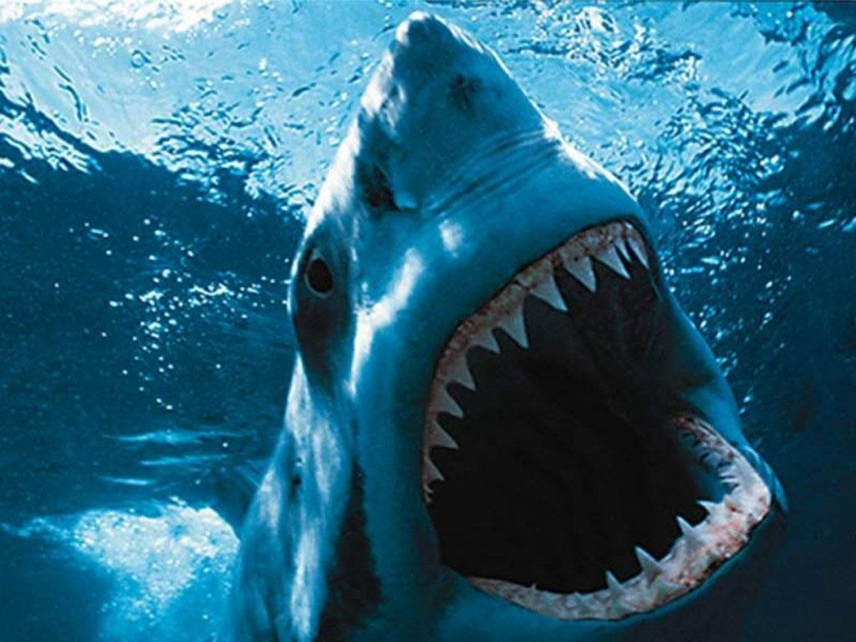

Slide 24
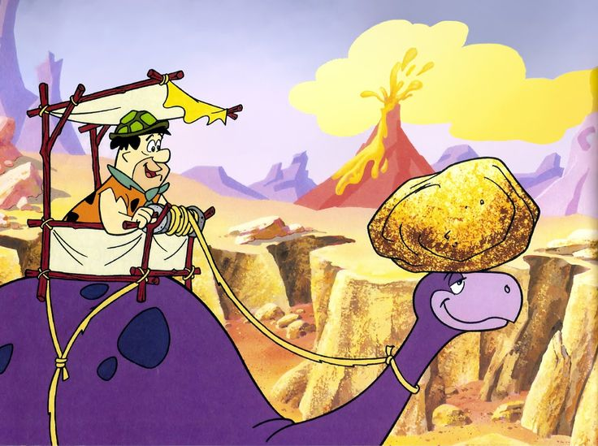

Slide 25
Could Mankind Truly Coexist with Dinosaurs?
Dinosaurs on the Ark? Sure! (Gen. 6:19-21; 7:7-9)
The Flood explains the numerous fossils in the “fossil record”

Slide 26
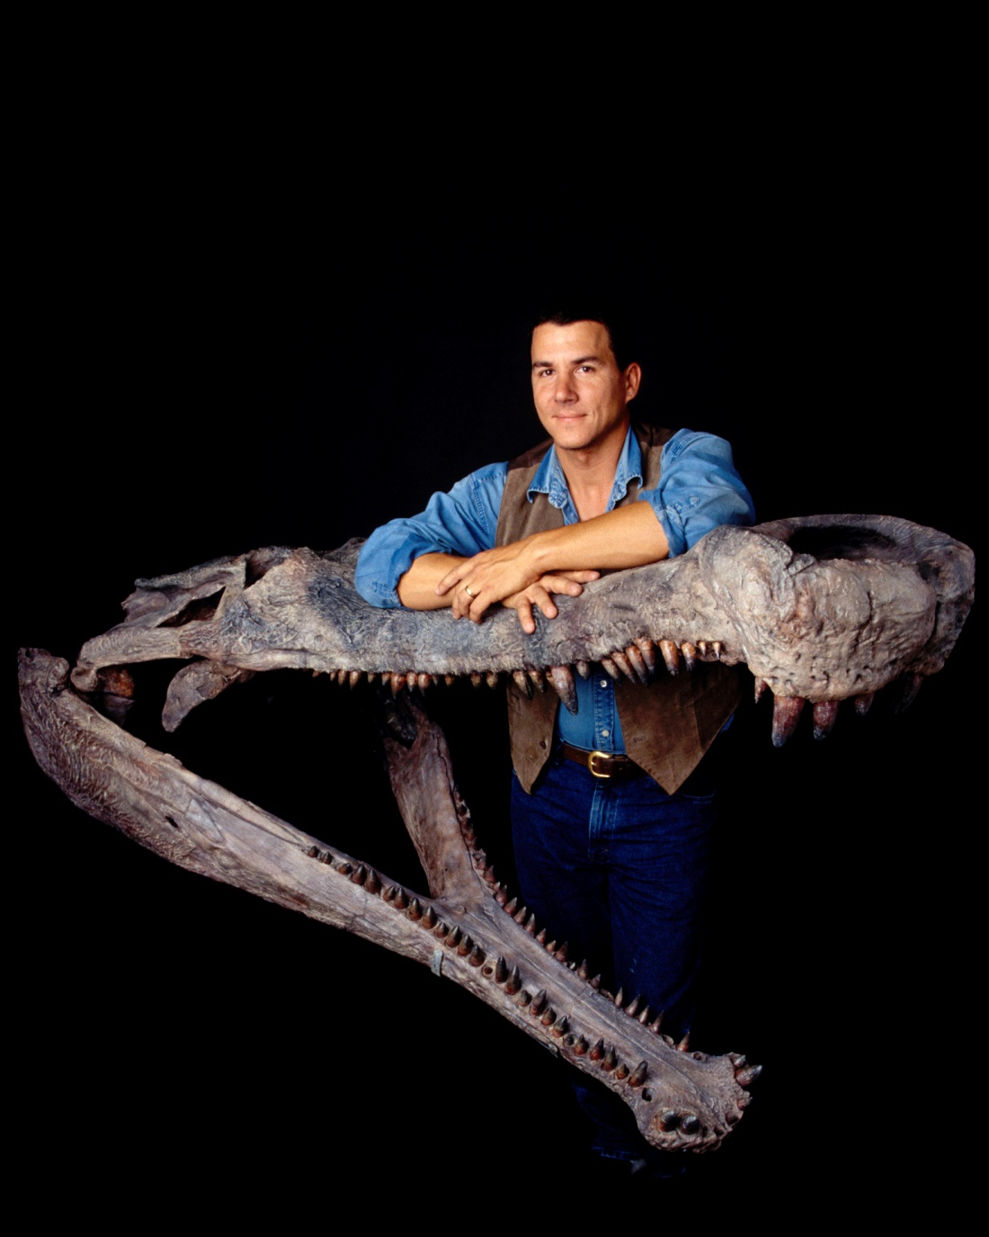
‘Super Croc’ Fossil

Slide 27
God’s Testimony - Tannin
Psalm 74:13-14
You divided the sea by Your strength; You broke the heads of the sea serpents [Tannin] in the waters.
You broke the heads of Leviathan in pieces, And gave him as food to the people inhabiting the wilderness.

Slide 28
God’s Testimony - Tannin
Jeremiah 51:34
Nebuchadnezzar the king of Babylon Has devoured me, he has crushed me; He has made me an empty vessel, He has swallowed me up like a monster [Tannin]; He has filled his stomach with my delicacies, He has spit me out.

Slide 29
God’s Testimony - Tannin
Ezekiel 29:3-5
Speak, and say, 'Thus says the Lord God: "Behold, I am against you, O Pharaoh king of Egypt, O great monster [Tannin] who lies in the midst of his rivers, Who has said, 'My River is my own; I have made it for myself.'
But I will put hooks in your jaws, And cause the fish of your rivers to stick to your scales; I will bring you up out of the midst of your rivers, And all the fish in your rivers will stick to your scales.
I will leave you in the wilderness, You and all the fish of your rivers; You shall fall on the open field; You shall not be picked up or gathered. I have given you as food To the beasts of the field And to the birds of the heavens.

Slide 30
God’s Testimony - Tannin
Ezekiel 32:2
"Son of man, take up a lamentation for Pharaoh king of Egypt, and say to him: 'You are like a young lion among the nations, And you are like a monster [Tannin] in the seas, Bursting forth in your rivers, Troubling the waters with your feet, And fouling their rivers.'
[Lions are a real & known animal]

Slide 31
God’s Testimony
Isaiah 30:6
The burden against the beasts of the South. Through a land of trouble and anguish, From which came the lioness and lion, The viper and fiery flying serpent, They will carry their riches on the backs of young donkeys, And their treasures on the humps of camels, To a people who shall not profit;
[“fiery flying serpents” (all other animals mentioned are real & known)]

Slide 32
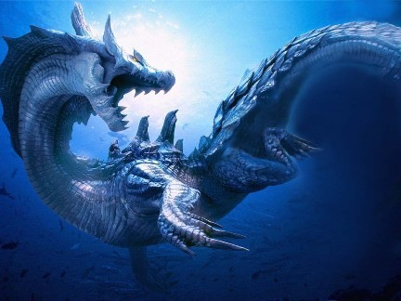
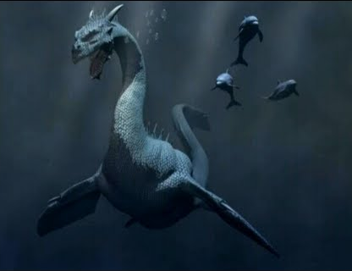
God’s Testimony - Leviathan
Isa. 27:1, “In that day the Lord with His severe sword, great and strong, Will punish Leviathan the fleeing serpent, Leviathan that twisted serpent; And He will slay the reptile [Tannin] that is in the sea.”
Psalm 74:14 – God crushes Leviathan!
Job 41 – Leviathan Described

Slide 33
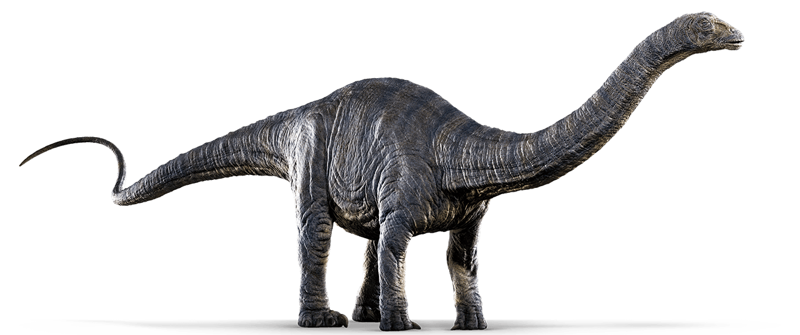
God’s Testimony - Behemoth
Job 40:15-19 – Behemoth Described
Apatosaurus

Slide 34
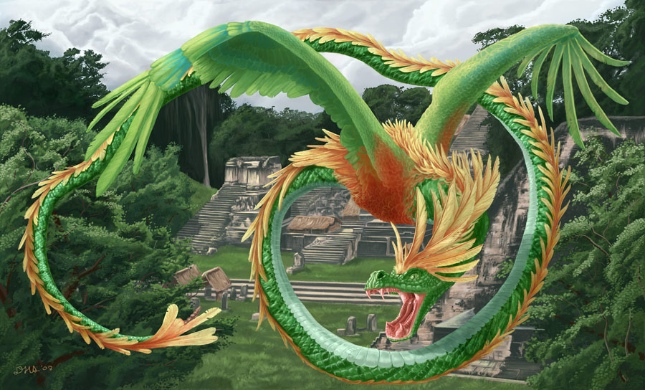
Pagan Religions
Quetzalcoatl

Slide 35
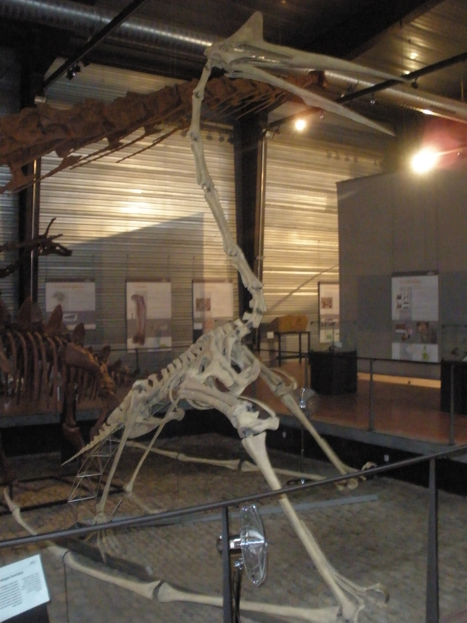
Pagan Religions
Quetzalcoatlus
Fossil

Slide 36
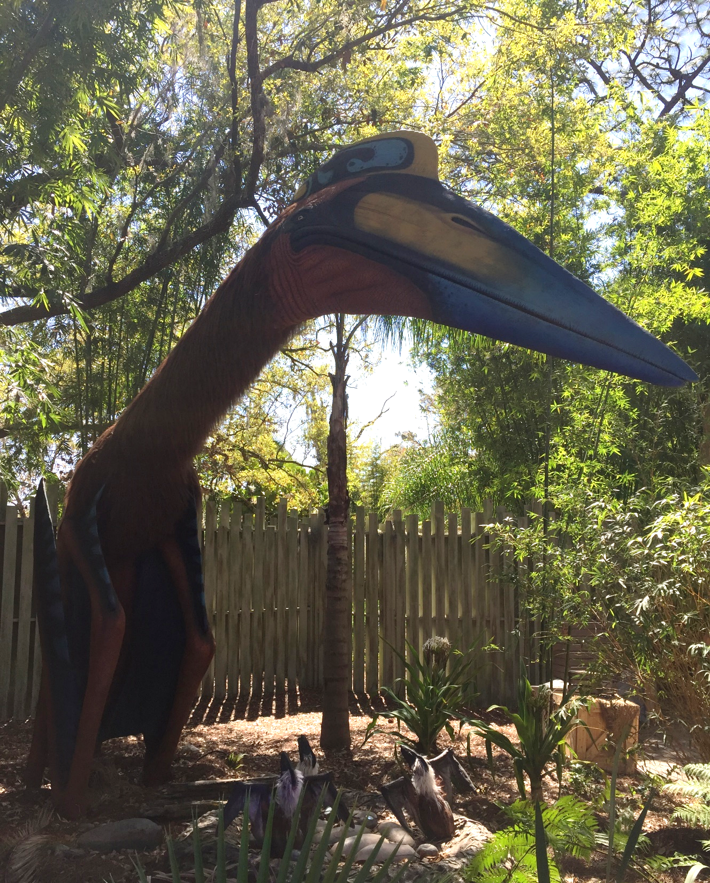
Pagan Religions
Quetzalcoatlus
Model

Slide 37
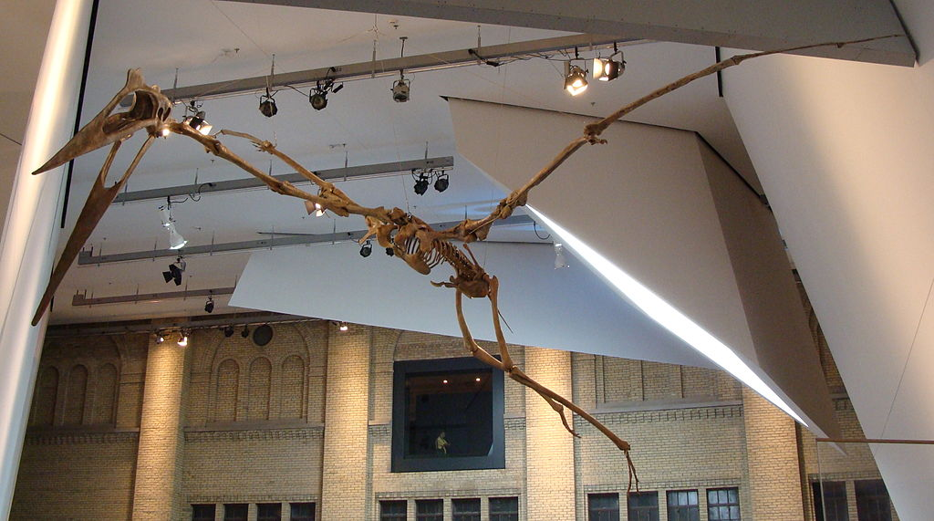
Quetzalcoatlus Fossil

Slide 38
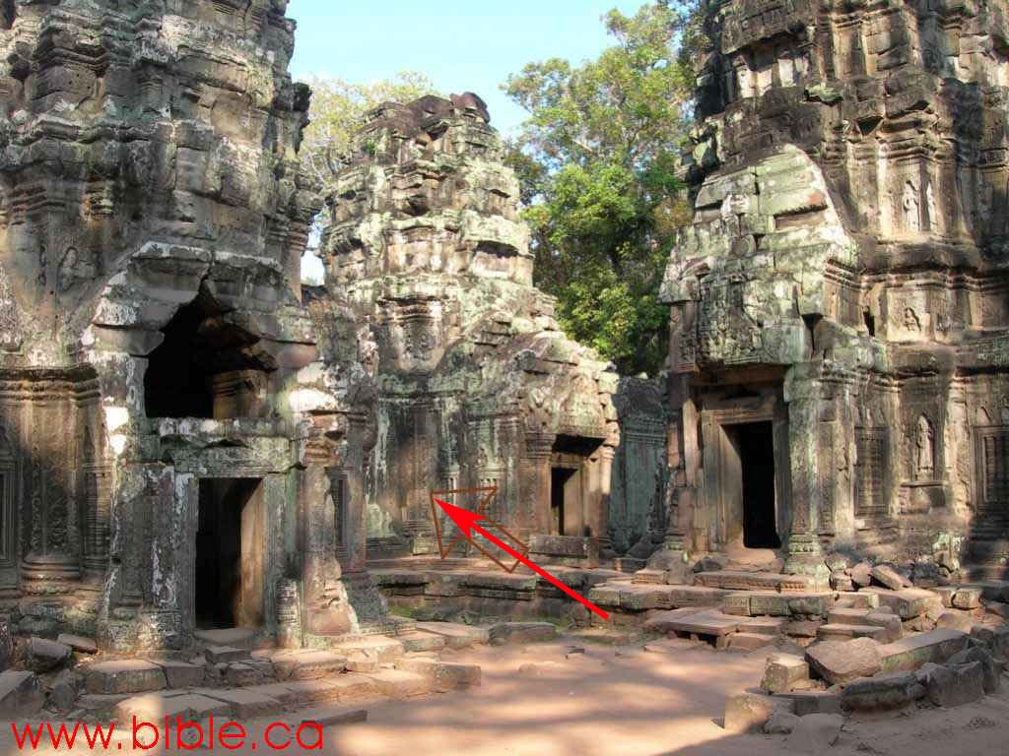
Ancient Temples & Pottery

Slide 39
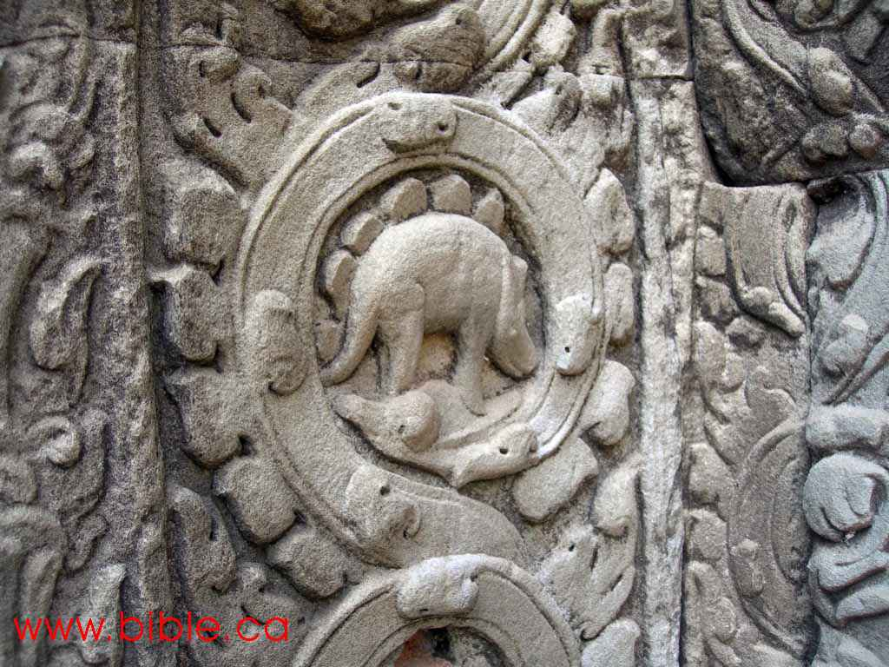
Ancient Temples & Pottery

Slide 40
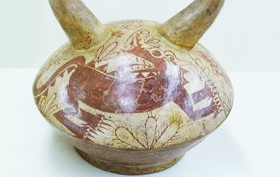
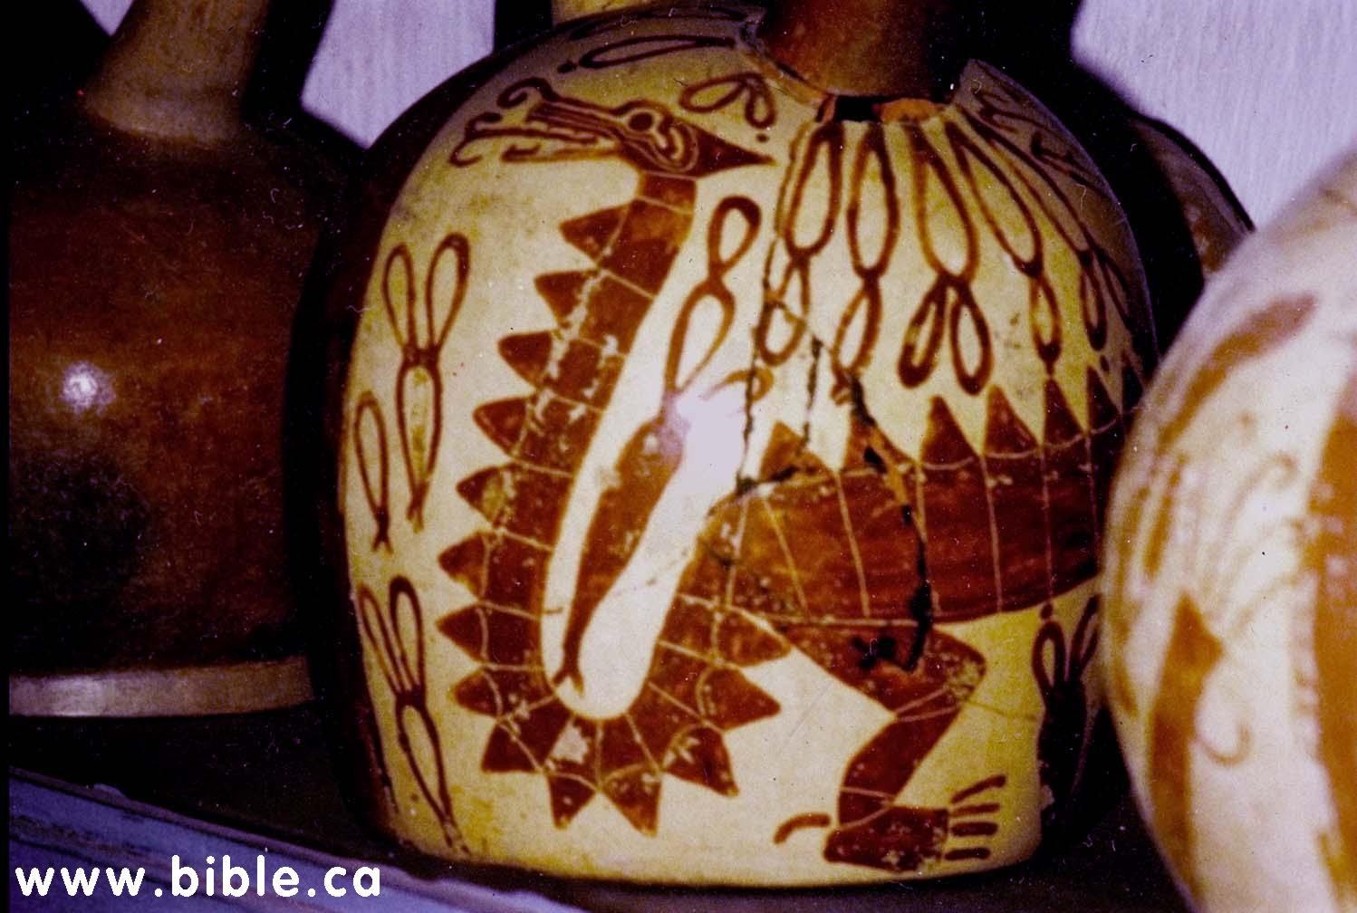
Ancient Temples & Pottery

Slide 41
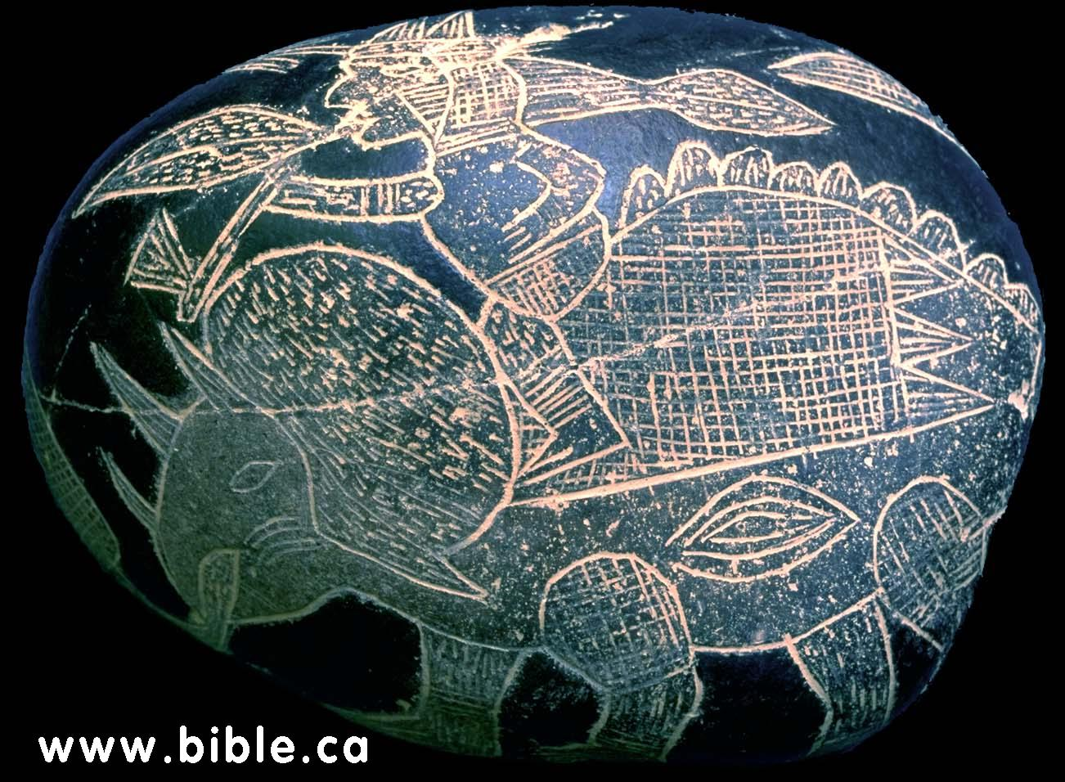
Ancient Grave Markers

Slide 42
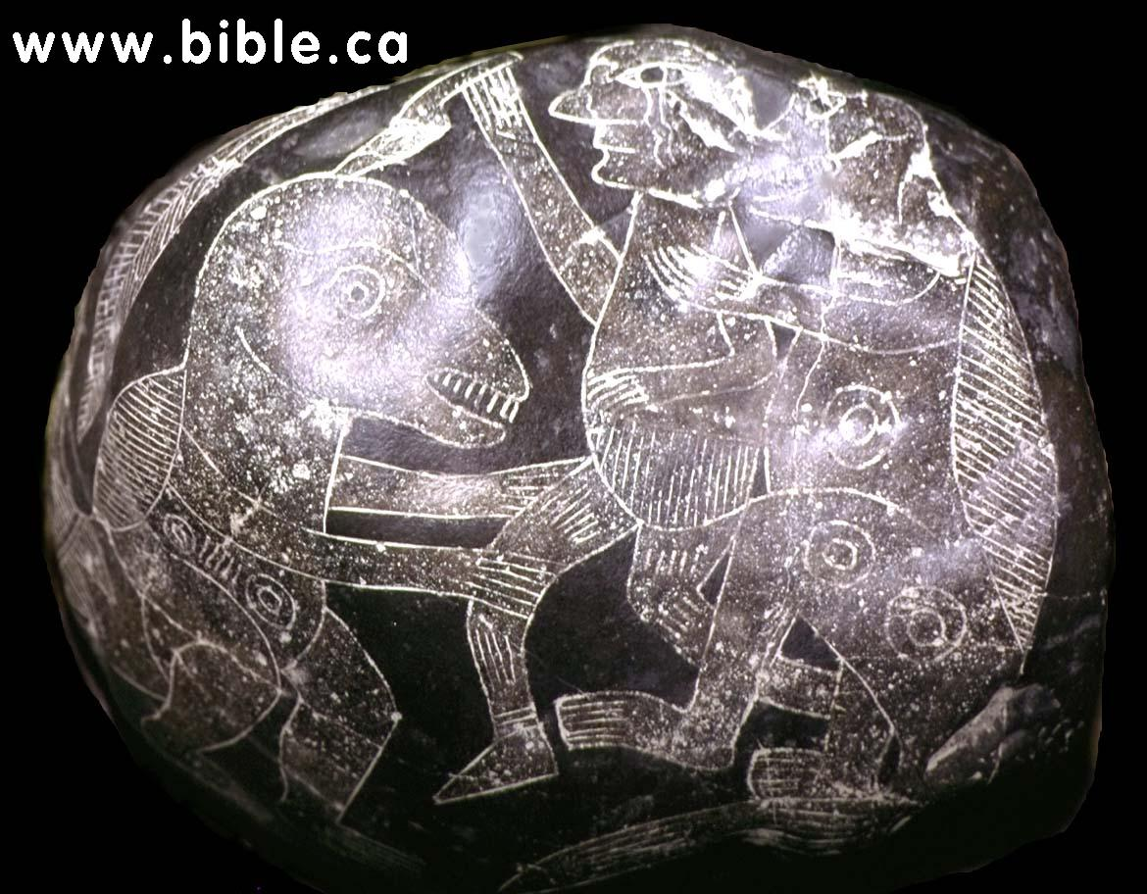
Ancient Grave Markers

Slide 43
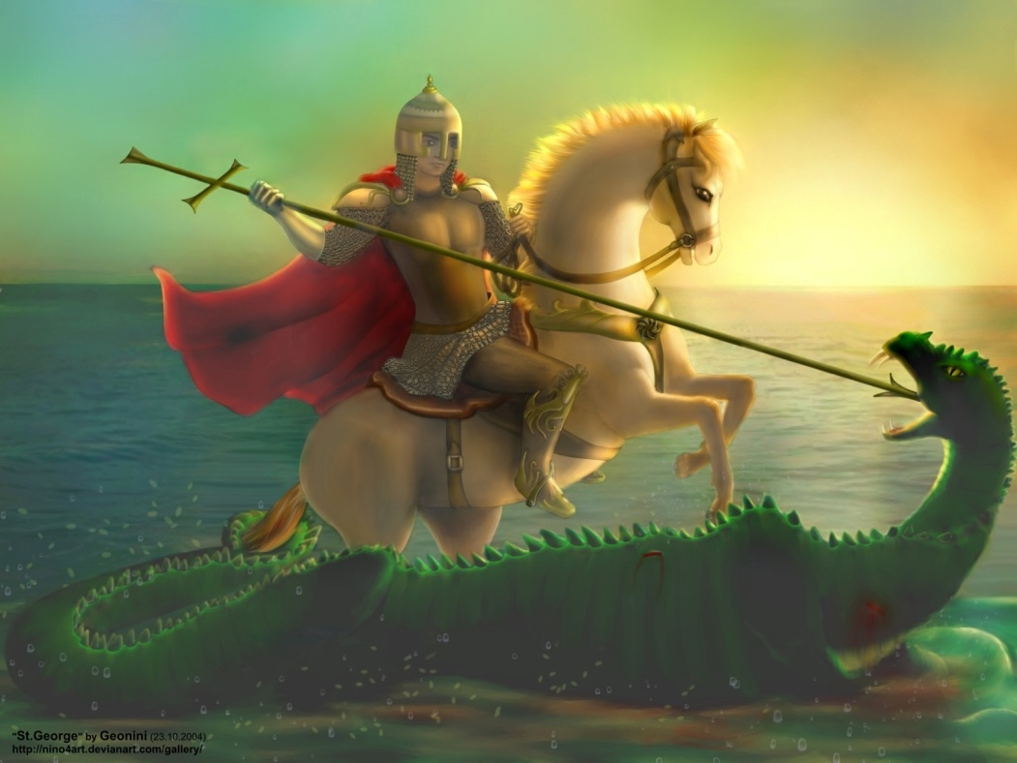
Universal Dragon Legends

Slide 44
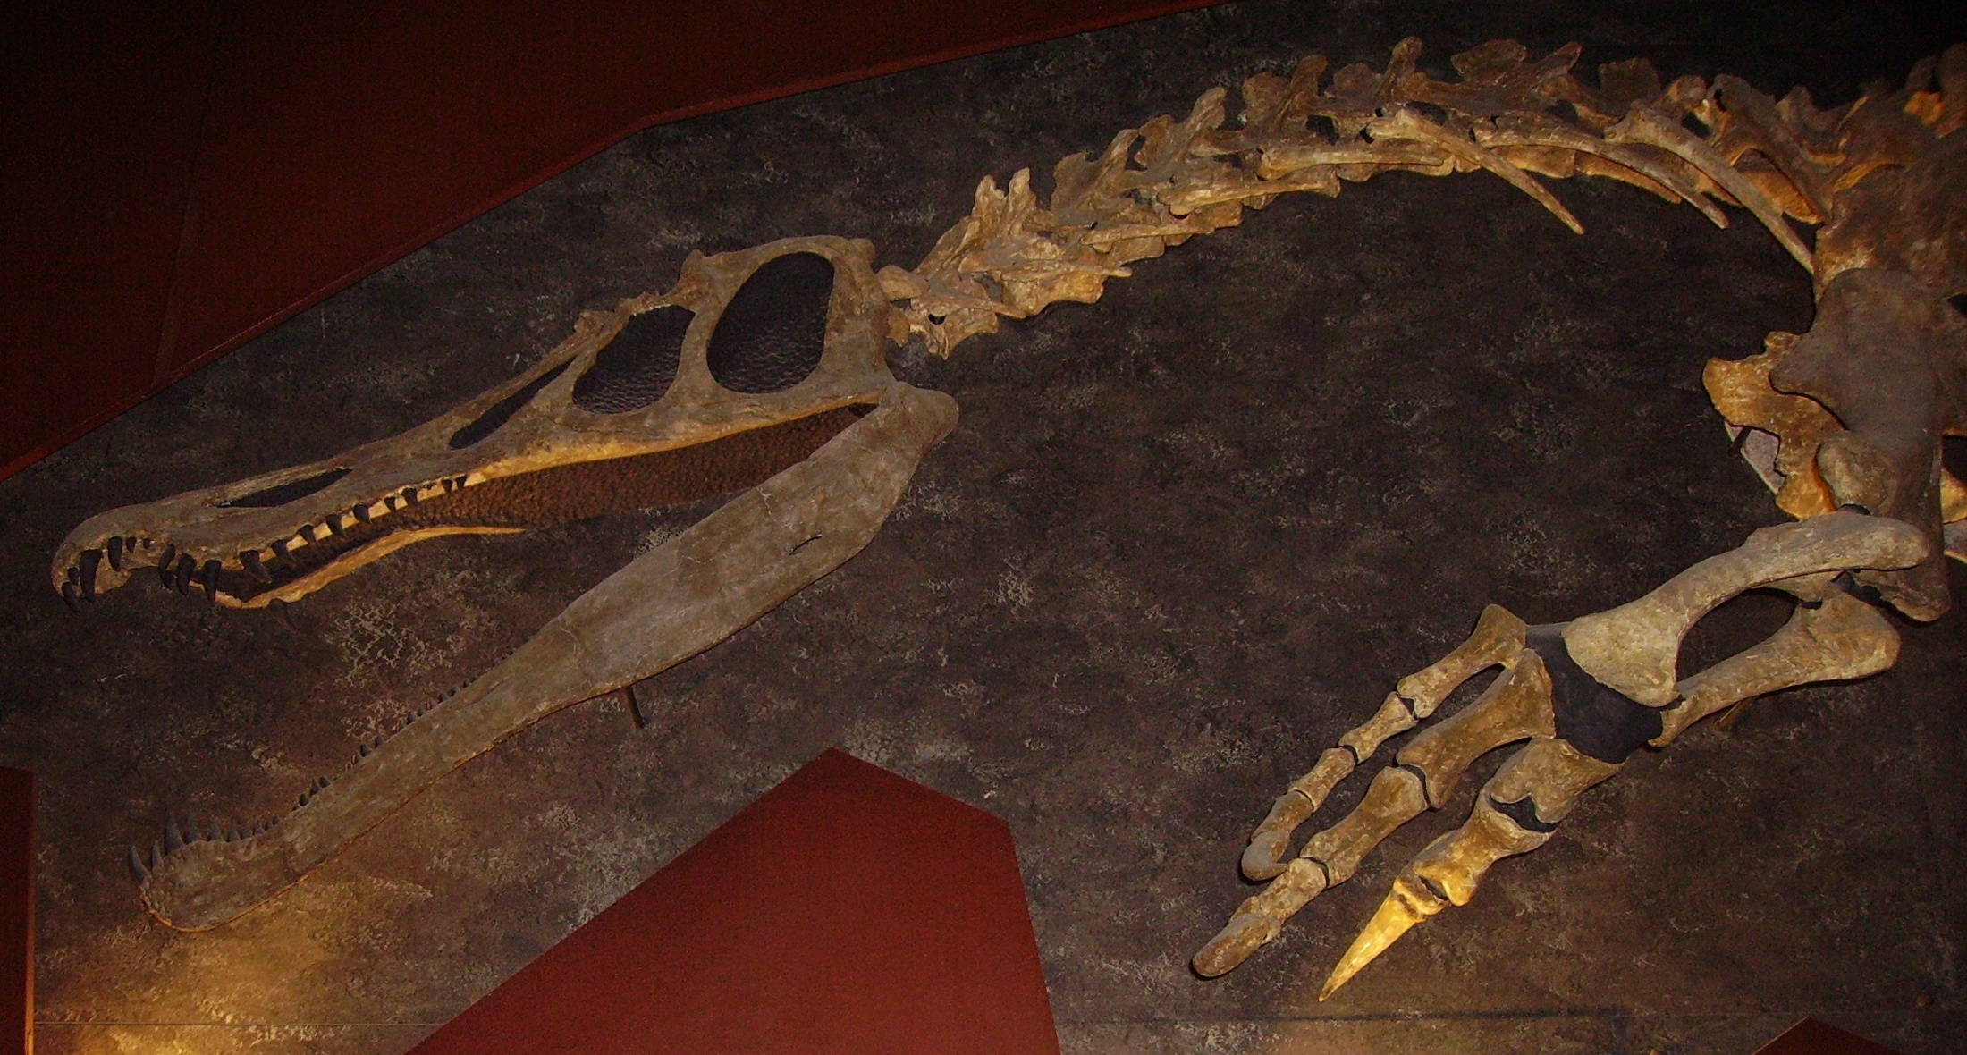
Universal Dragon Legends
Baryonyx Fossil

Slide 45
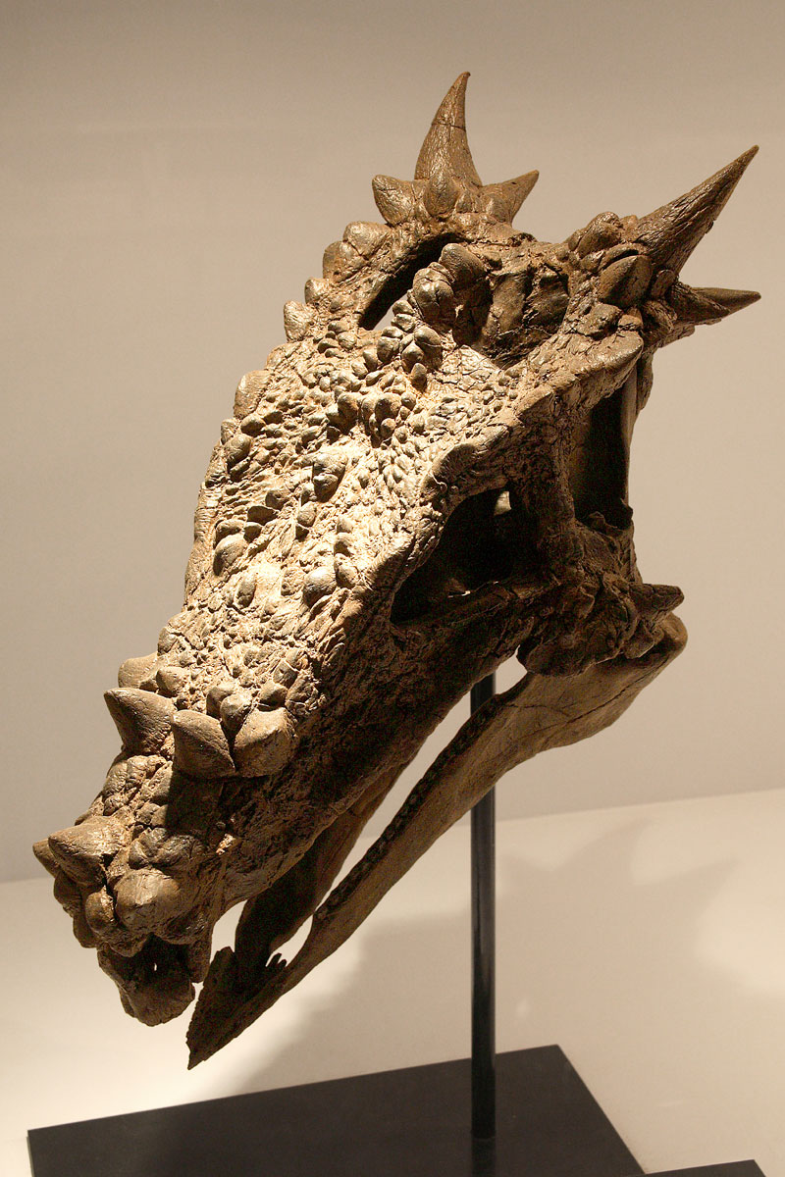
2003 – Dracorex Hogwartsia

Slide 46
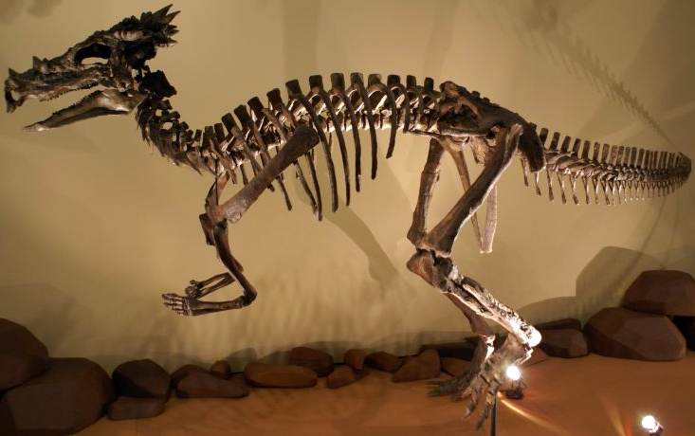
Dracorex Hogwartsia
Dracorex Hogwartsia Fossil

Slide 48
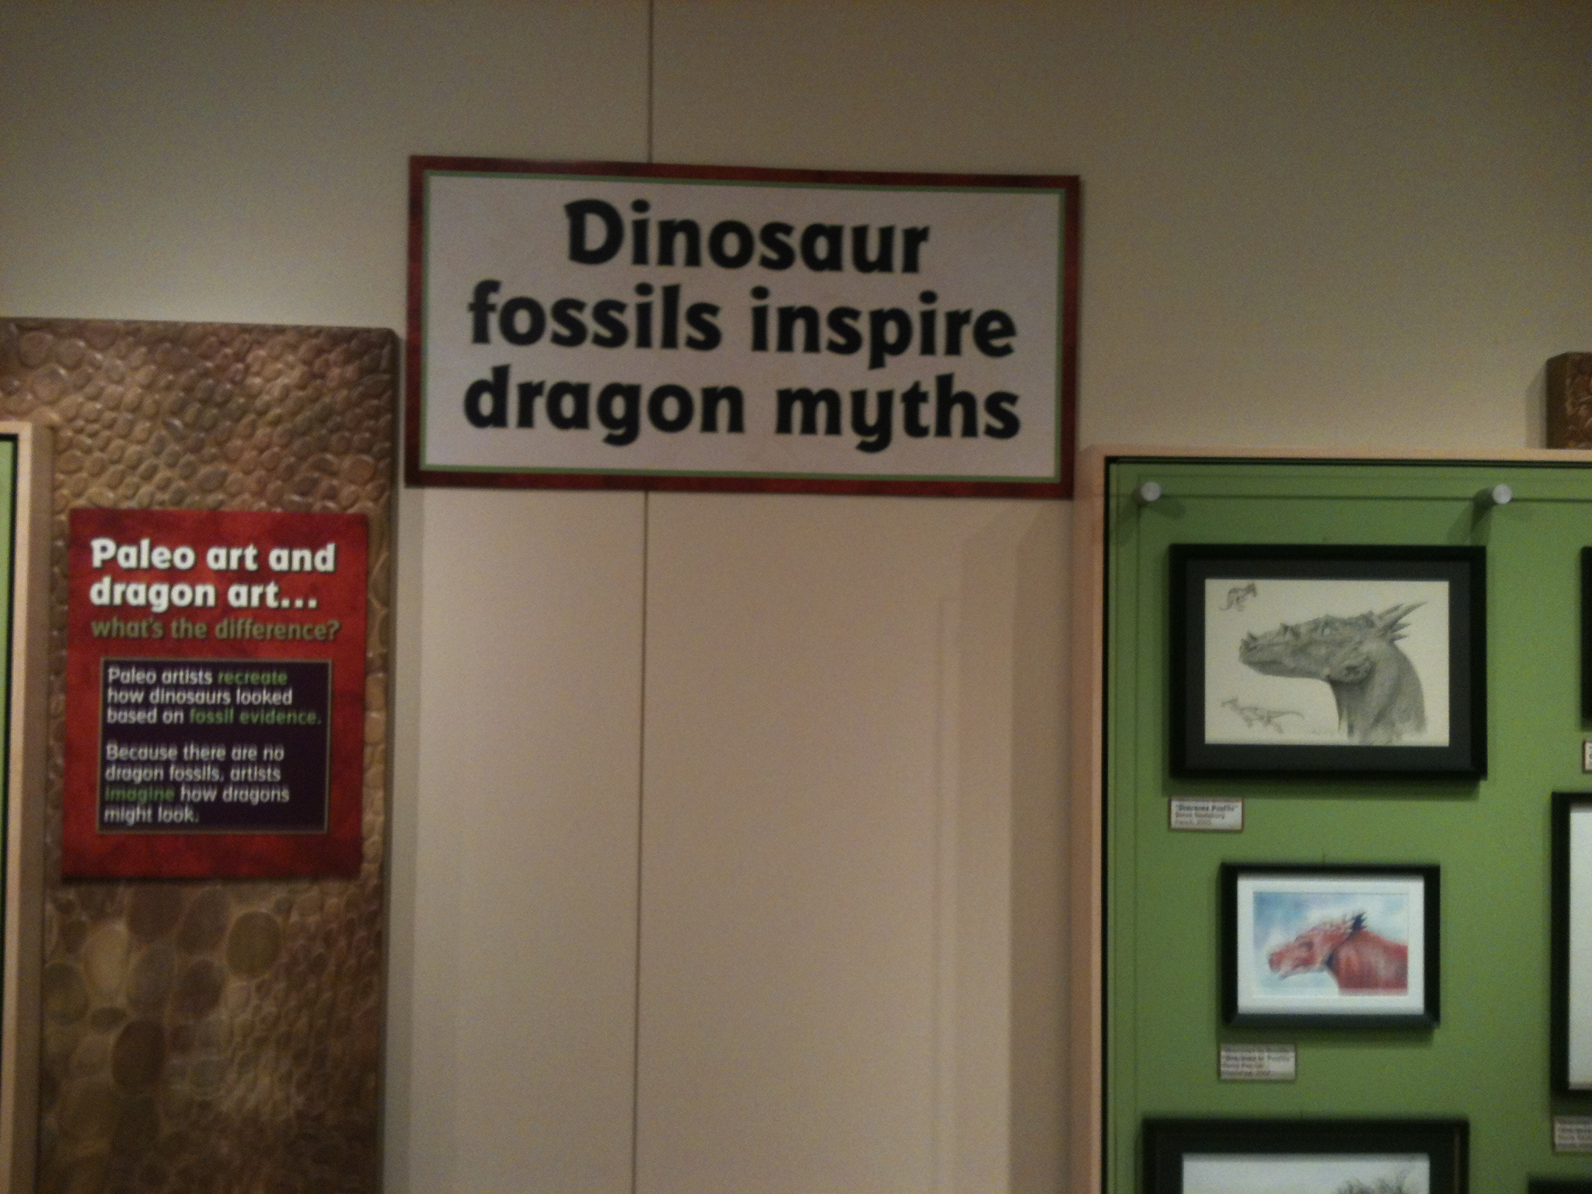
s
Every culture has legends of land, sea, or air dragons
Fossils of land, sea, and air dinosaurs have been found all over the globe

Slide 49
What Happened to the Dinosaurs?
The King
Of The Dinosaurs

Slide 50
What Happened to the Dinosaurs?
EXTINCTION

Slide 51
What Do Dinosaurs Do For Christians?
The King
Of The Dinosaurs

Slide 52
What Do Dinosaurs Do For Christians?
Dinosaurs: God is the powerful Creator (Job 41:10-11)
Fossils: God is the Judge; Sin will be judged (2 Pet. 3:1-10)
The Bible account of origins is true! Fossils of dinosaurs are exactly the kind of corroborating Evidence we would expect to find for the Genesis flood!

Slide 53
The King
Of The Dinosaurs

