Slide 2
Living the good life?

Slide 3
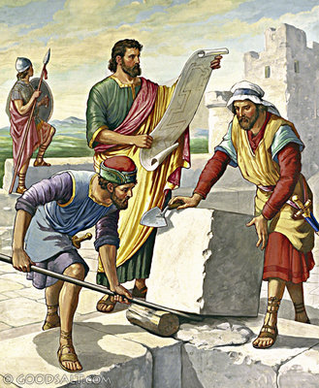
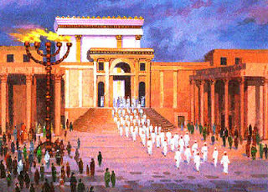
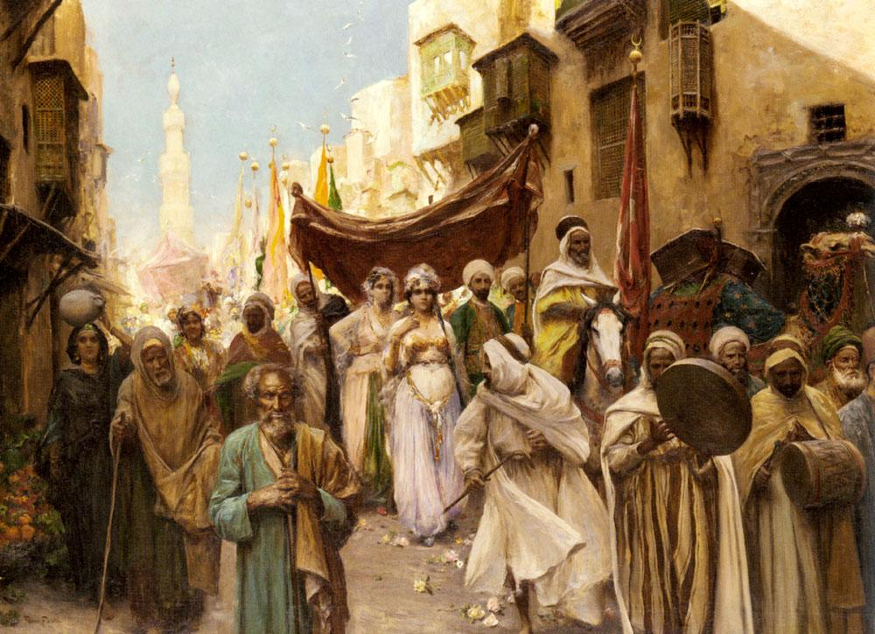
Psalm 127 – Psalm 128
“Songs of Ascent”- Psalms 120-134
…Unity & Blessings from the Lord…

Slide 4
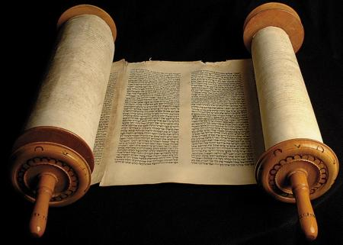
Psalm 127 – Psalm 128
Psalm 127:1 - Unless the Lord builds the house, They labor in vain who build it; Unless the Lord guards the city, The watchman stays awake in vain.
To build a physical building
To build a nation (city)
To build a family

Slide 5
Psalm 127 – Psalm 128
Psalm 127:1 - Unless the Lord builds the house, They labor in vain who build it; Unless the Lord guards the city, The watchman stays awake in vain.
"Verse one here is universal in its meaning, indicating that dependence upon God is vital in all human undertakings.“
Burton Coffman

Slide 6
Psalm 127 – Psalm 128
Psalm 127:2 - It is vain for you to rise up early, To sit up late, To eat the bread of sorrows; For so He gives His beloved sleep.
God blesses His people with sleep or rest John 14:27
God blesses His people while they sleep 2 Kings 19:17-19

Slide 7
Psalm 127 – Psalm 128
Whom Does God Bless?
Psalm 128:1 - Blessed is every one who fears the Lord, who walks in His ways...
v. 4 - Behold, thus shall the man be blessed who fears the Lord.

Slide 8
Psalm 127 – Psalm 128
What Does He Give?
Children are a Gift:
Psalm 127:3 - Behold, children are a heritage from the Lord, The fruit of the womb is a reward.
1) Children are given for the enjoyment of the parents, not the other way around.
2) Parents, because they were given to YOU, YOU are responsible for how they turn out.

Slide 9
Ephesians 6:4
…fathers, do not provoke your children to anger; but bring them up in the discipline and instruction of the Lord.
(NASB)

Slide 10
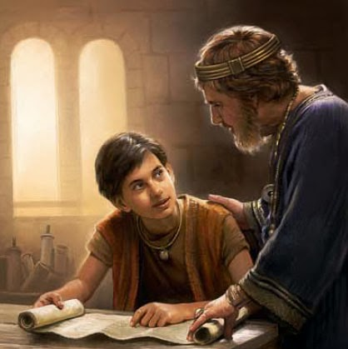
Deuteronomy 5:7-9
You shall teach them diligently to your children, and shall talk of them when you sit in your house, when you walk by the way, when you lie down, and when you rise up. You shall bind them as a sign on your hand, and they shall be as frontlets between your eyes. You shall write them on the doorposts of your house and on your gates.

Slide 11
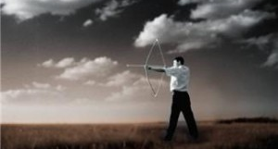
Psalm 127 – Psalm 128
Children are Arrows:
Psalm 127:4-5 - Like arrows in the hand of a warrior, So are the children of one's youth. Happy is the man who has his quiver full of them; They shall not be ashamed, But shall speak with their enemies in the gates.

Slide 12
Psalm 127 – Psalm 128
Children are Arrows:
Parents, your children, like a warrior’s arrows, must be crafted well and shot accurately at the target, or they are not a blessing.

Slide 13
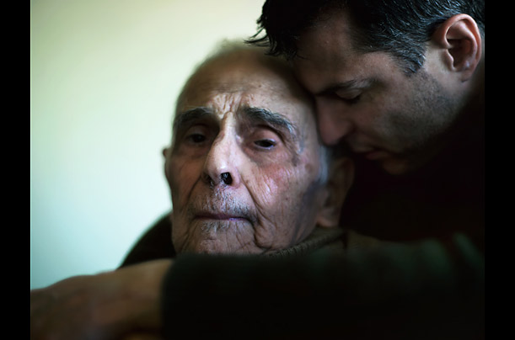
Psalm 127 – Psalm 128
Children are Arrows:
Children, as an arrow in their hand, you have a responsibility to protect your parents when they need protection.

Slide 14
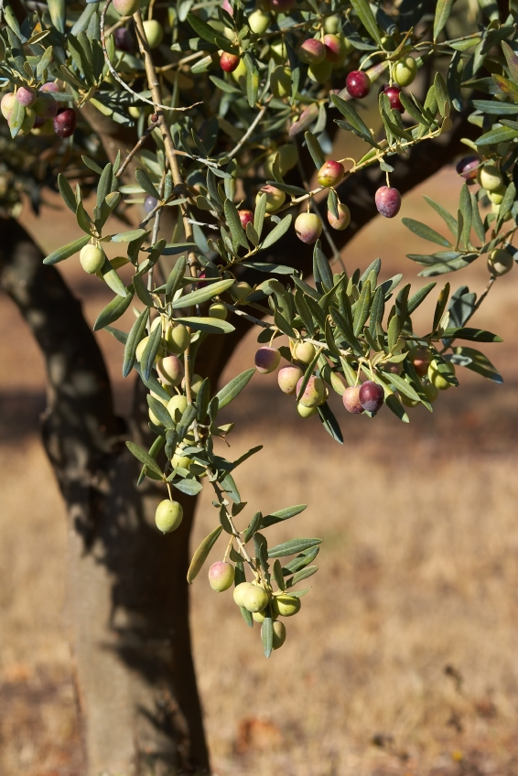
Psalm 127 – Psalm 128
Children are Olive Trees:
Psalm 128:3 - …Your children are like olive plants All around your table.
Children should be providers for the house, not just consumers.
“All around your table”

Slide 15
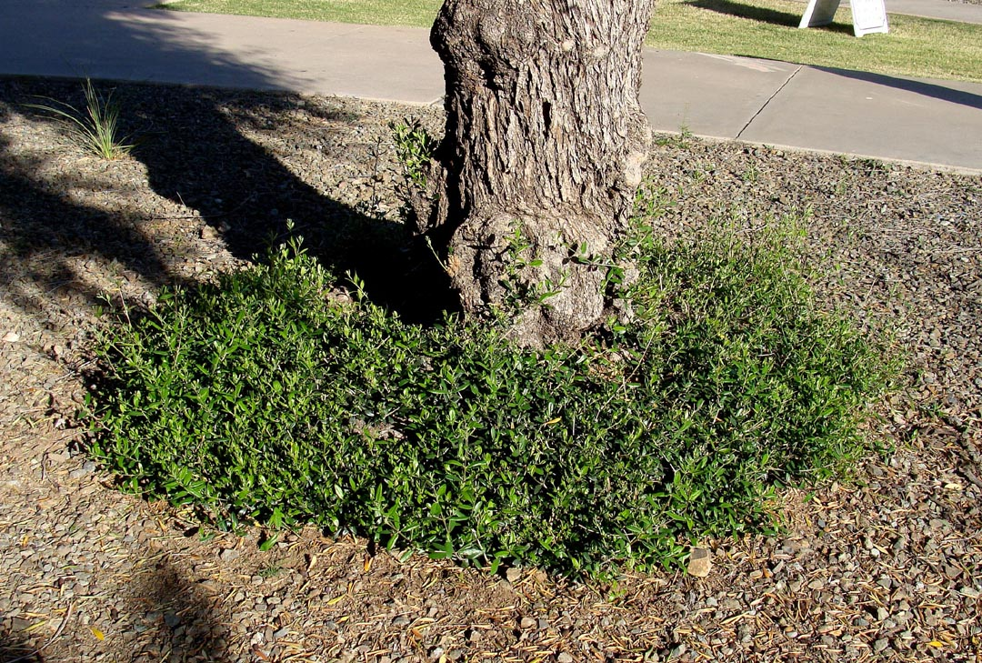
Psalm 127 – Psalm 128
Children are Olive Trees:
Psalm 128:3 - …Your children are like olive plants All around your table.
Children should be providers for the house, not just consumers.
“All around your table”
They are given to us to replace us.

Slide 16
Psalm 127 – Psalm 128
Children are Olive Trees:
Psalm 128:3 - …Your children are like olive plants All around your table.
"The good man is glad that a pious stock is likely to be continued; he rejoices in the belief that other homes as happy as his own will be established, wherein there are altars to the glory of God."
- Charles Spurgeon

Slide 17
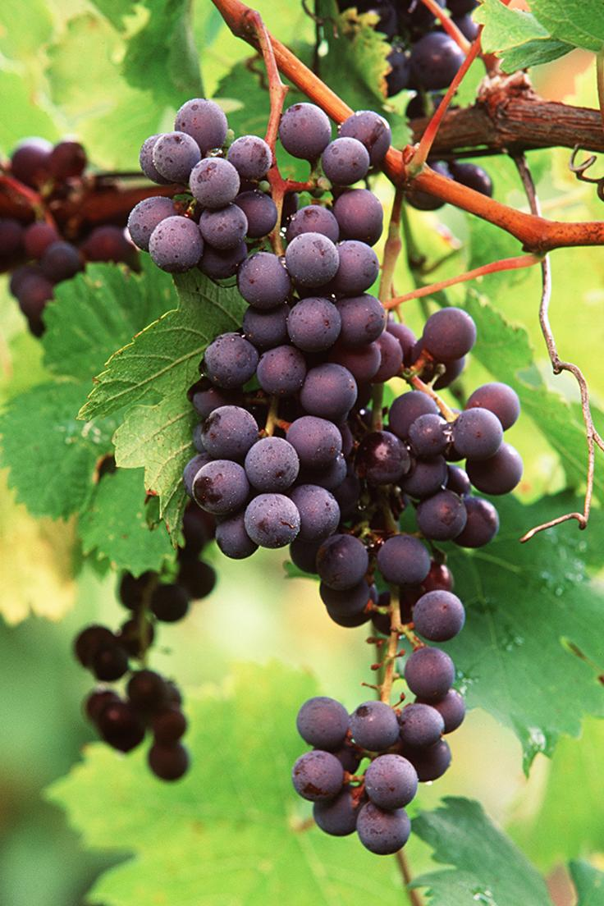
Psalm 127 – Psalm 128
Psalm 128:3 - …Your wife shall be like a fruitful vine In the very heart of your house.

Slide 18
Psalm 127 – Psalm 128
Psalm 128:5-6 - The Lord bless you out of Zion, And may you see the good of Jerusalem All the days of your life. Yes, may you see your children's children. Peace be upon Israel!
The blessings of God are in Zion – Hebrews 12:22-23
“May you see the good of Jerusalem… your children’s children”

