Slide 2
The Sermon on the Mount

Slide 3
Matt 5
Sermon on the Mount

Slide 4
Jesus the Master Teacher presents history’s greatest sermon
Matt. 5:20- True Righteousness
Sermon on the Mount explains the true nature of the “Kingdom of God”

Slide 5
Beatitudes- “Supreme blessedness”
“Nothing Succeeds like Failure”- Heaven belongs not to the Full but to the Empty

Slide 6
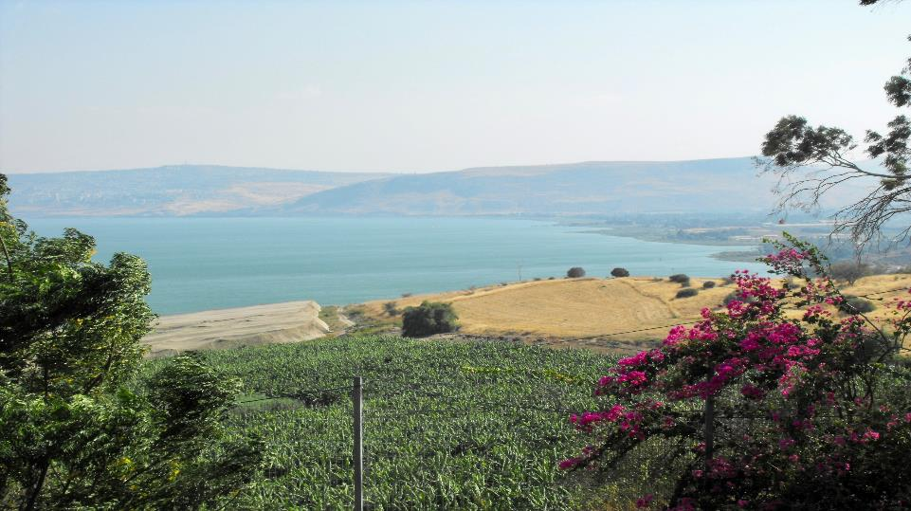

Slide 7
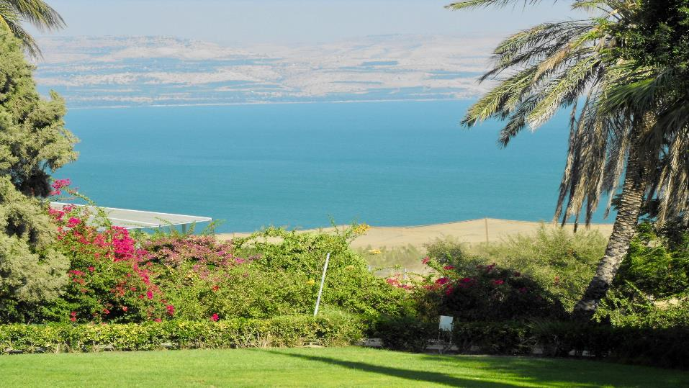

Slide 8
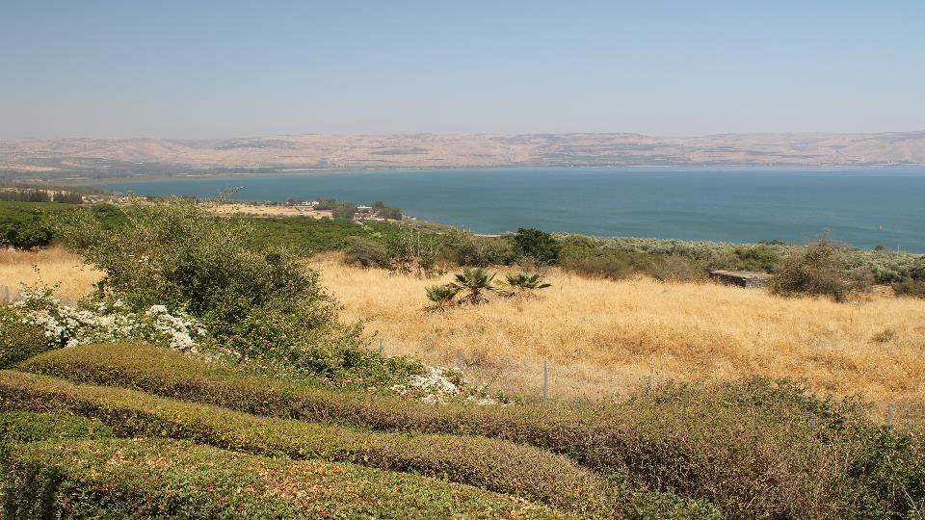

Slide 9
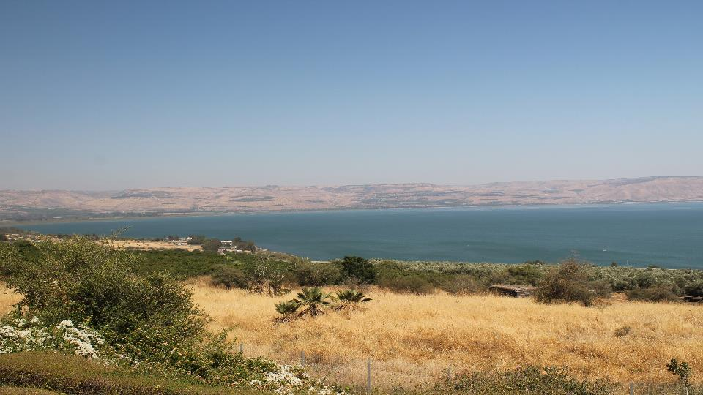

Slide 11
The Eight Beatitudes are not separate, to possess one is to possess them all.
Common word- Blessed- comes from the Latin word “beatus”- divine joy and perfect happiness.

Slide 12
Four attitudes described
Our attitude towards ourselves vs. 3
Our attitude towards our sins vs. 4-6
Our attitude toward the Lord vs. 7-9
Our attitude toward the world vs. 10-16

Slide 13
Vs. 13-16 You are the SALT and LIGHT of the world
Qualities of Salt-
Saves from decay
Salt adds flavor
Salt makes its presence known
Salt loses itself in its work
Makes you thirsty

Slide 14
Jesus came to fulfill the Law, not Destroy it vs. 17-20
True Righteousness must exceed that of the Scribes and Pharisees vs. 20
Jesus fulfilled the law in every way
His Birth
In His Life
In His Teaching
Thru His Death and Resurrection

Slide 15
Six Important OT laws interpreted for His people
Murder- Vs. 21-26
Adultery- Vs. 27-30
Divorce- Vs. 31-32
Making Oaths or Swearing- Vs. 33-37 (Lev. 19:12; Deut. 23:23)
Retaliation- Vs. 38-42
Love your Enemies-Vs. 43-38

Slide 16
Comments?

