Slide 2
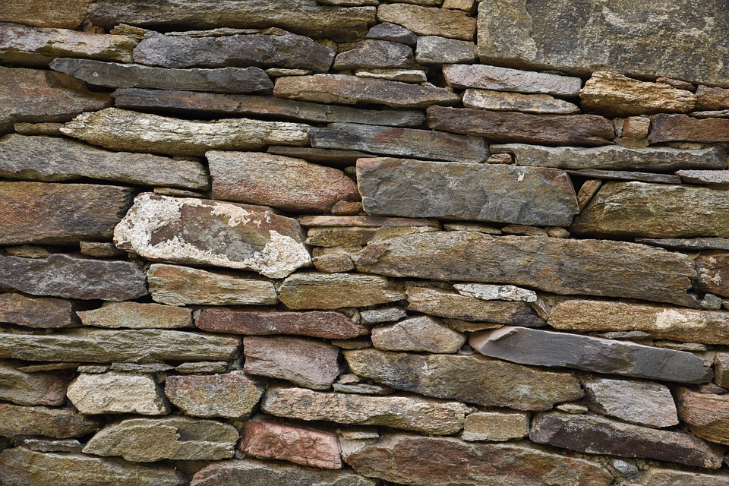
Building A Spiritual House
1st Peter 2
TRUE SPIRITUALITY

Slide 3
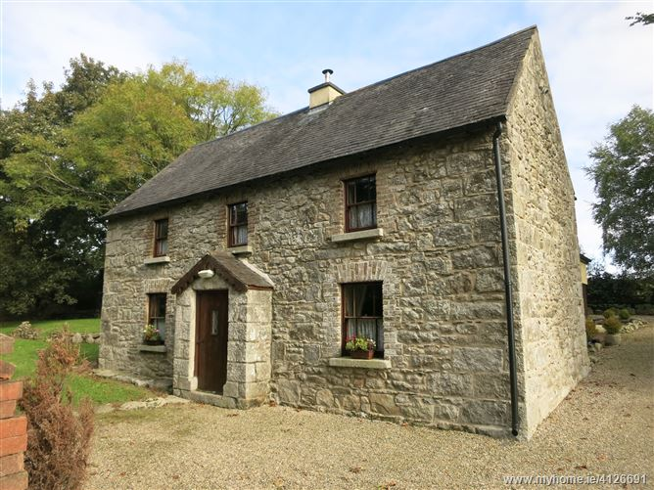
A Stone House

Slide 4
Living Stones Become a “Spiritual House”
It has a foundation cornerstone
A holy priesthood
A chosen people
A holy nation
A people for God’s own possession
A people that proclaim the excellencies of God
A people that were once not His people but are now
A people who once had not received mercy but now have
God’s House
God’s Dwelling Place

Slide 5
How do these spiritual people work together?
In local groups – as local spiritual houses
They are a spiritual people
They work together as God prescribes
They are a spiritual people guided by God’s Word into “all things that pertain to life and godliness”
They follow the teachings and patterns found in God’s Word

Slide 6
A Spiritual House
TRUE SPIRITUALITY

Slide 7
Becoming A Living Stone
TRUE SPIRITUALITY

