Slide 2
Mt. Carmel

Slide 3
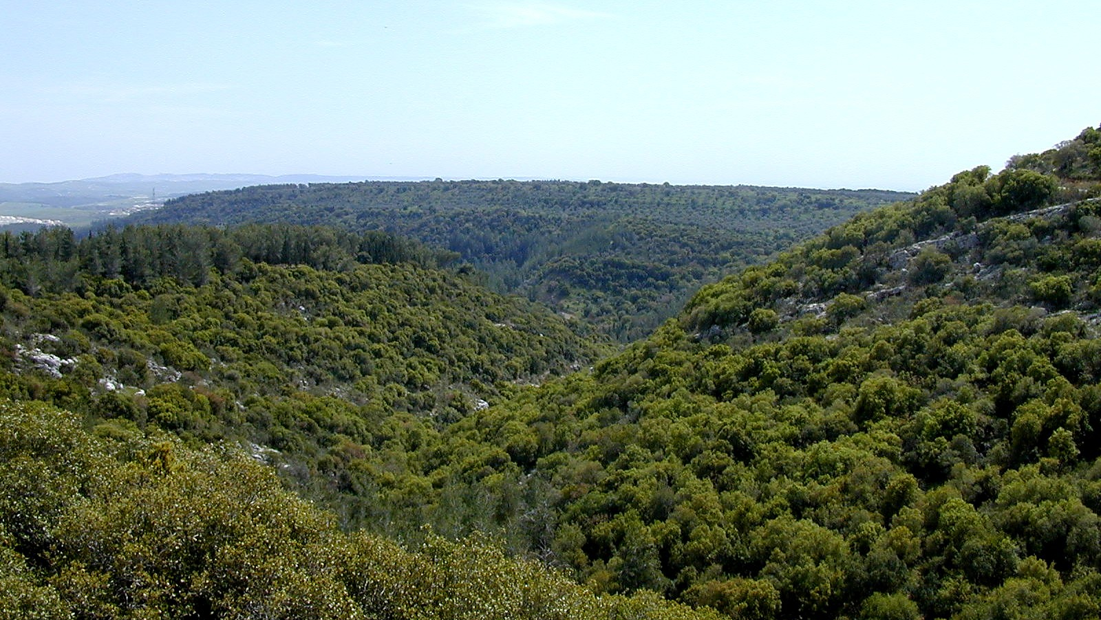
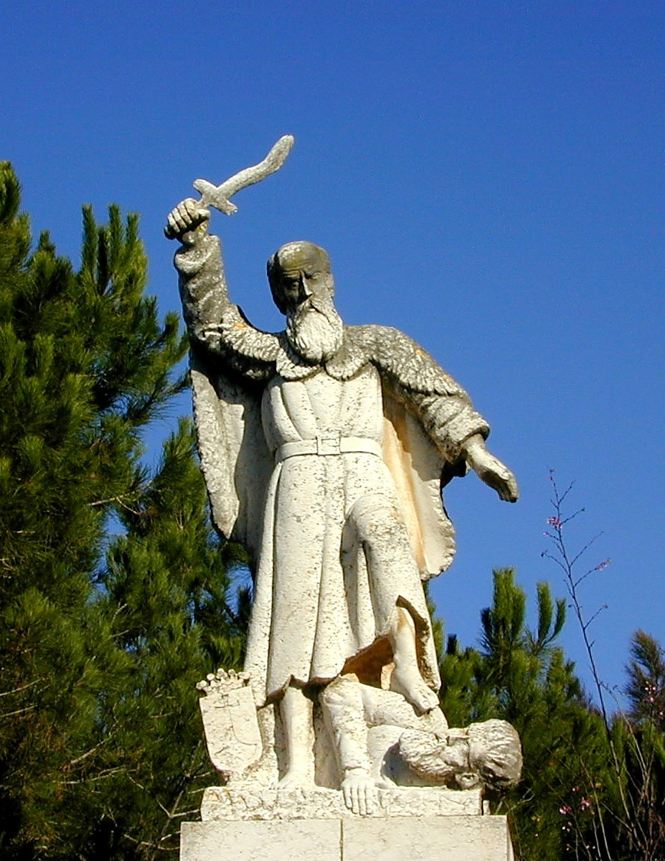

Slide 4
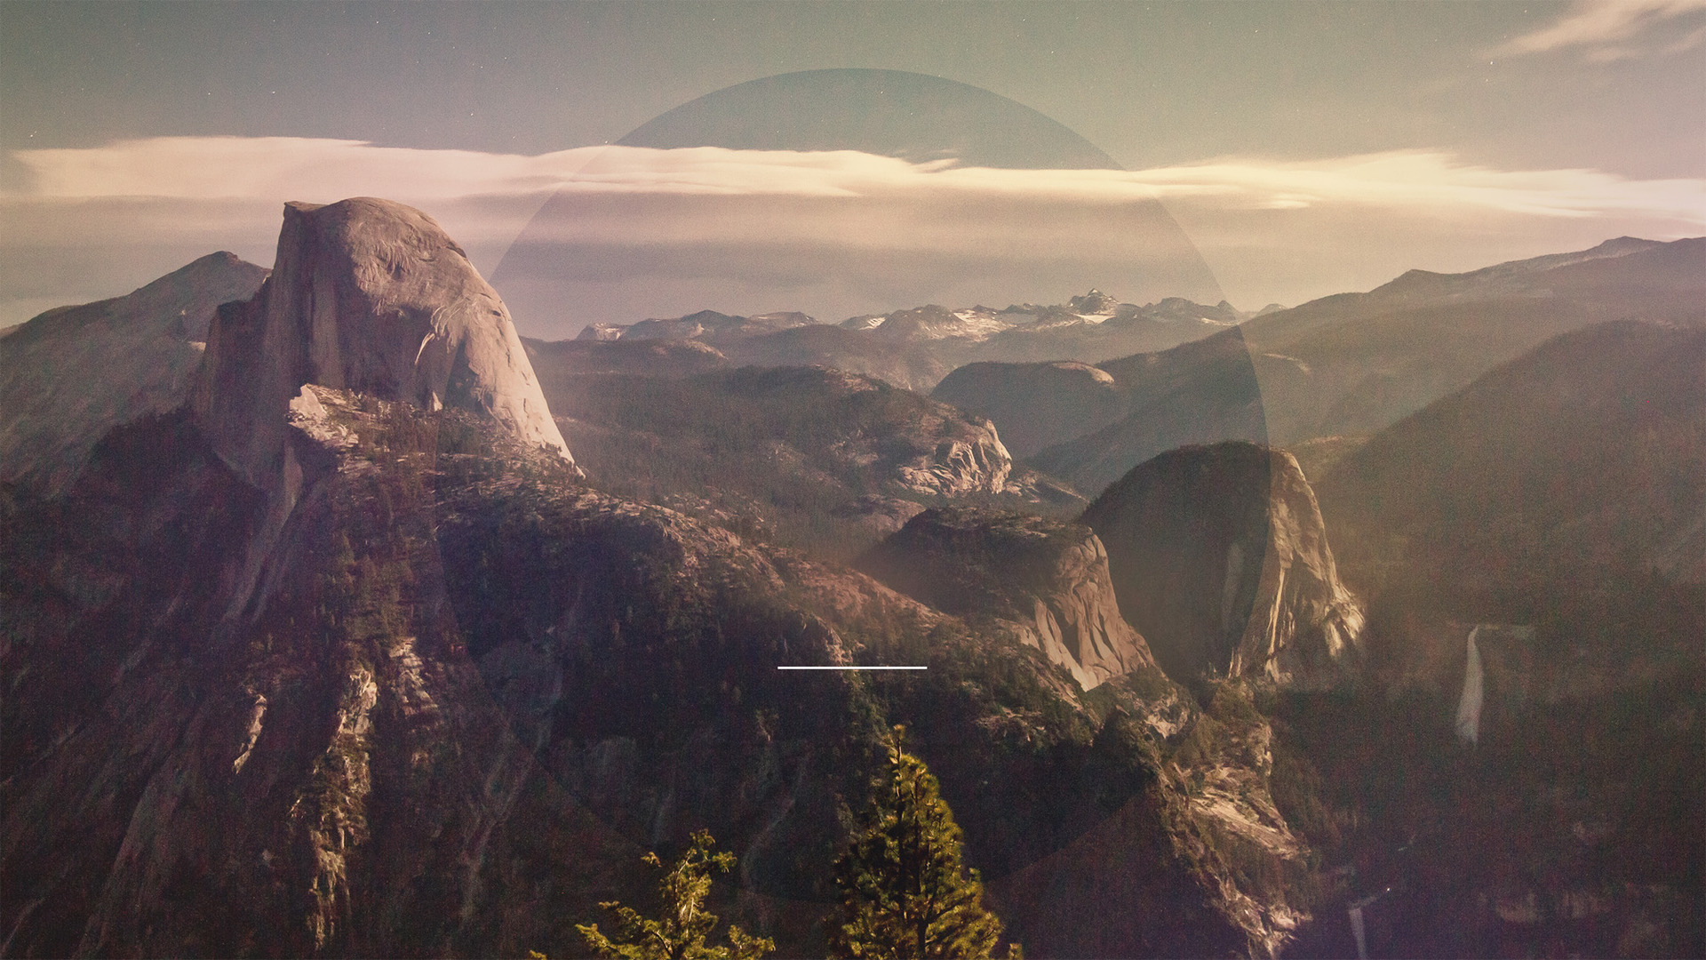
Faith In Dark Times
1 Kings 18-19

Slide 5
Elijah Prophesied In Dark Times
1 Kings 16.31-34; 18.9-14

Slide 7
Elijah Prophesied In Dark Times
1 Kings 16.31-34; 18.9-14

Slide 8
Yet, Jehovah Was Still God!
1 Kings 17.1; 18.19-45

Slide 9
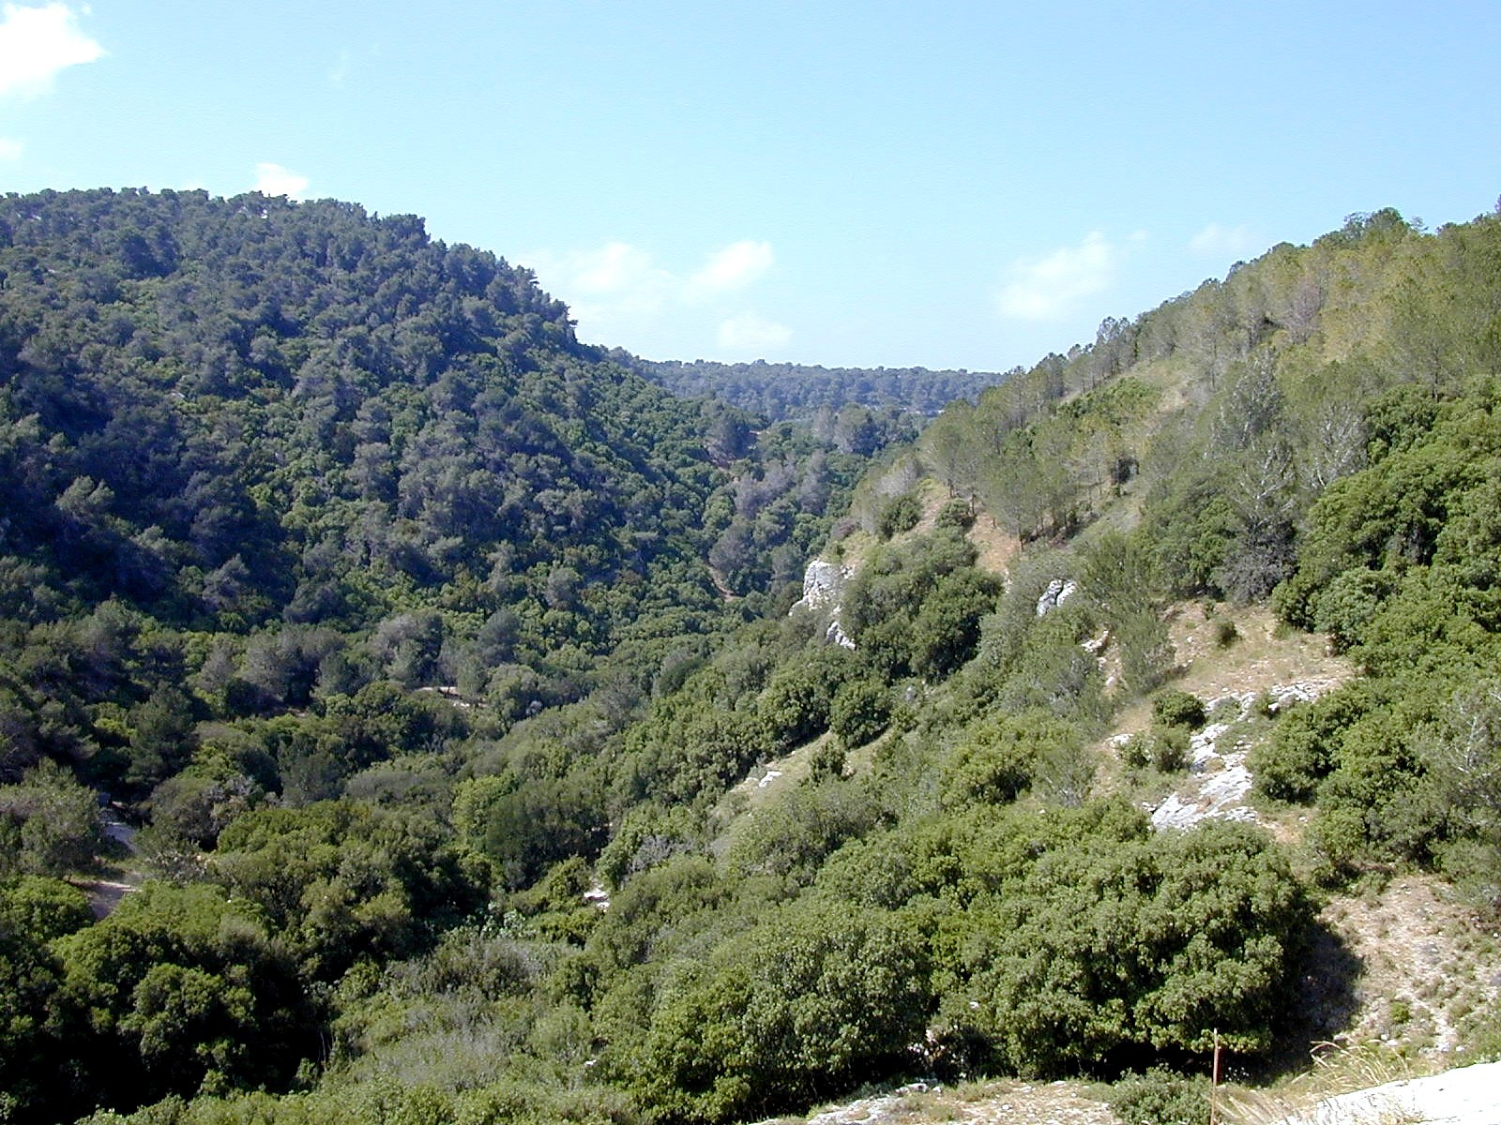

Slide 10
Yet, Jehovah Was Still God!
1 Kings 17.1; 18.19-45

Slide 11
Times Remained Dark…
1 Kings 19.1-18

Slide 12
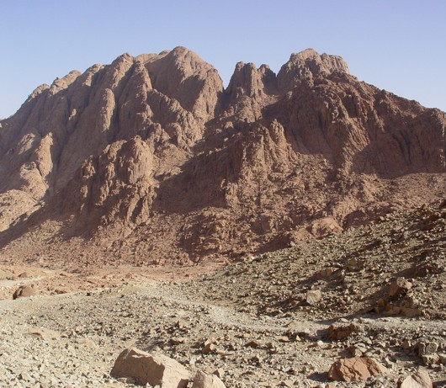

Slide 13
But The Lord Called Elijah To Continue Trusting Him
1 Kings 19.1-18

