Slide 2
“The LORD is gracious and merciful, slow to anger and abounding in steadfast love. The LORD is good to all, and his mercy is over all that he has made.” (Psalm 145.8-9)

Slide 3
“The God of the Old Testament is utterly unlike the God believed in by most practicing Christians... His justice is, by modern standards, outrageous... He is biased, querulous, vindictive, and jealous of his prerogatives.” (Charles Templeton)

Slide 4
“Whenever we read the obscene stories, the voluptuous debaucheries, the cruel and torturous executions, the unrelenting vindictiveness, with which more than half the Bible is filled, it would be more consistent that we called it the work of a demon, than the word of God.” (Thomas Paine)

Slide 5
“Whenever we read the obscene stories, the voluptuous debaucheries, the cruel and torturous executions, the unrelenting vindictiveness, with which more than half the Bible is filled, it would be more consistent that we called it the work of a demon, than the word of God.” (Thomas Paine)

Slide 6
Why are these charges leveled against God?
Because God’s people have done some terrible things
Because God punishes mankind, sometimes severely

Slide 7
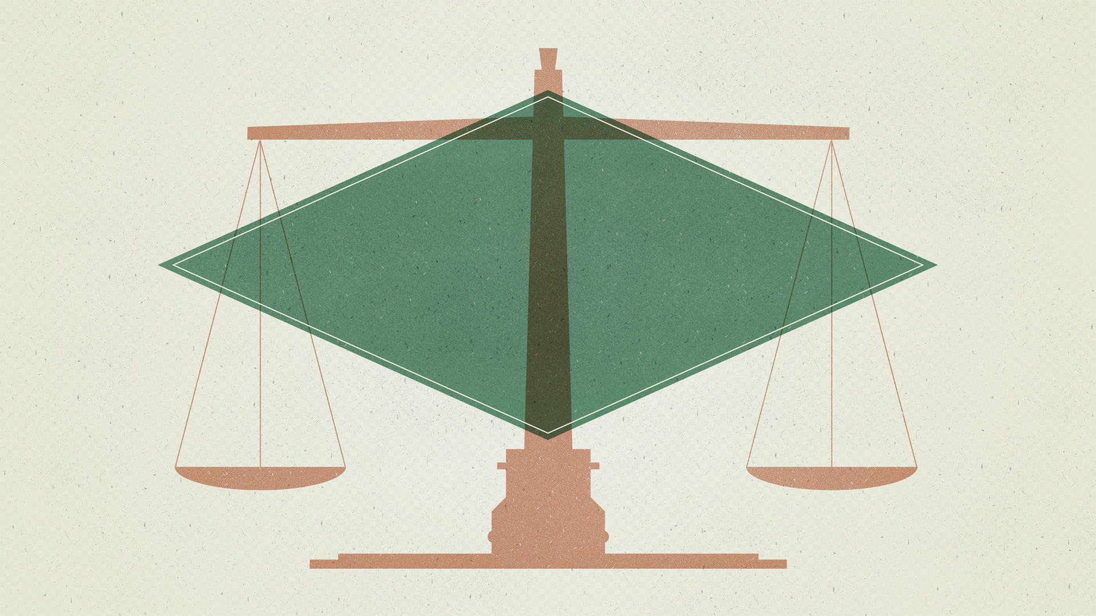
Making Sense Of
God’s Judgments

Slide 8
A Word of Caution…
Making Sense Of
God’s Judgments

Slide 9
“Behold, I am of small account; what shall I answer you? I lay my hand on my mouth.”
(Job 40:4 ESV)
Making Sense Of
God’s Judgments

Slide 10
“Righteousness and justice are the foundation of Your throne; Lovingkindness and truth go before You.” (Psalm 89:14)
“Clouds and thick darkness surround Him; Righteousness and justice are the foundation of His throne. Fire goes before Him And burns up His adversaries round about.” (Psalm 97:2–3)
Making Sense Of
God’s Judgments

Slide 11
Character of the Judge:
Foundation of his throne is “righteousness and justice” (Psalm 89.14)
He loves righteousness (Psalm 11.7)
He commits no injustice(Zephaniah3.5)
He judges in righteousness (Psalm 9.7-8)
Making Sense Of
God’s Judgments

Slide 12
He has the right to judge…
We are the work of His hands (Isaiah 64.8-9)
He reigns over all nations (Psalm 47.8-9)
We are His offspring (Acts17.26-31)
Making Sense Of
God’s Judgments

Slide 13
His judgments are not arbitrary
His judgments are retribution for wrongdoing (Romans 12.19)
His judgments are sometimes a means of correcting the sinner (Proverbs 3.11-12)
His judgments are meant to serve as a warning to others(1Corinthians10.9-12)
Making Sense Of
God’s Judgments

Slide 14
“Why should a divine being, with creation and eternity on his mind, care a fig
for petty human malefactions?”
(Richard Dawkins)
Making Sense Of
God’s Judgments

