Slide 1
A History of The biblical Text

Slide 2
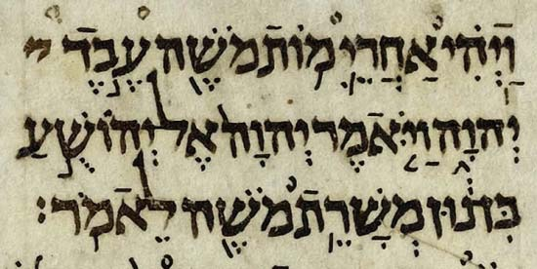
The Old Testament
No autographs
The basis for English versions is the Masoretic text(s)
Dated to the 7–11th AD

Slide 3
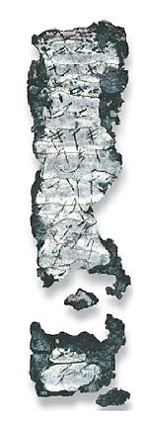
Ketef Hinnom Amulet
Num. 6:24-26
7th or 6th BC
Discovered in 1979

Slide 4
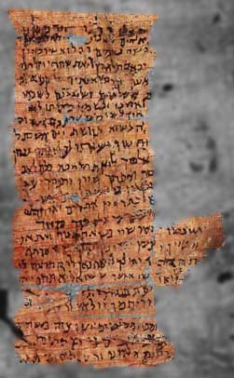
The Nash Papyrus
2nd or 1st BC
Ten Commandments from both Ex. 20 and Deut. 5 (and 6:4–5)
Discovered in Egypt in 1902

Slide 5
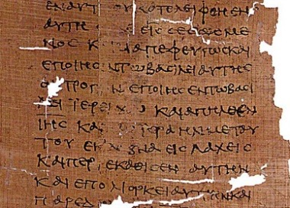
The LXX
Greek translation of Hebrew Bible
Many differences
Made around 200 BCE

Slide 6
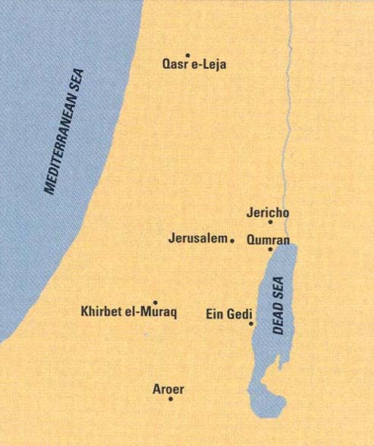
Qumran

Slide 7
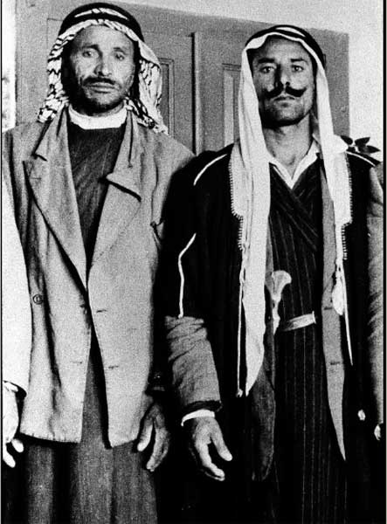
Muhammad edh-Dhib (“the Wolf”)

Slide 8
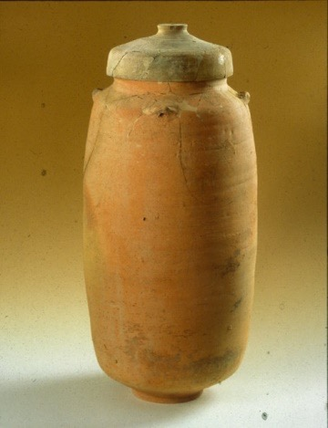
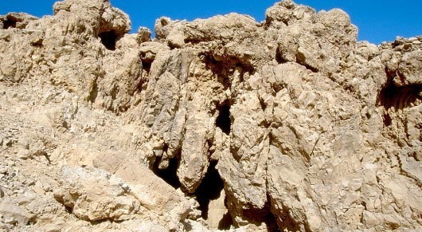
Cave 1

Slide 9
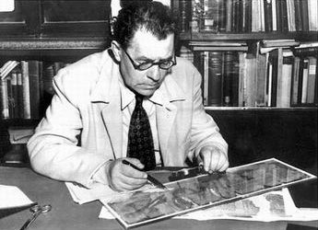
Eliezer Sukenik

Slide 10
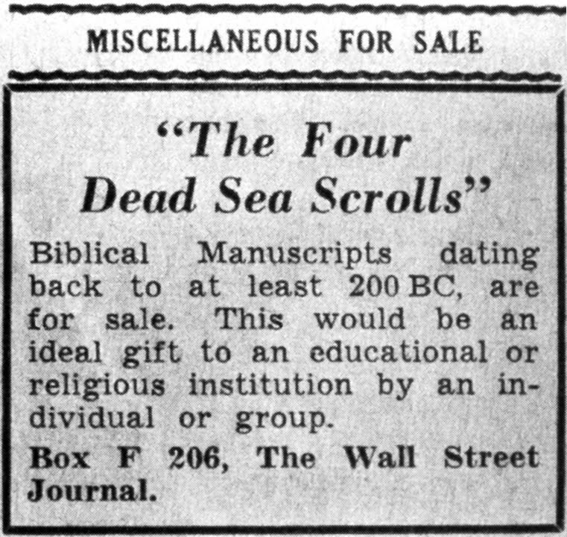
Metropolitan Samuel’s Ad

Slide 11
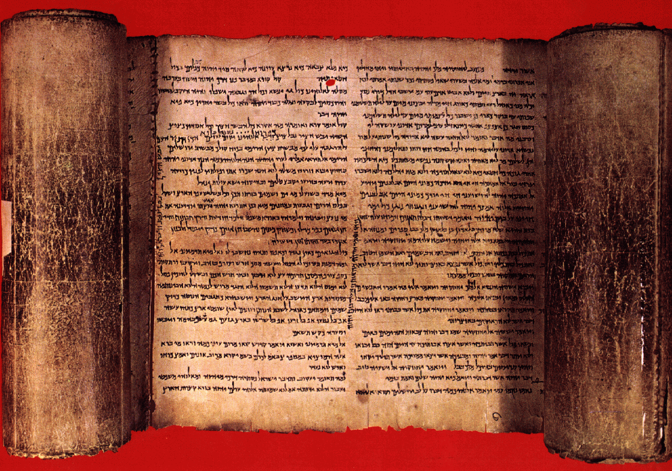
The Dead Sea Scrolls
11 Caves with fragments
Contain every biblical book except Esther
Some modern translations implement the findings

Slide 12
The Dead Sea Scrolls
MT
DSS (and LXX)
Isaiah 53:11 Out of the anguish of his soul he shall see and be satisfied; by his knowledge shall the righteous one, my servant, make many to be accounted righteous, and he shall bear their iniquities.
Isaiah 53:11 Out of his anguish he shall see light; he shall find satisfaction through his knowledge. The righteous one, my servant, shall make many righteous, and he shall bear their iniquities.

Slide 13
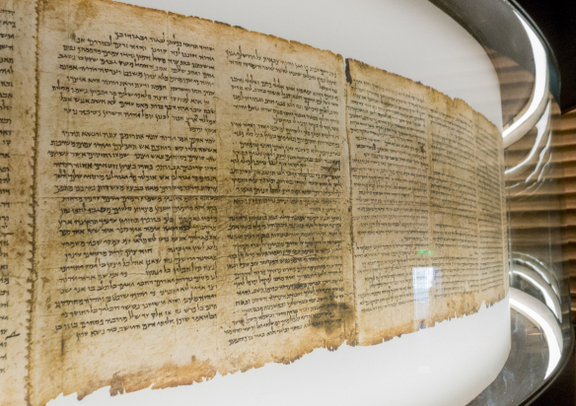
The Shrine of the Book

Slide 14
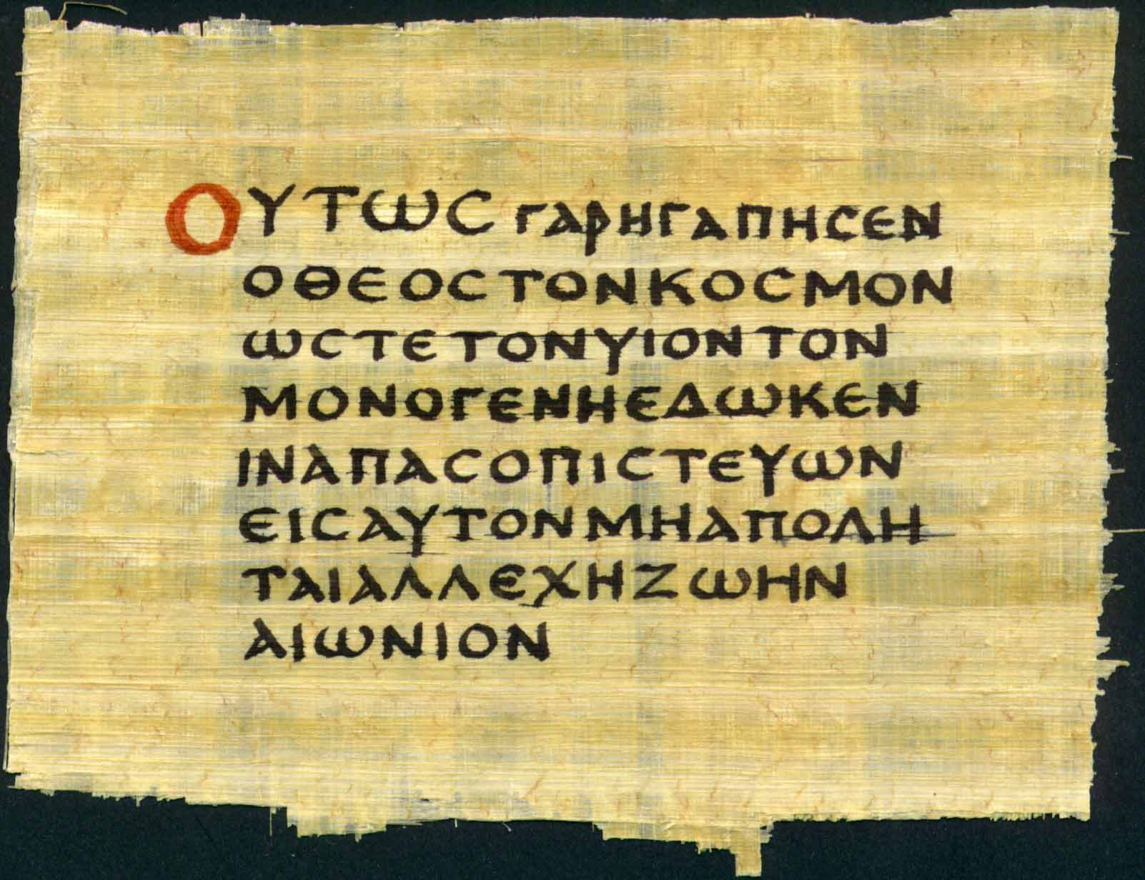
The New Testament
No autographs
Thousands of fragments and manuscripts
Some early papyri and codices

Slide 15
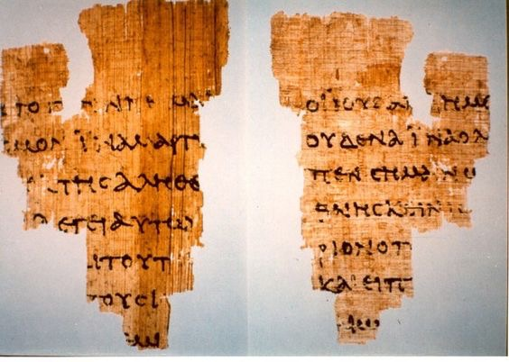
P. 52- Fragment of the Gospel of John
Dated 110–125
Only 20– 30 years from the original writing
Acquired in Egypt in 1920

Slide 16
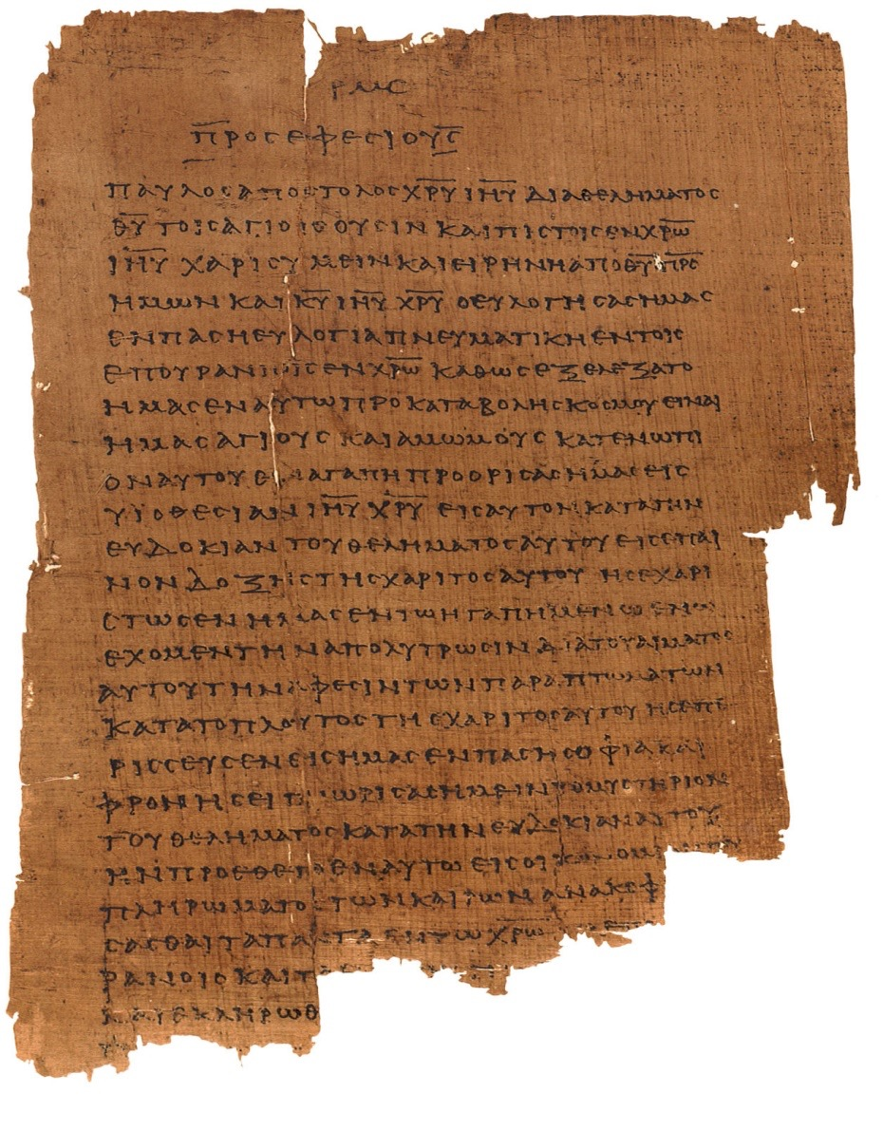
P 46
Dated to mid 2nd AD
Contains all of Paul’s epistles except Pastorals

Slide 17
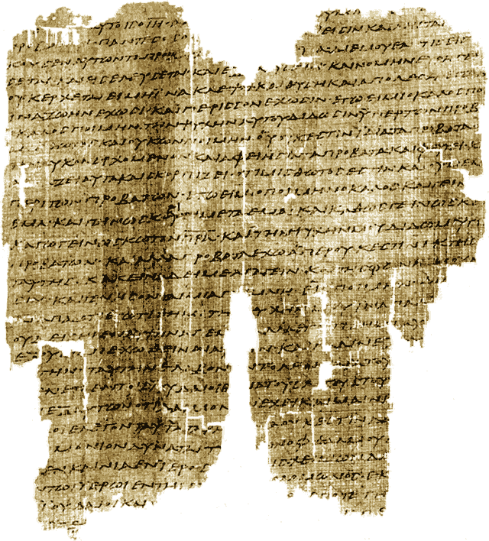
Chester Beatty Papyri
Purchased in 1930
Three early manuscripts containing: P45 (2nd– all four gospels and Acts); P46; P47 (3rd century- Rev. 9–17)

Slide 18
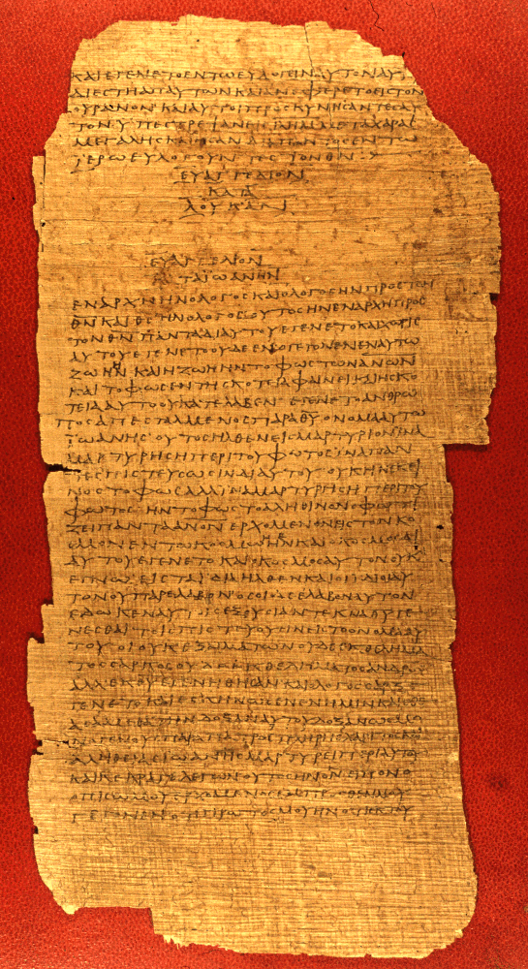
Bodmer Papyri
Purchased from a dealer in Egypt in 1950s and 60s
3 important papyri: P66 (c. 175, almost all of John); P72 (3rd, all of 1 & 2 Peter, Jude); P75 (200, large portions of Luke 3– John 15)

Slide 19
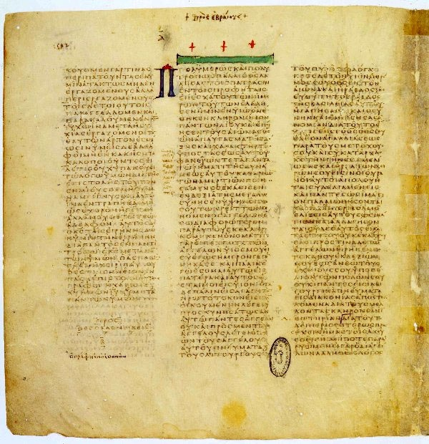
Important Codices
Codex Sinaiticus (350 CE- entire NT)
Codex Vaticanus (300-325- entire OT in Greek and almost entire NT)
Codex Alexandrinus (5th- almost all of NT)

Slide 20
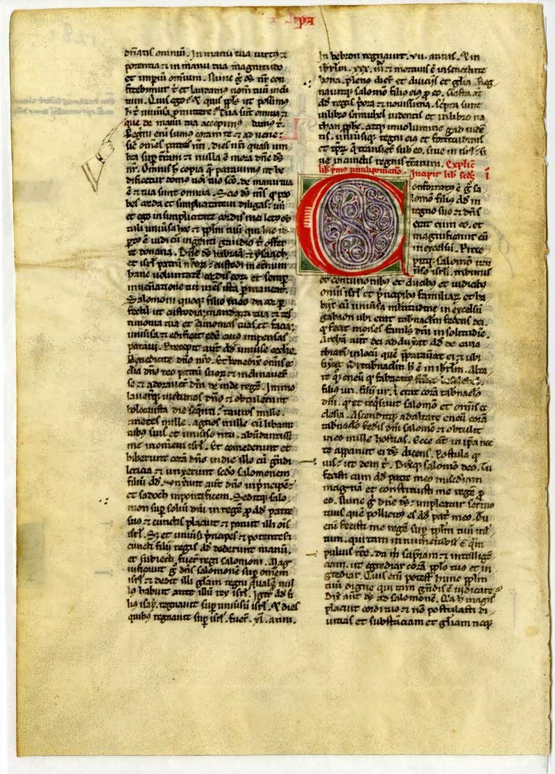
The English Bible
The Bible of the Middle Ages was the Latin Vulgate.
Earliest translation into English was by Caedmon (7th).
Bede is also said to have made an English translation.

Slide 21
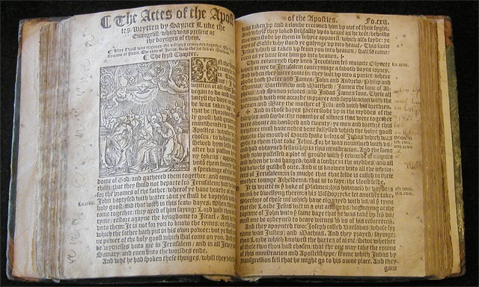
The English Bible
First translation of entire Vulgate by John Wycliffe (14th)
William Tyndale was the first to translate the Greek NT into English (1525).
Miles Coverdale would finish the translation of Hebrew Bible to English

Slide 22
William Tyndale
“If God spare my life, ere many years, I will cause a boy that driveth the plough to know more of the Scripture than thou dost.”

Slide 23
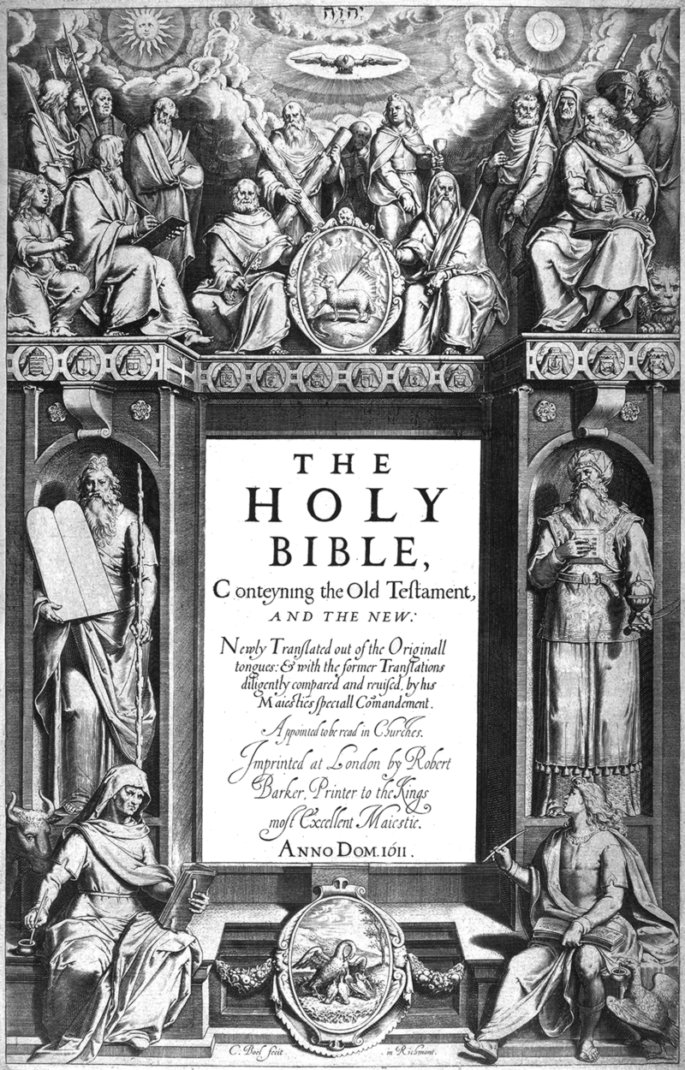
The King James Bible
James I decided to make a new translation.
More than 50 scholars worked beginning in 1607.
Most influential work of English literature.

Slide 24
Isaiah 40:8 The grass withers, the flower fades, but the word of our God will stand forever.
Matthew 24:35 "Heaven and earth will pass away, but My words will not pass away.

