Slide 1
Nehemiah

Slide 2
Persian kings | Jewish history
Cyrus – r. 559-530 BC | 538 1st group returns, Ezra 1-6 536 work on temple begins, stops
Cambyses II r. 530-522 BC
Darius I r. 522-486 BC | 520 work of Haggai 520 work on temple resumes 520-516 work of Zechariah 516 temple finished
Xerxes I r. 486-465 BC | 483-474 story of Esther
Artaxerxes I r. 464-425 BC | 458 2nd group, Ezra 7-10 445 3rd group, Nehemiah 1-13 work of Malachi

Slide 3
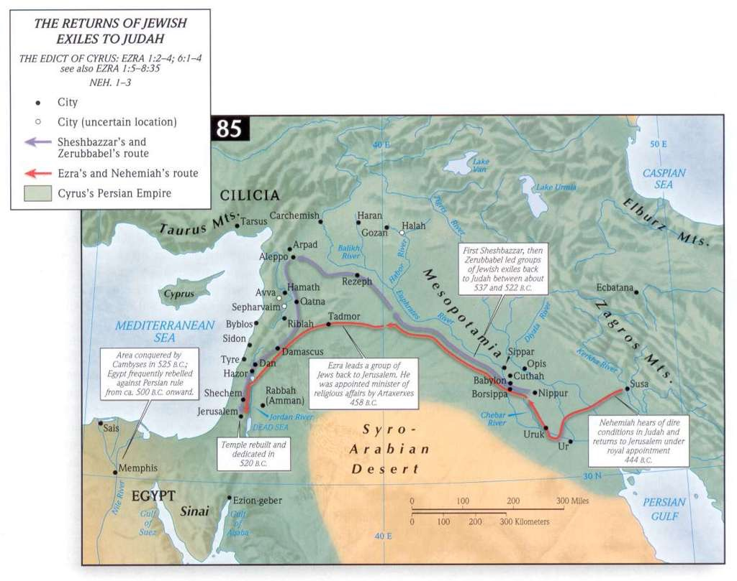

Slide 4
Nehemiah
1:1 – 20th year of Artaxerxes = 445/4 BC
cupbearer to the king
events in Neh 1-12 take place within one year

Slide 5
Nehemiah
Nehemiah 1:1 The words of Nehemiah the son of Hacaliah. Now it happened in the month of Chislev, in the twentieth year, as I was in Susa the citadel,² that Hanani, one of my brothers, came with certain men from Judah. And I asked them concerning the Jews who escaped, who had survived the exile, and concerning Jerusalem.³ And they said to me, "The remnant there in the province who had survived the exile is in great trouble and shame. The wall of Jerusalem is broken down, and its gates are destroyed by fire."⁴ As soon as I heard these words I sat down and wept and mourned for days, and I continued fasting and praying before the God of heaven.

Slide 6
Chislev, then Nisan?
1:1 Now it happened in the month of Chislev, in the twentieth year, as I was in Susa the citadel
2:1 In the month of Nisan, in the twentieth year of King Artaxerxes,
Nisan (March-April)= 1st month
Chislev (Nov. – Dec.)= 9th month

Slide 7
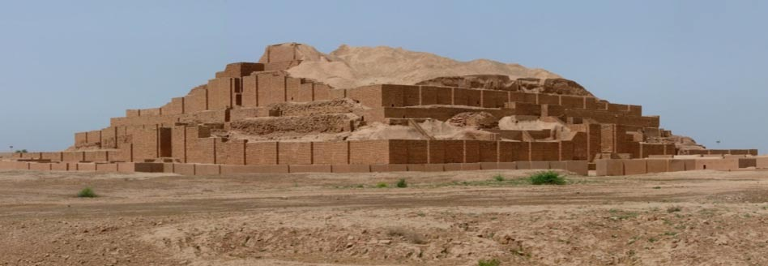

Slide 8
Nehemiah
Nehemiah 1:1 The words of Nehemiah the son of Hacaliah. Now it happened in the month of Chislev, in the twentieth year, as I was in Susa the citadel,² that Hanani, one of my brothers, came with certain men from Judah. And I asked them concerning the Jews who escaped, who had survived the exile, and concerning Jerusalem.³ And they said to me, "The remnant there in the province who had survived the exile is in great trouble and shame. The wall of Jerusalem is broken down, and its gates are destroyed by fire."⁴ As soon as I heard these words I sat down and wept and mourned for days, and I continued fasting and praying before the God of heaven.

Slide 9
Nehemiah
Ezra 4:23 As soon as the copy of the letter of King Artaxerxes was read to Rehum and Shimshai the secretary and their associates, they went immediately to the Jews in Jerusalem and compelled them by force to stop.

Slide 10
Nehemiah
And I said, "O LORD God of heaven, the great and awesome God who keeps covenant and steadfast love with those who love him and keep his commandments,⁶ let your ear be attentive and your eyes open, to hear the prayer of your servant that I now pray before you day and night for the people of Israel your servants, confessing the sins of the people of Israel, which we have sinned against you. Even I and my father's house have sinned.⁷ We have acted very corruptly against you and have not kept the commandments, the statutes, and the rules that you commanded your servant Moses.⁸ Remember the word that you commanded your servant Moses, saying, 'If you are unfaithful, I will scatter you among the peoples,⁹ but if you return to me and keep my commandments and do them, though your outcasts are in the uttermost parts of heaven, from there I will gather them and bring them to the place that I have chosen, to make my name dwell there.'¹⁰ They are your servants and your people, whom you have redeemed by your great power and by your strong hand.¹¹ O Lord, let your ear be attentive to the prayer of your servant, and to the prayer of your servants who delight to fear your name, and give success to your servant today, and grant him mercy in the sight of this man." Now I was cupbearer to the king. (Neh. 1:5-11)

Slide 11
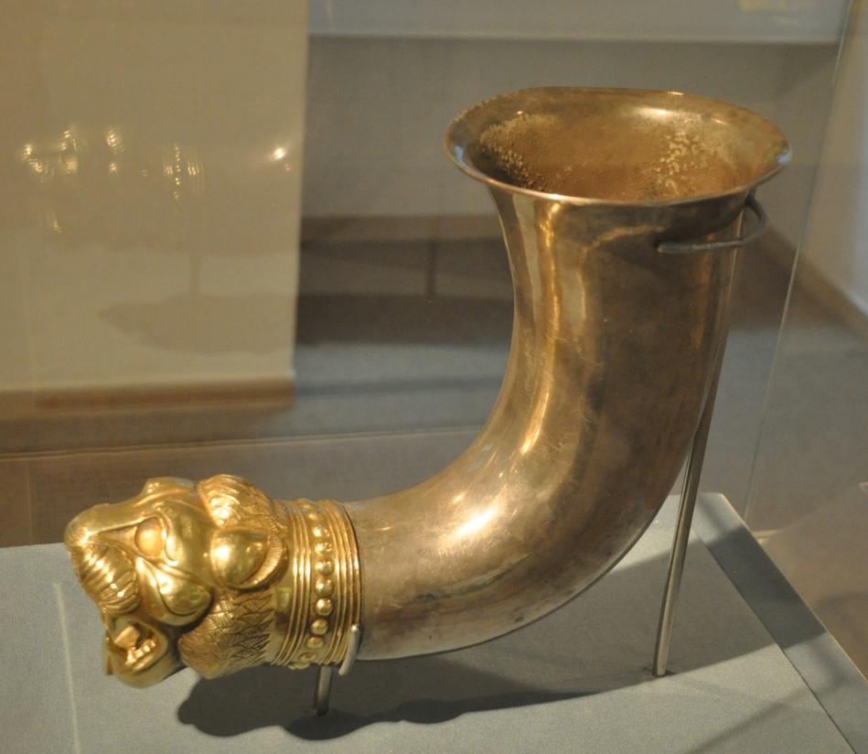
“Cupbearer to the King”

Slide 12
“Why is your face sad?”
Nehemiah 2:1 In the month of Nisan, in the twentieth year of King Artaxerxes, when wine was before him, I took up the wine and gave it to the king. Now I had not been sad in his presence.² And the king said to me, "Why is your face sad, seeing you are not sick? This is nothing but sadness of the heart." Then I was very much afraid.³ I said to the king, "Let the king live forever! Why should not my face be sad, when the city, the place of my fathers' graves, lies in ruins, and its gates have been destroyed by fire?"⁴ Then the king said to me, "What are you requesting?" So I prayed to the God of heaven.⁵ And I said to the king, "If it pleases the king, and if your servant has found favor in your sight, that you send me to Judah, to the city of my fathers' graves, that I may rebuild it."

Slide 13
The King Grants Permission
Nehemiah 2:6 The king said to me (the queen also was sitting beside him), “How long will you be gone, and when will you return?” So it pleased the king to send me, and I set him a date. 7 Then I said to the king, “If it pleases the king, let letters be given me to the governors of the province Beyond the River, that they may grant me passage until I arrive in Judah; 8 and a letter to Asaph, the keeper of the king’s forest, directing him to give me timber to make beams for the gates of the temple fortress, and for the wall of the city, and for the house that I shall occupy.” And the king granted me what I asked, for the gracious hand of my God was upon me.

Slide 14
The Opposition
Nehemiah 2:9 Then I came to the governors of the province Beyond the River, and gave them the king’s letters. Now the king had sent officers of the army and cavalry with me. 10 When Sanballat the Horonite and Tobiah the Ammonite official heard this, it displeased them greatly that someone had come to seek the welfare of the people of Israel.

Slide 15
The Opposition
“To our Lord, Bagavahya, governor of Judea…Moreover, all these things in a letter we sent to Delaiah and Shelemiah, sons of Sanballat governor of Samaria,” Elephantine Papyrus TAD A.4.7.

Slide 16
Nehemiah Inspects the Walls
Nehemiah 2:11 So I came to Jerusalem and was there for three days. 12 Then I got up during the night, I and a few men with me; I told no one what my God had put into my heart to do for Jerusalem. The only animal I took was the animal I rode. 13 I went out by night by the Valley Gate past the Dragon’s Spring and to the Dung Gate, and I inspected the walls of Jerusalem that had been broken down and its gates that had been destroyed by fire. 14 Then I went on to the Fountain Gate and to the King’s Pool; but there was no place for the animal I was riding to continue. 15 So I went up by way of the valley by night and inspected the wall. Then I turned back and entered by the Valley Gate, and so returned. 16 The officials did not know where I had gone or what I was doing; I had not yet told the Jews, the priests, the nobles, the officials, and the rest that were to do the work.

Slide 17
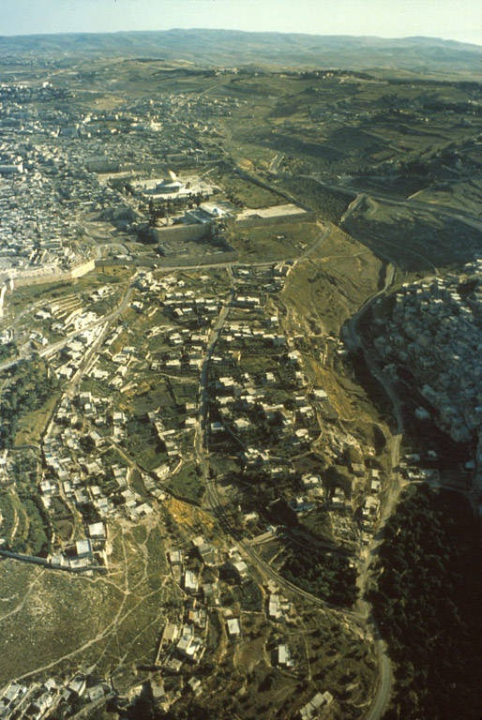

Slide 18
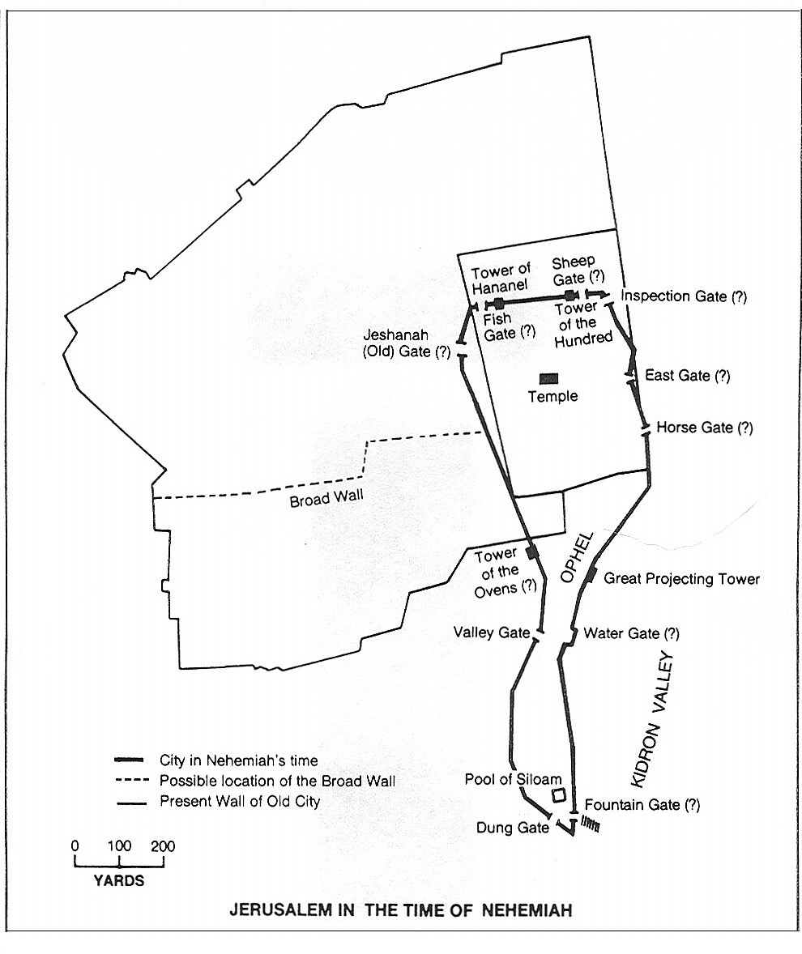

Slide 19
Nehemiah Inspects the Walls
Nehemiah 2:17 Then I said to them, “You see the trouble we are in, how Jerusalem lies in ruins with its gates burned. Come, let us rebuild the wall of Jerusalem, so that we may no longer suffer disgrace.” 18 I told them that the hand of my God had been gracious upon me, and also the words that the king had spoken to me. Then they said, “Let us start building!” So they committed themselves to the common good. 19 But when Sanballat the Horonite and Tobiah the Ammonite official, and Geshem the Arab heard of it, they mocked and ridiculed us, saying, “What is this that you are doing? Are you rebelling against the king?” 20 Then I replied to them, “The God of heaven is the one who will give us success, and we his servants are going to start building; but you have no share or claim or historic right in Jerusalem.”

Slide 20
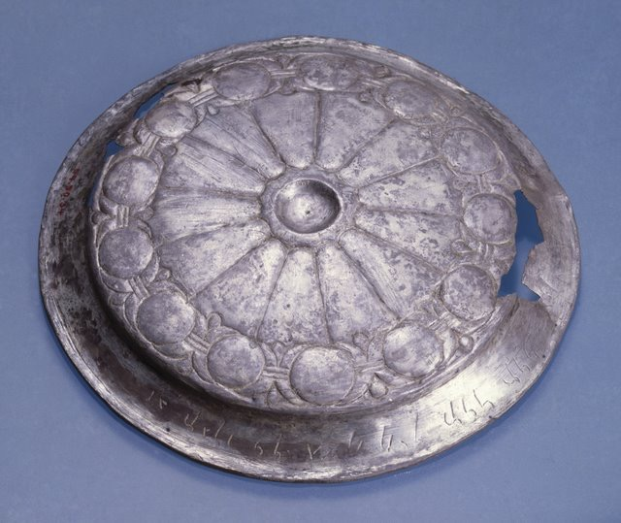
Nehemiah Inspects the Walls

Slide 21
The Work Commences
Nehemiah 3:1 Then the high priest Eliashib set to work with his fellow priests and rebuilt the Sheep Gate. They consecrated it and set up its doors; they consecrated it as far as the Tower of the Hundred and as far as the Tower of Hananel. 2 And the men of Jericho built next to him. And next to them Zaccur son of Imri built.3 The sons of Hassenaah built the Fish Gate; they laid its beams and set up its doors, its bolts, and its bars. 4 Next to them Meremoth son of Uriah son of Hakkoz made repairs. Next to them Meshullam son of Berechiah son of Meshezabel made repairs. Next to them Zadok son of Baana made repairs. 5 Next to them the Tekoites made repairs; but their nobles would not put their shoulders to the work of their Lord

Slide 22
The Work Commences
Nehemiah 3:6Joiada son of Paseah and Meshullam son of Besodeiah repaired the Old Gate; they laid its beams and set up its doors, its bolts, and its bars. 7 Next to them repairs were made by Melatiah the Gibeonite and Jadon the Meronothite—the men of Gibeon and of Mizpah—who were under the jurisdiction of the governor of the province Beyond the River. 8 Next to them Uzziel son of Harhaiah, one of the goldsmiths, made repairs. Next to him Hananiah, one of the perfumers, made repairs; and they restored Jerusalem as far as the Broad Wall. 9 Next to them Rephaiah son of Hur, ruler of half the district of Jerusalem, made repairs. 10 Next to them Jedaiah son of Harumaph made repairs opposite his house; and next to him Hattush son of Hashabneiah made repairs. 11 Malchijah son of Harim and Hasshub son of Pahath-moab repaired another section and the Tower of the Ovens. 12 Next to him Shallum son of Hallohesh, ruler of half the district of Jerusalem, made repairs, he and his daughters.

Slide 23
Opposition Commences
Nehemiah 4:1 Now when Sanballat heard that we were building the wall, he was angry and greatly enraged, and he mocked the Jews. 2 He said in the presence of his associates and of the army of Samaria, “What are these feeble Jews doing? Will they restore things? Will they sacrifice? Will they finish it in a day? Will they revive the stones out of the heaps of rubbish—and burned ones at that?” 3 Tobiah the Ammonite was beside him, and he said, “That stone wall they are building—any fox going up on it would break it down!” 4 Hear, O our God, for we are despised; turn their taunt back on their own heads, and give them over as plunder in a land of captivity. 5 Do not cover their guilt, and do not let their sin be blotted out from your sight; for they have hurled insults in the face of the builders. 6 So we rebuilt the wall, and all the wall was joined together to half its height; for the people had a mind to work.

Slide 24
Opposition Commences
Nehemiah 4:7 But when Sanballat and Tobiah and the Arabs and the Ammonites and the Ashdodites heard that the repairing of the walls of Jerusalem was going forward and the gaps were beginning to be closed, they were very angry, 8 and all plotted together to come and fight against Jerusalem and to cause confusion in it. 9 So we prayed to our God, and set a guard as a protection against them day and night.

