Slide 1
Nehemiah

Slide 2
Persian kings | Jewish history
Cyrus – r. 559-530 BC | 538 1st group returns, Ezra 1-6 536 work on temple begins, stops
Cambyses II r. 530-522 BC
Darius I r. 522-486 BC | 520 work of Haggai 520 work on temple resumes 520-516 work of Zechariah 516 temple finished
Xerxes I r. 486-465 BC | 483-474 story of Esther
Artaxerxes I r. 464-425 BC | 458 2nd group, Ezra 7-10 445 3rd group, Nehemiah 1-13 work of Malachi

Slide 3
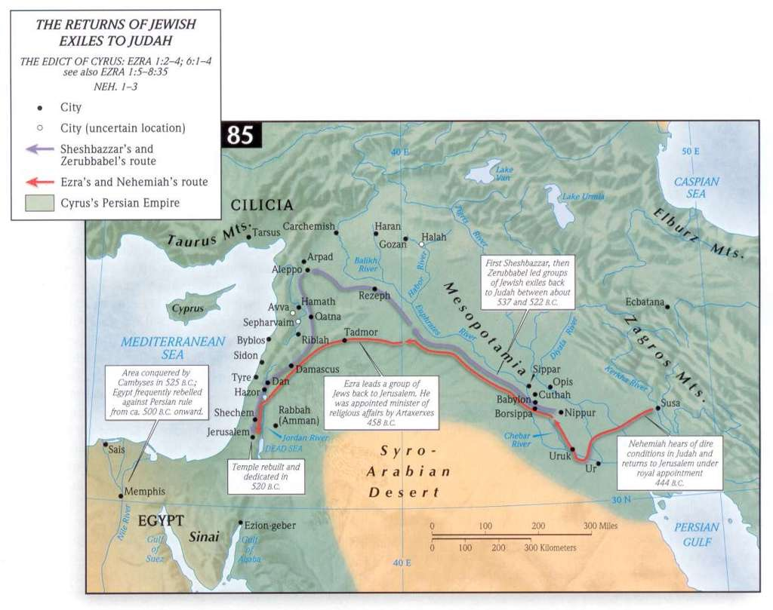

Slide 4
Nehemiah
1:1 – 20th year of Artaxerxes = 445/4 BC
cupbearer to the king
events in Neh 1-12 take place within one year

Slide 5
Nehemiah
Nehemiah 1:1 The words of Nehemiah the son of Hacaliah. Now it happened in the month of Chislev, in the twentieth year, as I was in Susa the citadel,² that Hanani, one of my brothers, came with certain men from Judah. And I asked them concerning the Jews who escaped, who had survived the exile, and concerning Jerusalem.³ And they said to me, "The remnant there in the province who had survived the exile is in great trouble and shame. The wall of Jerusalem is broken down, and its gates are destroyed by fire."⁴ As soon as I heard these words I sat down and wept and mourned for days, and I continued fasting and praying before the God of heaven.

Slide 6
Chislev, then Nisan?
1:1 Now it happened in the month of Chislev, in the twentieth year, as I was in Susa the citadel
2:1 In the month of Nisan, in the twentieth year of King Artaxerxes,
Nisan (March-April)= 1st month
Chislev (Nov. – Dec.)= 9th month

Slide 7
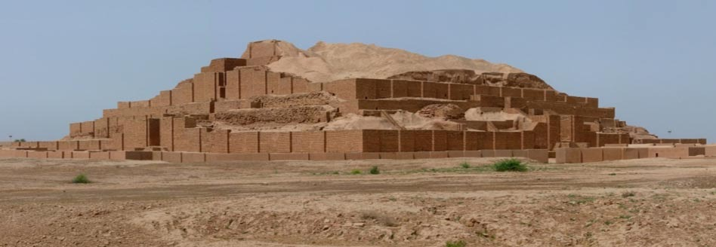

Slide 8
Nehemiah
Nehemiah 1:1 The words of Nehemiah the son of Hacaliah. Now it happened in the month of Chislev, in the twentieth year, as I was in Susa the citadel,² that Hanani, one of my brothers, came with certain men from Judah. And I asked them concerning the Jews who escaped, who had survived the exile, and concerning Jerusalem.³ And they said to me, "The remnant there in the province who had survived the exile is in great trouble and shame. The wall of Jerusalem is broken down, and its gates are destroyed by fire."⁴ As soon as I heard these words I sat down and wept and mourned for days, and I continued fasting and praying before the God of heaven.

Slide 9
Nehemiah
Ezra 4:23 As soon as the copy of the letter of King Artaxerxes was read to Rehum and Shimshai the secretary and their associates, they went immediately to the Jews in Jerusalem and compelled them by force to stop.

Slide 10
Nehemiah
And I said, "O LORD God of heaven, the great and awesome God who keeps covenant and steadfast love with those who love him and keep his commandments,⁶ let your ear be attentive and your eyes open, to hear the prayer of your servant that I now pray before you day and night for the people of Israel your servants, confessing the sins of the people of Israel, which we have sinned against you. Even I and my father's house have sinned.⁷ We have acted very corruptly against you and have not kept the commandments, the statutes, and the rules that you commanded your servant Moses.⁸ Remember the word that you commanded your servant Moses, saying, 'If you are unfaithful, I will scatter you among the peoples,⁹ but if you return to me and keep my commandments and do them, though your outcasts are in the uttermost parts of heaven, from there I will gather them and bring them to the place that I have chosen, to make my name dwell there.'¹⁰ They are your servants and your people, whom you have redeemed by your great power and by your strong hand.¹¹ O Lord, let your ear be attentive to the prayer of your servant, and to the prayer of your servants who delight to fear your name, and give success to your servant today, and grant him mercy in the sight of this man." Now I was cupbearer to the king. (Neh. 1:5-11)

Slide 11
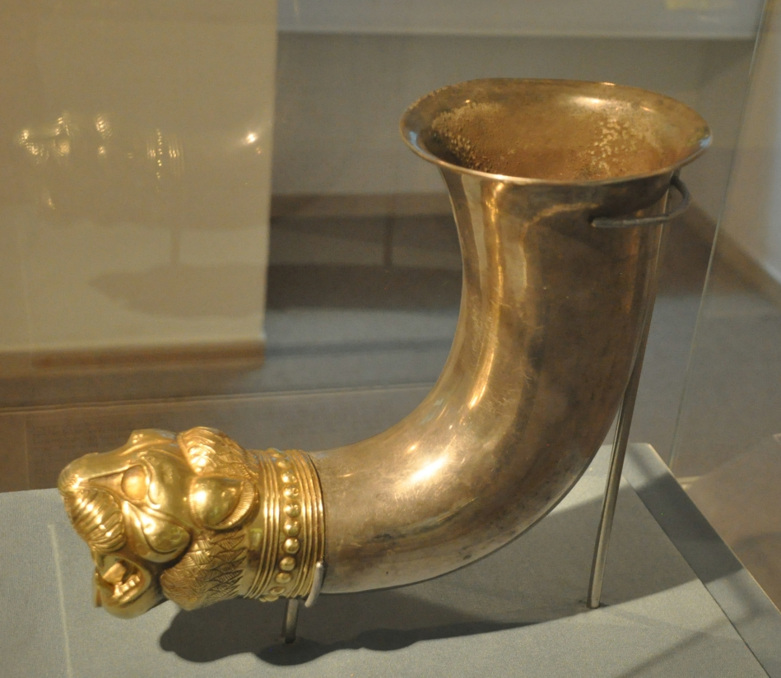
“Cupbearer to the King”

Slide 12
“Why is your face sad?”
Nehemiah 2:1 In the month of Nisan, in the twentieth year of King Artaxerxes, when wine was before him, I took up the wine and gave it to the king. Now I had not been sad in his presence.² And the king said to me, "Why is your face sad, seeing you are not sick? This is nothing but sadness of the heart." Then I was very much afraid.³ I said to the king, "Let the king live forever! Why should not my face be sad, when the city, the place of my fathers' graves, lies in ruins, and its gates have been destroyed by fire?"⁴ Then the king said to me, "What are you requesting?" So I prayed to the God of heaven.⁵ And I said to the king, "If it pleases the king, and if your servant has found favor in your sight, that you send me to Judah, to the city of my fathers' graves, that I may rebuild it."

Slide 13
The King Grants Permission
Nehemiah 2:6 The king said to me (the queen also was sitting beside him), “How long will you be gone, and when will you return?” So it pleased the king to send me, and I set him a date. 7 Then I said to the king, “If it pleases the king, let letters be given me to the governors of the province Beyond the River, that they may grant me passage until I arrive in Judah; 8 and a letter to Asaph, the keeper of the king’s forest, directing him to give me timber to make beams for the gates of the temple fortress, and for the wall of the city, and for the house that I shall occupy.” And the king granted me what I asked, for the gracious hand of my God was upon me.

Slide 14
The Opposition
Nehemiah 2:9 Then I came to the governors of the province Beyond the River, and gave them the king’s letters. Now the king had sent officers of the army and cavalry with me. 10 When Sanballat the Horonite and Tobiah the Ammonite official heard this, it displeased them greatly that someone had come to seek the welfare of the people of Israel.

