Slide 1
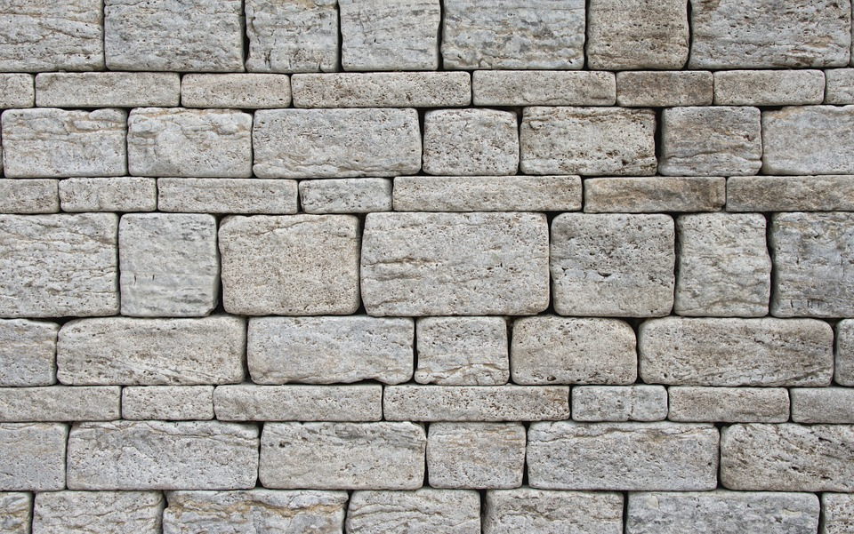
EZRA & NEHEMIAH

Slide 2
Ezra 1-6 Zerubbabel’s expedition
Rebuilding the temple in Jerusalem
7-10 Ezra’s expedition
Reestablishing the law and holiness
Neh 1-7 Nehemiah’s expedition
Rebuilding the wall of Jerusalem
8-10 Further work of Ezra
Recommitting to the law and covenant

Slide 3
Nehemiah 8

Slide 4
Nehemiah 8:13-18 Feast of Booths
On the second day the heads of fathers' houses of all the people, with the priests and the Levites, came together to Ezra the scribe in order to study the words of the Law.
Notes:
After harvest crops are gathered in, rest day, feast day, day of sacrifices, and making and living in booths
1 Kings 8:2; Ezra 3:4; 2 Chron 8:13; 31:3$$;
Exo 34:22;
Exo 23:16; Lev 23:43; Num 29:12-38; Deut 16:13-15

Slide 5
Nehemiah 8:13-18 Feast of Booths
And they found it written in the Law that the Lord had commanded by Moses that the people of Israel should dwell in booths during the feast of the seventh month, and that they should proclaim it and publish it in all their towns and in Jerusalem, “Go out to the hills and bring branches of olive, wild olive, myrtle, palm, and other leafy trees to make booths, as it is written.” So the people went out and brought them and made booths for themselves, each on his roof, and in their courts and in the courts of the house of God, and in the square at the Water Gate and in the square at the Gate of Ephraim. And all the assembly of those who had returned from the captivity made booths and lived in the booths, for from the days of Jeshua the son of Nun to that day the people of Israel had not done so. And there was very great rejoicing. And day by day, from the first day to the last day, he read from the Book of the Law of God. They kept the feast seven days, and on the eighth day there was a solemn assembly, according to the rule.
Notes:
1 Kings 8:2; Ezra 3:4; 2 Chron 8:13; 31:3$$;
Exo 34:22;
Exo 23:16; Lev 23:43; Num 29:12-38; Deut 16:13-15

Slide 6
Nehemiah 8:13-18 Feast of Booths
And they found it written in the Law that the Lord had commanded by Moses that the people of Israel should dwell in booths during the feast of the seventh month, and that they should proclaim it and publish it in all their towns and in Jerusalem, “Go out to the hills and bring branches of olive, wild olive, myrtle, palm, and other leafy trees to make booths, as it is written.” So the people went out and brought them and made booths for themselves, each on his roof, and in their courts and in the courts of the house of God, and in the square at the Water Gate and in the square at the Gate of Ephraim. And all the assembly of those who had returned from the captivity made booths and lived in the booths, for from the days of Jeshua the son of Nun to that day the people of Israel had not done so. And there was very great rejoicing. And day by day, from the first day to the last day, he read from the Book of the Law of God. They kept the feast seven days, and on the eighth day there was a solemn assembly, according to the rule.
Notes:
1 Kings 8:2; Ezra 3:4; 2 Chron 8:13; 31:3$$;
Exo 34:22;
Exo 23:16; Lev 23:43; Num 29:12-38; Deut 16:13-15

Slide 7
Leviticus 23:39-43
“On the fifteenth day of the seventh month…All native Israelites shall dwell in booths, that your generations may know that I made the people of Israel dwell in booths when I brought them out of the land of Egypt: I am the Lord your God.”
Notes:
1 Kings 8:2; Ezra 3:4; 2 Chron 8:13; 31:3$$;
Exo 34:22;
Exo 23:16; Lev 23:43; Num 29:12-38; Deut 16:13-15

Slide 8
Nehemiah 9

Slide 9
Nehemiah 9:1-5
Now on the twenty-fourth day of this month the people of Israel were assembled with fasting and in sackcloth, and with earth on their heads. And the Israelites separated themselves from all foreigners and stood and confessed their sins and the iniquities of their fathers. And they stood up in their place and read from the Book of the Law of the Lord their God for a quarter of the day; for another quarter of it they made confession and worshiped the Lord their God. On the stairs of the Levites stood Jeshua, Bani, Kadmiel, Shebaniah, Bunni, Sherebiah, Bani, and Chenani; and they cried with a loud voice to the Lord their God. Then the Levites, Jeshua, Kadmiel, Bani, Hashabneiah, Sherebiah, Hodiah, Shebaniah, and Pethahiah, said, “Stand up and bless the Lord your God from everlasting to everlasting. Blessed be Your glorious name, which is exalted above all blessing and praise.”
Notes:
1 Kings 8:2; Ezra 3:4; 2 Chron 8:13; 31:3$$;
Exo 34:22;
Exo 23:16; Lev 23:43; Num 29:12-38; Deut 16:13-15
Offer a prayer and make a covenant or agreement to follow God’s word.
Covenants often in the ancient world involved a recounting of where we’ve come from and how we got here. What led us to this point.

Slide 10
Nehemiah 9:6-38

