Slide 1
EZRA & NEHEMIAH

Slide 2
Ezra 1-6 Zerubbabel’s expedition
Rebuilding the temple in Jerusalem
7-10 Ezra’s expedition
Reestablishing the law and holiness
Neh 1-7 Nehemiah’s expedition
Rebuilding the wall of Jerusalem
8-10 Further work of Ezra
Recommitting to the law and covenant
11-13 Further work of Nehemiah
Restoring holiness

Slide 3
Nehemiah 11

Slide 4
11:1-21
Now the leaders of the people lived in Jerusalem. And the rest of the people cast lots to bring one out of ten to live in Jerusalem the holy city, while nine out of ten remained in the other towns. And the people blessed all the men who willingly offered to live in Jerusalem.
Notes:
1 Kings 8:2; Ezra 3:4; 2 Chron 8:13; 31:3$$;
Exo 34:22;
Exo 23:16; Lev 23:43; Num 29:12-38; Deut 16:13-15

Slide 5
Ch. 7
Ch. 8-10
Ch. 11
Few people actually living within the city of Jerusalem
People hearing the law, confessing and repenting of their sins, recommitting to God
People move into the city of Jerusalem

Slide 6
11:1-21
Now the leaders of the people lived in Jerusalem. And the rest of the people cast lots to bring one out of ten to live in Jerusalem the holy city, while nine out of ten remained in the other towns. And the people blessed all the men who willingly offered to live in Jerusalem.
Notes:
1 Kings 8:2; Ezra 3:4; 2 Chron 8:13; 31:3$$;
Exo 34:22;
Exo 23:16; Lev 23:43; Num 29:12-38; Deut 16:13-15

Slide 7
11:1-21
These are the chiefs of the province who lived in Jerusalem
Of the sons of Judah…
And these are the sons of Benjamin…
Of the priests…
And of the Levites…
The gatekeepers…
And the rest of Israel, and of the priests and the Levites, were in all the towns of Judah, every one in his inheritance.
As for the villages…
Notes:
Holiness
Territory surrounding Jerusalem and territory stretching across the whole territory of Judah
God’s people, in their cities, Jerusalem established, levites throughout, worship

Slide 8
Nehemiah 12

Slide 9
12:1-26 ---Listing the Priests & Levites
Notes:
Holy individuals
Linking everyone in as part of God restoring His people

Slide 10
12:27-43 ---Dedication of the Wall
Notes:
Holy individuals
Linking everyone in as part of God restoring His people

Slide 11
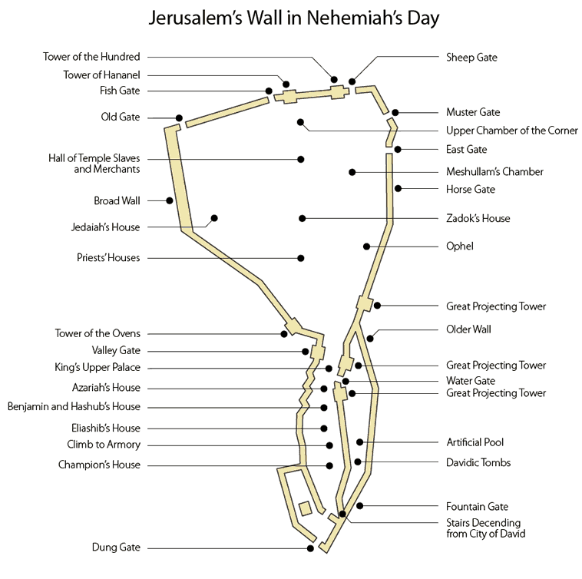

Slide 12
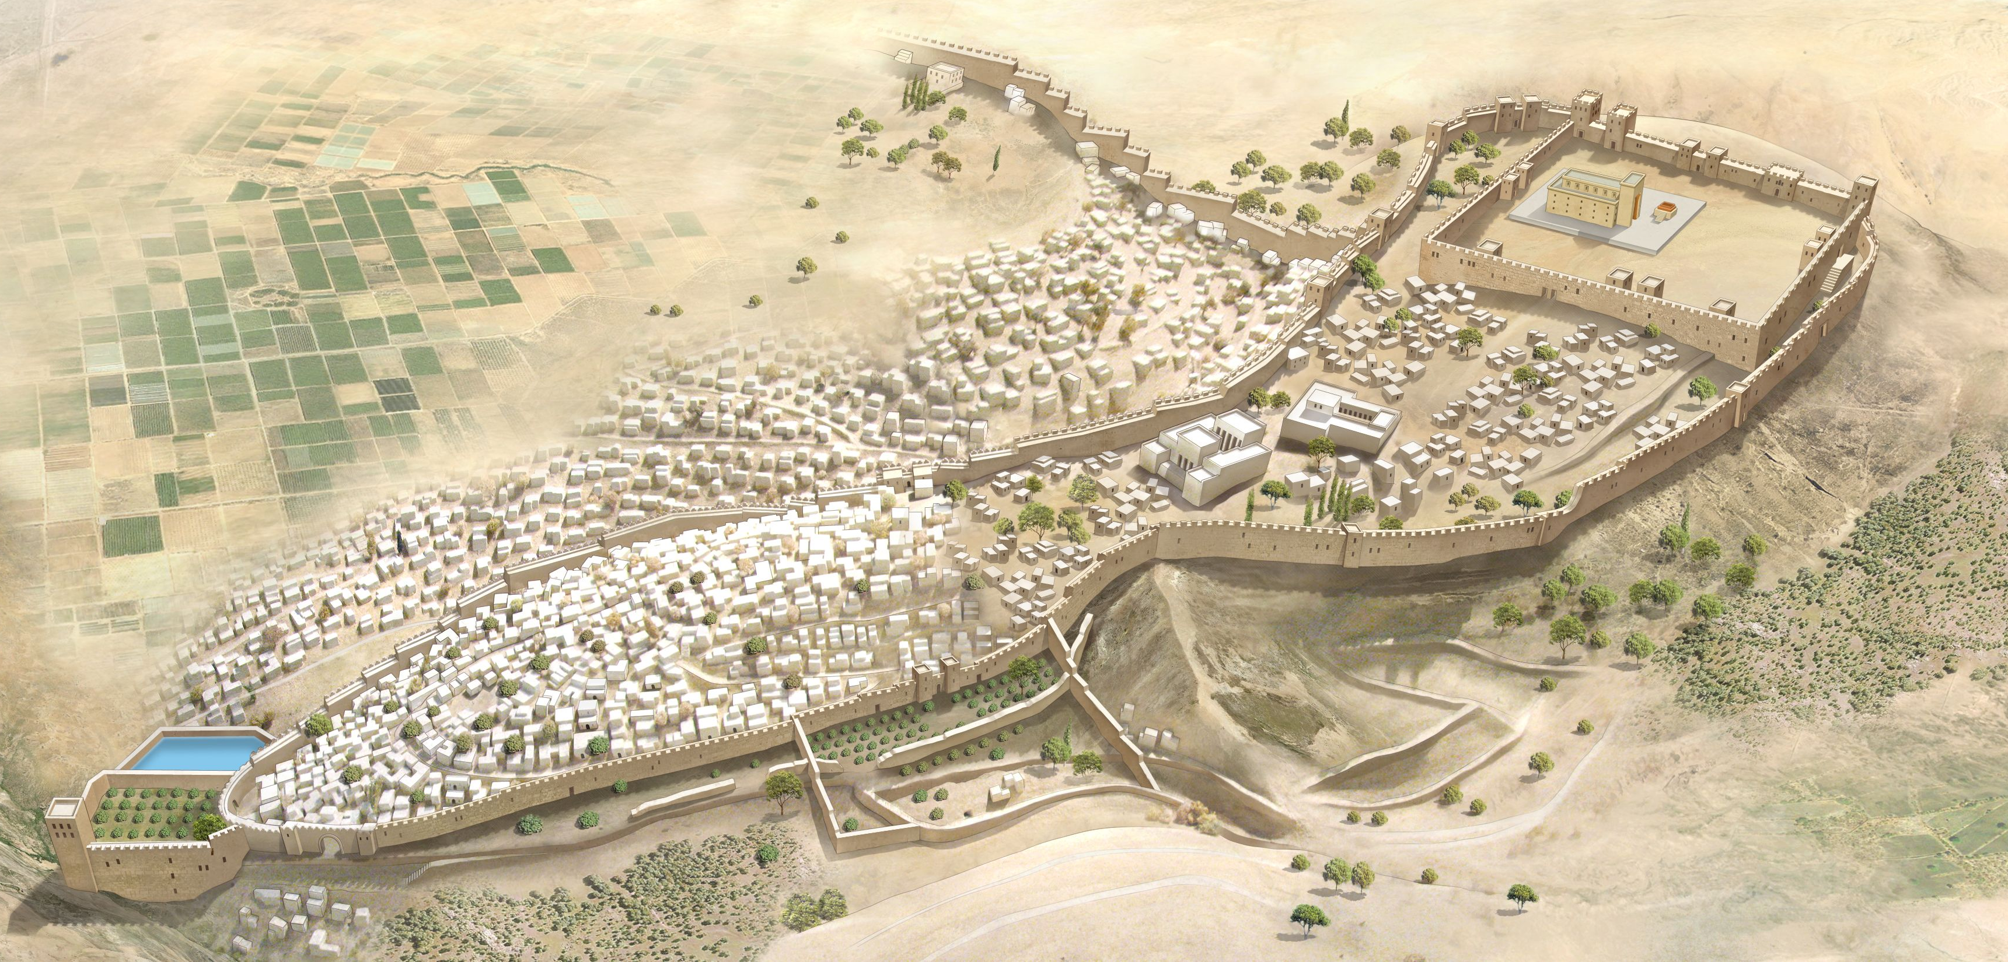

Slide 13
12:27-43 ---Dedication of the Wall
Ezra 3:11-13---And all the people shouted with a great shout when they praised the Lord, because the foundation of the house of the Lord was laid. But many of the priests and Levites and heads of fathers' houses, old men who had seen the first house, wept with a loud voice when they saw the foundation of this house being laid, though many shouted aloud for joy, so that the people could not distinguish the sound of the joyful shout from the sound of the people's weeping, for the people shouted with a great shout, and the sound was heard far away.
Notes:
Holy individuals
Linking everyone in as part of God restoring His people

Slide 14
12:27-43 ---Dedication of the Wall
“And the singers sang with Jezrahiah as their leader. And they offered great sacrifices that day and rejoiced, for God had made them rejoice with great joy; the women and children also rejoiced. And the joy of Jerusalem was heard far away.”
Notes:
Holy individuals
Linking everyone in as part of God restoring His people

Slide 15
12:27-43 ---Dedication of the Wall
“Then I brought the leaders of Judah up onto the wall and appointed two great choirs that gave thanks. One went to the south on the wall…The other choir of those who gave thanks went to the north, and I followed them with half of the people, on the wall…”
Tobiah said,
“Yes, what they are building—if a fox goes up on it he will break down their stone wall!”
Notes:
Holy individuals
Linking everyone in as part of God restoring His people

