Slide 2
Corinth: a church with vision problems

Slide 3
We have followed foolishness (1.18-31)
Losing sight of God’s wisdom

Slide 4
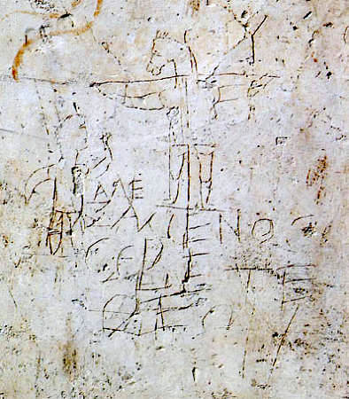
“Alexamenos worships his god”

Slide 5
We have followed foolishness (1.18-31)
We have a connection to God’s wisdom (2.1-13)
Leaving our connection to God’s wisdom brings disaster (2.14-3.17)
It’s time to be “foolish” again (3.18-23)
Losing sight of God’s wisdom

