Slide 2
Now the God of peace, who brought up from the dead the great Shepherd of the sheep through the blood of the eternal covenant, even Jesus our Lord, equip you in every good thing to do His will, working in us that which is pleasing in His sight, through Jesus Christ, to whom be the glory forever and ever. Amen.
Hebrews 13:20-21

Slide 4
For through the grace given to me I say to every man among you not to think more highly of himself than he ought to think; but to think so as to have sound judgment, as God has allotted to each a measure of faith. 4 For just as we have many members in one body and all the members do not have the same function, 5 so we, who are many, are one body in Christ, and individually members one of another. And since we have different gifts, according to the grace given to us, let us each exercise them accordingly…
Romans 12:3-6
many members in one body
All the members do not have the same function
Different gifts
Each exercise them accordingly

Slide 6
KING JOSIAH OVERCAME
YOUTH
(2 CHRON. 34:1,3)
FAMILY
(2 KINGS 21:2-7, 9, 16, 20-21)
SPIRITUALLY BANKRUPT NATION
(2 CHRON. 33:22; 34:8)

Slide 7
KING JOSIAH OVERCAME
HE REMOVED THE IDOLS
(2 CHRON. 34:3-7)
HE REPAIRED THE TEMPLE
(2 CHRON. 34:8-13)
13 So the workmen labored, and the repair work progressed in their hands, and they restored the house of God according to its specifications, and strengthened it.
2 Chronicles 24:13
In the first year of his reign, in the first month, he opened the doors of the house of the LORD and repaired them.
2 Chronicles 29:3

Slide 8
KING JOSIAH OVERCAME
HE REMOVED THE IDOLS
(2 CHRON. 34:3-7)
HE REPAIRED THE TEMPLE
(2 CHRON. 34:8-13)
Now it shall come about when he sits on the throne of his kingdom, he shall write for himself a copy of this law on a scroll in the presence of the Levitical priests. 19 "And it shall be with him, and he shall read it all the days of his life, that he may learn to fear the LORD his God, by carefully observing all the words of this law and these statutes,
Deuteronomy 17:18-19
HE RESTORED THE LAW
(2 CHRON. 34:14-21)

Slide 9
Let no one look down on your youthfulness, but rather in speech, conduct, love, faith and purity, show yourself an example of those who believe.
1 Timothy 4:12
YOUTH IS NOT AN EXCUSE
YOUTH IS AN OPPORTUNITY

Slide 10
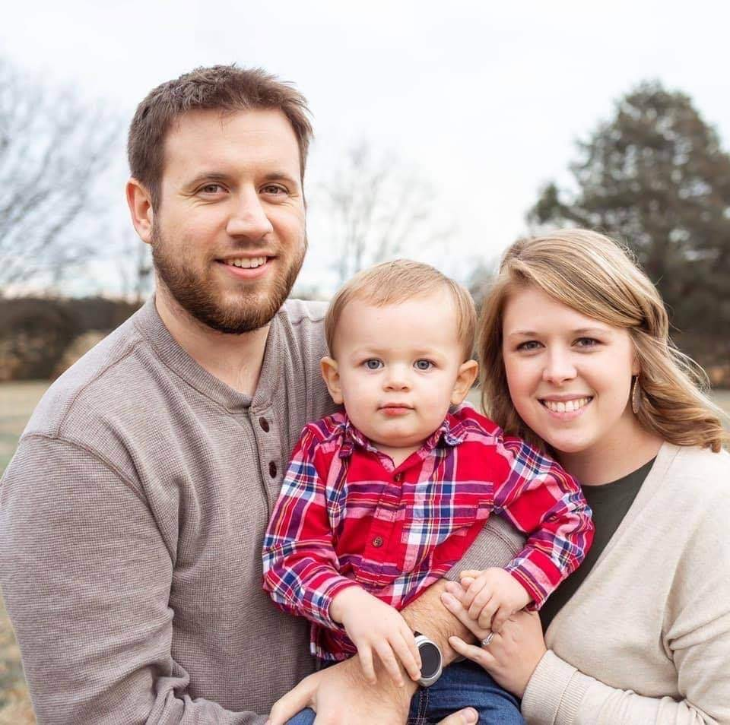
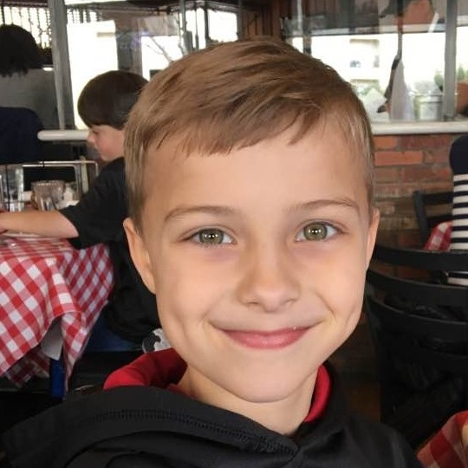
2 REMINDERS FROM JOSIAH
HE DIDN’T WAIT TO GET SERIOUS ABOUT THE LORD
and that from childhood you have known the sacred writings which are able to give you the wisdom that leads to salvation through faith which is in Christ Jesus. 2 Timothy 3:15

Slide 11
2 REMINDERS FROM JOSIAH
HE DIDN’T WAIT TO GET SERIOUS ABOUT THE LORD
HE SURROUNDED HIMSELF WITH AN INCREDIBLE TEAM
He who walks with wise men will be wise, But the companion of fools will suffer harm. Proverbs 13:20

Slide 12
I have written to you, fathers, because you know Him who has been from the beginning. I have written to you, young men, because you are strong, and the word of God abides in you, and you have overcome the evil one.
1 john 2:14

