Slide 2
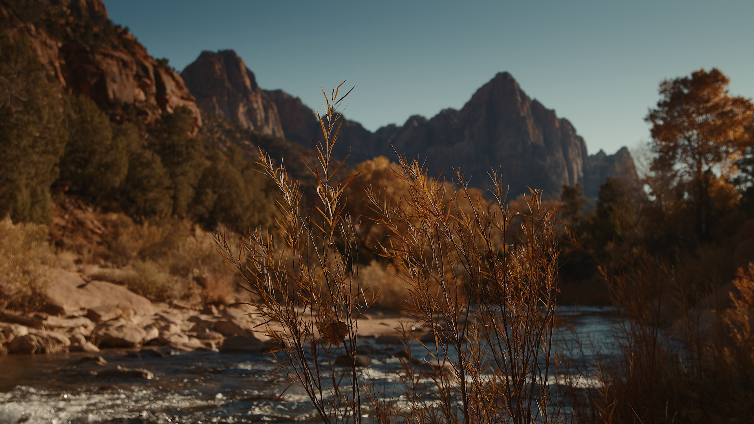
²³ For I received from the Lord what I also delivered to you, that the Lord Jesus on the night when he was betrayed took bread, ²⁴ and when he had given thanks, he broke it, and said, “This is my body, which is for you. Do this in remembrance of me.” ²⁵ In the same way also he took the cup, after supper, saying, “This cup is the new covenant in my blood. Do this, as often as you drink it, in remembrance of me.” ²⁶ For as often as you eat this bread and drink the cup, you proclaim the Lord's death until he comes.
1 Corinthians 11:23-26

Slide 4
21 For to this you have been called, because Christ also suffered for you, leaving you an example, so that you might follow in his steps. 22 He committed no sin, neither was deceit found in his mouth. 23 When he was reviled, he did not revile in return; when he suffered, he did not threaten, but continued entrusting himself to him who judges justly. 24 He himself bore our sins in his body on the tree, that we might die to sin and live to righteousness. By his wounds you have been healed. 1 Peter 2.21-24

Slide 6
Elect
Exiles
A Study of 1st Peter

Slide 7
Elders: shepherd the flock (vss. 1-4)
In The Meantime

Slide 8
¹ Therefore, I exhort the elders among you, as your fellow elder and witness of the sufferings of Christ, and a partaker also of the glory that is to be revealed, ² shepherd the flock of God among you, exercising oversight not under compulsion, but voluntarily, according to the will of God; and not for sordid gain, but with eagerness; ³ nor yet as lording it over those allotted to your charge, but proving to be examples to the flock. ⁴ And when the Chief Shepherd appears, you will receive the unfading crown of glory. (1 Peter 5:1–4 NASB95)
Elders: shepherd the flock

Slide 9
¹ Therefore, I exhort the elders among you, as your fellow elder and witness of the sufferings of Christ, and a partaker also of the glory that is to be revealed, ² shepherd the flock of God among you, exercising oversight not under compulsion, but voluntarily, according to the will of God; and not for sordid gain, but with eagerness; ³ nor yet as lording it over those allotted to your charge, but proving to be examples to the flock. ⁴ And when the Chief Shepherd appears, you will receive the unfading crown of glory. (1 Peter 5:1–4 NASB95)
Elders: shepherd the flock

Slide 10
¹ Therefore, I exhort the elders among you, as your fellow elder and witness of the sufferings of Christ, and a partaker also of the glory that is to be revealed, ² shepherd the flock of God among you, exercising oversight not under compulsion, but voluntarily, according to the will of God; and not for sordid gain, but with eagerness; ³ nor yet as lording it over those allotted to your charge, but proving to be examples to the flock. ⁴ And when the Chief Shepherd appears, you will receive the unfading crown of glory. (1 Peter 5:1–4 NASB95)
Elders: shepherd the flock

Slide 11
¹ Therefore, I exhort the elders among you, as your fellow elder and witness of the sufferings of Christ, and a partaker also of the glory that is to be revealed, ² shepherd the flock of God among you, exercising oversight not under compulsion, but voluntarily, according to the will of God; and not for sordid gain, but with eagerness; ³ nor yet as lording it over those allotted to your charge, but proving to be examples to the flock. ⁴ And when the Chief Shepherd appears, you will receive the unfading crown of glory. (1 Peter 5:1–4 NASB95)
Elders: shepherd the flock

Slide 12
Elders: shepherd the flock (vss. 1-4)
Congregation: let the shepherds lead you (vs. 5)
In The Meantime

Slide 13
⁵ You younger men, likewise, be subject to your elders; and all of you, clothe yourselves with humility toward one another, for God is opposed to the proud, but gives grace to the humble.
(1 Peter 5:5 NASB95)
Let the elders lead you

Slide 14
Elders: shepherd the flock (vss. 1-4)
Congregation: let the shepherds lead you (vs. 5)
Look beyond this world (vss. 6-11)
In The Meantime

Slide 15
⁶ Therefore humble yourselves under the mighty hand of God, that He may exalt you at the proper time, ⁷ casting all your anxiety on Him, because He cares for you. (1 Peter 5:6–7 NASB95)
Look beyond this world

Slide 16
⁸ Be of sober spirit, be on the alert. Your adversary, the devil, prowls around like a roaring lion, seeking someone to devour. ⁹ But resist him, firm in your faith, knowing that the same experiences of suffering are being accomplished by your brethren who are in the world.
(1 Peter 5:8–9 NASB95)
Look beyond this world

Slide 17
¹⁰ After you have suffered for a little while, the God of all grace, who called you to His eternal glory in Christ, will Himself perfect, confirm, strengthen and establish you. ¹¹ To Him be dominion forever and ever. Amen.
(1 Peter 5:10–11 NASB95)
Look beyond this world

Slide 18
Elect
Exiles
A Study of 1st Peter

