Slide 2


Slide 3

Give me understanding, and I shall keep thy law; Yea, I shall observe it with my whole heart.
Psalms 119:34

Slide 4
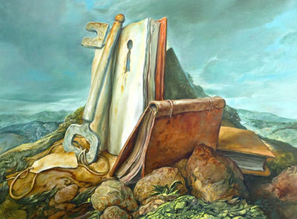
5 Keys to Interpretation

Slide 5
Keys to Interpretation
Content
Context
Comparison
Culture
Consultation

Slide 6
Content . . .
is the raw material, the database, with which you will interpret the text.
In observation, you looked for terms, structure, literary form and atmosphere.
You asked a series of penetrating questions: who, what, where, when, why, wherefore. You looked for things that are emphasized, repeated, related, alike, unlike and true to life.

Slide 7

Examining the Content

Slide 8
Context . . .
refers to that which goes before and that which follows after. There are several kinds of context:
Literary context
Historical context
Geographic context
Theological context

Slide 9
Looking For Context

Slide 10
Private interpretation never meant that individuals have the right to distort the Scriptures. With the right of private interpretation comes the sober responsibility of accurate interpretation. Private interpretation gives us license to interpret, not distort.
RC Sproul

Slide 11
Comparison . . .
We compare Scripture with Scripture.
The more you compare Scripture with Scripture, the more the meaning of the Bible becomes apparent.
The parts take on meaning in light of the whole.

Slide 12
‘equip’
And he gave the apostles, the prophets, the evangelists, the shepherds and teachers, to equip the saints for the work of ministry, for building up the body of Christ,
Ephesians 4:11-12

Slide 13
‘equip’
Discover three things by looking it up in a concordance.
Is used of the mending of broken nets.
Same word is used for setting of broken bones.
Used of outfitting a ship for a journey.

Slide 14
Making Relevant Comparisons

Slide 15
Culture. . .
You have to see the Biblical text against the right background, with the right light shining on it, to capture its meaning.
You have to pay attention to the cultural and historical context – to the factors that led to the writing of the passage, the influences they had on the text, and what happened as a result of the message.
.

Slide 16
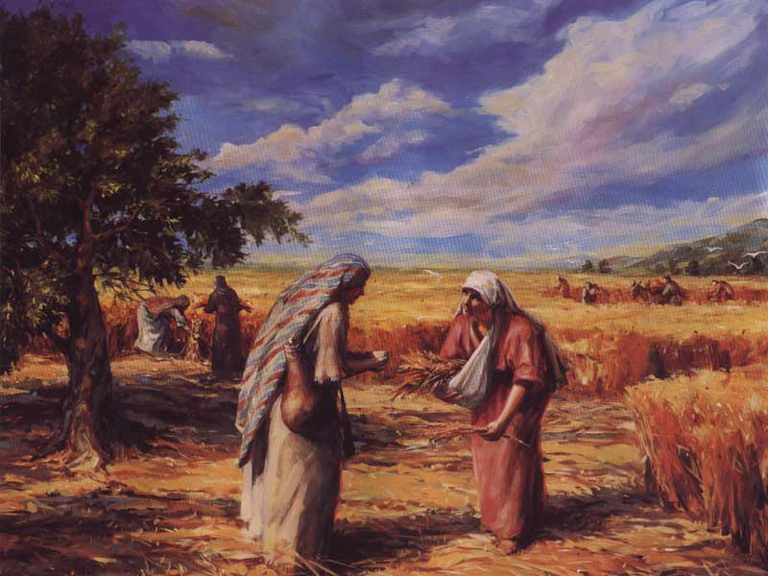

Slide 17
Considering the Culture

Slide 18
Consultation . . .
involves the use of secondary sources. They can shed light on the text that will help you make more sense of what you’re looking at.
A word of warning, though: Beware of relying too much on secondhand information. The use of extra-Biblical resources should never be a substitute for personal Bible study, but rather a stimulus for it.

Slide 19
Doing Further Consultation

Slide 20
Coming To Terms
Use a concordance for a word study
  Example: The word joy in Philippians.
  The word joy appears seven times in the letter. You would need to do a little observing to compare and contrast these different uses.
Use a concordance to study obscure words
  Example is the name Molech in I Kings 11:7

Slide 21
Coming To Terms

