Slide 3
Summarize
Your
Observations

Slide 4
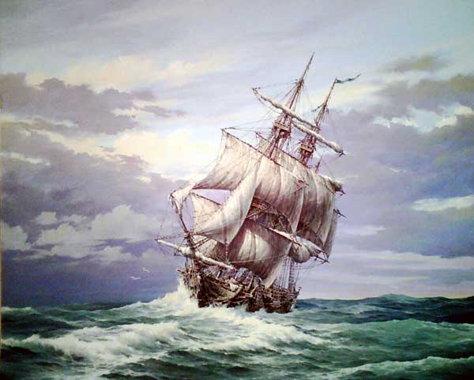
Good Chart Qualities
It uses the power of the picture
It tends to be memorable
It can illustrate your observations

Slide 5
The Gospel of Mark
“Came To Serve”
and
“Give His Life”
Prologue
Jesus
Came
1:1-45
Service
Who
Is He?
2:1-8:26
Who Do People Say That I Am?
8:27-30
Sacrifice
Where’s He Going?
8:31-15:47
Epilogue
Jesus . . . Received Up
16:1-20
His Person and His Purpose

Slide 6
1 PETER
SYLLABUS FOR SUFFERING SAINTS
How to Hold Up – Not Fold Up
Salvation | Submission | Suffering
Privileges of salvation 1:2-12 Products of salvation 1:13-25 Process of salvation 2:1-10 | In the state 2:13-17; civil In the household 2:18-25; social In the family 3:1-7; domestic | As a citizen 3:13-4:6 As a saint 4:7-19 As a shepherd 5:1-7 As a soldier 5:8-11
DOCTRINE IS DYNAMIC! | THE CHRISTIAN’S LIFESTYLE! | THE CHISEL TO SHAPE THE SOUL!
1:3 2:10 | 2:11 3:12 | 3:13 5:11
The DESTINY of the Christian | The DUTY of the Christian | The DISCIPLINE of the Christian

Slide 7
MALACHI
“The Wail of Wounded Love”
Intro
1:1-5
Salvation | Submission | Suffering
Priests 1:6-2:9 People 2:10-16 1:6 2:16 | Accusation 2:17 Announcement 2:17 3:6 2:17 3:6 | Response 3:7-18 Reason 3:7 4:3 3:7 4:3
Concl.
4:4-6

Slide 8
Luke Law of Proportion
Cf.
Matthew
(2 Chapters)
Mark
(20 Verses)
1:1 4:13 4:14 9:50 9:51 19:27 19:28 23:56 24:1 24:52
30 Years 2 ½ Years ½ Year 8 Days 50 Days
Preparation Galilean Samaritan Jerusalem Resurrection

Slide 9
Mark 4:35-5:42
Miracle
Realm
People
Means
Results
Faith
Stilling of the Storm
Disciples
Jesus
A Great Calm
No Faith/
Only Fear
Physical
Speaks
Jesus
Man
Townspeople
Normalcy
Sitting
Clothed
Rt mind
Recogni-tion
Desire to Follow
Demoniac
Mental
Speaks
Woman with the Hemorrhage
Physical/
Emotional
Disciples
Woman
Jesus
Immediate
Healing
Touch
Her Faith Healed Her
Physical/
Emotional/
Spiritual
Jairus
Daughter
Jesus
Disciples
Mourners
Stands
Walks
Eats
Jairus’ Daughter
Touch
Speaks
Great Faith

