Slide 1
Evangelism Class
Steve Patton & Don Bunting Interview
April 11, 2021

Slide 2
What Did They Try? Evangelism Class
Initially Advertised in Newspaper
30 calls a month > 15 came to class > 6-8 finish class > 4 continue to study
Baptized 8 per year for 8 years
Moved to Internet > Went from 2 website visits a month to 1000 website visits a month
Produced Phone calls, Classes
Google Ads > Mailing list > Newsletter
Web presence is current source producing: 8-10 classes a week plus Zoom classes in evenings
Flyers in laundry mat
Pass out literature on the street
Church sign
Meetup
Phone classes
Zoom classes

Slide 3
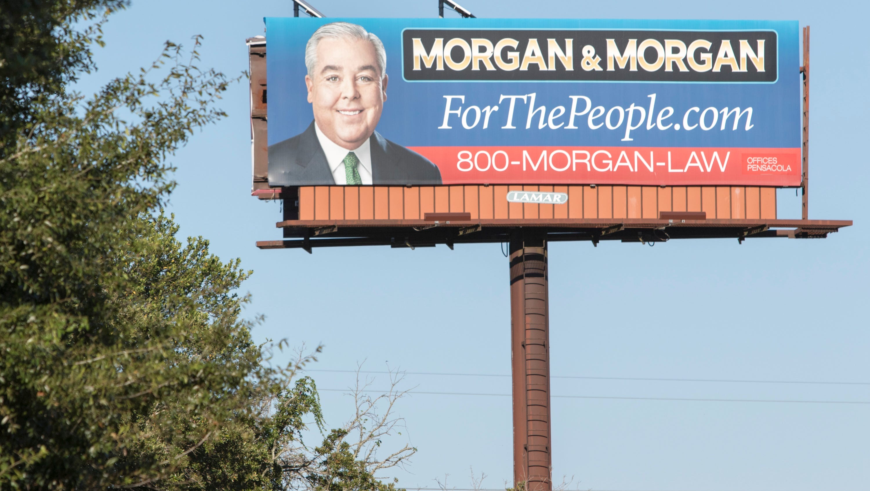
Lessons Learned Evangelism Class
Let People Know How To Find Us
“We need to do what we can in personal work, reaching out to people and contacting them … There are way more people looking than we will ever meet.
Put ourselves out there”
Don Bunting

Slide 4
Lessons Learned Evangelism Class
Let People Know How To Find Us
“Most aren’t interested in the gospel, but you keep asking and find those who are.”
“I am convinced that there are people all around us who are looking. We just have to find them, and we certainly have to put ourselves in front of them so they see us when they are looking”
Don Bunting

Slide 5
Lessons Learned Evangelism Class
Keep Trying Whatever Format Until it Works
Billboard, Newspaper, Radio, Internet, Fliers, Meetup, Church Sign
“I believe that you just keep trying whatever media/format that you are getting yourself out there until you figure out what is going to work.”
“The church needs to figure out how to make ourselves available. We need to spend more on advertising.”
Don Bunting

Slide 6
Lessons Learned Evangelism Class
When a Format is No Longer Effective, Change
“After several years, I stopped getting phone calls [from the newspaper ad]. Instead of 30 a month … it got down to where I was only getting six calls a month … what has changed … nobody is looking at the newspaper anymore … everyone on the train is looking at their phone. That’s when I quit running the newspaper ad and got serious about website presence with search engine optimization.”
Don Bunting

Slide 7
What Can Members Do? Evangelism Class
Put ourselves out there … small town America > Lawyer Billboard
When people need us, they need to know we are there.
Join classes
Be aware of evangelistic activities
Provide a warm welcome to guests

Slide 8
What Can Members Do? Evangelism Class
“The strongest evangelistic tool that a congregation has (besides one or a few people who can teach classes well) is going to be a warm, loving, emotionally open, friendly congregation”
Don Bunting

