Slide 1

Lesson 4: Disciples Think & Ask Questions
Studies to Help Disciples Grow Stronger

Slide 2

Disciples Think and Ask Questions
Lesson 4
How does the disciple grow to be more like Jesus? How does the disciple know what God wants him to do?
As a newborn Christian it is essential that you regularly study God’s word so that you can grow in Jesus Christ (read 1 Peter 2:2).
In this lesson you will learn:
  Why asking questions is so important.
  How to find God’s will in the Bible.
  Techniques for studying the Bible effectively and profitably.

Slide 3
Parables and questions
Lesson 4: Disciples Think & Ask Questions
Studies to Help Disciples Grow Stronger

Slide 4
Parables and questions
Lesson 4: Disciples Think and Ask Questions
Read Luke 8:4-15.
  A parable is an earthly story with a heavenly meaning.
  Identify the earthly story.
  Can you find the heavenly meaning?
  Did everyone understand the parable? Why not?
  Some who didn’t understand did something very important that enabled them to understand (v.9). What did they do?

Slide 5
Parables and questions
Lesson 4: Disciples Think and Ask Questions
Key principle: Disciples think and ask questions.
  The disciples were not content merely to hear a story about farming. They pressed for more.
  Disciples today must do the same. We cannot be content to let someone tell us what the Bible teaches or what we should believe.
  Creeds, edicts, and dogmas from denominational councils are all attempts to replace the process of Bible study with human ideas.
  Some religious groups do not want their members to search the Scriptures for themselves or to ask questions about the various events, activities, procedures, and teachings that are being implemented. Is this consistent with the spirit of Christ and discipleship?

Slide 6
Parables and questions
Lesson 4: Disciples Think and Ask Questions
What kind of questions do disciples ask?
  The primary question must always be “What does the Bible say?”
  What people think, write, or say is not as important as Scripture. Disciples must ask “Does this teaching match the Bible’s teaching?”
  Hear Paul’s strong warning: “But even if we, or an __________ from heaven, preach any other __________ to you than what we have preached to you, let him be accursed. As we have said before, so now I say again, if anyone preaches any other __________ to you than what you have received, let him be accursed” (Galatians 1:8-9).
  If someone claims a teaching is from God, do disciples automatically assume it is so?
  Is it wrong to ask questions or inquire about someone’s teachings
  (see 1 John 4:1; Revelation 2:2)?

Slide 7
Parables and questions
Lesson 4: Disciples Think and Ask Questions
What kind of questions do disciples ask?
  Jesus’ disciples must not accept any teaching without first checking it against Scripture to see if it is true.
  “These [in the city of Berea] were more fair-minded than those in Thessalonica, in that they __________ the word with all readiness, and __________ the __________ daily to find out whether these things were so” (Acts 17:11).
  Disciples know they can trust the Bible because it is from God (2 Timothy 3:16-17). When we have God’s word, we need nothing else.
  The New Testament functions as our only pattern and guide today. We must do exactly as it says, no more and no less (Galatians 1:8-9).
  Knowing the Scriptures is the key to discerning truth from error. Are you
  ready to study the Bible to understand God’s will?

Slide 8
How do we find God’s will in the scriptures?
Lesson 4: Disciples Think & Ask Questions
Studies to Help Disciples Grow Stronger

Slide 9
How do we find God’s will in the scriptures?
Lesson 4: Disciples Think and Ask Questions
Rightly divide the Word of God.
  Confusing the Old and New Testaments causes error.
  Read Galatians 3:24-25. What function did the Law of Moses serve?
  Now that “faith” has come, are we still under the tutor?
  What law are Christians under now? (see Galatians 6:2)

Slide 10
How do we find God’s will in the scriptures?
Lesson 4: Disciples Think and Ask Questions
Obey direct commands.
  Much of God’s will for us is communicated in plain, simple terms.
  Peter’s preaching contained clear commands: “Repent, and let every one of you be baptized…” (Acts 2:38).
  Jesus’ desires regarding His Supper are not hard to understand: “This do…in remembrance of Me”(1 Corinthians 11:25).
  Giving is clearly specified: “On the first day of the week let each one of you lay something aside…” (1 Corinthians 16:2).

Slide 11
How do we find God’s will in the scriptures?
Lesson 4: Disciples Think and Ask Questions
Observe approved examples.
  Approved examples are simply the practices of the New Testament church as it functioned under the guidance of the apostles.
  The New Testament urges us to follow the example of the apostles: “The things which you __________ and received and heard and saw in me, these do, and the __________ of peace will be with you” (Philippians 4:9).
  “Stand fast and hold the __________ which you were taught, whether by word or our epistle” (2 Thessalonians 2:15).
  Human tradition is not important, but apostolic tradition is from God and must be followed.
  Watching the example of the apostles and New Testament church helps us to know many things:
    Acts 20:7 -- When did the church take the Lord’s Supper?
    Acts 14:23 – Did the apostles teach one man should rule the church or several men should
    serve as elders?

Slide 12
How do we find God’s will in the scriptures?
Lesson 4: Disciples Think and Ask Questions
Draw forced conclusions.
  God expects disciples to reason to logical conclusions. The Bible presents the facts. We draw the conclusion the text forces us to draw.
  Read Matthew 3:16. The Bible nowhere says Jesus went down into the water, but if He came up from the water, sound reasoning concludes that He went down into it.
  Exodus 20:8 instructed Israel to keep the Sabbath holy. Since no other instruction is given, the only conclusion possible was that God wanted Israel to hallow every Sabbath.
  Acts 20:7 tells us disciples took the Lord’s Supper on Sunday. 1 Corinthians 16:1-2 shows us disciples met for worship every Sunday. Regarding the frequency of taking the Lord’s Supper what conclusion does the New Testament force us to draw?
      We should take the Supper once a year.
      We should take the Supper every Sunday, just as the New Testament church did.

Slide 13
How do we find God’s will in the scriptures?
Lesson 4: Disciples Think and Ask Questions
Summary:
  Following Christ means we obey Him. The disciple constantly searches to find Bible authority for every activity and doctrine.
  Disciples ask, “What passage commands this?,” ”Where is the example?,” or “How did we draw this conclusion?”
  In these ways God’s will is communicated to us, and we must obey it.
  If a teaching or practice cannot be established by command, example, or conclusion, we know that it is not God’s will.
  ”And whatever you do in word or deed, do all in the name of the Lord Jesus…” (Colossians 3:17).

Slide 14
Bible Study
Keys
Lesson 4: Disciples Think & Ask Questions
Studies to Help Disciples Grow Stronger

Slide 15
Bible Study Keys
Lesson 4: Disciples Think and Ask Questions
Bible study key 1: regular study
  Few things are meaningful if practiced haphazardly.
  Read your Bible daily to reap the greatest benefits from it.
  Study 2 Timothy 2:15. What does “give diligence” mean?

Slide 16
Bible Study Keys
Lesson 4: Disciples Think and Ask Questions
Bible study key 2: don’t study over your head
  Some parts of the Bible are more difficult than others.
  “But solid __________ belongs to those who are of full age, that is, those who by reason of use have their __________ exercised to discern both good and evil” (Hebrews 5:14).
  Try reading Luke or Mark. Jesus’ teachings are easy to understand and extraordinarily practical. These books will be of immediate help to you.
  Next read Acts which contains the account of what the first disciples did after Jesus left earth and returned to heaven.
  Wait to tackle the more difficult material such as Revelation or Daniel until you have a better feel for the overall message and theme of the Bible.

Slide 17
Bible Study Keys
Lesson 4: Disciples Think and Ask Questions
Bible study key 3: turn reading into Bible study
  Don’t settle for mere reading. Study the Bible by asking three questions as you read. This will maximize your time in the word.
  What is going on in this text?
    Be sure you understand the who, what, and where of the reading. Who are the main characters? What are they doing? Where are they?
    A Bible encyclopedia, atlas, or dictionary can help you with these questions. These are available in the church’s library, from a bookstore, or may be borrowed from another Christian.

Slide 18
Bible Study Keys
Lesson 4: Disciples Think and Ask Questions
Bible study key 3: turn reading into Bible study
  Why is this in the bible?
    Why did God choose to record this information?
    How does it fit into the Bible’s theme, the salvation of man from sin?
    What does the text teach us about God, man, sin, and righteousness?
  How can I apply this to my life?
    Don’t let Bible study be just facts and interesting trivia.
    Always examine your life in the light of His word and see where corrections or improvements
    need to be made.

Slide 19
Bible Study Keys
Lesson 4: Disciples Think and Ask Questions
Bible study key 3: turn reading into Bible study
  Extra tip: consider keeping a notebook in which you may write down the results of your study. We remember much more of what we studied when we take notes.

Slide 20
Conclusion
Lesson 4: Disciples Think & Ask Questions
Studies to Help Disciples Grow Stronger

Slide 21
Conclusion
Lesson 4: Disciples Think and Ask Questions
Disciples are seekers of truth.
  Because of this, disciples are never afraid to ask “Why are we doing this?” or “How do we know it is God’s will to teach this?”
  Disciples want to know the truth! True disciples are completely unwilling to accept anything but Bible truth as an answer.
  Our questions about discipleship must drive us to the Bible for answers.

Slide 22
Conclusion
Lesson 4: Disciples Think and Ask Questions
We can know God’s truth through the Bible.
  That truth can be communicated through direct commands.
  God wants us to observe the New Testament Christians in action and learn truth from their example.
  Often, the Bible forces us to an obvious conclusion about God’s will.
  Disciples use all three of these methods to discern truth.

Slide 23
Conclusion
Lesson 4: Disciples Think and Ask Questions
You can read and understand your Bible.
  Read regularly.
  Read material you can understand.
  Do more than read – study the Bible.
Disciples who do these things will be able to walk with God in confidence that they are obeying the truth.

Slide 24
Lesson 4: Disciples Think & Ask Questions
Studies to Help Disciples Grow Stronger

Slide 25
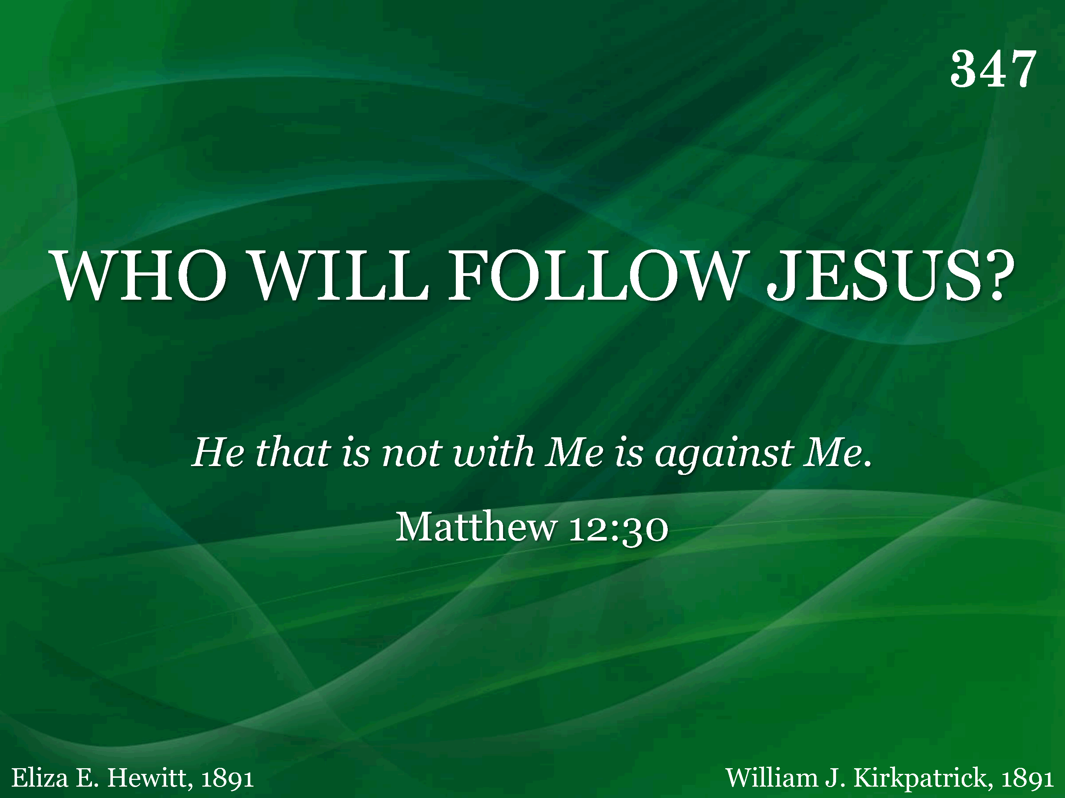
347 - Who Will Follow Jesus - Title

Slide 26
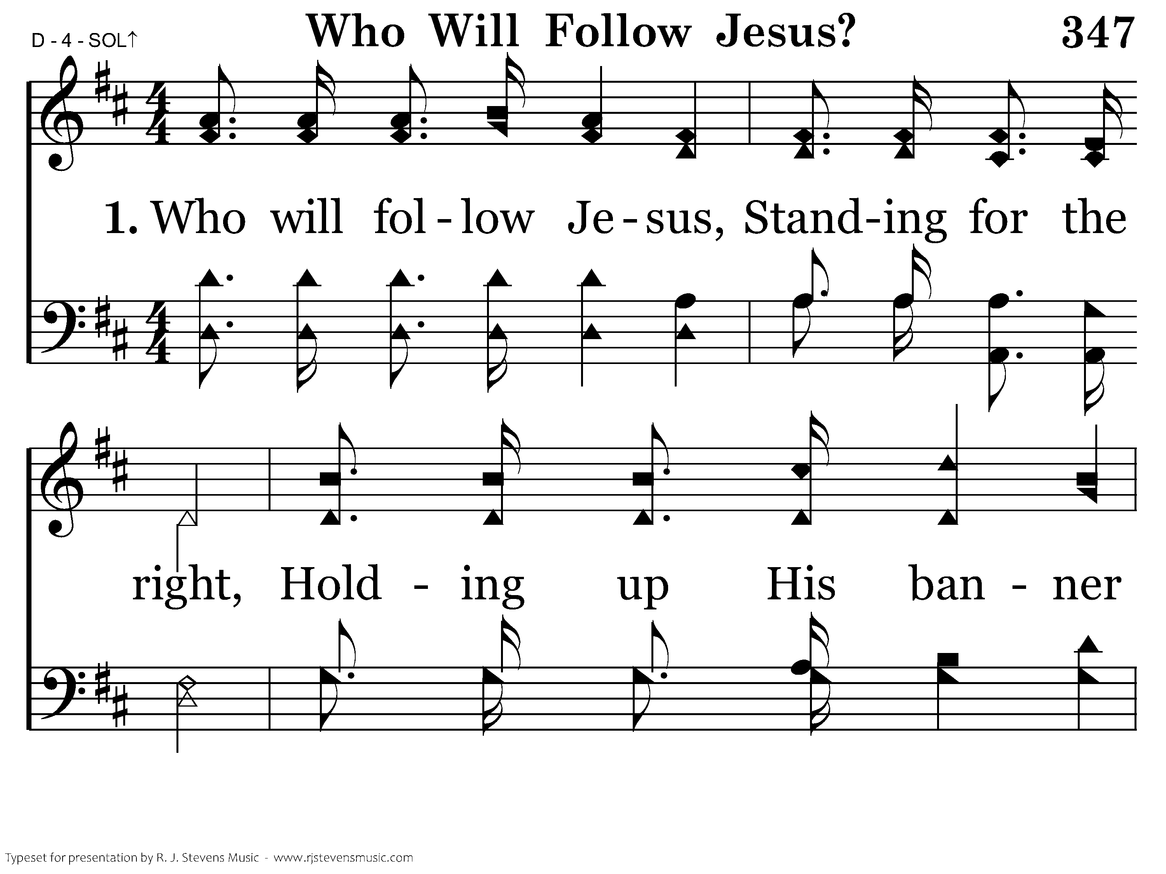
347 - Who Will Follow Jesus - 1.1

Slide 27
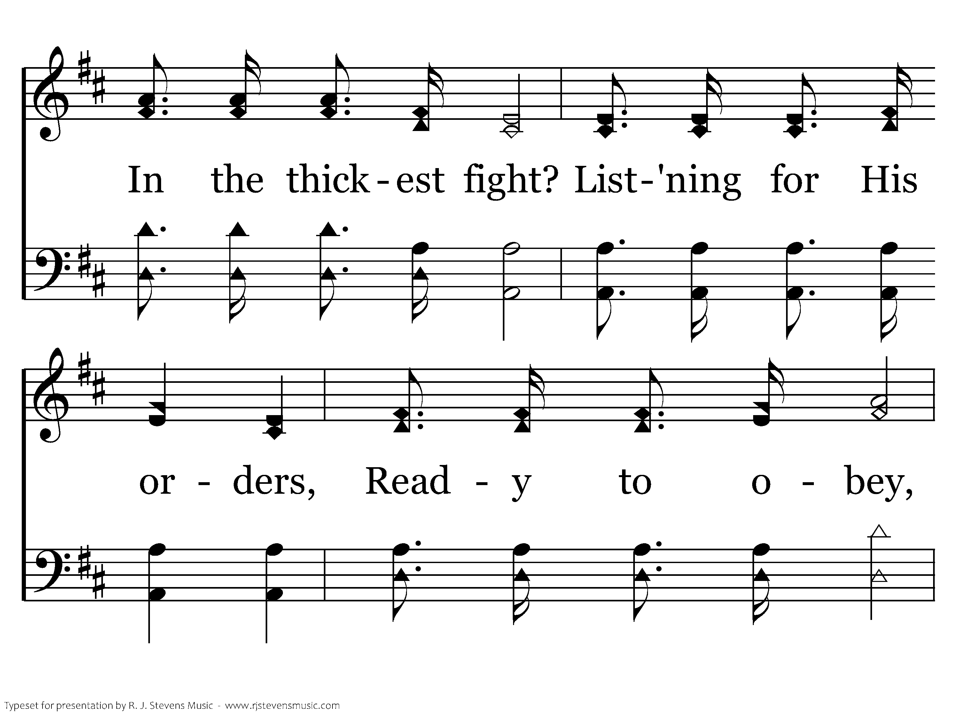
347 - Who Will Follow Jesus - 1.2

Slide 28
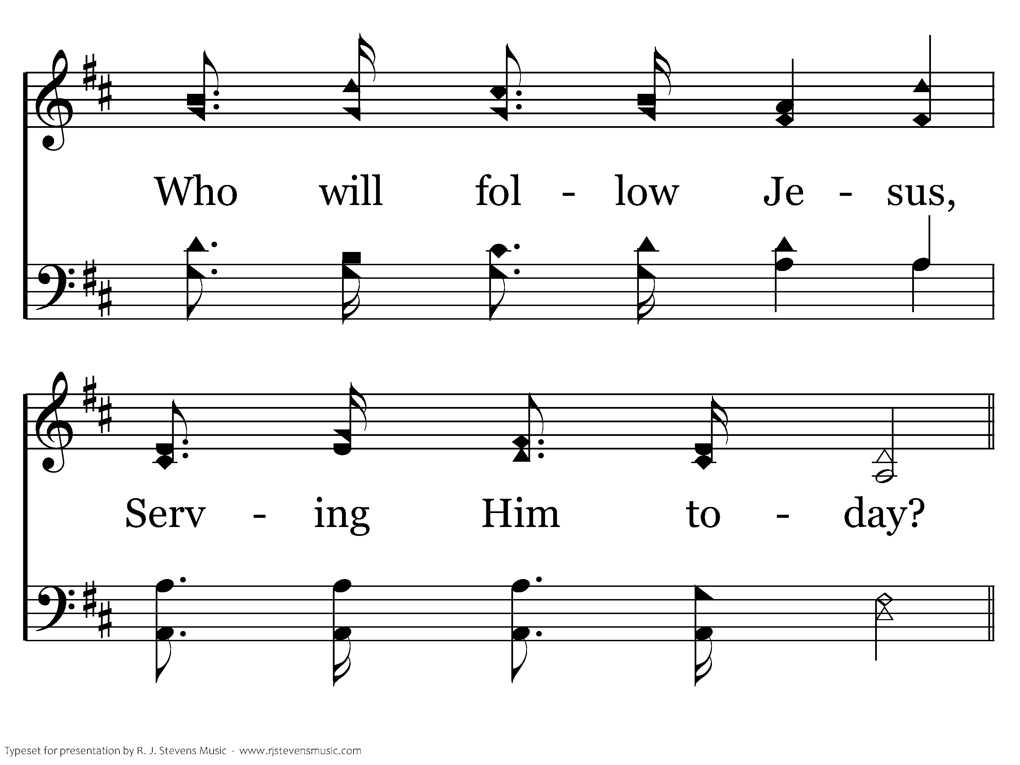
347 - Who Will Follow Jesus - 1.3

Slide 29
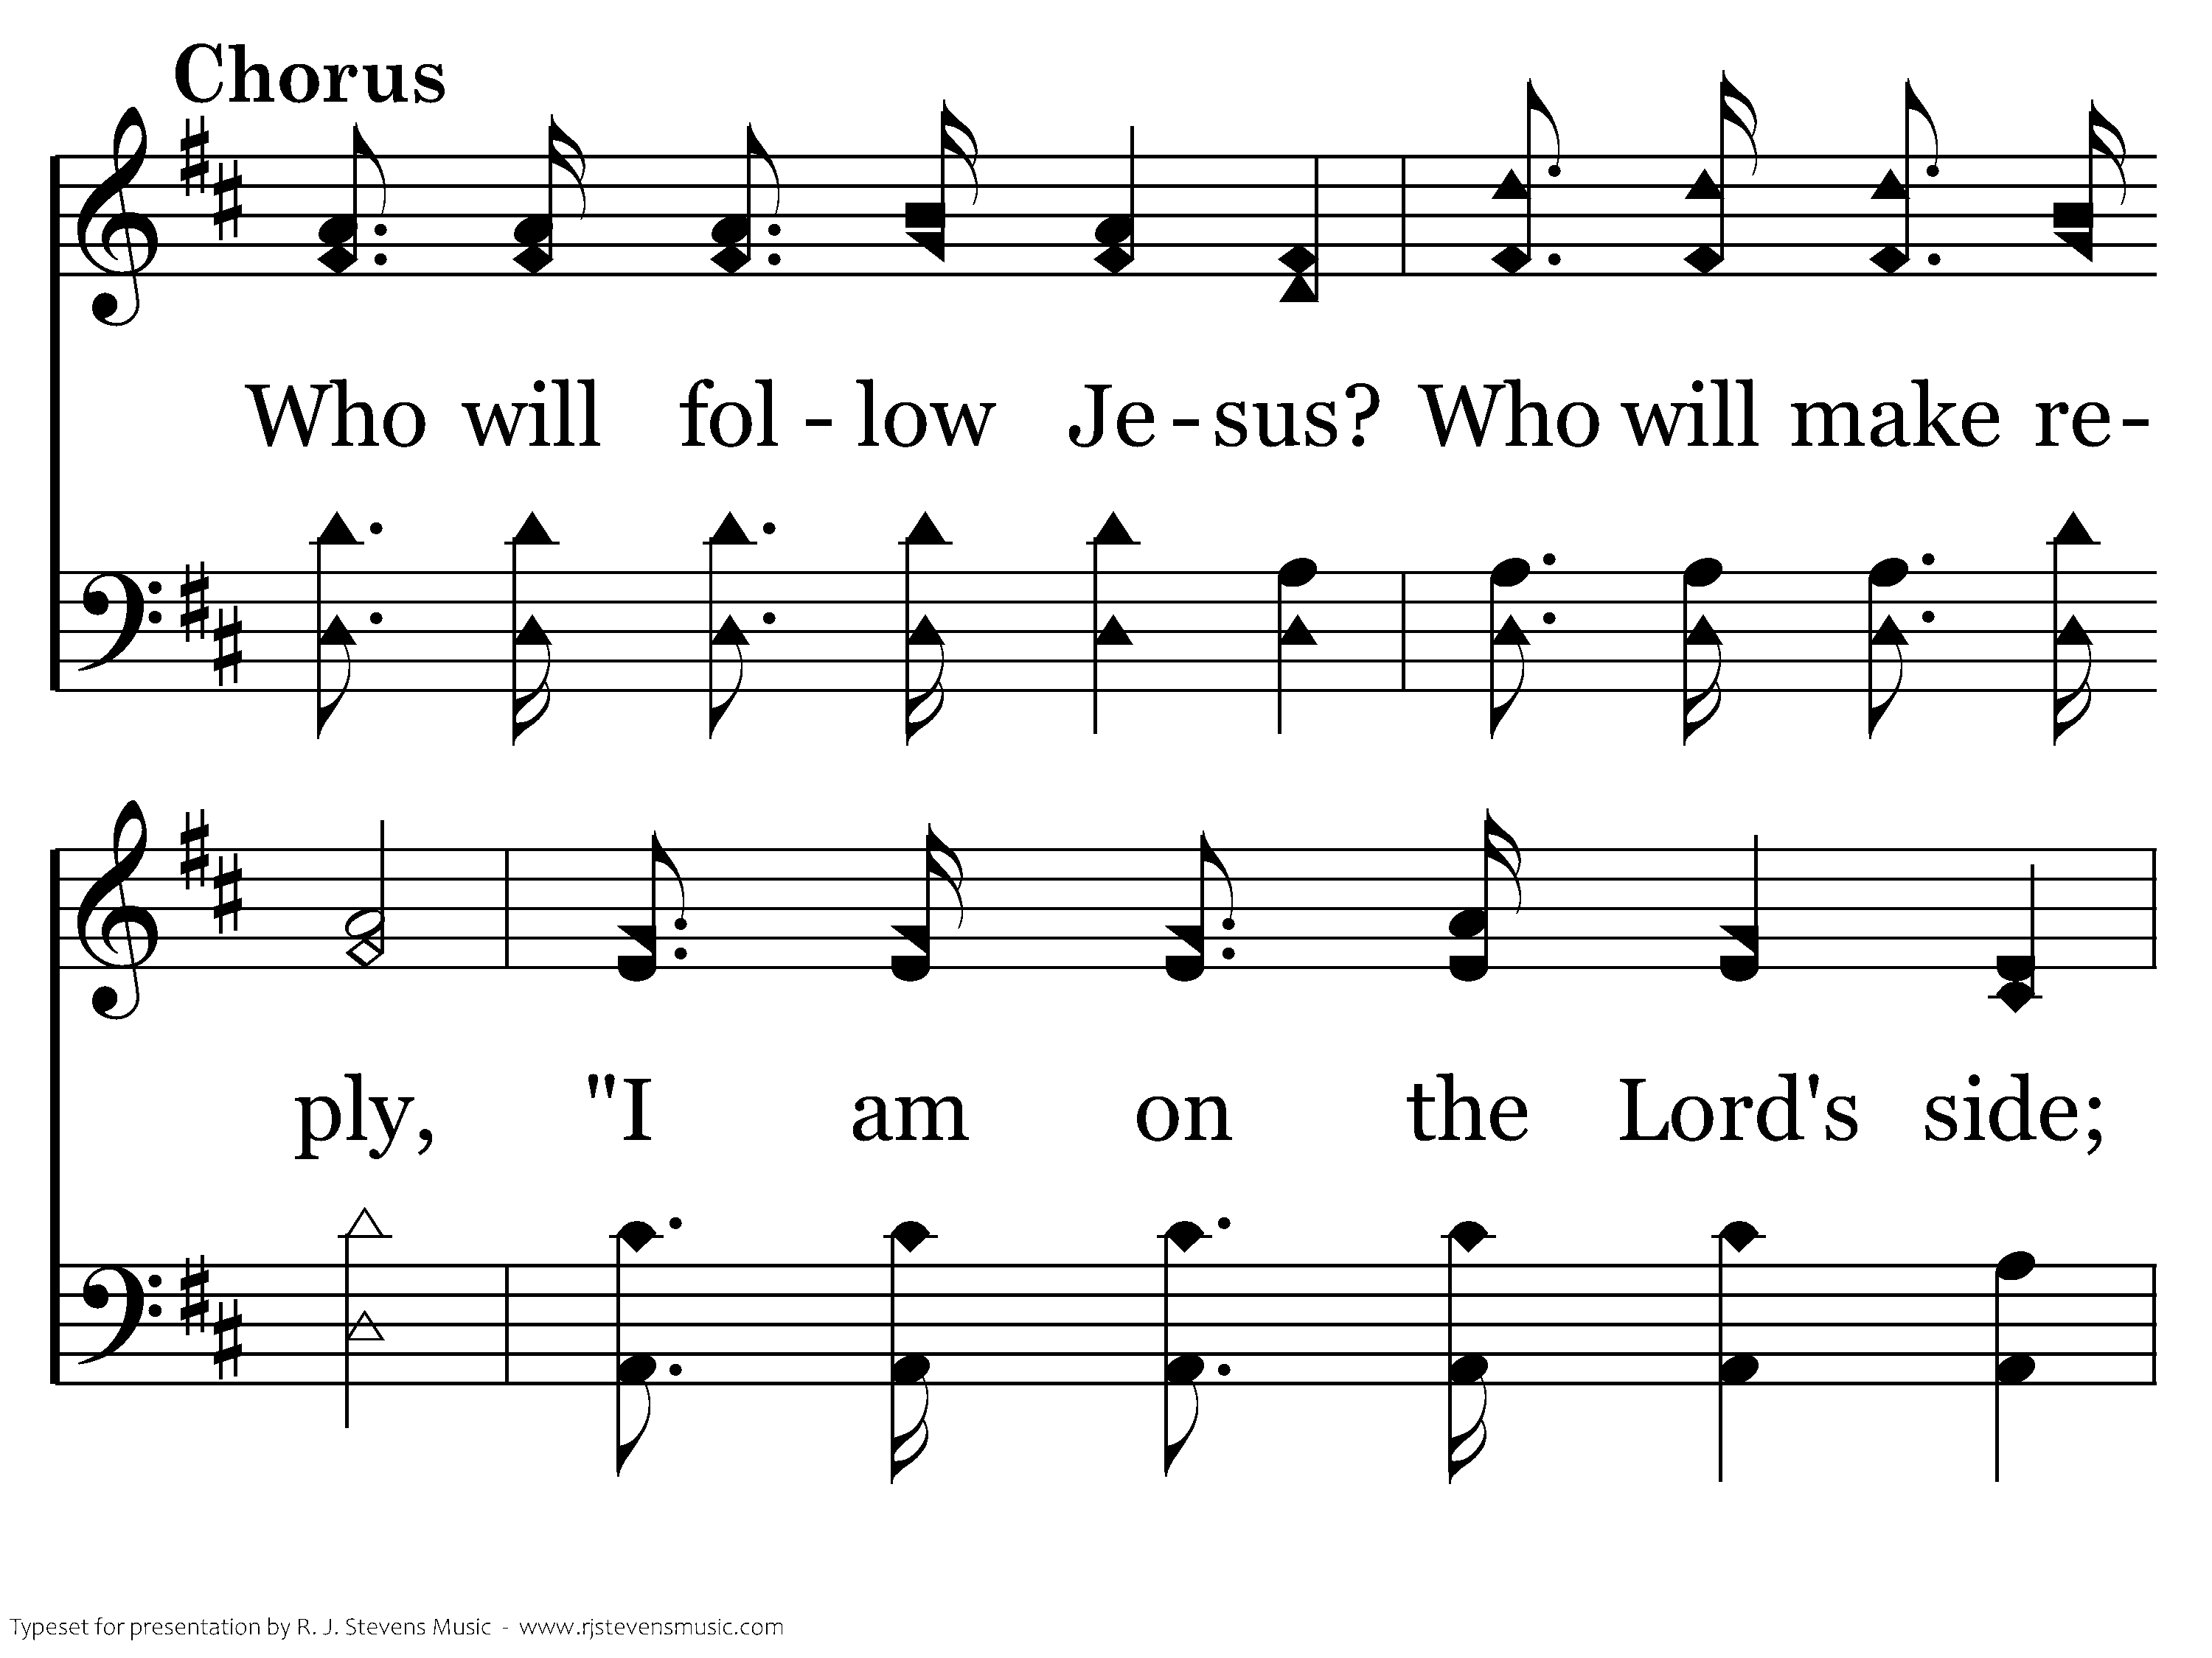
347 - Who Will Follow Jesus - C.1

Slide 30
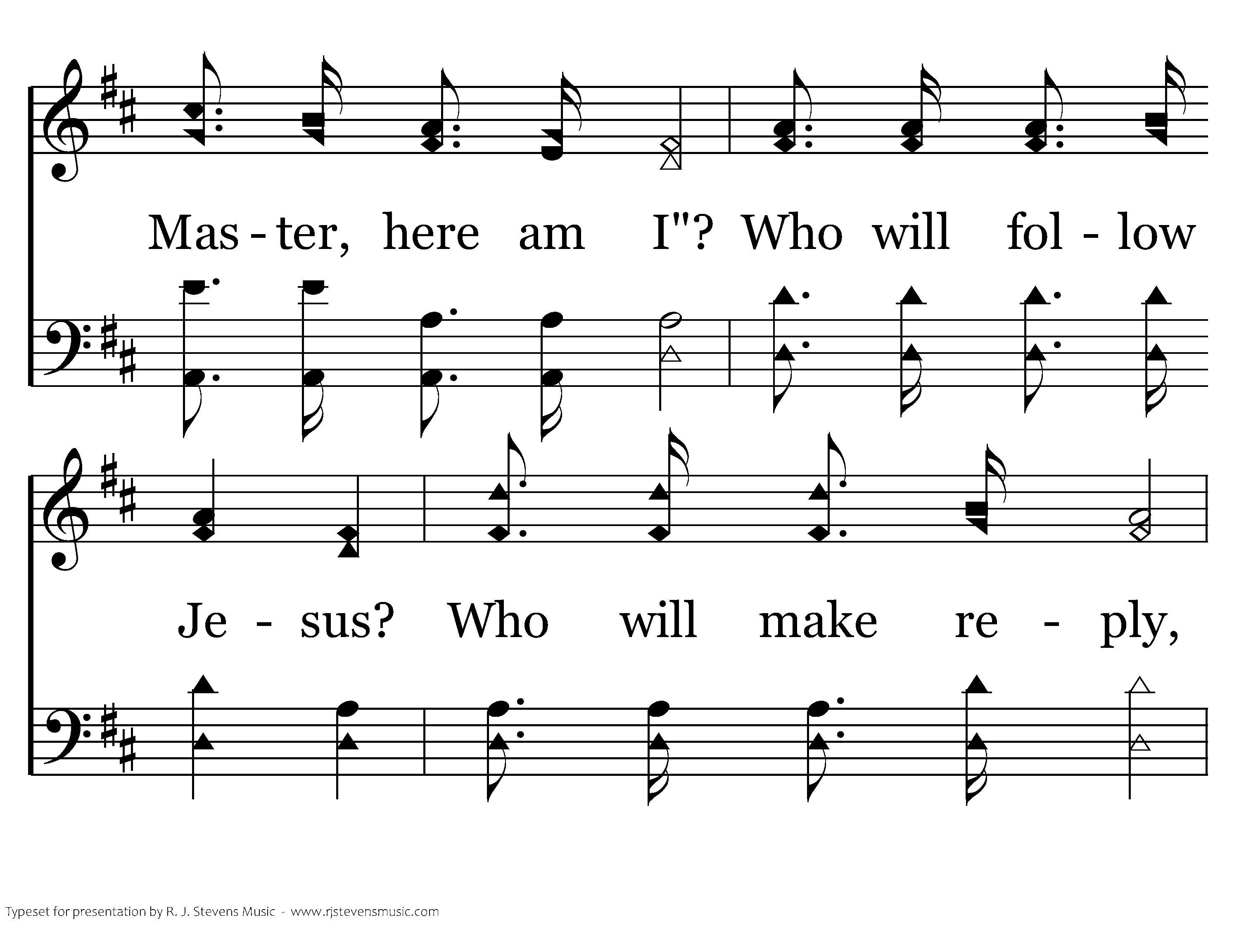
347 - Who Will Follow Jesus - C.2

Slide 31
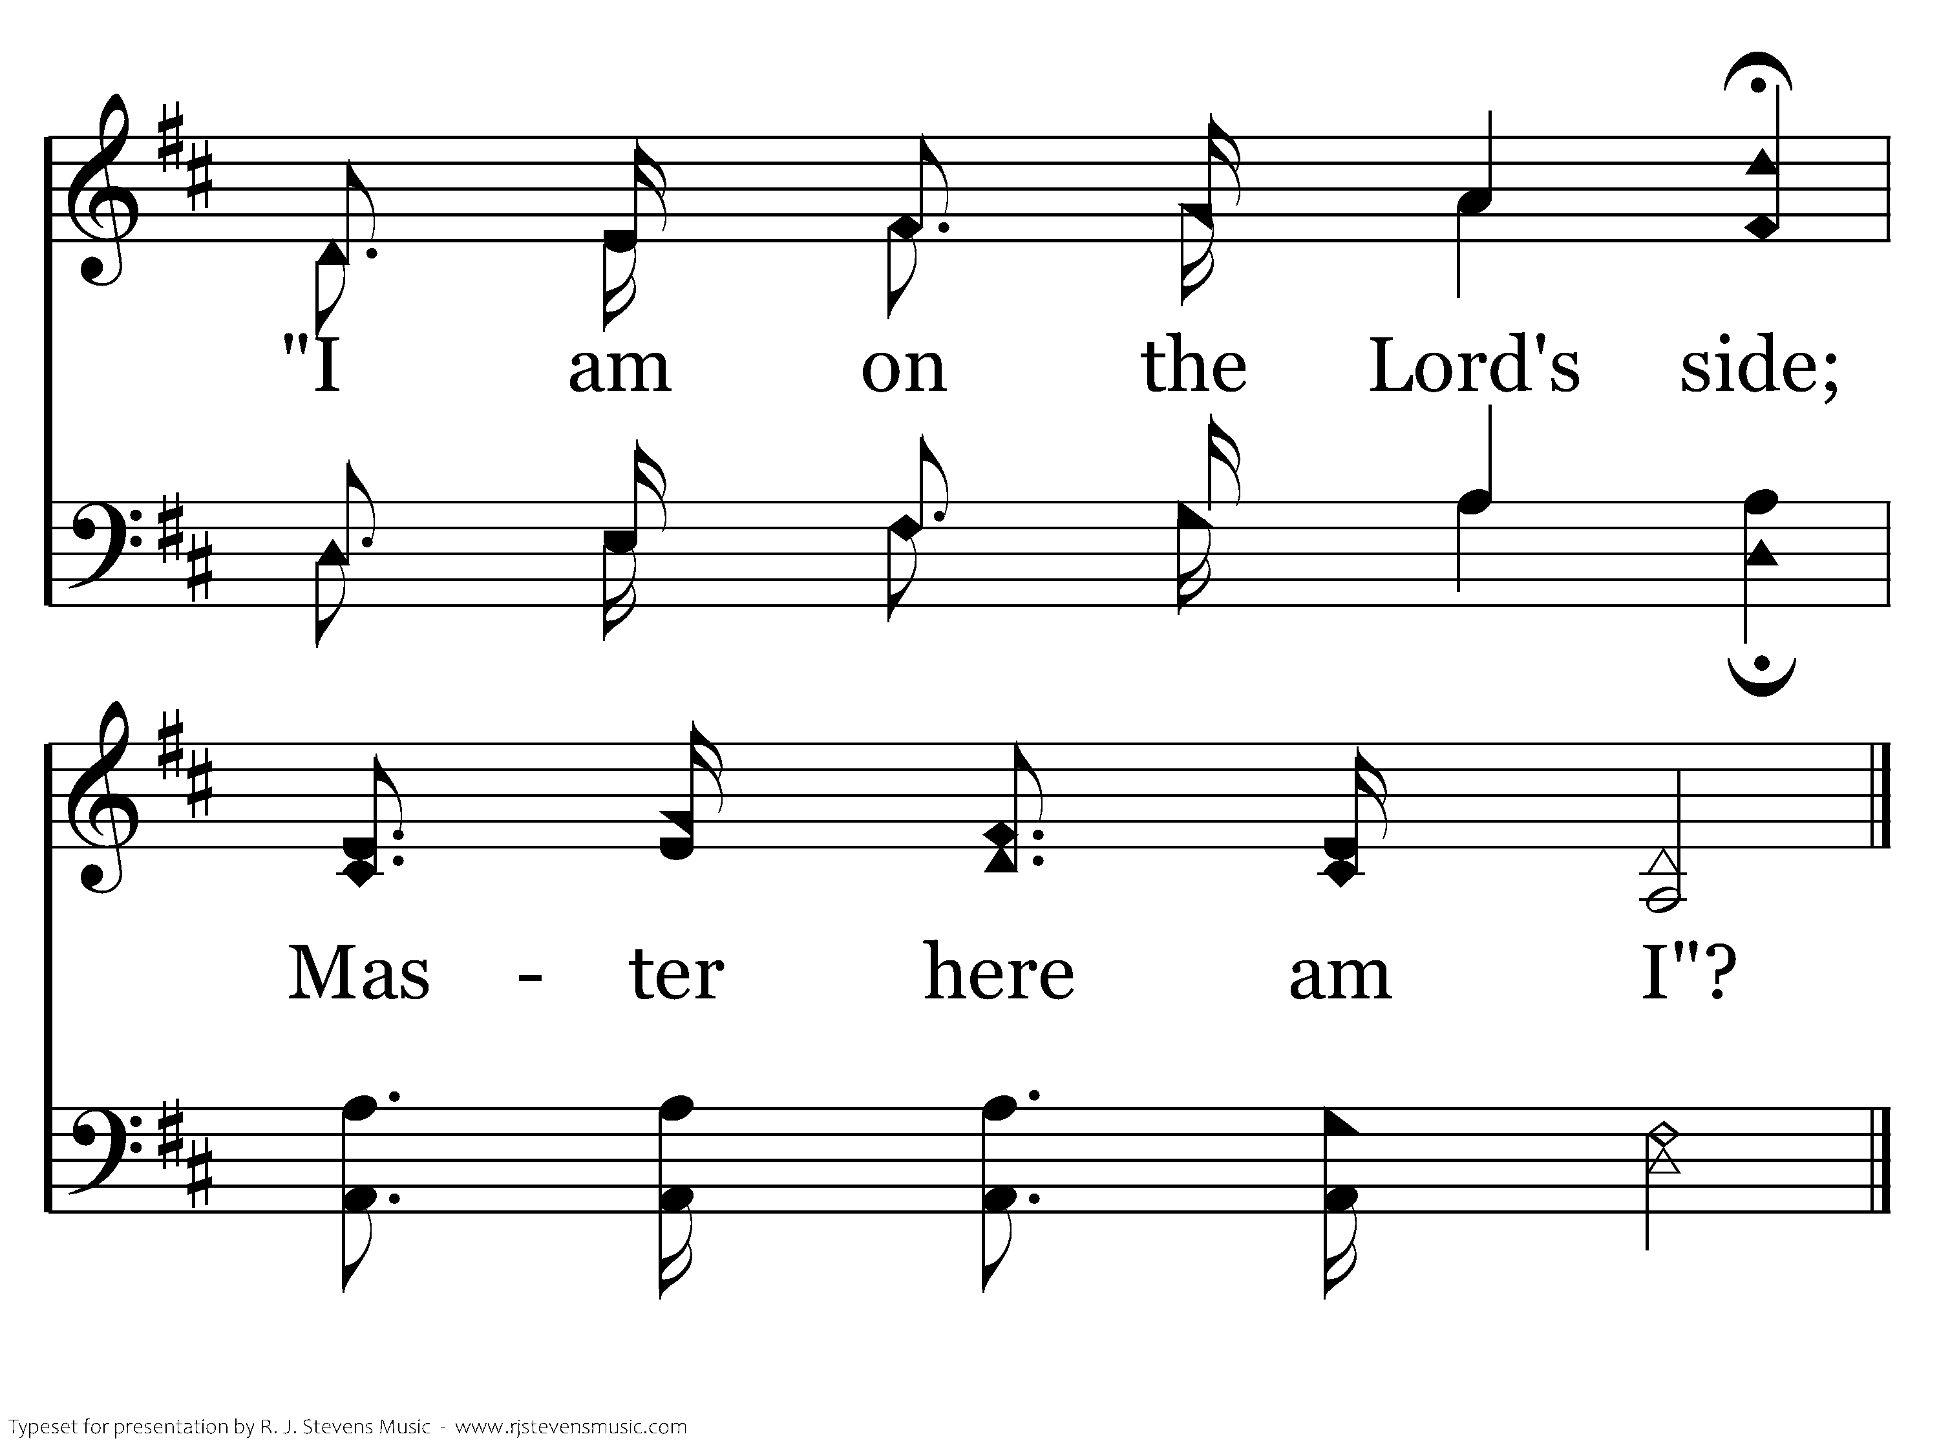
347 - Who Will Follow Jesus - C.3
End of Verse 1

Slide 32
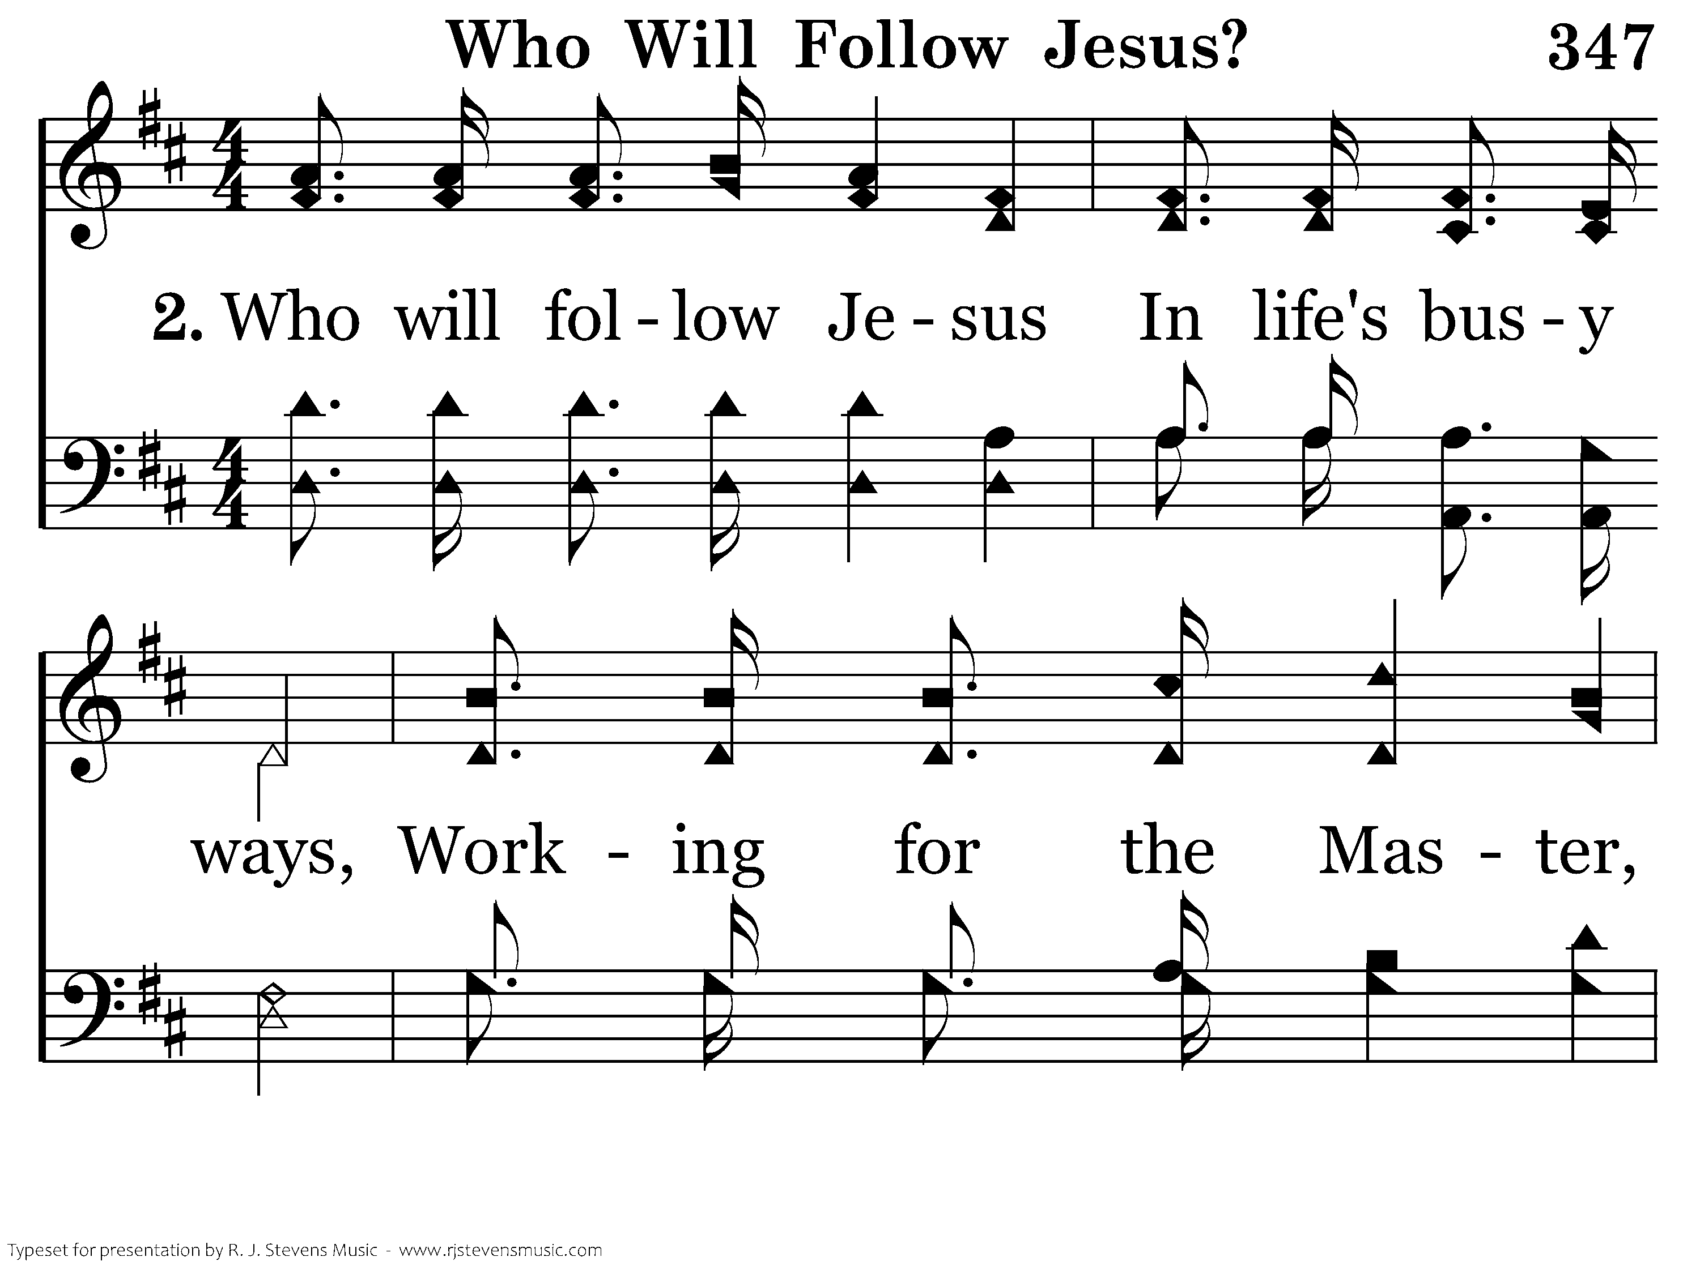
347 - Who Will Follow Jesus - 2.1

Slide 33
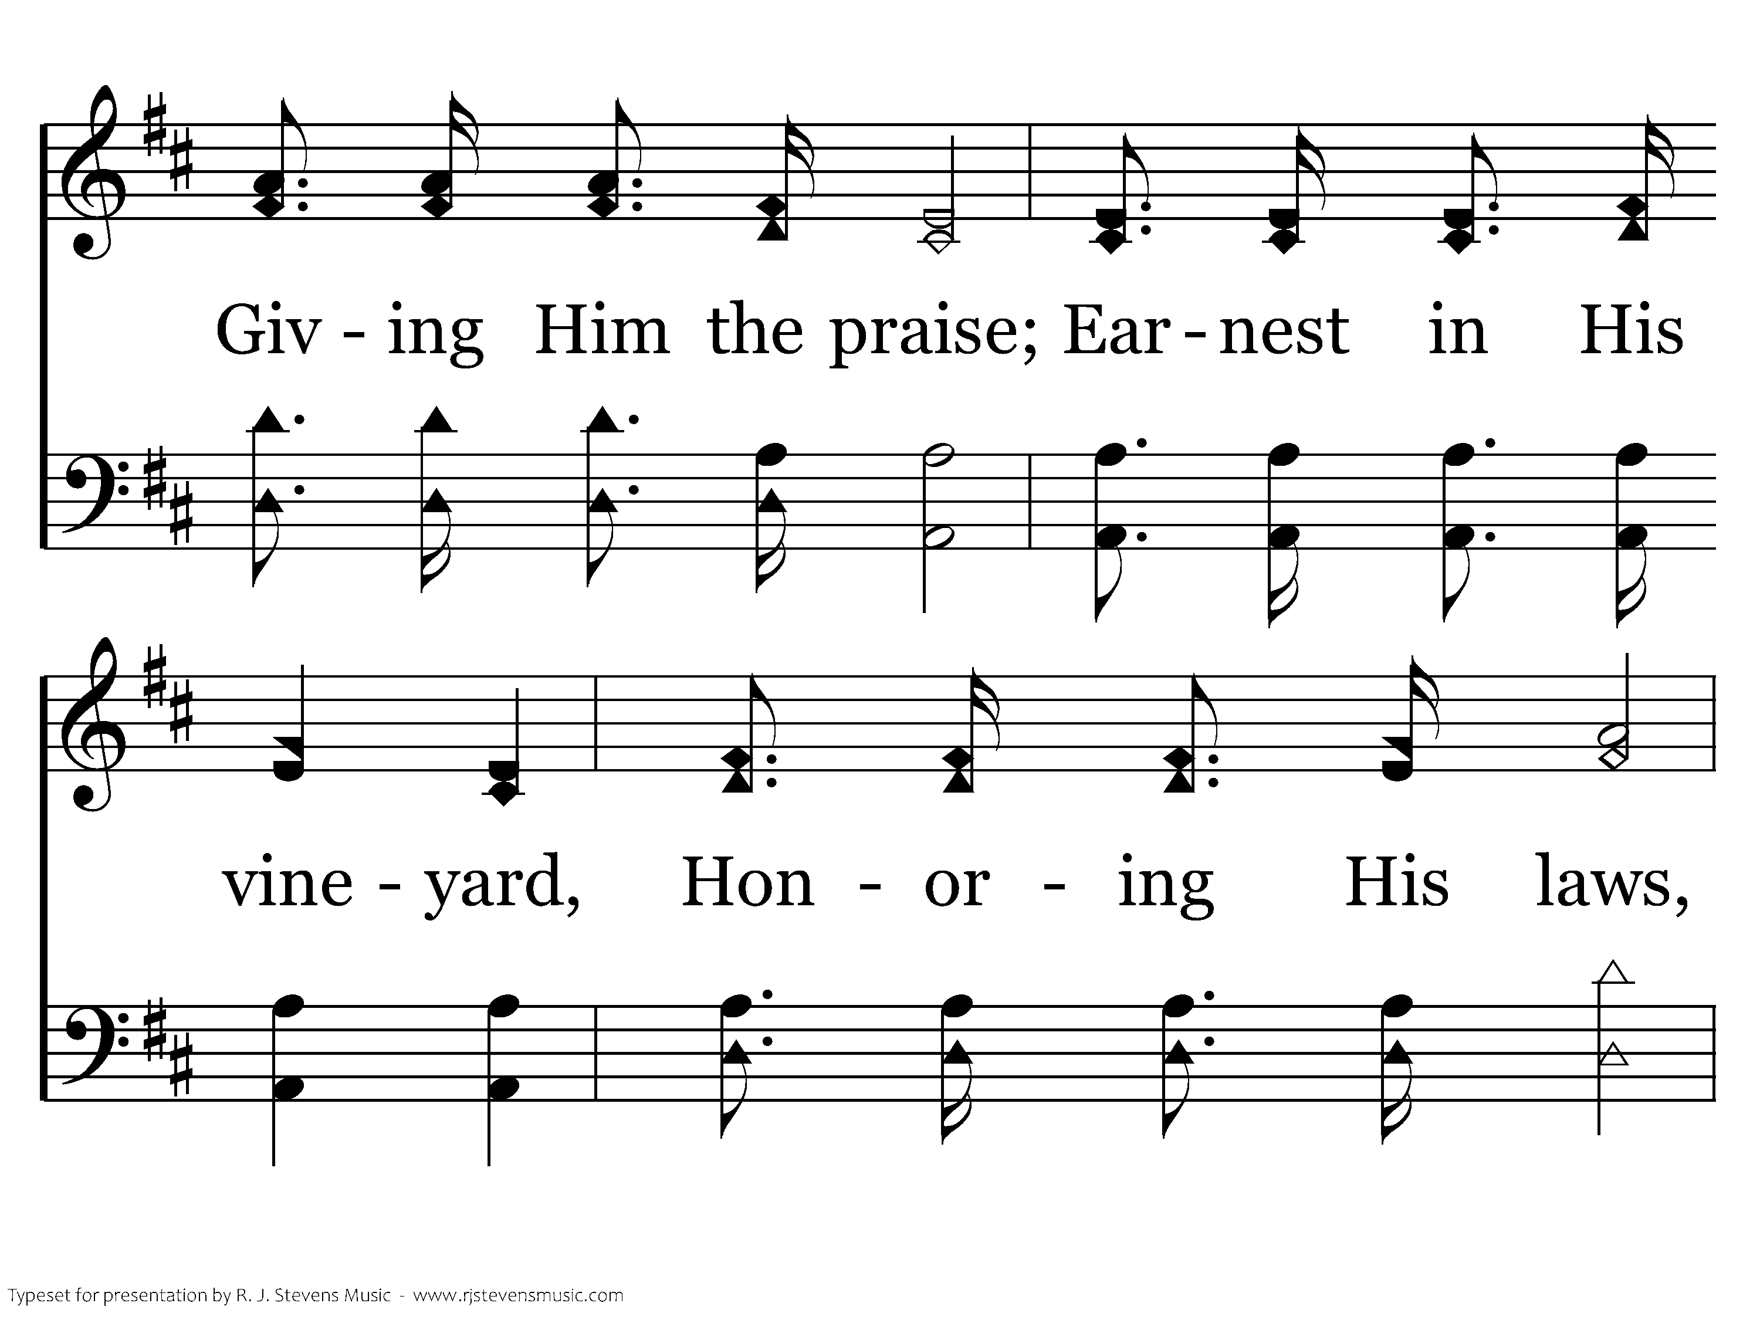
347 - Who Will Follow Jesus - 2.2

Slide 34
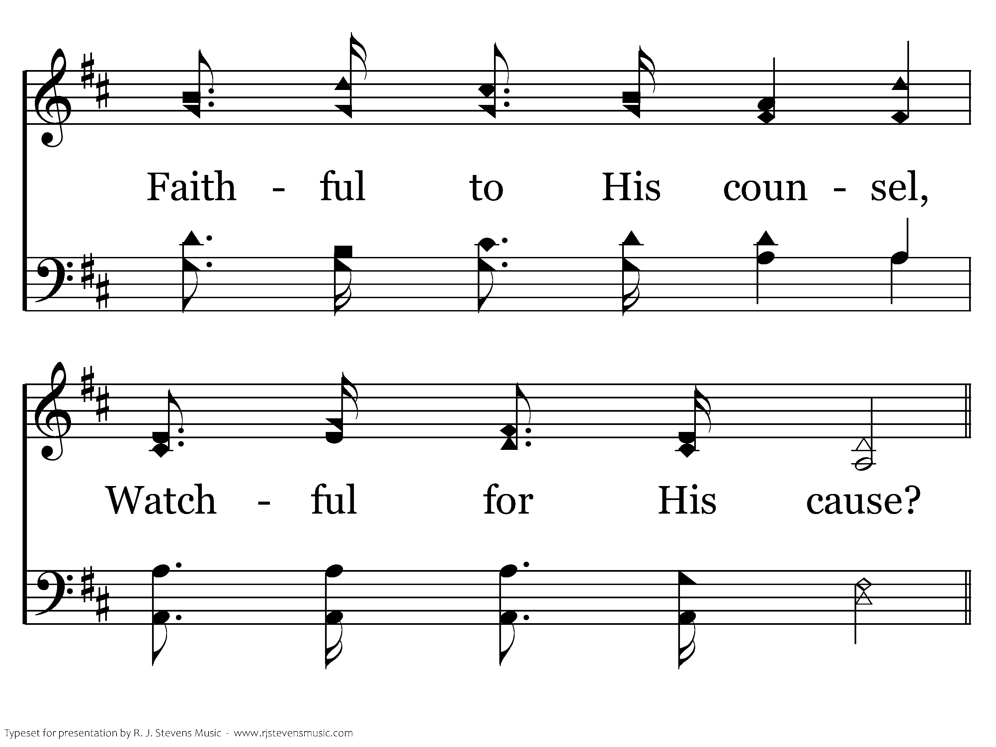
347 - Who Will Follow Jesus - 2.3

Slide 35
347 - Who Will Follow Jesus - C.1

Slide 36
347 - Who Will Follow Jesus - C.2

Slide 37
347 - Who Will Follow Jesus - C.3
End of Verse 2

Slide 38
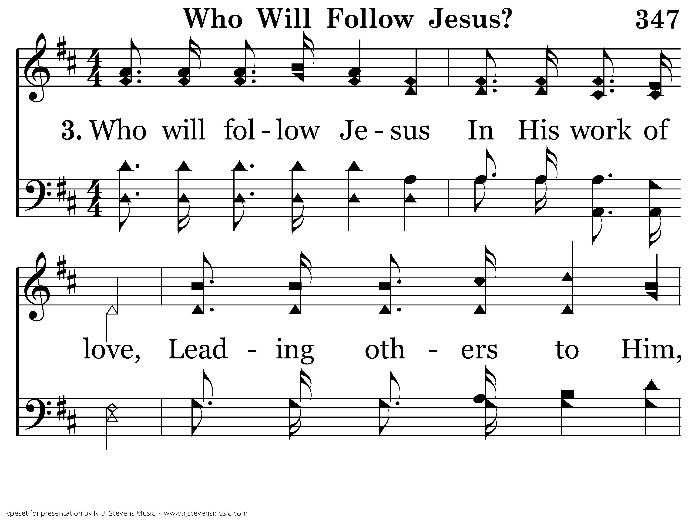
347 - Who Will Follow Jesus - 3.1

Slide 39
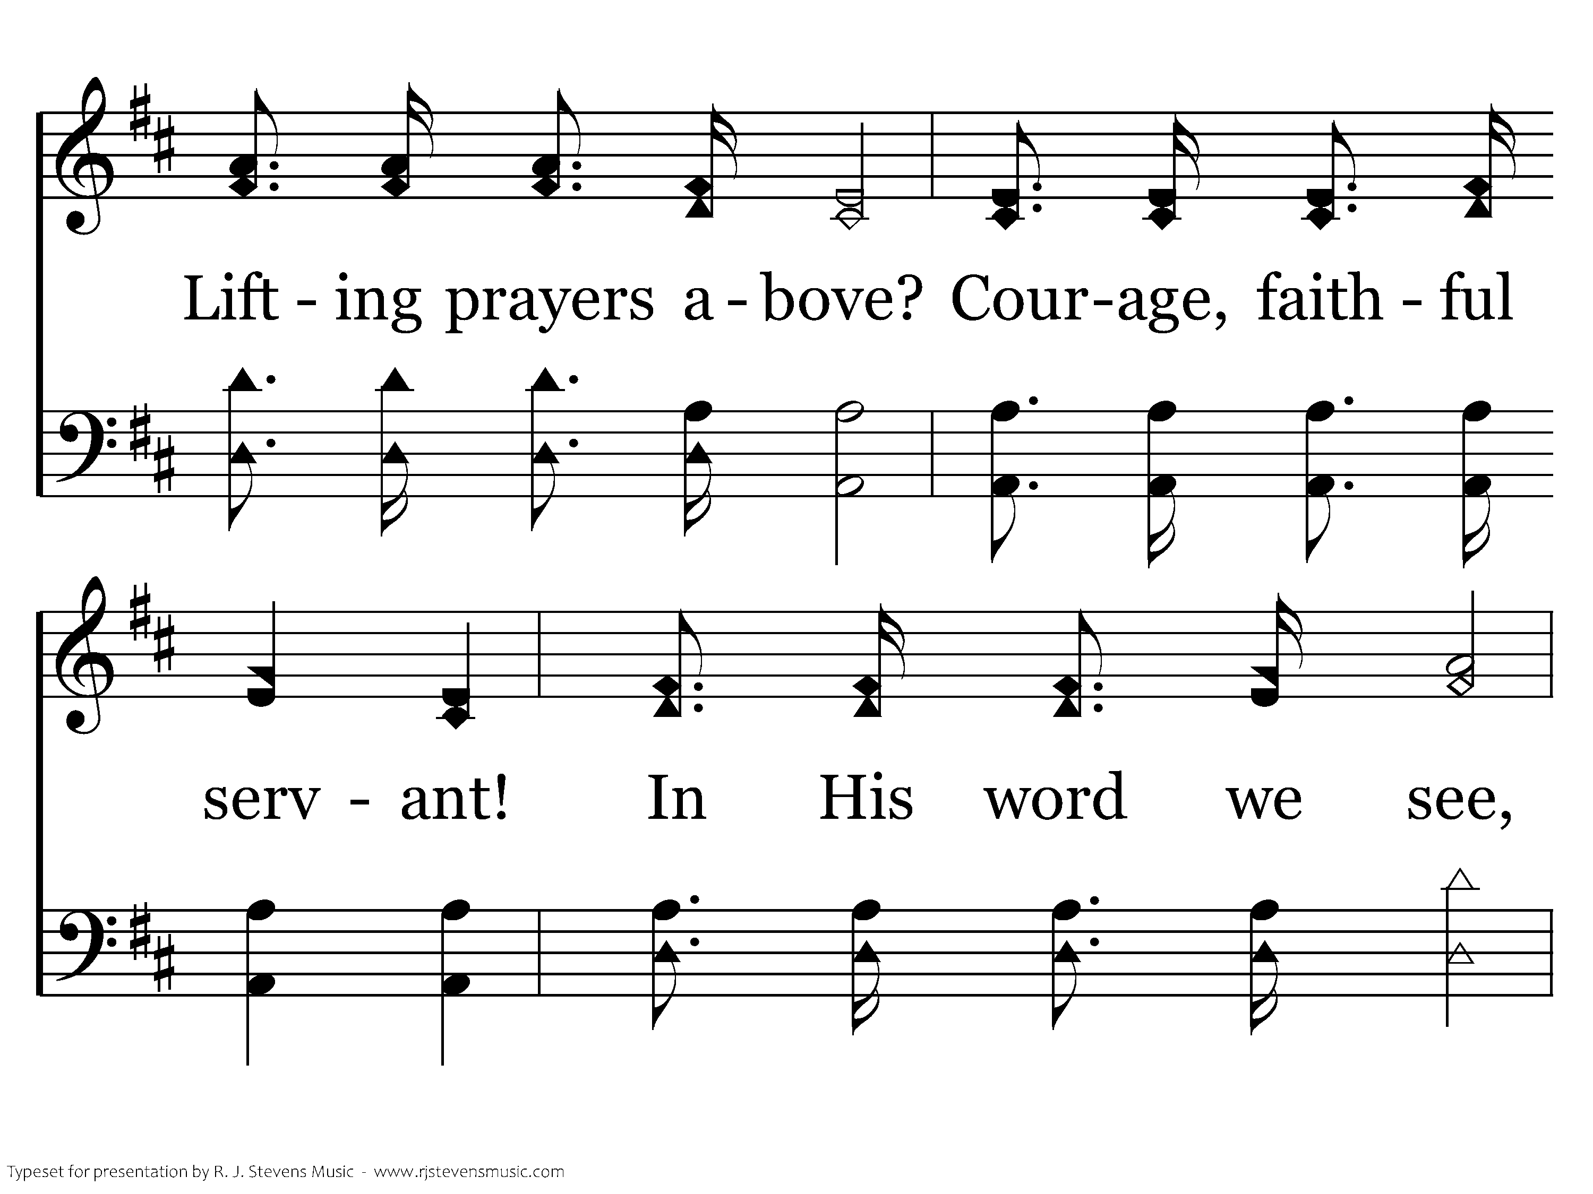
347 - Who Will Follow Jesus - 3.2

Slide 40
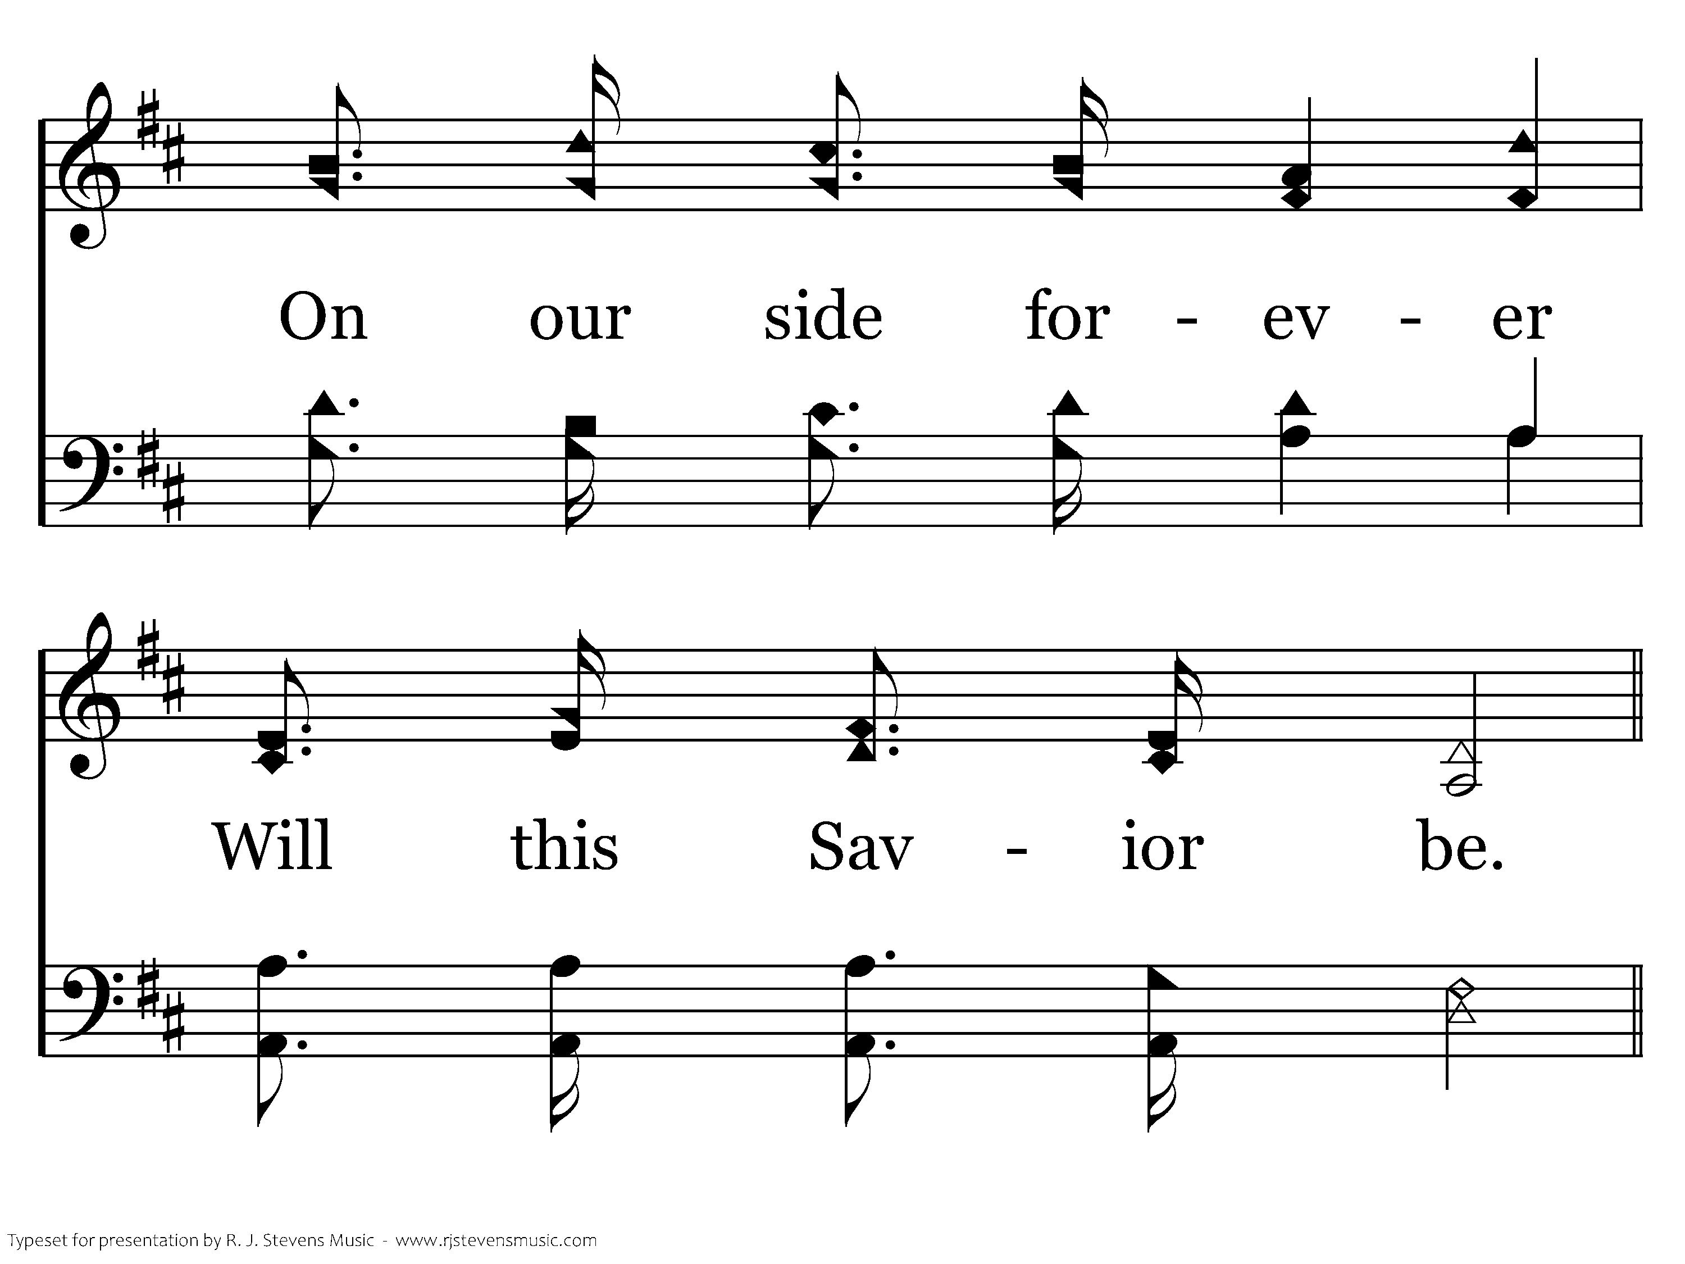
347 - Who Will Follow Jesus - 3.3

Slide 41
347 - Who Will Follow Jesus - C.1

Slide 42
347 - Who Will Follow Jesus - C.2

Slide 43
347 - Who Will Follow Jesus - C.3
End of Song

Slide 44
Lesson 4: Disciples Think & Ask Questions
Studies to Help Disciples Grow Stronger

