Slide 1
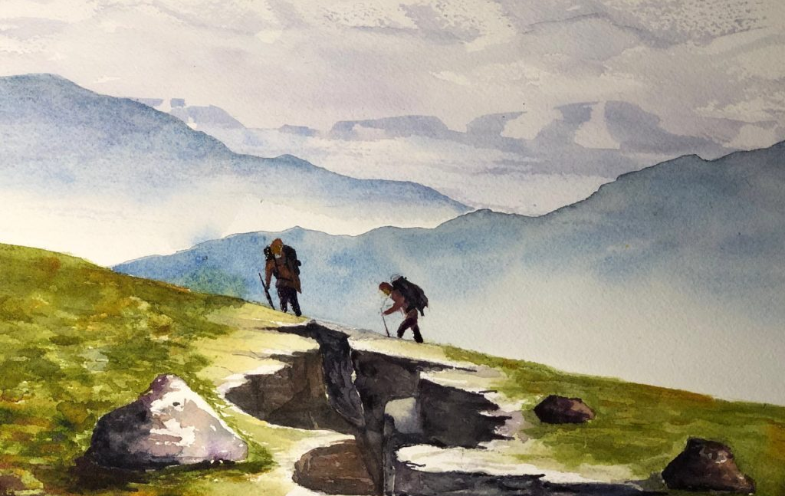
THE BLESSING OF
Walking Together

Slide 2
THE PROBLEM OF
Loneliness

Slide 3
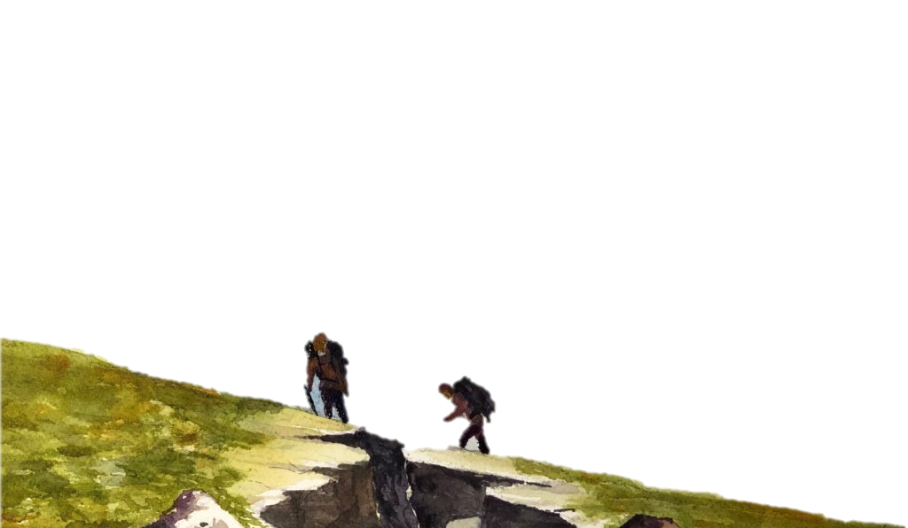
God’s Solution: Two are better than One
The church is God’s Family
1 Timothy 3:14-15, “I am writing these things to you, hoping to come to you before long; 15 but in case I am delayed, I write so that you will know how one ought to conduct himself in the household of God, which is the church of the living God, the pillar and support of the truth.” (NASB)

Slide 4
God’s Solution: Two are better than One
The church is Jesus’ Friends (John 15:13-15)
Luke 18:29-30, “So He said to them, "Assuredly, I say to you, there is no one who has left house or parents or brothers or wife or children, for the sake of the kingdom of God, 30 who shall not receive many times more in this present time, and in the age to come eternal life."

Slide 5
THE POTENTIAL OF
Shared Labors

Slide 6
Encourage One Another
1 Thessalonians 5:11, “Therefore encourage one another and build up one another, just as you also are doing” (NASB)

Slide 7
THE PROTECTION FROM
A Fall

Slide 8
THE PROMISE OF
Warmth

Slide 9
Spread Warmth with Hospitality
1 Peter 4:9, “Be hospitable to one another without grumbling.”
Romans 12:13, “distributing to the needs of the saints, given to hospitality”

Slide 10
Spiritually Cool Hearts Need Assembly
Hebrews 10:24-25, “And let us consider one another in order to stir up love and good works, 25 not forsaking the assembling of ourselves together, as is the manner of some, but exhorting one another, and so much the more as you see the Day approaching.”

Slide 11
THE POWER OF
Unity

Slide 12
United to Withstand the Devil
Escape Temptation
1 Corinthians 10:13, “No temptation has overtaken you except such as is common to man; but God is faithful, who will not allow you to be tempted beyond what you are able, but with the temptation will also make the way of escape, that you may be able to bear it.”

Slide 13
United to Withstand the Devil
Seek the Wandering
James 5:19-20, “Brethren, if anyone among you wanders from the truth, and someone turns him back, 20 let him know that he who turns a sinner from the error of his way will save a soul from death and cover a multitude of sins.”

Slide 14
United to Withstand the Devil
Restore the Trespassing
Galatians 6:1, “Brethren, if a man is overtaken in any trespass, you who are spiritual restore such a one in a spirit of gentleness, considering yourself lest you also be tempted.”

Slide 15
United to Evangelize the Lost
John 13:34-35, “A new commandment I give to you, that you love one another; as I have loved you, that you also love one another. 35 By this all will know that you are My disciples, if you have love for one another."

Slide 16
United to Evangelize the Lost
John 17:20-21, "I do not pray for these alone, but also for those who will believe in Me through their word; 21 that they all may be one, as You, Father, are in Me, and I in You; that they also may be one in Us, that the world may believe that You sent Me.”

Slide 17
THE BLESSING OF
Walking Together

