Slide 2
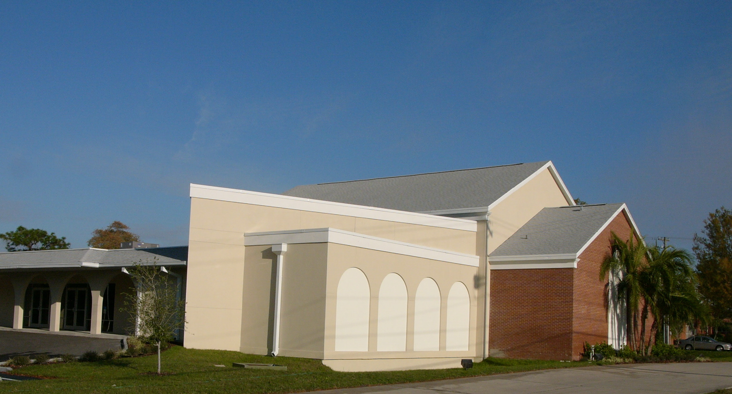
LOVE
HAPPENS
HERE

Slide 3
GOD’S LOVE
HAPPENS
HERE
¹⁸ may be able to comprehend with all the saints what is the breadth and length and height and depth, ¹⁹ and to know the love of Christ which surpasses knowledge, that you may be filled up to all the fullness of God.
Ephesians 3:18–19 (NASB95)

Slide 4
OUR LOVE
HAPPENS
HERE
¹⁸ may be able to comprehend with all the saints what is the breadth and length and height and depth, ¹⁹ and to know the love of Christ which surpasses knowledge, that you may be filled up to all the fullness of God.
Ephesians 3:18–19 (NASB95)

Slide 5
OUR LOVE
HAPPENS
HERE
Our love must be long enough to reach brethren who are like us… and those who aren’t (James 2.1-7; Romans 14)
Our love needs to be long enough to reach the community around us (John 4)

Slide 6
OUR LOVE
HAPPENS
HERE
¹⁸ may be able to comprehend with all the saints what is the breadth and length and height and depth, ¹⁹ and to know the love of Christ which surpasses knowledge, that you may be filled up to all the fullness of God.
Ephesians 3:18–19 (NASB95)

Slide 7
OUR LOVE
HAPPENS
HERE
“We urge you, brethren, admonish the unruly, encourage the fainthearted, help the weak, be patient with everyone.”
1 Thessalonians 5:14 (NASB95)

Slide 8
OUR LOVE
HAPPENS
HERE
¹⁸ may be able to comprehend with all the saints what is the breadth and length and height and depth, ¹⁹ and to know the love of Christ which surpasses knowledge, that you may be filled up to all the fullness of God.
Ephesians 3:18–19 (NASB95)

Slide 9
LOVE
HAPPENS
HERE

