Slide 2
Follow Me

Slide 3
Obeying Like Jesus

Slide 4
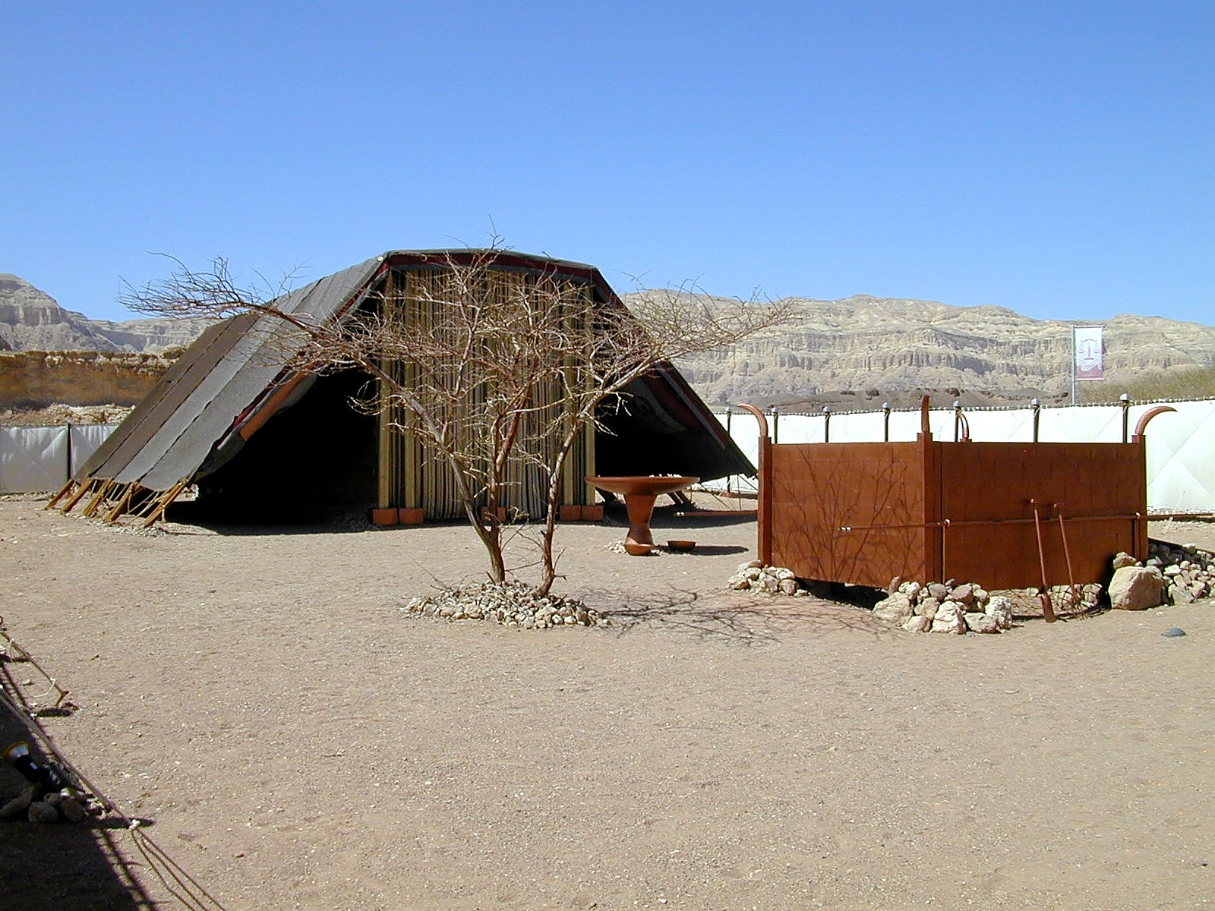
Daily offerings
Weekly offerings
Monthly offerings
Passover offerings
Feast of Unleavened Bread offerings
Day of Firstfruits offerings
Pentecost offerings
Day of Trumpets offerings
Day of Atonement offerings
Feast of Tabernacles offerings
Sin and Trespass offerings as needed

Slide 5
“Has the LORD as much delight in burnt offerings and sacrifices as in obeying the voice of the LORD? Behold, to obey is better than sacrifice, And to heed than the fat of rams.”
(1 Samuel 15.22 NASB)

Slide 6
“For You do not delight in sacrifice, otherwise I would give it; You are not pleased with burnt offering. The sacrifices of God are a broken spirit; A broken and a contrite heart, O God, You will not despise.”
(Psalms 51.16–17 NASB)

Slide 7
“What are your multiplied sacrifices to Me?” Says the LORD. “I have had enough of burnt offerings of rams And the fat of fed cattle; And I take no pleasure in the blood of bulls, lambs or goats...”
(Isaiah 1.11 NASB)

Slide 8
“With what shall I come to the LORD And bow myself before the God on high? Shall I come to Him with burnt offerings, With yearling calves? Does the LORD take delight in thousands of rams, In ten thousand rivers of oil? Shall I present my firstborn for my rebellious acts, The fruit of my body for the sin of my soul?”
(Micah 6.6–7 NASB)

Slide 9
“He has told you, O man, what is good; And what does the LORD require of you But to do justice, to love kindness, And to walk humbly with your God?”
(Micah 6.8 NASB)

Slide 10
“Sacrifice and meal offering You have not desired; My ears You have opened; Burnt offering and sin offering You have not required. Then I said, ‘Behold, I come; In the scroll of the book it is written of me. I delight to do Your will, O my God; Your Law is within my heart.’”
(Psalms 40.6–8 NASB)

Slide 11
Obeying Like Jesus
Obedience is not always pleasant, but always necessary (Hebrews 10.9-10)
Obedience achieves what God intends (Hebrews 10.11-18)
Obedience is the sacrifice that pleases God!

Slide 12
Obeying Like Jesus
“Therefore be imitators of God, as beloved children; and walk in love, just as Christ also loved you and gave Himself up for us, an offering and a sacrifice to God as a fragrant aroma.”
(Ephesians 5.1–2)

Slide 13
Obeying Like Jesus
“Therefore I urge you, brethren, by the mercies of God, to present your bodies a living and holy sacrifice, acceptable to God, which is your spiritual service of worship.”
(Romans 12.1)

