Slide 1
John 11
Jesus raises Lazarus

Slide 2
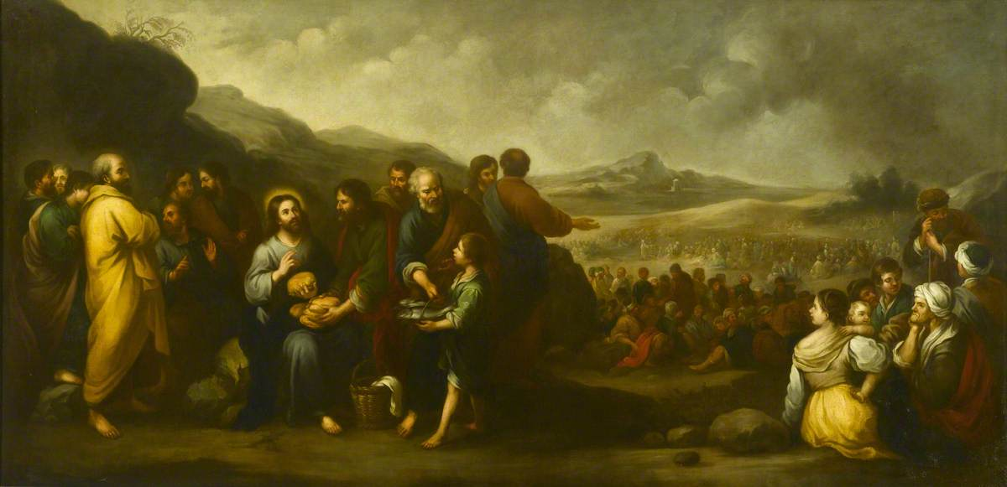
The Seven Signs of John's Gospel (1:19-12)
Water to wine
Healing of an official's son
Healing of the paralytic
Feeding of the 5000
Walking on water
Healing the blind man
Raising of Lazarus

Slide 3
The core of the gospel of john
^{3:16}“For God so loved the world that he gave his only Son, so that everyone who believes in him may not perish but may have eternal life.
¹⁷ “Indeed, God did not send the Son into the world to condemn the world, but in order that the world might be saved through him.
11:45 Many of the Jews therefore, who had come with Mary and had seen what Jesus did, believed in him... ⁵³So from that day on they planned to put him to death.

Slide 4
Lazarus, the one jesus loved
Now a certain man was ill, Lazarus of Bethany, the village of Mary and her sister Martha. ² Mary was the one who anointed the Lord with perfume and wiped his feet with her hair; her brother Lazarus was ill. ³ So the sisters sent a message to Jesus, “Lord, he whom you love is ill.” ⁴ But when Jesus heard it, he said, “This illness does not lead to death; rather it is for God’s glory, so that the Son of God may be glorified through it.” ⁵ Accordingly, though Jesus loved Martha and her sister and Lazarus, ⁶ after having heard that Lazarus was ill, he stayed two days longer in the place where he was.

Slide 5
Going to judea again?
Then after this he said to the disciples, “Let us go to Judea again.” ⁸ The disciples said to him, “Rabbi, the Jews were just now trying to stone you, and are you going there again?” ⁹ Jesus answered, “Are there not twelve hours of daylight? Those who walk during the day do not stumble, because they see the light of this world. ¹⁰ But those who walk at night stumble, because the light is not in them.” ¹¹ After saying this, he told them, “Our friend Lazarus has fallen asleep, but I am going there to awaken him.” ¹² The disciples said to him, “Lord, if he has fallen asleep, he will be all right.” ¹³ Jesus, however, had been speaking about his death, but they thought that he was referring merely to sleep. ¹⁴ Then Jesus told them plainly, “Lazarus is dead. ¹⁵ For your sake I am glad I was not there, so that you may believe. But let us go to him.” ¹⁶ Thomas, who was called the Twin, said to his fellow disciples, “Let us also go, that we may die with him.”

Slide 6
Sleep as metaphor for death
Daniel 12:2 Many of those who sleep in the dust of the earth shall awake, some to everlasting life, and some to shame and everlasting contempt
1 Kings 2:10 Then David slept with his ancestors, and was buried in the city of David.

Slide 7
Going to judea again?
Then after this he said to the disciples, “Let us go to Judea again.” ⁸ The disciples said to him, “Rabbi, the Jews were just now trying to stone you, and are you going there again?” ⁹ Jesus answered, “Are there not twelve hours of daylight? Those who walk during the day do not stumble, because they see the light of this world. ¹⁰ But those who walk at night stumble, because the light is not in them.” ¹¹ After saying this, he told them, “Our friend Lazarus has fallen asleep, but I am going there to awaken him.” ¹² The disciples said to him, “Lord, if he has fallen asleep, he will be all right.” ¹³ Jesus, however, had been speaking about his death, but they thought that he was referring merely to sleep. ¹⁴ Then Jesus told them plainly, “Lazarus is dead. ¹⁵ For your sake I am glad I was not there, so that you may believe. But let us go to him.” ¹⁶ Thomas, who was called the Twin, said to his fellow disciples, “Let us also go, that we may die with him.”

Slide 8
The resurrection and the life
When Jesus arrived, he found that Lazarus had already been in the tomb four days. ¹⁸ Now Bethany was near Jerusalem, some two miles away, ¹⁹ and many of the Jews had come to Martha and Mary to console them about their brother. ²⁰ When Martha heard that Jesus was coming, she went and met him, while Mary stayed at home. ²¹ Martha said to Jesus, “Lord, if you had been here, my brother would not have died. ²² But even now I know that God will give you whatever you ask of him.” ²³ Jesus said to her, “Your brother will rise again.” ²⁴ Martha said to him, “I know that he will rise again in the resurrection on the last day.” ²⁵ Jesus said to her, “I am the resurrection and the life. Those who believe in me, even though they die, will live, ²⁶ and everyone who lives and believes in me will never die. Do you believe this?” ²⁷ She said to him, “Yes, Lord, I believe that you are the Messiah, the Son of God, the one coming into the world.”

Slide 9
Jesus wept
When she had said this, she went back and called her sister Mary, and told her privately, “The Teacher is here and is calling for you.” ²⁹ And when she heard it, she got up quickly and went to him. ³⁰ Now Jesus had not yet come to the village, but was still at the place where Martha had met him. ³¹ The Jews who were with her in the house, consoling her, saw Mary get up quickly and go out. They followed her because they thought that she was going to the tomb to weep there. ³² When Mary came where Jesus was and saw him, she knelt at his feet and said to him, “Lord, if you had been here, my brother would not have died.” ³³ When Jesus saw her weeping, and the Jews who came with her also weeping, he was greatly disturbed in spirit and deeply moved. ³⁴ He said, “Where have you laid him?” They said to him, “Lord, come and see.” ³⁵ Jesus began to weep. ³⁶ So the Jews said, “See how he loved him!” ³⁷ But some of them said, “Could not he who opened the eyes of the blind man have kept this man from dying?”

Slide 10
The miracle
Then Jesus, again greatly disturbed, came to the tomb. It was a cave, and a stone was lying against it. ³⁹ Jesus said, “Take away the stone.” Martha, the sister of the dead man, said to him, “Lord, already there is a stench because he has been dead four days.” ⁴⁰ Jesus said to her, “Did I not tell you that if you believed, you would see the glory of God?” ⁴¹ So they took away the stone. And Jesus looked upward and said, “Father, I thank you for having heard me. ⁴² I knew that you always hear me, but I have said this for the sake of the crowd standing here, so that they may believe that you sent me.” ⁴³ When he had said this, he cried with a loud voice, “Lazarus, come out!” ⁴⁴ The dead man came out, his hands and feet bound with strips of cloth, and his face wrapped in a cloth. Jesus said to them, “Unbind him, and let him go.”

Slide 11
"They planned to put him to death"
Many of the Jews therefore, who had come with Mary and had seen what Jesus did, believed in him. ⁴⁶ But some of them went to the Pharisees and told them what he had done. ⁴⁷ So the chief priests and the Pharisees called a meeting of the council, and said, “What are we to do? This man is performing many signs. ⁴⁸ If we let him go on like this, everyone will believe in him, and the Romans will come and destroy both our holy place and our nation.” ⁴⁹ But one of them, Caiaphas, who was high priest that year, said to them, “You know nothing at all! ⁵⁰ You do not understand that it is better for you to have one man die for the people than to have the whole nation destroyed.” ⁵¹ He did not say this on his own, but being high priest that year he prophesied that Jesus was about to die for the nation, ⁵² and not for the nation only, but to gather into one the dispersed children of God. ⁵³ So from that day on they planned to put him to death.

Slide 12
Mary anoints jesus
Six days before the Passover Jesus came to Bethany, the home of Lazarus, whom he had raised from the dead. ² There they gave a dinner for him. Martha served, and Lazarus was one of those at the table with him. ³ Mary took a pound of costly perfume made of pure nard, anointed Jesus’ feet, and wiped them with her hair. The house was filled with the fragrance of the perfume. ⁴ But Judas Iscariot, one of his disciples (the one who was about to betray him), said, ⁵ “Why was this perfume not sold for three hundred denarii and the money given to the poor?” ⁶ (He said this not because he cared about the poor, but because he was a thief; he kept the common purse and used to steal what was put into it.) ⁷ Jesus said, “Leave her alone. She bought it so that she might keep it for the day of my burial. ⁸ You always have the poor with you, but you do not always have me.”

Slide 13
The plot to kill...lazarus?
When the great crowd of the Jews learned that he was there, they came not only because of Jesus but also to see Lazarus, whom he had raised from the dead. ¹⁰ So the chief priests planned to put Lazarus to death as well, ¹¹ since it was on account of him that many of the Jews were deserting and were believing in Jesus.

