Slide 1
download lessons at
www.builtbyhim.com

Slide 3
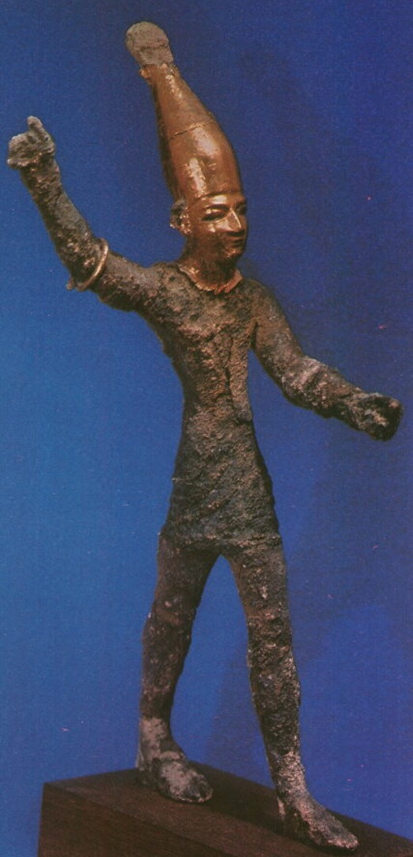

Slide 4
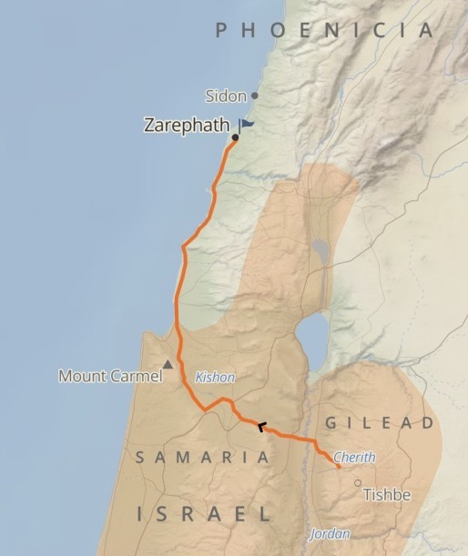

Slide 7
Sample Header

Slide 8
Sample Scripture

