Slide 1
Love does not: Brag
1 Corinthians 13

Slide 2
(p.559 in the pew bible)
1 Corinthians 13:4b NASB95-; love does not brag and is not arrogant
KVJ- charity vaunteth not itself, is not puffed up,
NKVJ- love does not parade itself, is not puffed up;
God’s word- It doesn't sing its own praises. It isn't arrogant.

Slide 3
The positive of “love does not brag”:
Love is modest, quiet, servile
The positive of “love is not arrogant”:
Love is humble, meet, modest, servile
Be love. Be Christ.

Slide 4
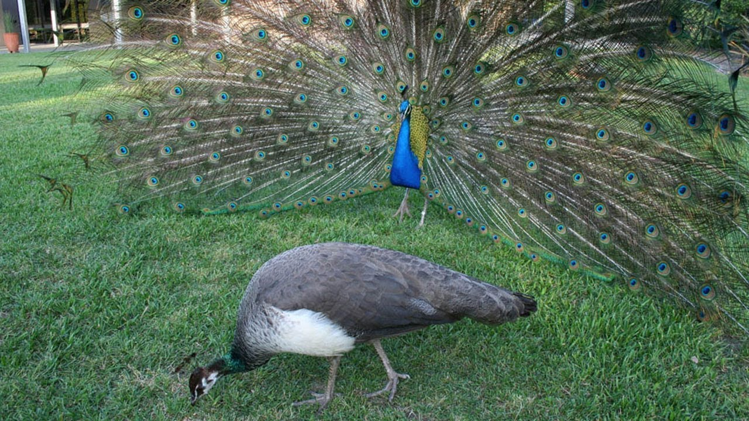
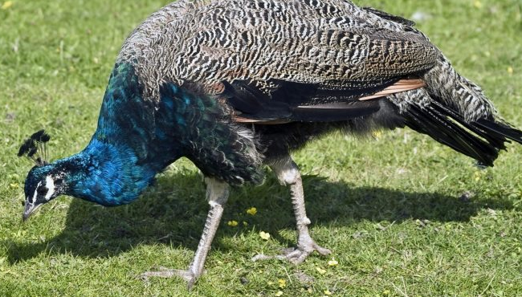

Slide 5
Romans 12:3 NLT (p.552)
Because of the privilege and authority God has given me, I give each of you this warning: Don’t think you are better than you really are. Be honest in your evaluation of yourselves, measuring yourselves by the faith God has given us.

Slide 6
Am I the headline of every conversation I leave?
Do conversations continually revert back to something I did?
In conversation do I leave knowing something about the other person?
Did I hear a thing the other person said?

Slide 7
Philippians 2:3 NLT- Don’t be selfish; don’t try to impress others. Be humble, thinking of others as better than yourselves.
Proverbs 27:2 NASB95- Let another praise you, and not your own mouth; A stranger, and not your own lips.
Proverbs 25:27 NASB95- It is not good to eat much honey, Nor is it glory to search out one’s own glory
Luke 14:11 NASB95- For everyone who exalts himself will be humbled, and he who humbles himself will be exalted.”

Slide 8
LOVE DOES NOT BRAG! LOVE DOES!

Slide 9
Love is not in competition
1 Corinthians 4:6-7 NASB95- Now these things, brethren, I have figuratively applied to myself and Apollos for your sakes, so that in us you may learn not to exceed what is written, so that no one of you will become arrogant in behalf of one against the other. [7] For who regards you as superior? What do you have that you did not receive? And if you did receive it, why do you boast as if you had not received it?

Slide 10
Love is not careless
1 Corinthians 4:18-21 NASB95- Now some have become arrogant, as though I were not coming to you. [19] But I will come to you soon, if the Lord wills, and I shall find out, not the words of those who are arrogant but their power. [20] For the kingdom of God does not consist in words but in power. [21] What do you desire? Shall I come to you with a rod, or with love and a spirit of gentleness?

Slide 11
Love is not apathetic
1 Corinthians 5:2 NASB95- You have become arrogant and have not mourned instead, so that the one who had done this deed would be removed from your midst.

Slide 12
Love is not hypocritical
1 Corinthians 8:1 NASB95- Now concerning things sacrificed to idols, we know that we all have knowledge. Knowledge makes arrogant, but love edifies.

Slide 13
Love is not conceited
Colossians 2:18 NASB95- Let no one keep defrauding you of your prize by delighting in self-abasement and the worship of the angels, taking his stand on visions he has seen, inflated without cause by his fleshly mind

Slide 14
Dangers of Bragging and Arrogance
Discourages Unity (Romans 12:3-6)
Discourages Development (1 Corinthians 12:14-26)
Discourages Praise (Philippians 2:29)

Slide 15
Love is: Kind
Don’t be less arrogant, be love.

Slide 16
Love does not: Brag
1 Corinthians 13

