Slide 1
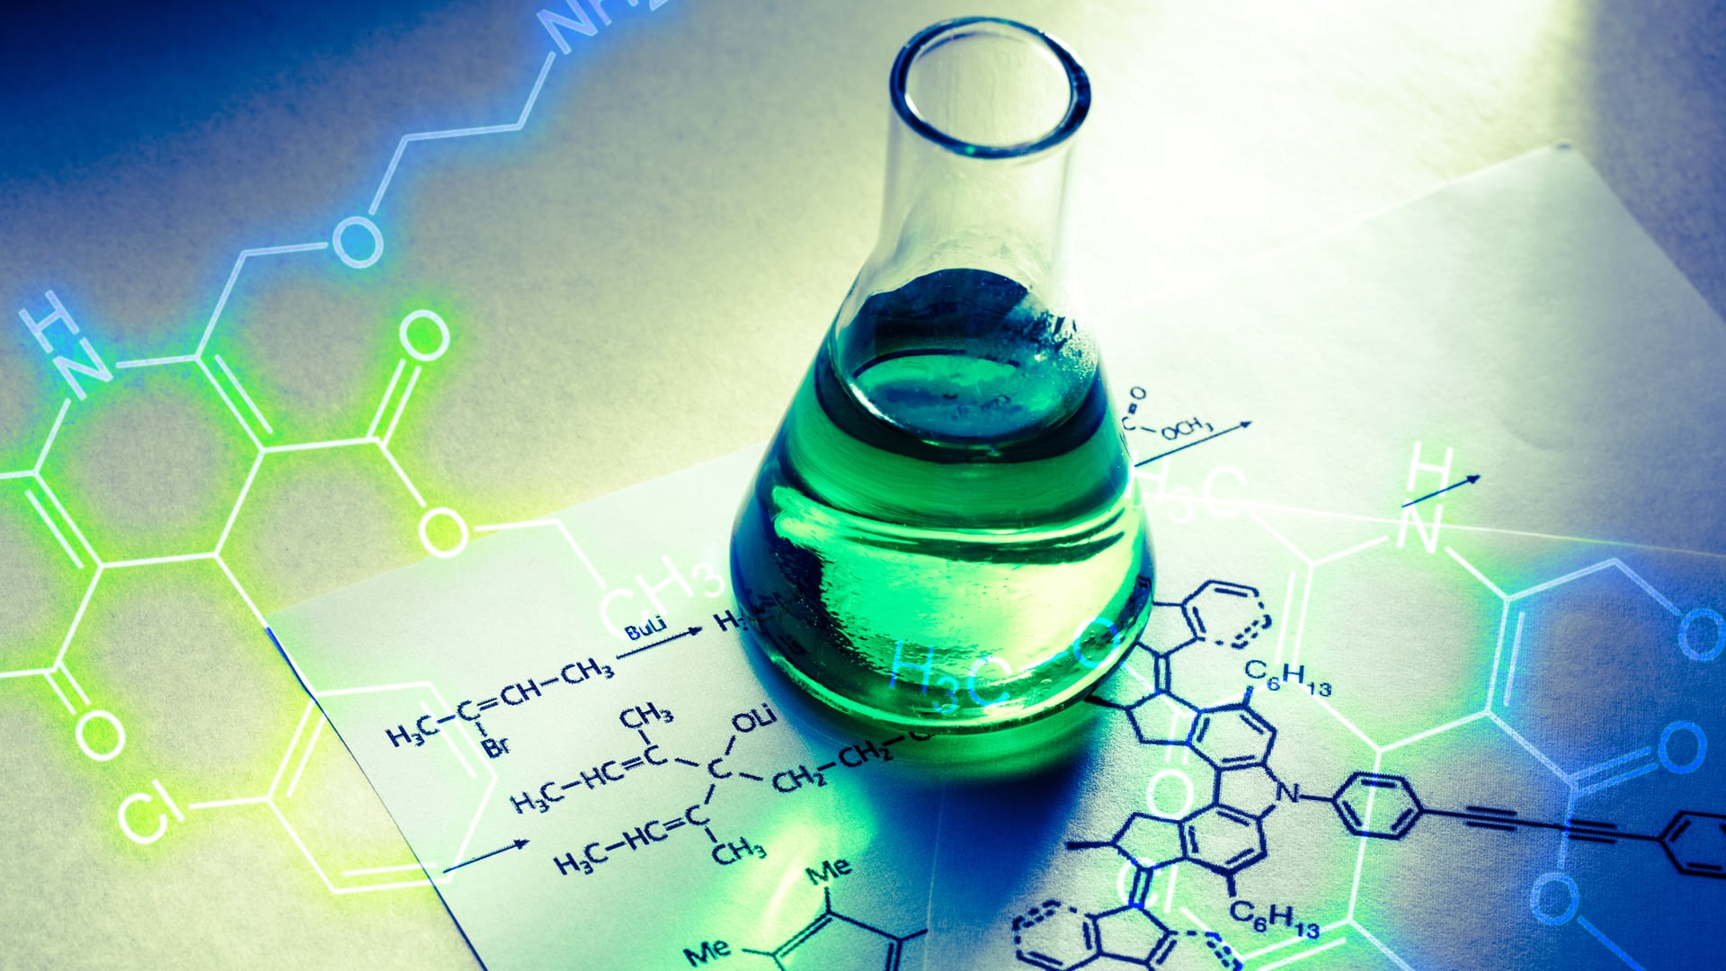
The Great Designer
Evidence from
the Chemistry of Living Things

Slide 2
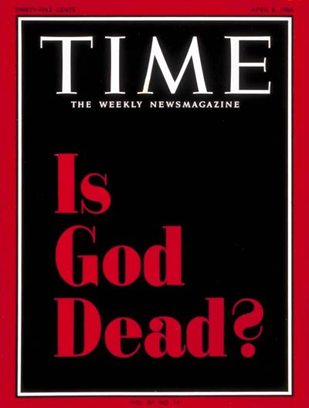
April 8, 1966
A.W. Dicus wrote
“Our God, He Is Alive”
in 1966

Slide 3
Thomas J.J. Altizer & William Hamilton
Radical Theology and the Death of God
“We must realize that the death of God is an historical event, that God has died in our cosmos, in our history…”
April 8, 1966

Slide 4
Thomas J.J. Altizer & William Hamilton
Radical Theology and the Death of God
“…the dead God is … the God of the historic Christian Church, and beyond the Church, of Christendom at large.”
April 8, 1966

Slide 5
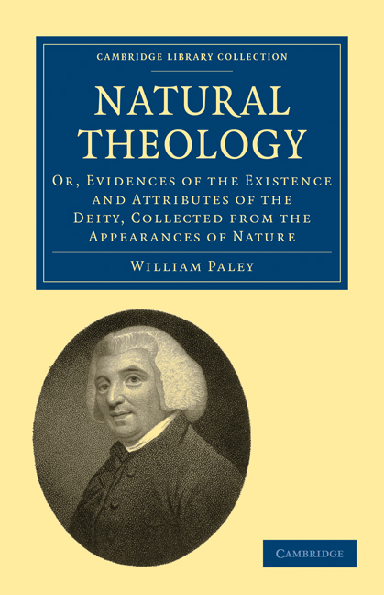
First published
in 1802

Slide 6
The Scriptures also teach that the study of nature can lead to belief in God
Rom. 1:20 - His invisible attributes … understood by the things that are made
  His Eternal Power
  His Divine Nature (Godhead)
Argument from Design

Slide 7
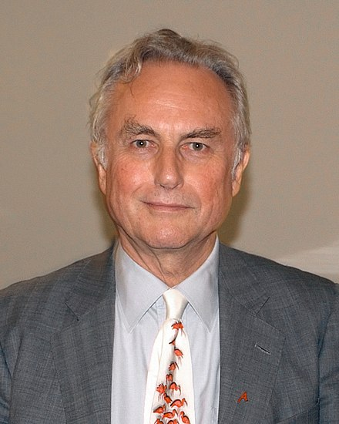
Richard Dawkins
The Blind Watchmaker
1986
Charles Darwin
1809-1882
“All appearances to the contrary, the only watchmaker in nature is the blind forces of physics, albeit deployed in a very special way … Natural selection, the blind, unconscious, automatic process which Darwin discovered, … has no purpose in mind …
it is the blind watchmaker.” (pg. 5)

Slide 8
The Great Designer
Evidence from
the Chemistry of Living Things

Slide 9
Critical Components of Life
Dr. Francis Crick in Life Itself (1981)
Components
Assembled
Organic Compounds
Function
Structural Materials
Proteins
(assembled from amino acids)
Construction
(shape and mobility)
Tools and Machinery
Enzymes
(special forms of proteins)
Metabolism
(growth and maintenance)
Blueprints
Genes - Nucleic Acid
(DNA and RNA)
Reproduction
(information and directive function)
Notes:
28

Slide 10
The Twenty Common Amino Acids Occurring in Proteins
Glycine (Gly)
Alanine (Ala)
Valine (Val)
Leucine (Leu)
Isoleucine (Ileu)
NH₃
NH₃
CH₃
NH₃
CH₃
NH₃
CH₃
NH₃
-
⁺
-
⁺
-
-
⁺
-
-
⁺
-
-
⁺
H-CH-COO⁻
CH₃-CH-COO⁻
CH₃ CH - CH-COO⁻
CH₃CH CH₂-CH-COO⁻
CH₃CH₂CH - CH-COO⁻
Proline (Pro)
Serine (Ser)
Threonine (Thr)
Aspartic acid
(Asp)
Asparagine
(Asp N)
CH₂
OH
NH₃
OH
NH₃
COOH
NH₃
CO NH₂
NH₃
NH₂
⁺
⁺
⁺
⁺
CH₂
-
⁺
-
-
-
-
-
-
-
-
CH-COO⁻
CH₂-CH-COO⁻
CH₃ CH - CH-COO⁻
CH₂ - CH - COO⁻
CH₂ - CH - COO⁻
CH₂
Glutamic acid
(Glu)
Glutamine (Glu N)
Lysine (Lys)
Arginine (Arg)
Cysteine (CySH)
COOH
NH₃
CO NH₂
NH₃
NH₂
NH₃
NH₂
NH₃
SH
NH₃
-
-
⁺
-
-
⁺
-
-
⁺
-
-
⁺
-
-
⁺
CH₂
CH₂-CH-COO⁻
CH₂
CH₂-CH-COO⁻
CH₂CH₂CH₂
CH₂-CH-COO⁻
CNH CH₂CH₂
CH₂-CH-COO⁻
CH₂-CH-COO⁻
-
-
NH
Methionine (Met)
Phenylalanine
(Phe)
Tyrosine (Tyr)
Tryptophan
(Try)
Histidine (His)
NH₃
S-CH₃
NH₃
NH₃
NH₃
⁺
N
CH
NH₃
⁺
⁺
⁺
-
-
-
⁺
-
-
-
-
-
-
C-
-
CH₂-CH-COO⁻
C
C-
-
H
CH₂-CH-COO⁻
CH₂
CH₂-CH-COO⁻
CH₂-CH-COO⁻
HO
CH₂-CH-COO⁻
-
CH
N
N
-
-
H
H
Notes:
31

Slide 11
The Twenty Common Amino Acids Occurring in Proteins
Glycine (Gly)
Alanine (Ala)
Valine (Val)
Leucine (Leu)
Isoleucine (Ileu)
NH₃
NH₃
CH₃
NH₃
CH₃
NH₃
CH₃
NH₃
-
⁺
-
⁺
-
-
⁺
-
-
⁺
-
-
⁺
H-CH-COO⁻
CH₃-CH-COO⁻
CH₃ CH - CH-COO⁻
CH₃CH CH₂-CH-COO⁻
CH₃CH₂CH - CH-COO⁻
Proline (Pro)
Serine (Ser)
Threonine (Thr)
Aspartic acid (Asp)
Asparagine (Asp N)
CH₂
Every protein is a
combination of these 20.
OH
NH₃
OH
NH₃
COOH
NH₃
CO NH₂
NH₃
NH₂
⁺
⁺
⁺
⁺
CH₂
-
⁺
-
-
-
-
-
-
-
-
CH-COO⁻
CH₂-CH-COO⁻
CH₃ CH - CH-COO⁻
CH₂ - CH - COO⁻
CH₂ - CH - COO⁻
CH₂
Glutamic acid (Glu)
Glutamine (Glu N)
Lysine (Lys)
Arginine (Arg)
Cysteine (CySH)
COOH
NH₃
CO NH₂
NH₃
NH₂
NH₃
NH₂
NH₃
SH
NH₃
-
-
⁺
-
-
⁺
-
-
⁺
-
-
⁺
-
-
⁺
CH₂
CH₂-CH-COO⁻
CH₂
CH₂-CH-COO⁻
CH₂CH₂CH₂
CH₂-CH-COO⁻
CNH CH₂CH₂
CH₂-CH-COO⁻
CH₂-CH-COO⁻
-
-
NH
Methionine (Met)
Phenylalanine (Phe)
Tyrosine (Tyr)
Tryptophan (Try)
Histidine (His)
NH₃
S-CH₃
NH₃
NH₃
NH₃
⁺
N
CH
NH₃
⁺
⁺
⁺
-
-
-
⁺
-
-
-
-
-
-
C-
-
CH₂-CH-COO⁻
C
C-
-
H
CH₂-CH-COO⁻
CH₂
CH₂-CH-COO⁻
CH₂-CH-COO⁻
HO
CH₂-CH-COO⁻
-
CH
N
N
-
-
H
H
Notes:
32

Slide 12
The Twenty Common Amino Acids Occurring in Proteins
Glycine (Gly)
Alanine (Ala)
Valine (Val)
Leucine (Leu)
Isoleucine (Ileu)
NH₃
NH₃
CH₃
NH₃
CH₃
NH₃
CH₃
NH₃
-
⁺
-
⁺
-
-
⁺
-
-
⁺
-
-
⁺
H-CH-COO⁻
CH₃-CH-COO⁻
CH₃ CH - CH-COO⁻
CH₃CH CH₂-CH-COO⁻
CH₃CH₂CH - CH-COO⁻
Proline (Pro)
Serine (Ser)
Threonine (Thr)
Aspartic acid (Asp)
Asparagine (Asp N)
CH₂
OH
NH₃
OH
NH₃
COOH
NH₃
CO NH₂
NH₃
⁺
⁺
⁺
⁺
NH₂
Like the 26 letters of the alphabet which make up our words
CH₂
-
⁺
-
-
-
-
-
-
-
-
CH-COO⁻
CH₂-CH-COO⁻
CH₃ CH - CH-COO⁻
CH₂ - CH - COO⁻
CH₂ - CH - COO⁻
CH₂
Glutamic acid (Glu)
Glutamine (Glu N)
Lysine (Lys)
Arginine (Arg)
Cysteine (CySH)
COOH
NH₃
CO NH₂
NH₃
NH₂
NH₃
NH₂
NH₃
SH
NH₃
-
-
⁺
-
-
⁺
-
-
⁺
-
-
⁺
-
-
⁺
CH₂
CH₂-CH-COO⁻
CH₂
CH₂-CH-COO⁻
CH₂CH₂CH₂
CH₂-CH-COO⁻
CNH CH₂CH₂
CH₂-CH-COO⁻
CH₂-CH-COO⁻
-
-
NH
Methionine (Met)
Phenylalanine (Phe)
Tyrosine (Tyr)
Tryptophan (Try)
Histidine (His)
NH₃
S-CH₃
NH₃
NH₃
NH₃
⁺
N
CH
NH₃
⁺
⁺
⁺
-
-
-
⁺
-
-
-
-
-
-
C-
-
CH₂-CH-COO⁻
C
C-
-
H
CH₂-CH-COO⁻
CH₂
CH₂-CH-COO⁻
CH₂-CH-COO⁻
HO
CH₂-CH-COO⁻
-
CH
N
N
-
-
H
H
Notes:
33

Slide 13
Dumb Blondes of the Biochemical World
Dr. Francis Crick in Life Itself (1981)
DNA
RNA
Notes:
29

Slide 14
DNA
Double helix with cross bars
Capacity to reproduce itself
Contains a language!
Notes:
46

Slide 15
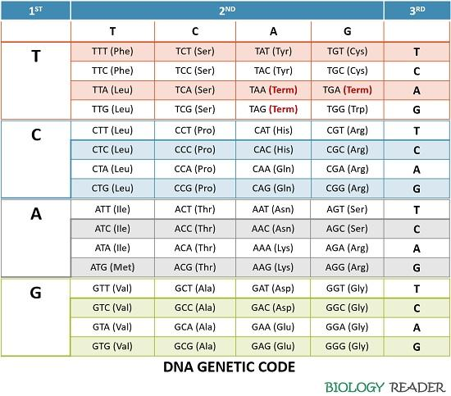
Genetic Code
T=Thymine
C=Cytosine
A=Adenine
G=Guanine

Slide 16
Genetic Code
All 20 Amino Acids are Coded Here
T=Thymine
C=Cytosine
A=Adenine
G=Guanine
Notes:
49

Slide 17
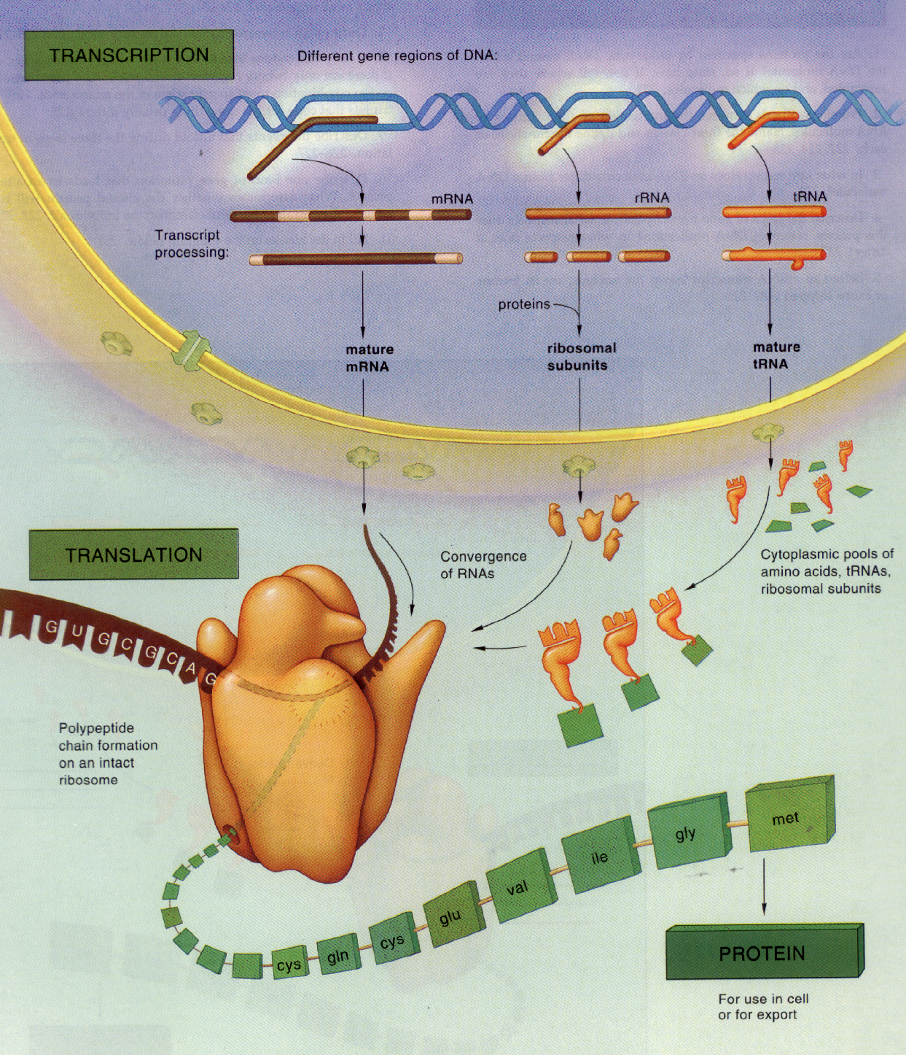
Transcription,
Migration,
& Translation for Protein Building

Slide 18

Video clip from
Signatureinthecell.com

Slide 19
The chemistry of building proteins in every living cell is sufficient to proclaim there must be a
Great Designer!

Slide 20
The chemistry of building proteins in every living cell is sufficient to proclaim there must be a
Great Designer!
But, we have learned so much more about the chemistry of living things in the last fifty years.
Consider just the single cell!!

Slide 21
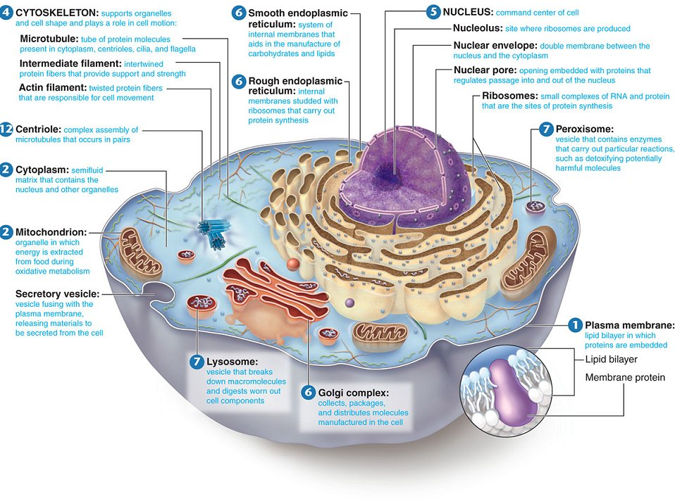
The Cell:
A self-replicating nanoscale robot

Slide 22
The Cell:
A self-replicating nanoscale robot
Self-replicating because it can and does reproduce itself.
Nanoscale because cells are quite small and can manipulate single molecules.
Robot because its activities are carried out unconsciously and automatically by precision molecular machines that follow ordinary physical laws.

Slide 23
Molecular Machine
A natural device on the molecular scale (with few exceptions made of proteins) able to convert chemical energy to produce linear or rotary motion, as well as controlling many biological functions.

Slide 24
Biological Molecular Machines
Examples
Myosin – contraction of muscles
Kinesin – cargo movement
Dynein – beating of cilia & flagella
Motile cilia – motion of many micro-organisms

Slide 25
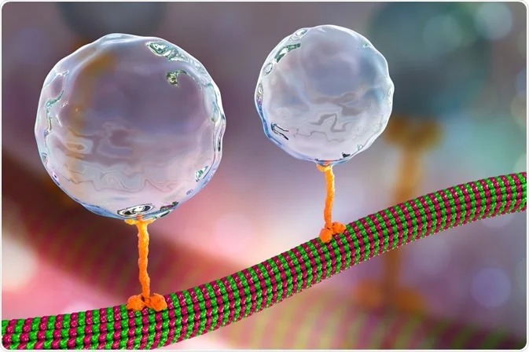
Kinesin Walker Along a Microtubule

Slide 26
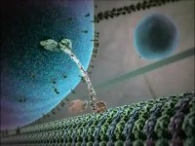
Kinesin Walker Along a Microtubule

Slide 27
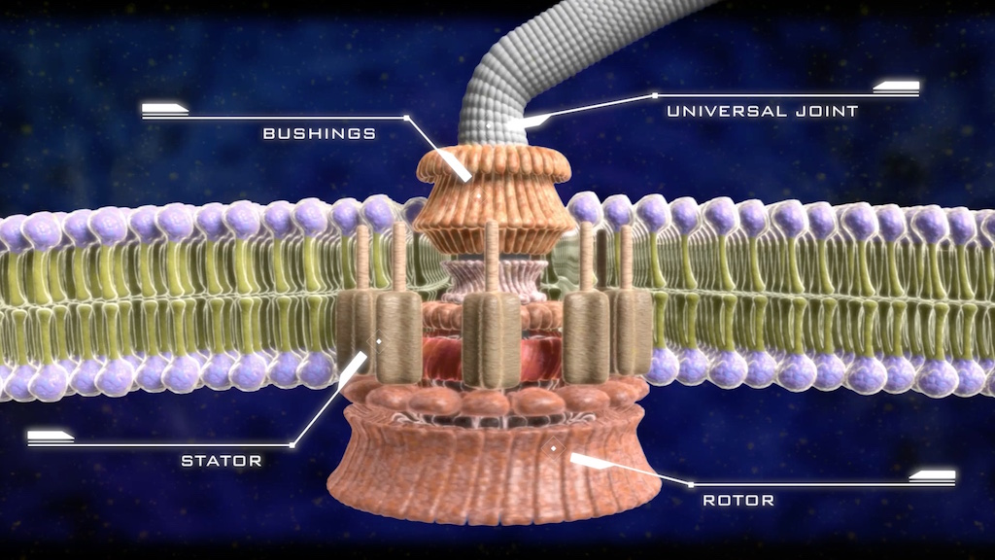
Bacterial Flagellum Motor

Slide 28
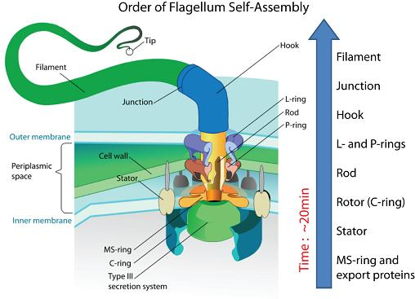
Bacterial Flagellum Motor

Slide 29
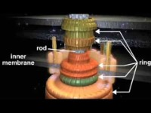
Bacterial Flaggellum Motor

Slide 30
Biological Molecular Machines
Multiple-Protein Processes
Each Protein is Complex and Suited for its function.
Each machine is highly sophisticated, intricate, dynamic and elegant.
These machines are spontaneously self-assembled in the cell
1000’s of them in every living cell!

Slide 31
  Antony Flew
  Professor of Philosophy, Atheist, Author & Debater

Slide 32
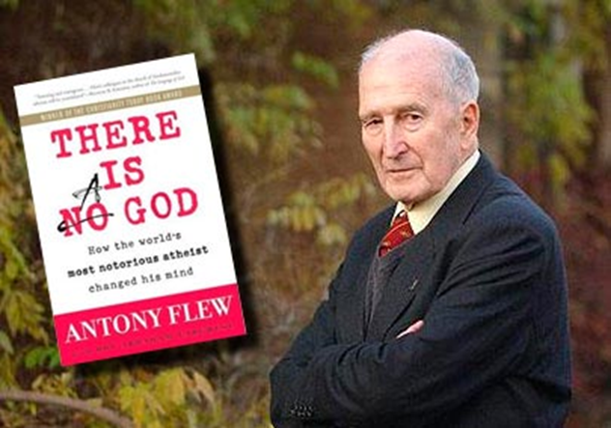
  Antony Flew
  Professor of Philosophy, Atheist, Author & Debater
How the World’s Most Notorious Atheist Changed His Mind - 2007

Slide 33
  Antony Flew
  Professor of Philosophy, atheist, author and debater at 80 years old
  “It has become inordinately difficult even to begin to think about constructing a naturalistic theory of the evolution of that first reproducing organism … The enormous complexity by which the results were achieved looks to me like the work of intelligence …It now seems to me that the findings of more than fifty years of DNA research have provided materials for a new and enormously powerful argument to design.”
  “My Pilgrimage from Atheism to Theism: An exclusive interview with Former British Atheist Professor Antony Flew,” An Interview with Craig Hazen, Gary Habermas & Antony Flew, 2004

Slide 34
Is It Reasonable to Believe in God the Great Designer in this Scientific Age?
  It is more reasonable than ever!!!

