Slide 3
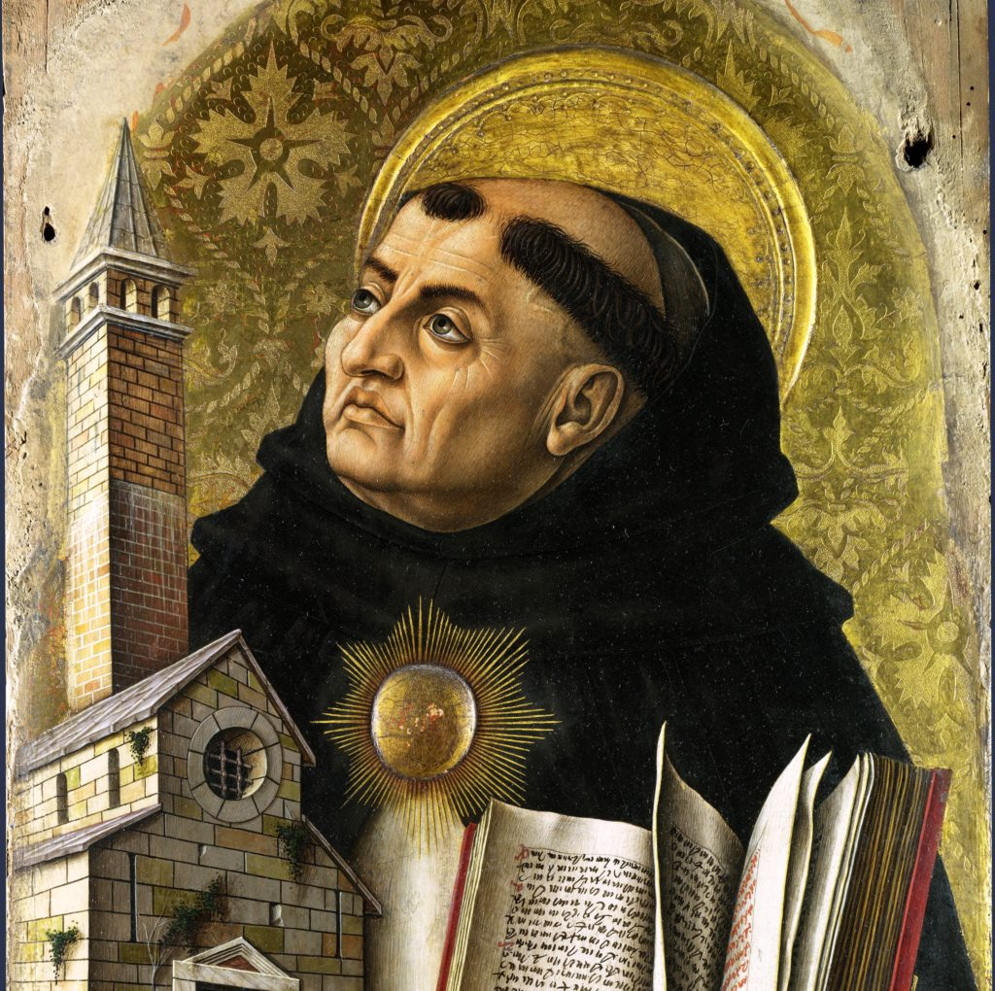
May I not rejoice in anything
unless it leads me to You;
may I not be saddened by anything
unless it turns me from You.
May I desire to please no one,
nor fear to displease anyone, but You.
May all transitory things, O Lord,
be worthless to me
and may all things eternal
be ever cherished by me.
May any joy without You
be burdensome for me
and may I not desire anything else
besides You.

Slide 4
Can Man Worship as He Pleases?

Slide 5
Vain worship (Mtt 15.7-9)
Ignorant worship (Acts 17.22-23)
Self-made worship (Col 2.20-23)
Acceptable worship (Heb 12.28-29)

Slide 6
28 Therefore let us be grateful for receiving a kingdom that cannot be shaken, and thus let us offer to God acceptable worship, with reverence and awe, 29 for our God is a consuming fire.
Hebrews 12.28-29 (ESV)

Slide 7
What is acceptable worship?

Slide 8
Worship in the New Testament

Slide 9
In light of passages like Luke 24.1 and Acts 2.1, why do you think the first day of the week came to carry great significance for the earliest disciples of Jesus?

Slide 10
The First Day of the Week:
Women came to the empty tomb. (Lk 24.1)
Many gathered together for Pentecost. (Acts 2.1)
Gathered together to break bread and listen to Paul. (Acts 20.7)
Collection for the saints. (1 Cor 16.1-2)

Slide 11
Assemblies of Christians:
Assembled in the name of the Lord. (1 Cor 5.4)
When you come together. (1 Cor 11.17)
The whole church comes together. (1 Cor 14.23)
Not neglecting to meet together. (Heb 10.24-25)

Slide 12
God is to be glorified.
Disciples are to be built up.
Offer up a sacrifice of praise to God. (Heb 13.15)
Let all things be done for building up. (1 Cor 14.26)

Slide 13
How are these ideals accomplished?
Prayer (Acts 2.42)
Singing (Eph 5.18-21; Col 3.16-17)
Preaching (Acts 2.42; 2 Tim 3.16-17; 4.1-2)
The observance of the Lord’s Supper (1 Cor 11.17-34)

Slide 14
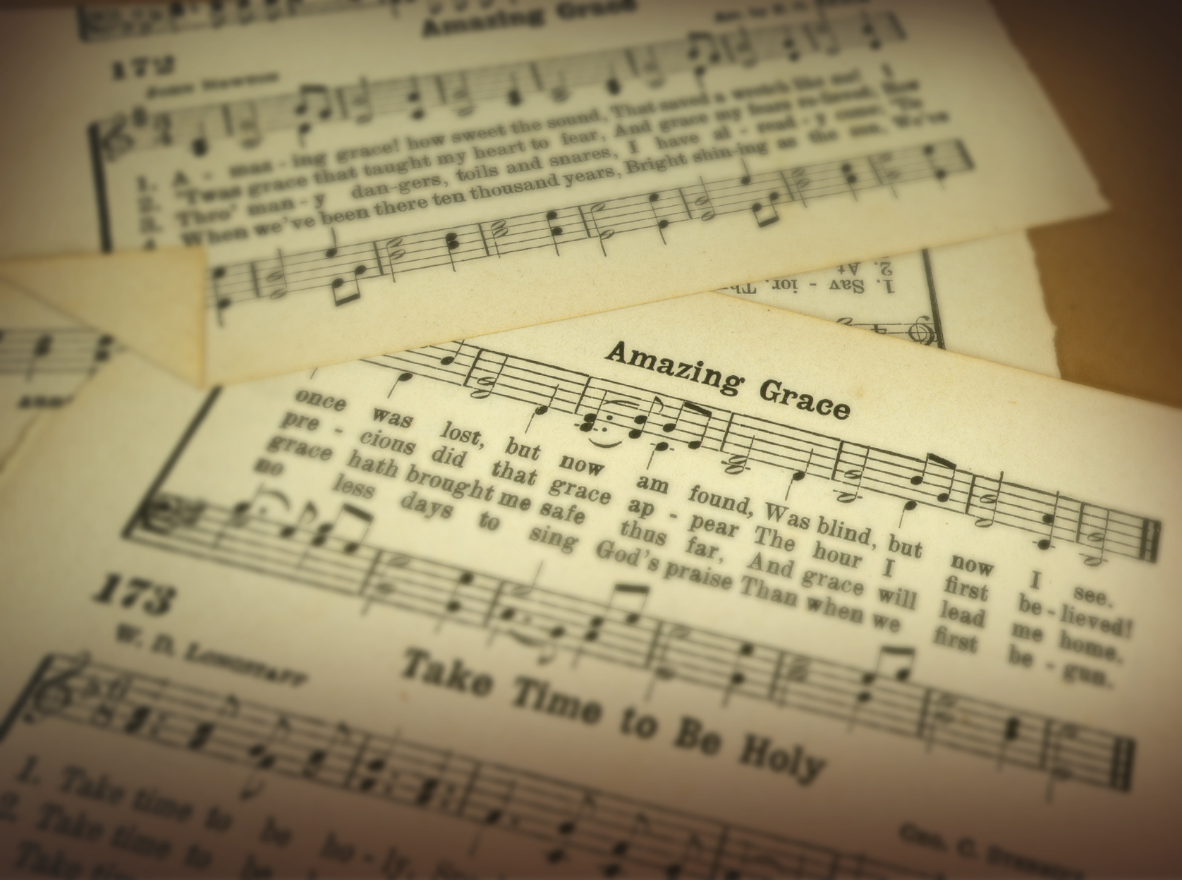

Slide 15
First, is the authority for church music general or specific?
And, secondly, if this authority is specific, did God specify vocal music or did He specify instrumental music?

Slide 16
The NT on Music
Mtt 26.30 — “When they had sung a hymn, they went out to the Mount of Olives.”
Acts 16.25 — “About midnight Paul and Silas were praying and singing hymns to God, and the other prisoners were listening to them.”
Rom 15.9 — “so that the Gentiles may glorify God for his mercy, as it is written: ‘Therefore I will praise you among the Gentiles; I will sing hymns to your name’.”
1 Cor 14.15 — “So what shall I do? I will pray with my spirit, but I will also pray with my mind; I will sing with my spirit, but I will also sing with my mind.”
Eph 5.19 — “Speak to one another with psalms, hymns and spiritual songs. Sing and make music in your heart to the Lord,”
Col 3.16 — “Let the word of Christ dwell in you richly as you teach and admonish one another with all wisdom, and as you sing psalms, hymns and spiritual songs with gratitude in your hearts to God.”
Heb 2.12 — “He says, ‘I will declare your name to my brothers; in the presence of the congregation I will sing your praises’.”

Slide 17
Why does the NT contrast so powerfully to the OT regarding instrumental music?
If God still wants it today, why does He not clearly mention it in the NT, as He mentioned it in the OT?
He mentions instruments in the NT, but never for our praise to God. Why not?

Slide 18
Outside of divine revelation, we have no basis for faith or religious action.
If we are discontent with Bible-directed worship, we can certainly introduce our own preferences as creatures of free choice.
But we’d best not expect our actions to have the approval of heaven.
If our aim is “acceptable worship,” we must submit ourselves to the authority of our heavenly King.

