Slide 3
The Power of a
Godly Parent

Slide 4
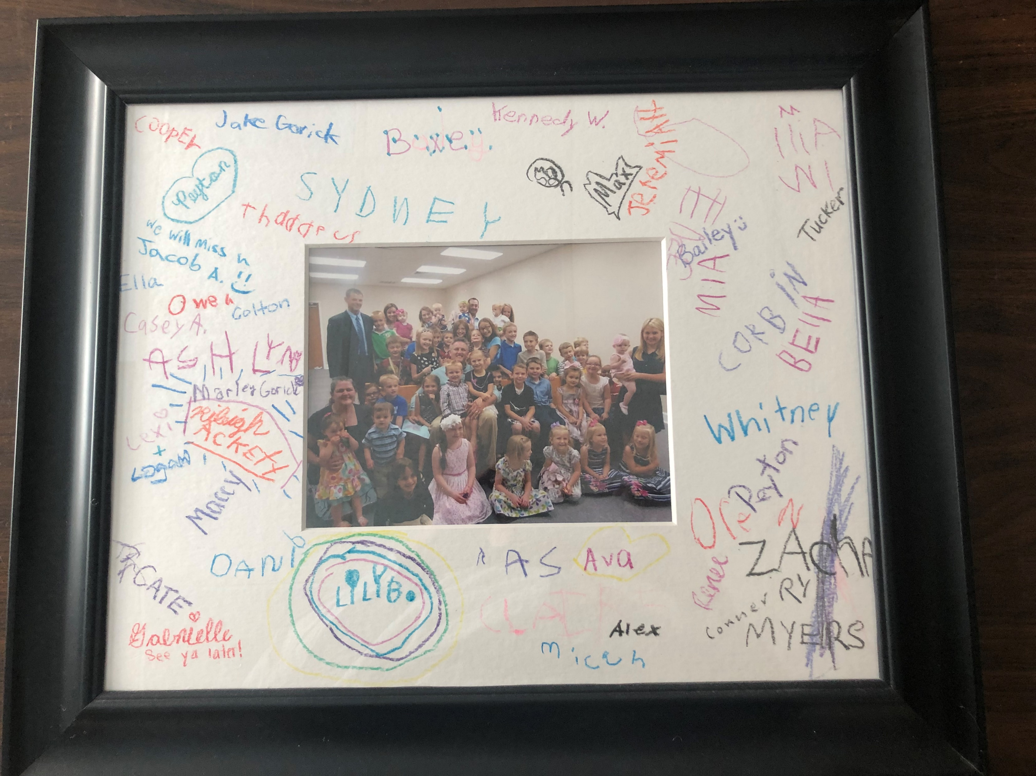

Slide 5
Unless the Lord builds the house, they labor in vain who build it.
Psalm 127:1

Slide 6
Show your kids what loving God looks like.
Deuteronomy 6

Slide 7
2. Teach your your kids about God daily.
Deuteronomy 6

Slide 8
3. Give them good, solid, biblical answers.
Genesis-Revelation

Slide 9
4. Teach them about God’s righteous order.
Genesis 1:26-27

Slide 10
Teach them the conclusion....
Ecclesiastes

