Slide 1
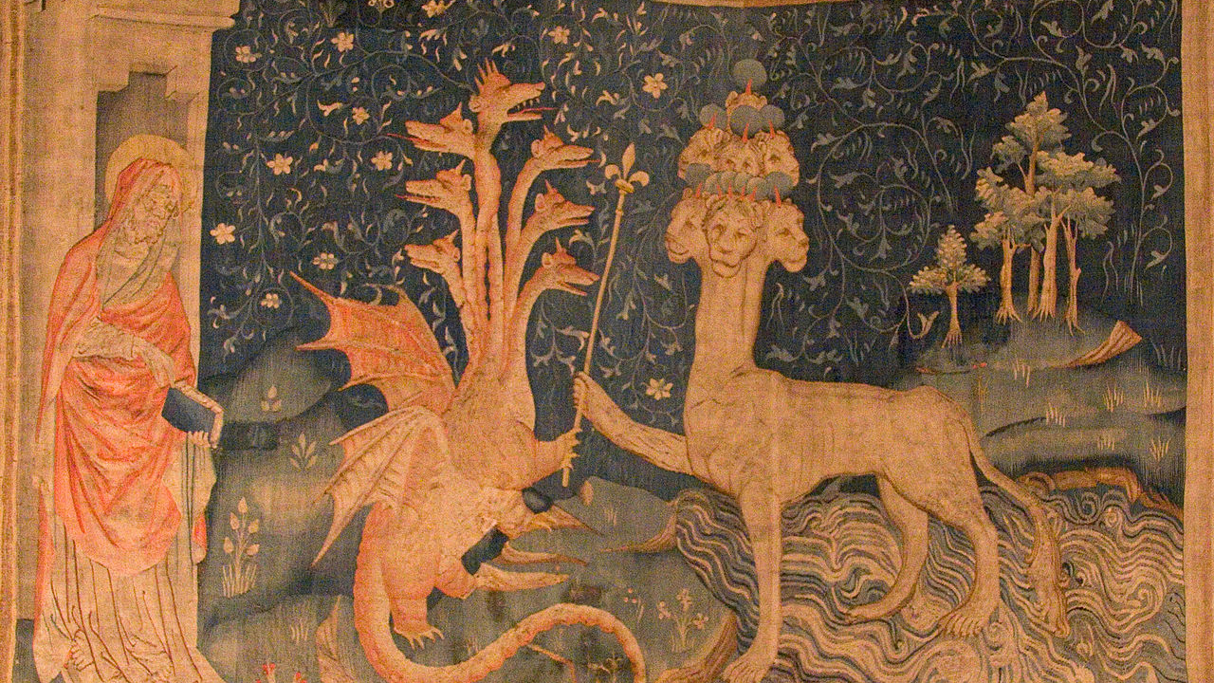
Revelation 13
Subtitle
Notes:
NOTE: Want a different image on this slide? Select the picture and delete it. Now click the Pictures icon in the placeholder to insert your own image.

Slide 2
Satan's expulsion from heaven?
Isaiah 14:12 How you are fallen from heaven, O Day Star, son of Dawn! How you are cut down to the ground, you who laid the nations low!
Luke 10:17 The seventy returned with joy, saying, ‘Lord, in your name even the demons submit to us!’ ¹⁸ He said to them, ‘I watched Satan fall from heaven like a flash of lightning. ¹⁹ See, I have given you authority to tread on snakes and scorpions, and over all the power of the enemy; and nothing will hurt you. ²⁰ Nevertheless, do not rejoice at this, that the spirits submit to you, but rejoice that your names are written in heaven.’

Slide 3
The accuser is thrown down
Revelation 12:10 Then I heard a loud voice in heaven proclaiming,“Now have come the salvation and the power and the kingdom of our God and the authority of his Messiah,
for the accuser of our brothers and sisters has been thrown down, who accuses them day and night before our God.11 But they have conquered him by the blood of the Lamb and by the word of their testimony, for they loved not their lives unto the death. 12 Rejoice then, you heavens and those who dwell in them! But woe to the earth and the sea, for the devil has come down to you with great wrath because he knows that his time is short!”

Slide 4
Not everyone kept the faith
"Those who denied that they were or had been Christians, when they invoked the gods in words dictated by me, offered prayer with incense and wine to your image, which I had ordered to be brought for this purpose together with statues of the gods, and also cursed Christ – none of which those who are really Christians can, it is said, be forced to do — these I thought should be discharged. Others named by the informer declared that they were Christians, but then denied it, asserting that they had been but had ceased to be, some three years before, others many years, some as much as twenty-five years," Pliny, Letter to Trajan, circa 112.

Slide 5
The Two Beasts of Revelation 13
Reminiscent of Leviathan and Behemoth
God assigns Leviathan to the sea (Psalm 104:25-26) and Behemoth to land (Job 40:15-24)
Some Jewish sources argue for their symbolic eschatological role

Slide 6
The Two Beasts of Revelation 13
"Then you kept in existence two living creatures; the name of one you called Behemoth and the name of the other Leviathan.[50] You separated one from the other, for the seventh part where the water had been gathered together could not hold them both. [51] You assigned Behemoth to one of the parts which had been dried up on the third day, to live in it, where there are a thousand mountains; [52] but to Leviathan you assigned the seventh part, the watery part; and you have kept them to be eaten by those you choose, and at the time of your choosing," 4 Ezra 6.49-52.

Slide 7
The Sea Beast
Revelation 13:1 And I saw a beast rising out of the sea, having ten horns and seven heads; and on its horns were ten diadems, and on its heads were blasphemous names. ² And the beast that I saw was like a leopard, its feet were like a bear’s, and its mouth was like a lion’s mouth. And the dragon gave it his power and his throne and great authority. ³ One of its heads seemed to have received a death-blow, but its mortal wound had been healed. In amazement the whole earth followed the beast. ⁴ They worshipped the dragon, for he had given his authority to the beast, and they worshipped the beast, saying, ‘Who is like the beast, and who can fight against it?’

Slide 8
Blasphemous names
“Of Nero Caesar the Lord (kurios)” (P.Oxy. II, 246).

Slide 9
Blasphemous names
"It seemed good for the Greeks of Asia...to declare, 'Since Providence which has ordered all things and is deeply interested in our life, has set in most perfect order giving us Augustus...sending him as savior, both for us and for our descendants...and since he, Caesar, by his appearance...and since the birthday of the god Augustus was the beginning of the good news for the world the came by reason of him,' which Asia resolved in Smyrna," OGIS 458.

Slide 10
The Sea Beast
Revelation 13:1 And I saw a beast rising out of the sea, having ten horns and seven heads; and on its horns were ten diadems, and on its heads were blasphemous names. ² And the beast that I saw was like a leopard, its feet were like a bear’s, and its mouth was like a lion’s mouth. And the dragon gave it his power and his throne and great authority. ³ One of its heads seemed to have received a death-blow, but its mortal wound had been healed. In amazement the whole earth followed the beast. ⁴ They worshipped the dragon, for he had given his authority to the beast, and they worshipped the beast, saying, ‘Who is like the beast, and who can fight against it?’

Slide 11
Power from the dragon
"All who are prepared for battle will march out and pitch their camp before the king of the Kittim and before all the host of Satan (Belial) gathered around him for the Day by the sword of God," 1QM 15:2-3.

Slide 12
The Sea Beast
Revelation 13:1 And I saw a beast rising out of the sea, having ten horns and seven heads; and on its horns were ten diadems, and on its heads were blasphemous names. ² And the beast that I saw was like a leopard, its feet were like a bear’s, and its mouth was like a lion’s mouth. And the dragon gave it his power and his throne and great authority. ³ One of its heads seemed to have received a death-blow, but its mortal wound had been healed. In amazement the whole earth followed the beast. ⁴ They worshipped the dragon, for he had given his authority to the beast, and they worshipped the beast, saying, ‘Who is like the beast, and who can fight against it?’

Slide 13
Healing of the mortal wound= Nero?
Reigned 54-68 AD
Committed suicide with a sword on June 9 68.
Not everyone believed he was dead.
Others who believed he had died, in turn believed he would live again.

Slide 14
Nero redivivus
"Yet there were some who for a long time decorated his tomb with spring and summer flowers, and now produced his statues on the rostra in the fringed toga, and now his edicts, as if he were still alive and would shortly return and deal destruction to his enemies. 2 Nay more, Vologaesus, king of the Parthians, when he sent envoys to the senate to renew his alliance, earnestly begged this too, that honour be paid to the memory of Nero. In fact, twenty years later, when I was a young man, a person of obscure origin appeared, who claimed to be Nero, and the name was still in such favour with the Parthians that they supported him vigorously and surrendered him with great reluctance," Suetonius, Nero 57.

Slide 15
Nero redivivus
"During the time in which the last of the Flavii was flaying the half-dying world, and Rome was enslaved to a bald-headed Nero,³ there fell into a net in the sea of Hadria, in front of the shrine of Venus that stands in Dorian Ancona, a turbot of wondrous size," Juvenal, Satires 4.38.

Slide 16
Nero redivivus
"After the world is consummated, Beliar the great ruler, the king of this world, will descend, who has ruled it since it came into being; behold, he will descent from his firmament in the likeness of a man, a lawless king, the killer of his mother," Ascension of Isaiah 4.2.

Slide 17
The Sea Beast
Revelation 13:5 The beast was given a mouth uttering haughty and blasphemous words, and it was allowed to exercise authority for forty-two months. ⁶ It opened its mouth to utter blasphemies against God, blaspheming his name and his dwelling, that is, those who dwell in heaven. ⁷ Also, it was allowed to make war on the saints and to conquer them. It was given authority over every tribe and people and language and nation, ⁸ and all the inhabitants of the earth will worship it, everyone whose name has not been written from the foundation of the world in the book of life of the Lamb that was slaughtered.

Slide 18
The land beast
Revelation 13:11 Then I saw another beast that rose out of the earth; it had two horns like a lamb and it spoke like a dragon. ¹² It exercises all the authority of the first beast on its behalf, and it makes the earth and its inhabitants worship the first beast, whose mortal wound had been healed. ¹³ It performs great signs, even making fire come down from heaven to earth in the sight of all; ¹⁴ and by the signs that it is allowed to perform on behalf of the beast, it deceives the inhabitants of earth, telling them to make an image for the beast that had been wounded by the sword and yet lived;

