Slide 1
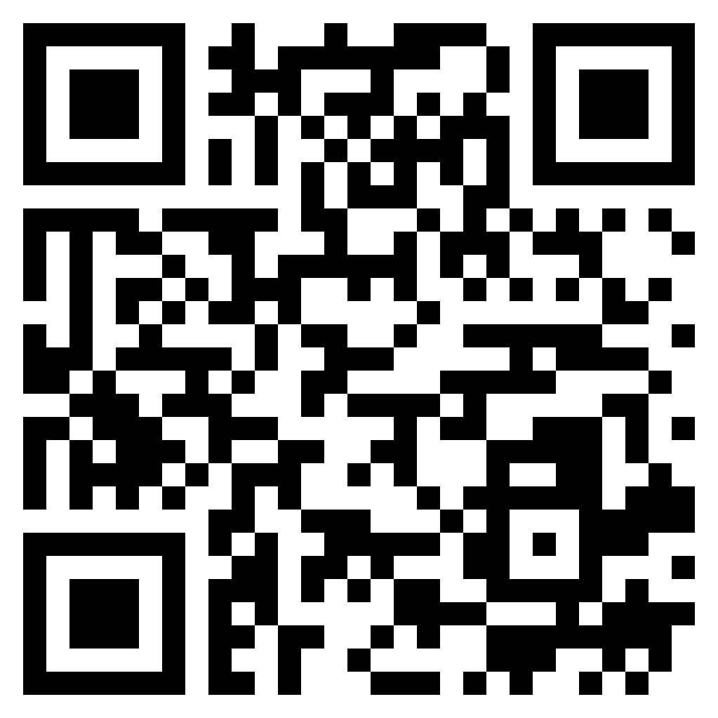
Paul’s letter
to the ROMANS

Slide 2
Philippians 3:4–6 (ESV)
⁴ though I myself have reason for confidence in the flesh also. If anyone else thinks he has reason for confidence in the flesh, I have more: ⁵ circumcised on the eighth day, of the people of Israel, of the tribe of Benjamin, a Hebrew of Hebrews; as to the law, a Pharisee; ⁶ as to zeal, a persecutor of the church; as to righteousness under the law, blameless.
the apostle
PAUL

Slide 3
Acts 26:16–18 (ESV)
¹⁶ But rise and stand upon your feet, for I have appeared to you for this purpose, to appoint you as a servant and witness to the things in which you have seen me and to those in which I will appear to you, ¹⁷ delivering you from your people and from the Gentiles—to whom I am sending you ¹⁸ to open their eyes, so that they may turn from darkness to light and from the power of Satan to God, that they may receive forgiveness of sins and a place among those who are sanctified by faith in me.’
the apostle
PAUL

Slide 4
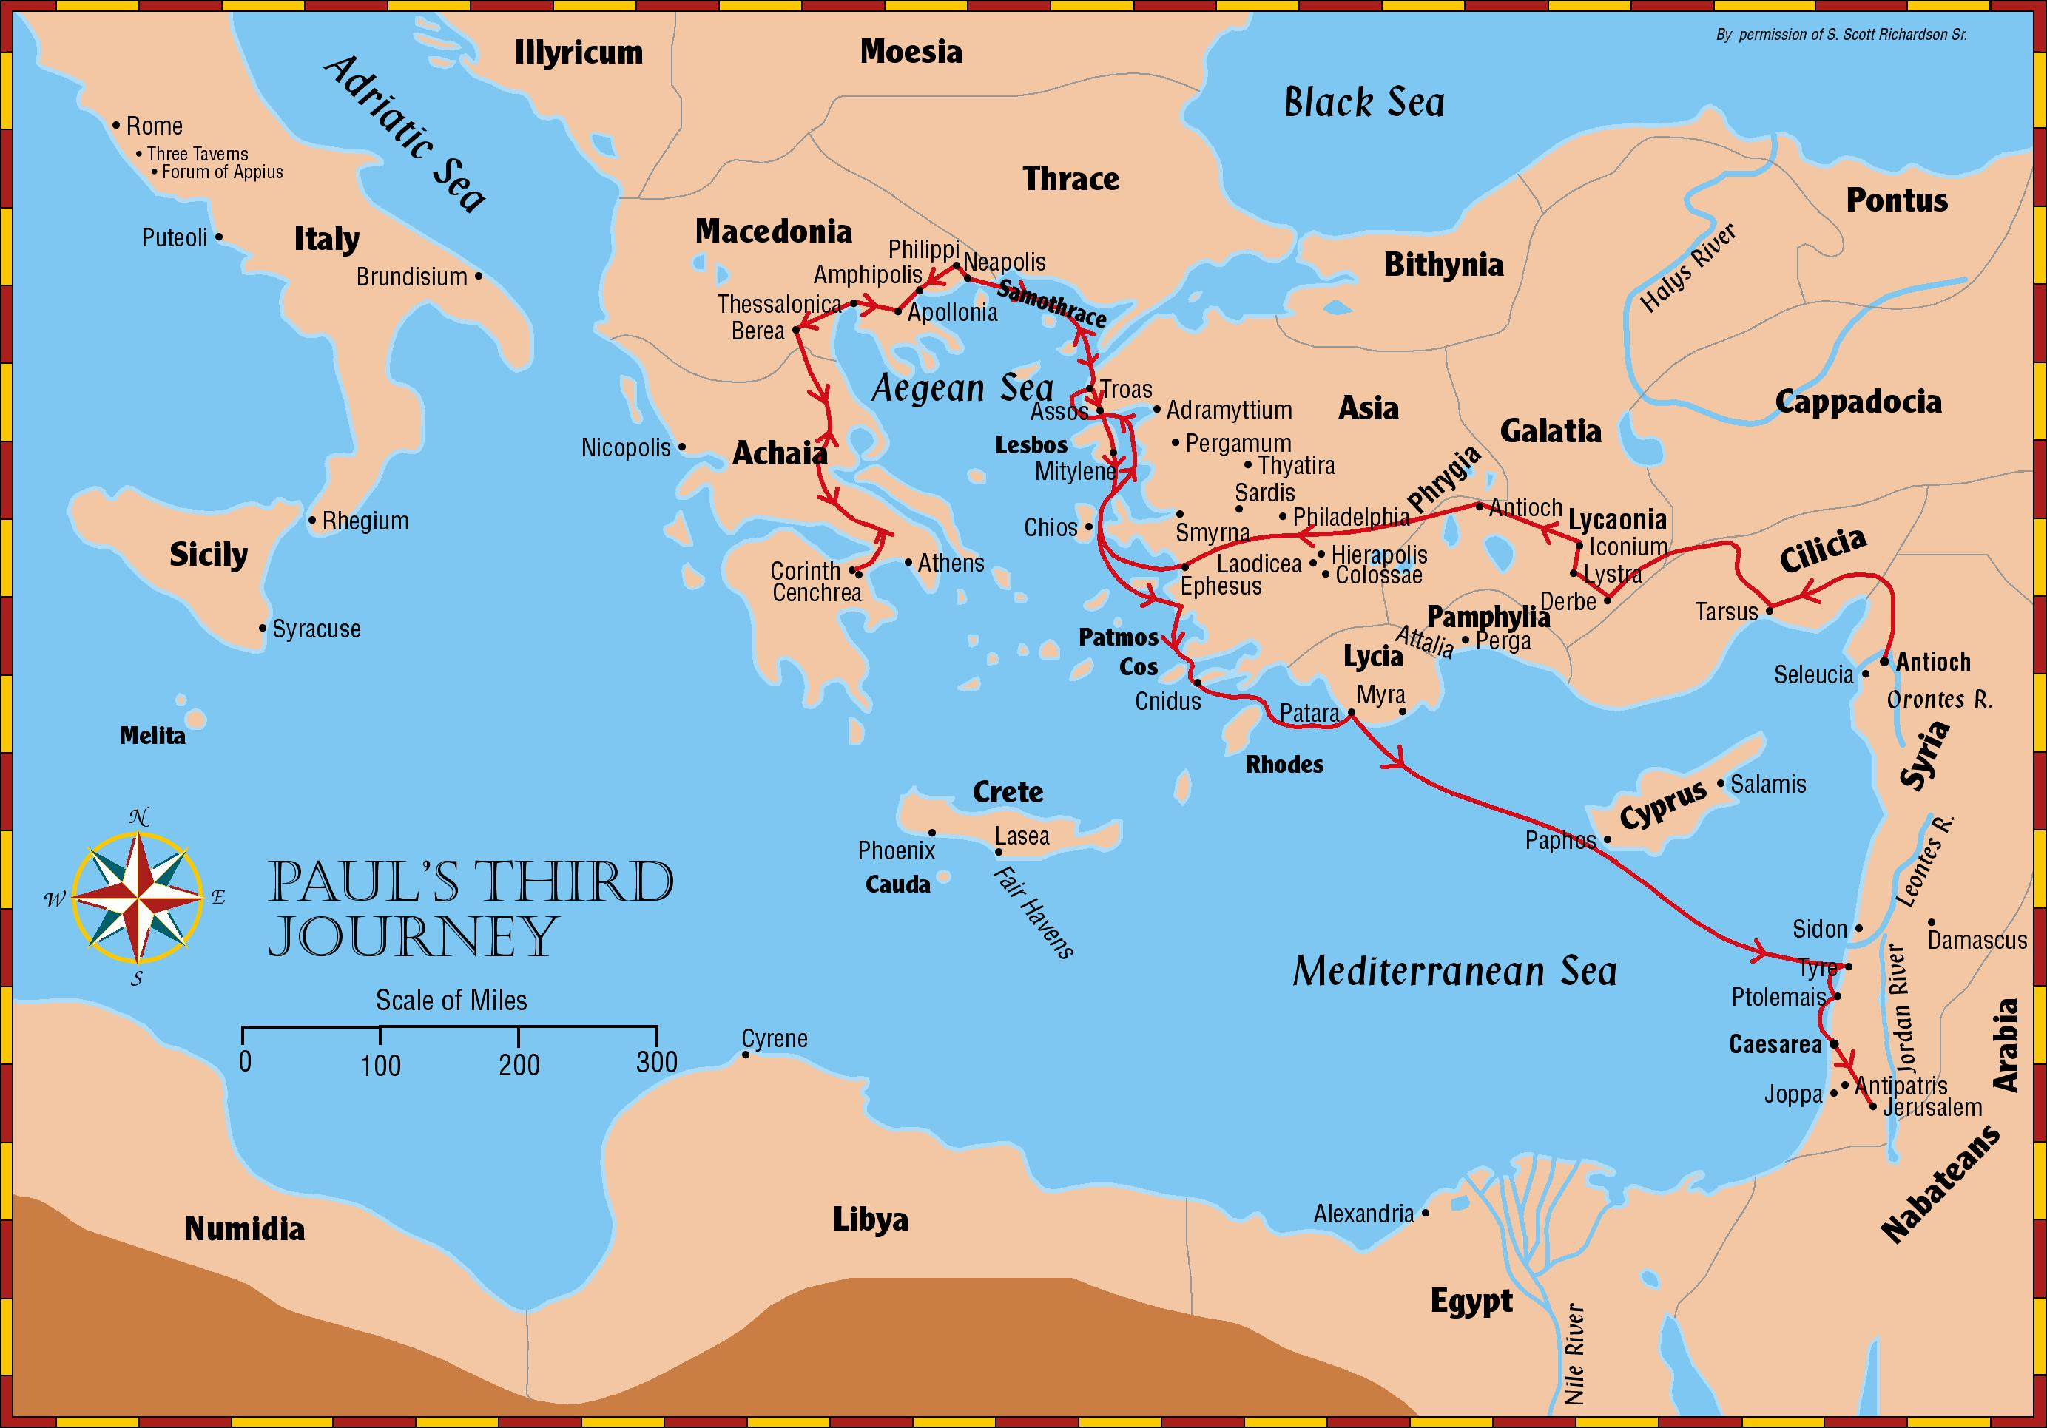

Slide 5
Colossians 1:20 (ESV)
²⁰ and through him to reconcile to himself all things, whether on earth or in heaven, making peace by the blood of his cross.
the apostle
PAUL

Slide 6
Ephesians 2:17–18 (ESV)
¹⁷ And he came and preached peace to you who were far off and peace to those who were near. ¹⁸ For through him we both have access in one Spirit to the Father.
the apostle
PAUL

Slide 7
Galatians 3:28 (ESV)
²⁸ There is neither Jew nor Greek, there is neither slave nor free, there is no male and female, for you are all one in Christ Jesus.
the apostle
PAUL

Slide 8
Acts 11:2–3 (ESV)
² So when Peter went up to Jerusalem, the circumcision party criticized him, saying, ³ “You went to uncircumcised men and ate with them.”
TENSION
in the church

Slide 9
Acts 15:1 (ESV)
¹ But some men came down from Judea and were teaching the brothers, “Unless you are circumcised according to the custom of Moses, you cannot be saved.”
TENSION
in the church

Slide 10
Acts 21:21 (ESV)
²¹ and they have been told about you that you teach all the Jews who are among the Gentiles to forsake Moses, telling them not to circumcise their children or walk according to our customs.
TENSION
in the church

Slide 12
“the Jews interpreted their (i.e., the group’s) special relationship with God as a matter of status… It is for this reason that the Jews prided themselves in their unusual way of life according to the Law of Moses, for this distinctive way of life identified them as God’s special people. When seen in this way, their obedience to the Torah was not so much viewed as earning them their salvation but instead was understood as the ‘mark’ or ‘badge’ that identified them as the people of God. Obeying the Law of Moses makes one a jew, it makes one a member of God’s special people…”
TENSION
in the church

Slide 13
This question of the status of the Jewish people with God in light of the gospel stands at the heart of Romans. The Gentile Christians argued that Jewish rejection of the gospel left them (the Gentile Christians) as God’s special people, but the Jewish Christians had Scriptural statements to the contrary on their side. To put the matter in different terms, there was an argument going on within the church at Rome. The two groups, the Jewish Christians and the Gentile Christians, were arguing over ‘Who is the greatest in the kingdom of heaven?’ (cf. Matthew 18.1)” (McClister 202-203)
TENSION
in the church

Slide 14
Romans 15:7–9 (ESV)
⁷ Therefore welcome one another as Christ has welcomed you, for the glory of God. ⁸ For I tell you that Christ became a servant to the circumcised to show God’s truthfulness, in order to confirm the promises given to the patriarchs, ⁹ and in order that the Gentiles might glorify God for his mercy. As it is written, “Therefore I will praise you among the Gentiles, and sing to your name.”
TENSION
in the church

Slide 15
The Gospel shows that both Jew and Gentile stand in equal need (Romans 1-3)
The Gospel shows how salvation can be received by both Jew and Gentile (Romans 4-8)
The Gospel shows God’s true will for the Jews (Romans 9-11)
The Gospel shows how all of our lives should look in Christ (Romans 12-16)
the solution
THE GOSPEL

