Slide 1
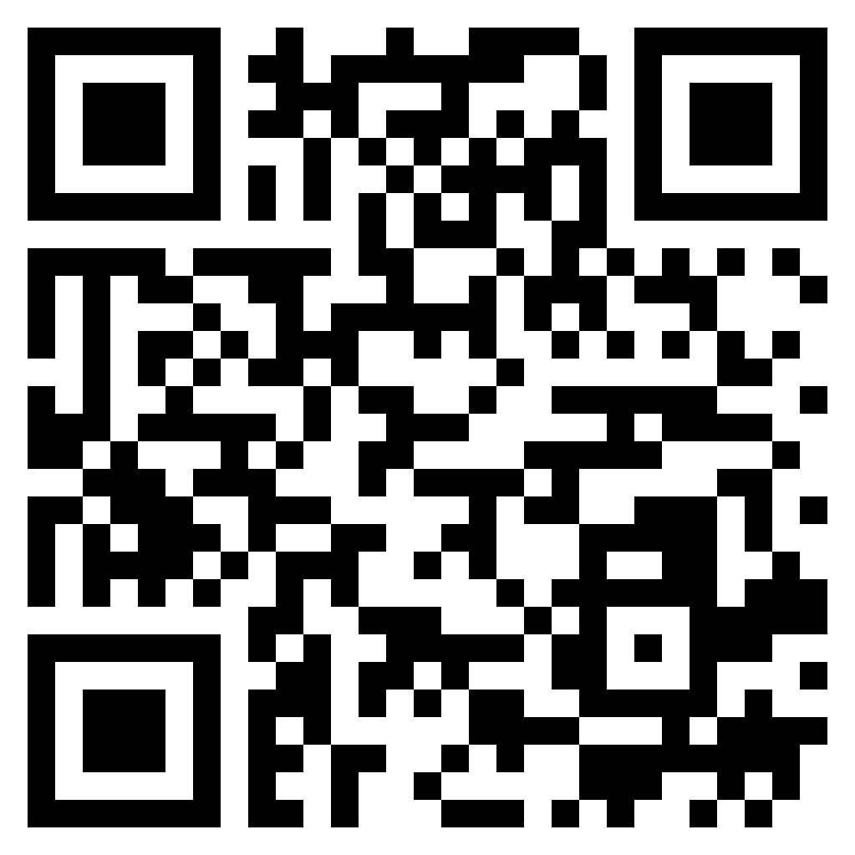
Paul’s letter
to the ROMANS

Slide 2
Romans 9 is NOT about…
Steve
elected to salvation
Eric
elected to damnation

Slide 3
Romans 9 IS about…
Spiritual Israel
righteous through faith
Physical Israel
unrighteous through law

Slide 4
Election in Romans 9
Isaac
chosen by promise
Ishmael

Slide 5
Election in Romans 9
Jacob
chosen by promise
Esau

Slide 6
Election in Romans 9
Israel
Pharaoh

Slide 7
Romans 9:14–18 (ESV)
¹⁴ What shall we say then? Is there injustice on God’s part? By no means! ¹⁵ For he says to Moses, “I will have mercy on whom I have mercy, and I will have compassion on whom I have compassion.” ¹⁶ So then it depends not on human will or exertion, but on God, who has mercy. ¹⁷ For the Scripture says to Pharaoh, “For this very purpose I have raised you up, that I might show my power in you, and that my name might be proclaimed in all the earth.” ¹⁸ So then he has mercy on whomever he wills, and he hardens whomever he wills.
the doctrine
of election

Slide 8
Election in Romans 9
Israel
chosen to serve
Pharaoh
chosen to serve

Slide 9
Election in Romans 9
Israel
chosen to serve
undeserved mercy
Pharaoh
chosen to serve
deserved hardening

Slide 10
Romans 9:19–24 (ESV)
¹⁹ You will say to me then, “Why does he still find fault? For who can resist his will?” ²⁰ But who are you, O man, to answer back to God? Will what is molded say to its molder, “Why have you made me like this?” ²¹ Has the potter no right over the clay, to make out of the same lump one vessel for honorable use and another for dishonorable use? ²² What if God, desiring to show his wrath and to make known his power, has endured with much patience vessels of wrath prepared for destruction, ²³ in order to make known the riches of his glory for vessels of mercy, which he has prepared beforehand for glory— ²⁴ even us whom he has called, not from the Jews only but also from the Gentiles?
the doctrine
of election

Slide 11
Election in Romans 9
Spiritual Israel
vessels of mercy
Physical Israel
vessels of wrath

Slide 12
Romans 9:30–33 (ESV)
³⁰ What shall we say, then? That Gentiles who did not pursue righteousness have attained it, that is, a righteousness that is by faith; ³¹ but that Israel who pursued a law that would lead to righteousness did not succeed in reaching that law. ³² Why? Because they did not pursue it by faith, but as if it were based on works. They have stumbled over the stumbling stone, ³³ as it is written, “Behold, I am laying in Zion a stone of stumbling, and a rock of offense; and whoever believes in him will not be put to shame.”
the doctrine
of election

Slide 13
Election in Romans 9
Spiritual Israel
vessels of mercy
righteous by faith
Physical Israel
vessels of wrath
unrighteous by works

