Slide 1
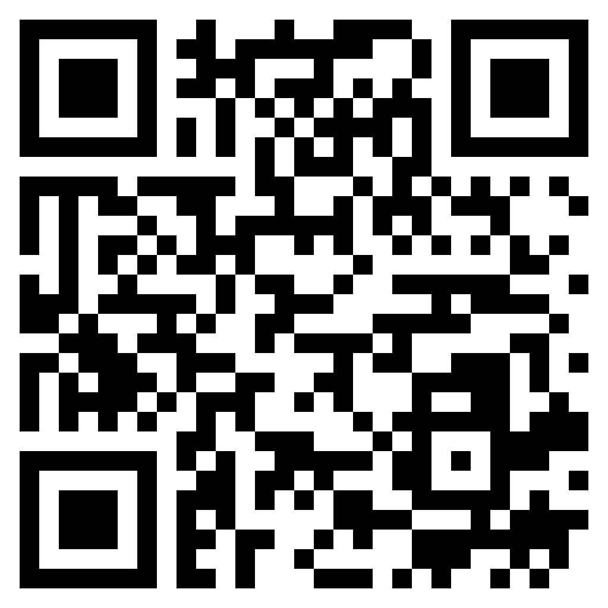
Paul’s letter
to the ROMANS

Slide 2
Romans 8:1 (ESV)
¹ There is therefore now no condemnation for those who are in Christ Jesus.
No
Condemnation

Slide 3
Romans 8:2 (ESV)
² For the law of the Spirit of life has set you free in Christ Jesus from the law of sin and death.”
Romans 8:6 (ESV)
⁶ For to set the mind on the flesh is death, but to set the mind on the Spirit is life and peace.”
Romans 8:14 (ESV)
¹⁴ For all who are led by the Spirit of God are sons of God.”
Holy
Spirit

Slide 4
Romans 8:18 (ESV)
¹⁸ For I consider that the sufferings of this present time are not worth comparing with the glory that is to be revealed to us.
Unworthy
Comparison

Slide 5
Romans 8:19-23 (ESV)
¹⁹ For the creation waits with eager longing for the revealing of the sons of God. ²⁰ For the creation was subjected to futility, not willingly, but because of him who subjected it, in hope ²¹ that the creation itself will be set free from its bondage to corruption and obtain the freedom of the glory of the children of God. ²² For we know that the whole creation has been groaning together in the pains of childbirth until now. ²³ For And not only the creation, but we ourselves, who have the first fruits of the Spirit, groan inwardly as we wait eagerly for adoption as sons, the redemption of our bodies.
Eagerly waiting
For redemption

Slide 6
Romans 8:24-25 (ESV)
²⁴ For in this hope we were saved. Now hope that is seen is not hope. For who hopes for what he sees? ²⁵ But if we hope for what we do not see, we wait for it with patience.
Unseen
Hope

Slide 7
Romans 8:26-27 (ESV)
²⁶ Likewise the Spirit helps us in our weakness. For we do not know what to pray for as we ought, the Spirit Himself intercedes for us with groanings too deep for words. ²⁷ And He who searches the hearts knows what is the mind of the Spirit, because the Spirit intercedes for saints according to the will of God.
Interceding
Spirit

Slide 8
Romans 8:28-30 (ESV)
²⁸ And we know that for those who love God all things work together for good, for those who are called according to His purpose. ²⁹ For those whom He foreknew He also predestined to be conformed to the image of His Son, in order that He might be the firstborn among many brothers. ³⁰ And those whom He predestined He also called, and those whom He called He also justified, and those whom He justified He also glorified.
Called
To His purpose

Slide 9
Ephesians chapter 1.3-14: 3Blessed be the God and Father of our Lord Jesus Christ, who has blessed us in Christ with every spiritual blessing in the heavenly places, 4even as He chose us in Him before the foundation of the world, that we should be holy and blameless before Him. In love 5He predestined us for adoption to Himself as sons through Jesus Christ, according to the purpose of His will, 6to the praise of His glorious grace, with which He has blessed us in the Beloved. 7In Him we have redemption through His blood, the forgiveness of our trespasses, according to the riches of His grace, 8which He lavished upon us, in all wisdom and insight 9making known to us the mystery of His will, according to His purpose which He set forth in Christ 10as a plan for the fullness of time, to unite all things in Him, things in heaven and things on earth. 11In Him we have obtained an inheritance, having been predestined according to the purpose of Him who works all thing according to the counsel of His will, 12so that we who were the first to hope in Christ might be to the praise of His glory. 13In Him you also, when you heard the word of truth, the gospel of your salvation, and believed in Him, were sealed with the promised Holy Spirit, 14who is the guarantee of our inheritance until we acquire possession of it, to the praise of His glory.
Predestined
To His purpose

Slide 10
“Eternal life is free, but not without cost; it is by grace, but not without conditions. It is promised to those who “by perseverance in doing good seek for glory and honor and immortality” (Romans 2:7). Unbelievers are told the conditions of salvation; believers are told the conditions of continuance in salvation; these conditions are declared by God to be the appointed means of enjoying eternal life.”
Once saved,
Always striving

Slide 11
Romans 8:31-35 (ESV)
³¹ What then shall we say to these things? If God is for us, who can be against us? ³² He who did not spare His own Son, but gave Him up for us all, how will He not also with Him graciously give us all things? ³³Who shall bring any charge against God’s elect? It is God who justifies. ³⁴ Who is to condemn? Christ Jesus is the One who died-more than that, who was raised-who is at the right hand of God, who is indeed interceding for us. ³⁵ Who shall separate us from the love of Christ? Shall tribulation, or distress, or persecution, or famine, or nakedness, or danger, or sword?
Christ
Intercedes

Slide 12
Romans 8:36-39 (ESV)
³⁶ As it is written. “For Your sake we are being killed all the day long; we are regarded as sheep to be slaughtered.” ³⁷ No, in all these things we are more than conquerors through Him who loved us. ³⁸ For I am sure that neither death nor life, nor angels nor rulers, nor things present nor things to come, nor powers, ³⁹ nor height nor depth, nor anything else in all creation, will be able to seprate us from the love of God in Christ Jesus our Lord.
Conquerors
In Christ

