Slide 1
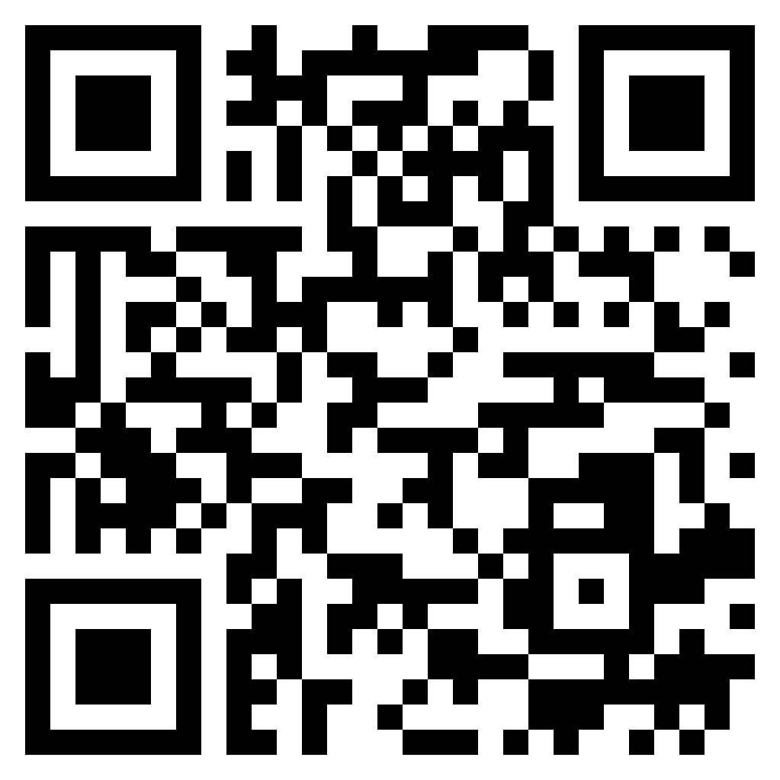
Paul’s letter
to the ROMANS

Slide 2
Romans 15:15–16 (ESV)
¹⁵ But on some points I have written to you very boldly by way of reminder, because of the grace given me by God ¹⁶ to be a minister of Christ Jesus to the Gentiles in the priestly service of the gospel of God, so that the offering of the Gentiles may be acceptable, sanctified by the Holy Spirit.
a minister of
Christ Jesus

Slide 4
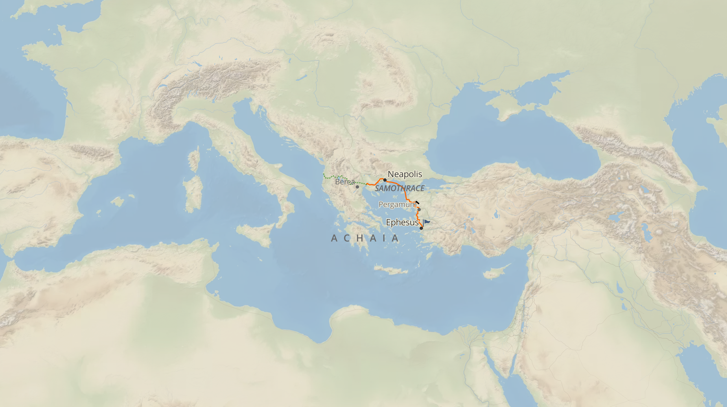

Slide 5
Paul’s
greetings

Slide 6
Romans 16:17–20 (ESV)
¹⁷ I appeal to you, brothers, to watch out for those who cause divisions and create obstacles contrary to the doctrine that you have been taught; avoid them. ¹⁸ For such persons do not serve our Lord Christ, but their own appetites, and by smooth talk and flattery they deceive the hearts of the naive. ¹⁹ For your obedience is known to all, so that I rejoice over you, but I want you to be wise as to what is good and innocent as to what is evil. ²⁰ The God of peace will soon crush Satan under your feet. The grace of our Lord Jesus Christ be with you.
warning against
false teachers

Slide 7
Romans 16:17–20 (ESV)
¹⁷ I appeal to you, brothers, to watch out for those who cause divisions and create obstacles contrary to the doctrine that you have been taught; avoid them. ¹⁸ For such persons do not serve our Lord Christ, but their own appetites, and by smooth talk and flattery they deceive the hearts of the naive. ¹⁹ For your obedience is known to all, so that I rejoice over you, but I want you to be wise as to what is good and innocent as to what is evil. ²⁰ The God of peace will soon crush Satan under your feet. The grace of our Lord Jesus Christ be with you.
warning against
false teachers

Slide 8
Romans 16:17–20 (ESV)
¹⁷ I appeal to you, brothers, to watch out for those who cause divisions and create obstacles contrary to the doctrine that you have been taught; avoid them. ¹⁸ For such persons do not serve our Lord Christ, but their own appetites, and by smooth talk and flattery they deceive the hearts of the naive. ¹⁹ For your obedience is known to all, so that I rejoice over you, but I want you to be wise as to what is good and innocent as to what is evil. ²⁰ The God of peace will soon crush Satan under your feet. The grace of our Lord Jesus Christ be with you.
warning against
false teachers

Slide 9
Romans 16:25–27 (ESV)
²⁵ Now to him who is able to strengthen you according to my gospel and the preaching of Jesus Christ, according to the revelation of the mystery that was kept secret for long ages ²⁶ but has now been disclosed and through the prophetic writings has been made known to all nations, according to the command of the eternal God, to bring about the obedience of faith— ²⁷ to the only wise God be glory forevermore through Jesus Christ! Amen.
concluding
remarks

