Slide 2
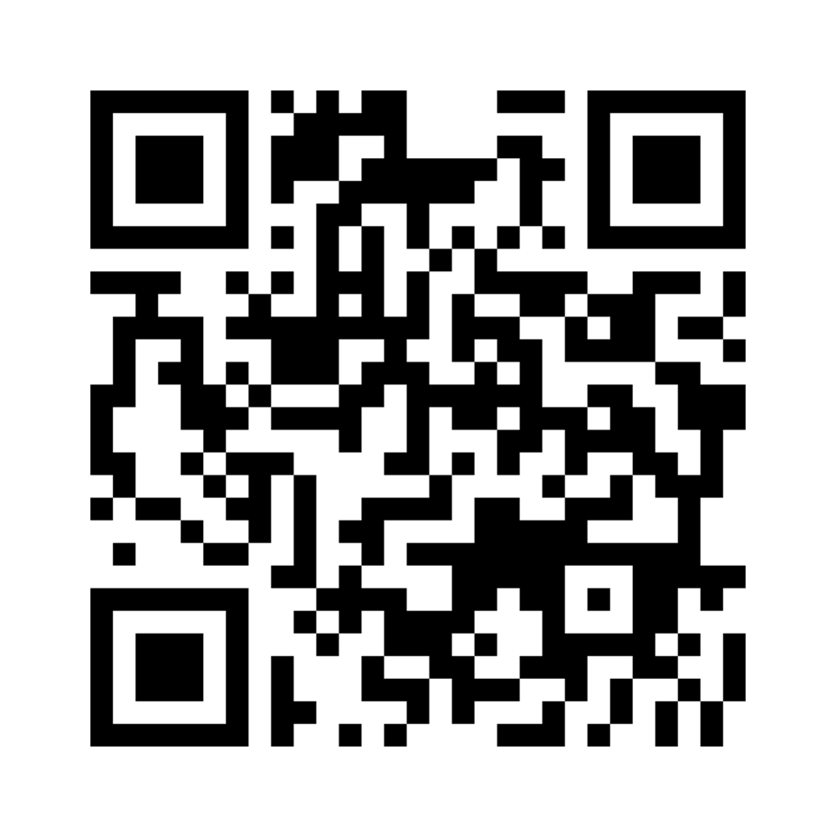
To our guests, we would like to know more about you! Scan the QR code to share your contact info with us.
A nuestros invitados, ¡nos gustaría saber más sobre ustedes! Escanee el código QR para compartir su información de contacto con nosotros.
Welcome | Mike Quick

Slide 5
Why 3 Times?

Slide 6
Why 3 Times?
He was Human

Slide 7
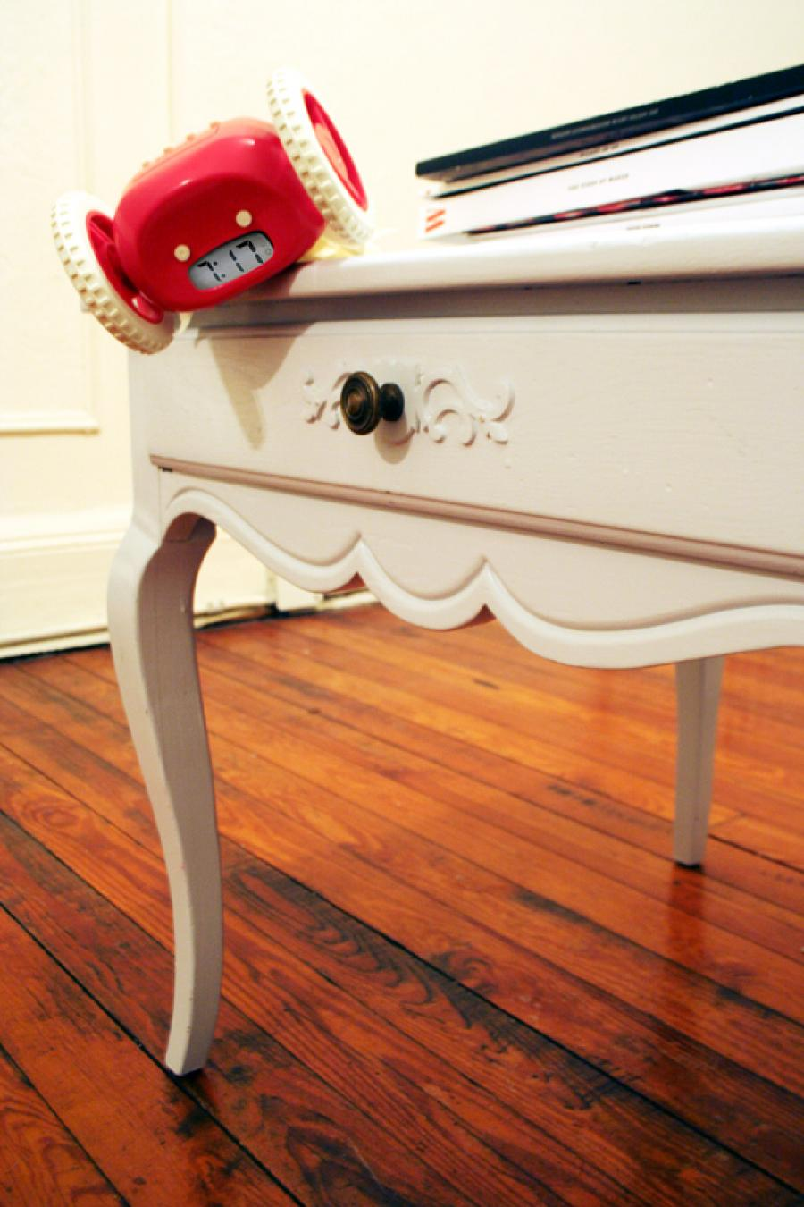
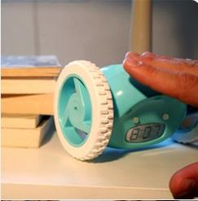

Slide 8
Be Strong & Courageous
1. People…Joshua 1.6

Slide 9
Be Strong & Courageous
1. People…Joshua 1.6
1Corinthians 15.33
Philippians 2.12
Galatians 6

Slide 10
Be Strong & Courageous
1. People…Joshua 1.6
1Corinthians 15.33
Philippians 2.12
Galatians 6
Nice vs Kind

Slide 11
Be Strong & Courageous
1. People. Joshua 1.6
2. The Word…Joshua 1.7-8

Slide 12
Be Strong & Courageous
2. The Word…Joshua 1.7-8
Proverbs 3.5-6

Slide 13
Be Strong & Courageous
2. The Word…Joshua 1.7-8
Proverbs 3.5-6
Judges 2.6-10, Fathers

Slide 14
Be Strong & Courageous
1. People…Joshua 1.6
2. The Word…Joshua 1.7-8
3. Personally…Joshua 1.9

Slide 15
Be Strong & Courageous
3. Personally…Joshua 1.9
Joshua 7.6-9

Slide 16
Be Strong & Courageous
3. Personally…Joshua 1.9
Joshua 7.6-9
Why??

Slide 17
Be Strong & Courageous
3. Personally…Joshua 1.9
Joshua 7.6-9
Why??
Joshua 7.10 Get Up!

Slide 18
Why 3 times?

Slide 19
Why 3 times?
Was it Because of these 3 Times?

Slide 20
Be Strong & Courageous

