Slide 2
“When he came to Jerusalem, he tried to join the disciples, but they were all afraid of him, not believing that he really was a disciple.”
Acts 9:26
What is your greatest spiritual success?
What is your greatest spiritual failure?

Slide 3
TWO VERSES / TWO WORDS
“Even though I was once a blasphemer and a persecutor and a violent man, I was shown mercy because I acted in ignorance and unbelief. The grace of our Lord was poured out on me abundantly, along with the faith and love that are in Christ Jesus.” 1 Timothy 1:13, 14
Mercy: “Not getting what I deserve.”
Mercy: “Not getting what I deserve.”
Grace: “Getting what I don’t deserve.”

Slide 4
YOU HAVE TO RECEIVE GRACE
Real grace frees us from our guilt and shame.
“Here is a trustworthy saying that deserves full acceptance: Christ Jesus came into the world to save sinners of whom I am the worst.” 1 Timothy 1:15
“There is therefore now no condemnation to those who are in Christ Jesus, who do not walk according to the flesh, but according to the Spirit.” Romans 8:1
“If we confess our sins, He is faithful and just to forgive us our sins and to cleanse us from all unrighteousness.” 1 John 1:9
Single
epic
fail.

Slide 5
YOU HAVE TO RECEIVE GRACE
Real grace frees us from our guilt and shame.
“All of us have become like one who is unclean, and all our righteous acts are like filthy rags…” Isaiah 64:6
Pretending I’m not sick is not a very effective way to get well.

Slide 6
YOU HAVE TO RECEIVE GRACE
Real grace is not about who we are or what we did but what we want to become.
“And Saul approved of his execution. And there arose on that day a great persecution against the church in Jerusalem, and they were all scattered throughout the regions of Judea and Samaria, except the apostles. Devout men buried Stephen and made great lamentation over him. But Saul was ravaging the church, and entering house after house, he dragged off men and women and committed them to prison.” Acts 8:1-3
“But by the grace of God I am what I am, and his grace toward me was not in vain. On the contrary, I worked harder than any of them, though it was not I, but the grace of God that is with me.” 1 Corinthians 15:10
“At this they covered their ears and, yelling at the top of their voices, they all rushed at him, dragged him out of the city and began to stone him. Meanwhile, the witnesses laid their coats at the feet of a young man named Saul.” Acts 7:57, 58
“I too was convinced that I ought to do all that was possible to oppose the name of Jesus of Nazareth. And that is just what I did in Jerusalem. On the authority of the chief priests I put many of the Lord’s people in prison, and when they were put to death, I cast my vote against them…
…Many a time I went from one synagogue to another to have them punished, and I tried to force them to blaspheme. I was so obsessed with persecuting them that I even hunted them down in foreign cities.” Acts 26:9-11
“For you have heard of my former life in Judaism, how I persecuted the church of
God violently and tried to destroy it.” Galatians 1:13
“For I am the least of the apostles, unworthy to be called an apostle, because I persecuted the church of God.” 1 Corinthians 15:9
“Meanwhile, Saul was still breathing out murderous threats against the Lord’s disciples. He went to the high priest and asked him for letters to the synagogues in Damascus, so that if he found any there who belonged to the Way, whether men or women, he might take them as prisoners to Jerusalem.” Acts 9:1, 2
Single
epic
fail.

Slide 7
YOU HAVE TO RECEIVE GRACE
Real grace is not about who we are or what we did but what we want to become.
You and I are alive today because of the mercy of God.
You and I are alive today because of the mercy of God.
You and I are saved today
because of the grace of God.
“For by grace you have been saved through faith. And this is not your own doing; it is the gift of God.” Ephesians 2:8

Slide 8
YOU HAVE TO LIVE GRACE
“After Paul was saved, he became a foremost
saint and the Lord did not allot
him a second class place in the church.
He had been a leading sinner but his Lord did not, therefore,
say “I will save you but I’ll always remember
your wickedness as a disadvantage. Not so!
He counted him faithful, put him into ministry and into apostleship, so that he was not a wit behind the very chief apostles. Brother, there is no reason why, if you have gone very far in sin, you should go equally far in usefulness.”
- Charles Spurgeon

Slide 9
YOU HAVE TO LIVE GRACE
Living grace means that I am no longer in charge.
“I thank him who has given me strength, Christ Jesus our Lord, because he judged me faithful, appointing me to his service…” 1 Timothy 1:12
“I have been crucified with Christ; it is no longer I who live, but Christ lives in me; and the life which I now live in the flesh I live by faith in the Son of God, who loved me and gave Himself for me.” Galatians 2:20

Slide 10
YOU HAVE TO LIVE GRACE
Living grace means that I am no longer in charge.
Under
New Management
“If we live, we live for the Lord; and if we die, we die for the Lord. So, whether we live or die, we belong to the Lord.” Romans 14:8

Slide 11
YOU HAVE TO LIVE GRACE
Living grace means that I am no longer in charge.
Goodness made bad…
“What shall we say then? Are we to continue in sin that grace may abound? By no means! How can we who died to sin still live in it?” Romans 6:1, 2

Slide 12
YOU HAVE TO LIVE GRACE
Living grace means loving those that Jesus loved.
“But I received mercy for this reason, that in me, as the foremost, Jesus Christ might display his perfect patience as an example to those who were to believe in him for eternal life.” 1 Timothy 1:16
“And the grace of our Lord overflowed for me with the faith and love that are in Christ Jesus.” 1 Timothy 1:14

Slide 13
YOU HAVE TO LIVE GRACE
Living grace means living life of thankfulness and worship.
“Now to the King eternal, immortal, invisible, the only God, be honor and glory for ever and ever. Amen” 1 Timothy 1:17

Slide 14
YOU HAVE TO LIVE GRACE
Living grace means living life of thankfulness and worship.
Roadblocks to
praise & worship…
Maybe you’ve forgotten who you were / are.
“For he who lacks these things is shortsighted, even to blindness, and has forgotten that he was cleansed from his old sins.” 2 Peter 1:9
Maybe you’ve forgotten God’s grace.

Slide 15
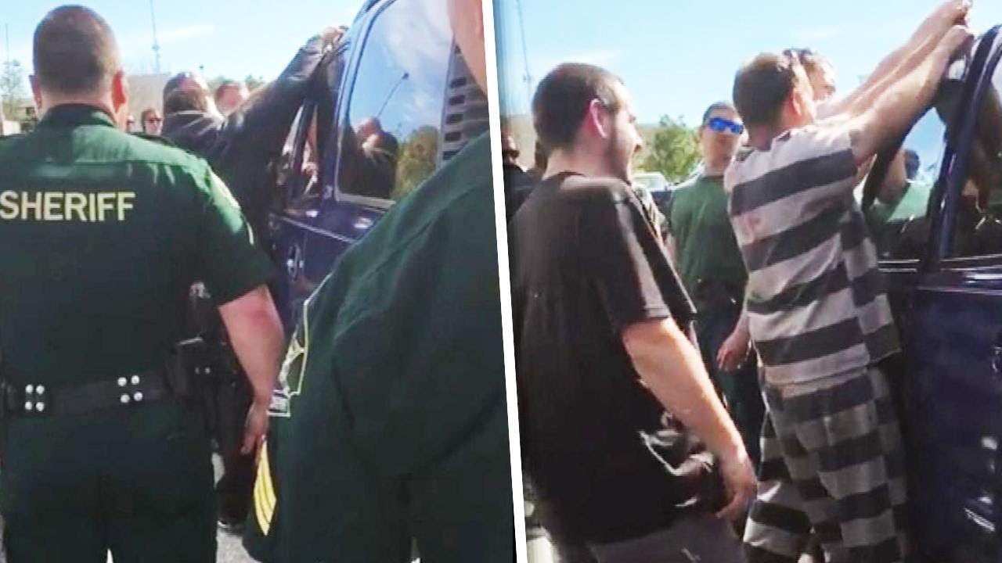
CASE STUDY: PAUL, AFTER THE TRANSFORMATION
“For I do not understand my own actions. For I do not do what I want, but I do the very thing I hate.” Romans 7:15
“But go, tell His disciples and Peter that He is going before you into Galilee; there you will see Him, as He said to you.” Mark 16:7
We’re often better at remembering our worst than remembering God’s best.
You can’t sin yourself outside the reach of the grace of God.

Slide 16
CASE STUDY: PAUL, AFTER THE TRANSFORMATION
“For by grace you have been saved through faith, and that not of yourselves; it is the gift of God, not of works, lest anyone should boast. For we are His workmanship, created in Christ Jesus for good works, which God prepared beforehand that we should walk in them.” Ephesians 2:8-10
“What shall we say then? Are we to continue in sin that grace may abound? By no means! How can we who died to sin still live in it?” Romans 6:1, 2
“But God, who is rich in mercy, because of His great love with which He loved us, even when we were dead in trespasses, made us alive together with Christ (by grace you have been saved)…” Ephesians 2:4, 5
“And you He made alive, who were dead in trespasses and sins…” Ephesians 2:1

Slide 17
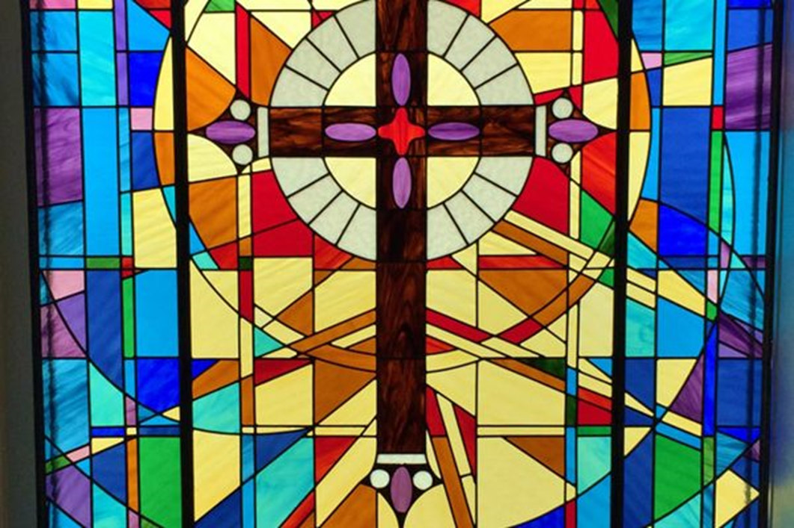
“Do you not know that all of us who have been baptized into Christ Jesus were baptized into his death? We were buried therefore with him by baptism into death, in order that, just as Christ was raised from the dead by the glory of the Father, we too might walk in newness of life.” Romans 6:3, 4
“He was delivered over to death for our sins and was raised to life for our justification.”
Romans 4:25

