Slide 2
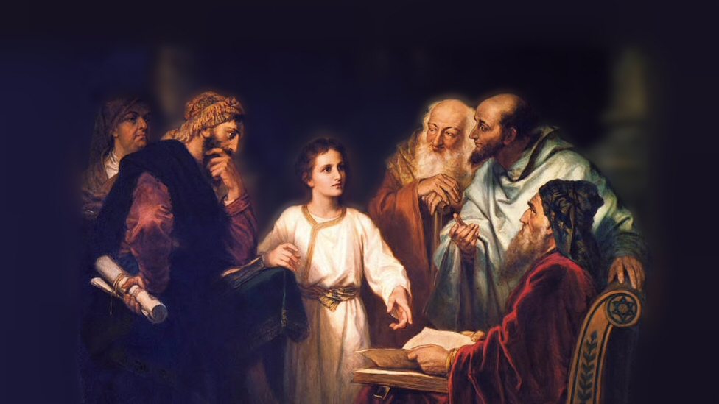
Flawed NOT Failed Series
Mary and Martha
Source: https://www.flickr.com/photos/moregoodfoundation/5135438113
Notes:
Picture attribution: More Good Foundation (cropped, with background blurred) Creative Commons License
https://www.flickr.com/photos/moregoodfoundation/5135438113

Slide 3
Outline
Background:
Luke 10:38-42 – Jesus visits Mary and Martha’s Home
John 11:1-44 – Raising of Lazarus
John 12:1-11 – A dinner for Jesus and Lazarus
About Martha
About Mary
Additional Details
Lessons to be Learned

Slide 4
Background
Luke 10:38-42 – Jesus visits Mary and Martha’s Home
³⁸ Now as they went on their way, Jesus entered a village. And a woman named Martha welcomed him into her house. ³⁹ And she had a sister called Mary, who sat at the Lord's feet and listened to his teaching. ⁴⁰ But Martha was distracted with much serving. And she went up to him and said, “Lord, do you not care that my sister has left me to serve alone? Tell her then to help me.” ⁴¹ But the Lord answered her, “Martha, Martha, you are anxious and troubled about many things, ⁴² but one thing is necessary. Mary has chosen the good portion, which will not be taken away from her.”

Slide 5
Background
John 11:1-6, 17-27 – Raising of Lazarus
Now a certain man was ill, Lazarus of Bethany, the village of Mary and her sister Martha. ² It was Mary who anointed the Lord with ointment and wiped his feet with her hair, whose brother Lazarus was ill. ³ So the sisters sent to him, saying, “Lord, he whom you love is ill.” ⁴ But when Jesus heard it he said, “This illness does not lead to death. It is for the glory of God, so that the Son of God may be glorified through it.”
⁵ Now Jesus loved Martha and her sister and Lazarus. ⁶ So, when he heard that Lazarus^{[a]} was ill, he stayed two days longer in the place where he was.
¹⁷ Now when Jesus came, he found that Lazarus had already been in the tomb four days. ¹⁸ Bethany was near Jerusalem, about two miles^{[c]} off, ¹⁹ and many of the Jews had come to Martha and Mary to console them concerning their brother. ²⁰ So when Martha heard that Jesus was coming, she went and met him, but Mary remained seated in the house. ²¹ Martha said to Jesus, “Lord, if you had been here, my brother would not have died. ²² But even now I know that whatever you ask from God, God will give you.” ²³ Jesus said to her, “Your brother will rise again.” ²⁴ Martha said to him, “I know that he will rise again in the resurrection on the last day.” ²⁵ Jesus said to her, “I am the resurrection and the life.^{[d]} Whoever believes in me, though he die, yet shall he live, ²⁶ and everyone who lives and believes in me shall never die. Do you believe this?” ²⁷ She said to him, “Yes, Lord; I believe that you are the Christ, the Son of God, who is coming into the world.”

Slide 6
Background
John 11:28-32, 38-40 – Raising of Lazarus
²⁸ When she had said this, she went and called her sister Mary, saying in private, “The Teacher is here and is calling for you.” ²⁹ And when she heard it, she rose quickly and went to him. ³⁰ Now Jesus had not yet come into the village, but was still in the place where Martha had met him. ³¹ When the Jews who were with her in the house, consoling her, saw Mary rise quickly and go out, they followed her, supposing that she was going to the tomb to weep there. ³² Now when Mary came to where Jesus was and saw him, she fell at his feet, saying to him, “Lord, if you had been here, my brother would not have died.
³⁸ Then Jesus, deeply moved again, came to the tomb. It was a cave, and a stone lay against it. ³⁹ Jesus said, “Take away the stone.” Martha, the sister of the dead man, said to him, “Lord, by this time there will be an odor, for he has been dead four days.” ⁴⁰ Jesus said to her, “Did I not tell you that if you believed you would see the glory of God?”

Slide 7
Background
John 12:1-8 – A dinner for Jesus and Lazarus
¹Six days before the Passover, Jesus therefore came to Bethany, where Lazarus was, whom Jesus had raised from the dead. ² So they gave a dinner for him there. Martha served, and Lazarus was one of those reclining with him at table. ³ Mary therefore took a pound of expensive ointment made from pure nard, and anointed the feet of Jesus and wiped his feet with her hair. The house was filled with the fragrance of the perfume. ⁴ But Judas Iscariot, one of his disciples (he who was about to betray him), said, ⁵ “Why was this ointment not sold for three hundred denarii and given to the poor?” ⁶ He said this, not because he cared about the poor, but because he was a thief, and having charge of the moneybag he used to help himself to what was put into it. ⁷ Jesus said, “Leave her alone, so that she may keep it for the day of my burial. ⁸ For the poor you always have with you, but you do not always have me.”

Slide 8
About Martha
³⁸ Now as they went on their way, Jesus^{[d]} entered a village. And a woman named Martha welcomed him into her house. (Luke 10:38)
Martha was welcoming and hospitable
⁴⁰ But Martha was distracted with much serving. (Luke 10:40)
Martha wanted to serve
⁵ Now Jesus loved Martha and her sister and Lazarus. (John 11:5)
Jesus loved Martha (Friendship)
…and many of the Jews had come to Martha and Mary to console them concerning their brother. ²⁰ So when Martha heard that Jesus was coming, she went and met him, …(John 11:19-20)
Martha was excited to see Jesus
²² But even now I know that whatever you ask from God, God will give you.” ²³ Jesus said to her, “Your brother will rise again.” ²⁴ Martha said to him, “I know that he will rise again in the resurrection on the last day.” ²⁵ Jesus said to her, “I am the resurrection and the life.^{[d]} Whoever believes in me, though he die, yet shall he live, ²⁶ and everyone who lives and believes in me shall never die. Do you believe this?” ²⁷ She said to him, “Yes, Lord; I believe that you are the Christ, the Son of God, who is coming into the world.” (Jn. 11:22-27)
Martha believed and confessed that Jesus was the Son of God.
²⁸ When she had said this, she went and called her sister Mary, saying in private, “The Teacher is here and is calling for you.” (Jn. 11:28)
Martha was smart and aware

Slide 9
About Martha
When Jesus arrived after Lazarus' death, Martha said, "Lord, if You had been here, my brother would not have died" (Jn. 11:21)
Upset that Jesus was not there to save Lazarus’ from death
When Jesus was ready to raise Lazarus from the dead and had said, "Remove the stone," Martha piped up, "Lord, by this time there will be a stench; for he has been dead four days" (Jn. 11:39)
Again, she is anxious and worried about the situation
With Mary sitting at the feet of Jesus while she herself served as hostess, Martha felt the need to counsel the Lord. She said, "Lord do You not care that my sister has left me to do all the serving alone? Then tell her to help me" (Lk. 10:40b).
She counsel’s the Lord and demands that he tell Mary to help – threw her under the bus
But Martha was distracted with much serving. (Luke. 10:40a)
Martha was distracted by housework
Jesus told her; “Martha, Martha, you are anxious and troubled about many things…” (Lk. 10:41)
Martha was anxious and troubled
⁴⁰ Jesus said to her, “Did I not tell you that if you believed you would see the glory of God?” (Jn. 11:40)
Martha was learning the power of Jesus

Slide 10
About Mary
³⁹ And she had a sister called Mary, who sat at the Lord's feet and listened to his teaching. (Lk.10:39)
Choose to sit and listen to Jesus teach
⁴² but one thing is necessary.^{[e]} Mary has chosen the good portion, which will not be taken away from her.” (Lk. 10:42)
Choose the “good portion” - Spiritually Minded
² It was Mary who anointed the Lord with ointment and wiped his feet with her hair, … (Jn. 12:2)
Tender hearted
²⁰ So when Martha heard that Jesus was coming, she went and met him, but Mary remained seated in the house. (Luke 11:20)
Too emotional to run to meet Jesus
And she went up to him and said, “Lord, do you not care that my sister (Mary) has left me to serve alone? Tell her then to help me.” (Lk. 10:40)
Did not help her sister with the serving and housework
³² Now when Mary came to where Jesus was and saw him, she fell at his feet, saying to him, “Lord, if you had been here, my brother would not have died.” (Jn. 11:32)
Voiced her concern, but showed humility and knew the power of Jesus

Slide 11
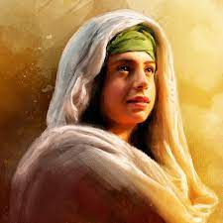
Martha
“Type A” personality – on top of things, focused on getting things done, in charge, energetic, did not want to miss out

Slide 12
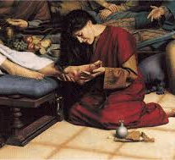
Mary
Calm, laid back and more interested in building relationships than getting things done, did not argue with her sister, kept focused on spiritual things

Slide 13
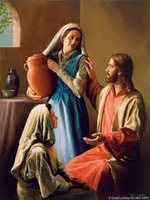
Mary and Martha are both very comfortable and confident in their relationship with Jesus.
Martha was willing to take her problem/complaint directly to Jesus
Mary put ointment on his feet and dried it with her hair

Slide 14
Additional Details
The Jewish tradition was that the women would serve guest in their homes and the men would listen to teachings – Martha was doing what her culture expected
How many of us can relate to Martha?
How many of us can relate to Mary?
How many of us would be irritated with Mary?
How many of us would be jealous of Mary and not know how to address it?

Slide 15
Lessons to be Learned
Jesus met Mary and Martha where they were emotionally:
Jesus responded back to Mary and Martha in two different ways (at Lazarus’ tomb)
Jesus wept with them even though he knew Lazarus’s was going to be raised
Be hospitable:
Rom. 12:13 - Contribute to the needs of the saints and seek to show hospitality.
1 Pet. 4:9 - Show hospitality to one another without grumbling.
Do not be Anxious:
Philippians 4:6-7 - do not be anxious about anything, but in everything by prayer and supplication with thanksgiving let your requests be made known to God. 7 And the peace of God, which surpasses all understanding, will guard your hearts and your minds in Christ Jesus.
Do not Worry
(Matthew 13:22), “Now he who received seed among the thorns is he who hears the word, and the cares of this world and the deceitfulness of riches choke the word, and he becomes unfruitful.”
(Matthew 6:25), “Therefore I say to you, do not worry about your life, what you will eat or what you will drink; nor about your body, what you will put on. Is not life more than food and the body more than clothing?”
(Matt. 6:33), “But seek first the kingdom of God and His righteousness, and all these things shall be added to you. 34 Therefore do not worry about tomorrow, for tomorrow will worry about its own things. Sufficient for the day is its own trouble.”
Notes:
Consider the woman who rejoices having individuals in their homes, and is unconcerned if all is not perfect. She knows that the important thing is the hospitality and association
The consider the woman who is having individuals over, and MUST have everything JUST SO! She worries about how she will be perceived, what her house looks like, what people might think. Hospitality becomes a burden… or worse, a chance to show off, (an occasion of pride).

Slide 16
Lessons to be Learned
Focus on what is important:
Our Walk with Christ – being devoted – just like Mary
PRAYER + the WORD + TIME = INTIMACY with GOD
Allow Love to Shine:
John 13:35 - By this all people will know that you are my disciples, if you have love for one another.”
Story
Be Spiritually Minded:
(Psalm 19:7-10), “The law of the Lord is perfect, converting the soul; The testimony of the Lord is sure, making wise the simple; 8 The statutes of the Lord are right, rejoicing the heart; The commandment of the Lord is pure, enlightening the eyes; 9 The fear of the Lord is clean, enduring forever; The judgments of the Lord are true and righteous altogether. 10 More to be desired are they than gold, Yea, than much fine gold; Sweeter also than honey and the honeycomb.”
Notes:
Consider the woman who rejoices having individuals in their homes, and is unconcerned if all is not perfect. She knows that the important thing is the hospitality and association
The consider the woman who is having individuals over, and MUST have everything JUST SO! She worries about how she will be perceived, what her house looks like, what people might think. Hospitality becomes a burden… or worse, a chance to show off, (an occasion of pride).

Slide 17
Conclusion
Mary and Martha, though sisters, seemed to have very different personalities.
However, they were both faithful, and both were loved by the Lord!
Notes:
There is room in the kingdom for all. No matter culture, gender or personality. So long as you are faithful to the Lord!

