Slide 2
Luke Chapter 12
12: 13-21 Parable of the Rich Fool
12:22-34 Seek The Kingdom of God
12: 35-48 Parable ot the Expectant Steward
12: 41-48 Parable of the Faithful Steward

Slide 3
Luke 22-33
What word or phrase stands out?

Slide 4
Luke 12:22-34
In our lives today, if we take a look around us, what are some things that we value?
~Our children ~Homes ~ Jobs
~Our marriage ~Friends ~Success
~Integrity ~Health ~Relationship with God
~A Cause/Organization of some kind
~Our church family
Notes:
Value means worth, importance, desirable, favorable

Slide 5
In terms of earthly things, what does God appear to value most according to Luke 12:24?
YOU!!!
Notes:
How much more valuable are you than the birds….in every way!! People excel when they feel valued.

Slide 6
Luke 12:22-34
How does Jesus' teaching on worry and anxiety challenge our modern concerns about wealth, security, and possessions?
Notes:
Answer: It encourages us to trust in God's provision and prioritize seeking His kingdom above all else.

Slide 7
We live out what we truly believe, aka, your belief system. If we believe what God says about our value to Him, it will alter how we live our lives……..
1) It frees us from hypocrisy
2) It frees us from unnecessary fear vs 4- “I tell you, my friends, do not be afraid of those who kill the body and after that can do nothing more.”

Slide 8
3) It frees us from the need for riches vs. 33 “sell your possessions and give to the poor”
4) It frees us from worry- vs. 25 “Can any of you add one moment to your life by worrying?”
Why do we find it so difficult to not worry and what is the remedy?
Notes:
Vs 33 not sell everything…the point is a promotion of an unselfish spirit which places heavenly and eternal concerns above the accumulation of earthly possessions.
I have to opportunity to see poverty and people who don’t put trust in earthly possessions……
In each case of the parallel accounts of Jesus He tell his disciples not to worry.. With no doubt the message is to SEEK the Kingdom first!!!
Is it wrong to worry???
Did Jesus worry?

Slide 9
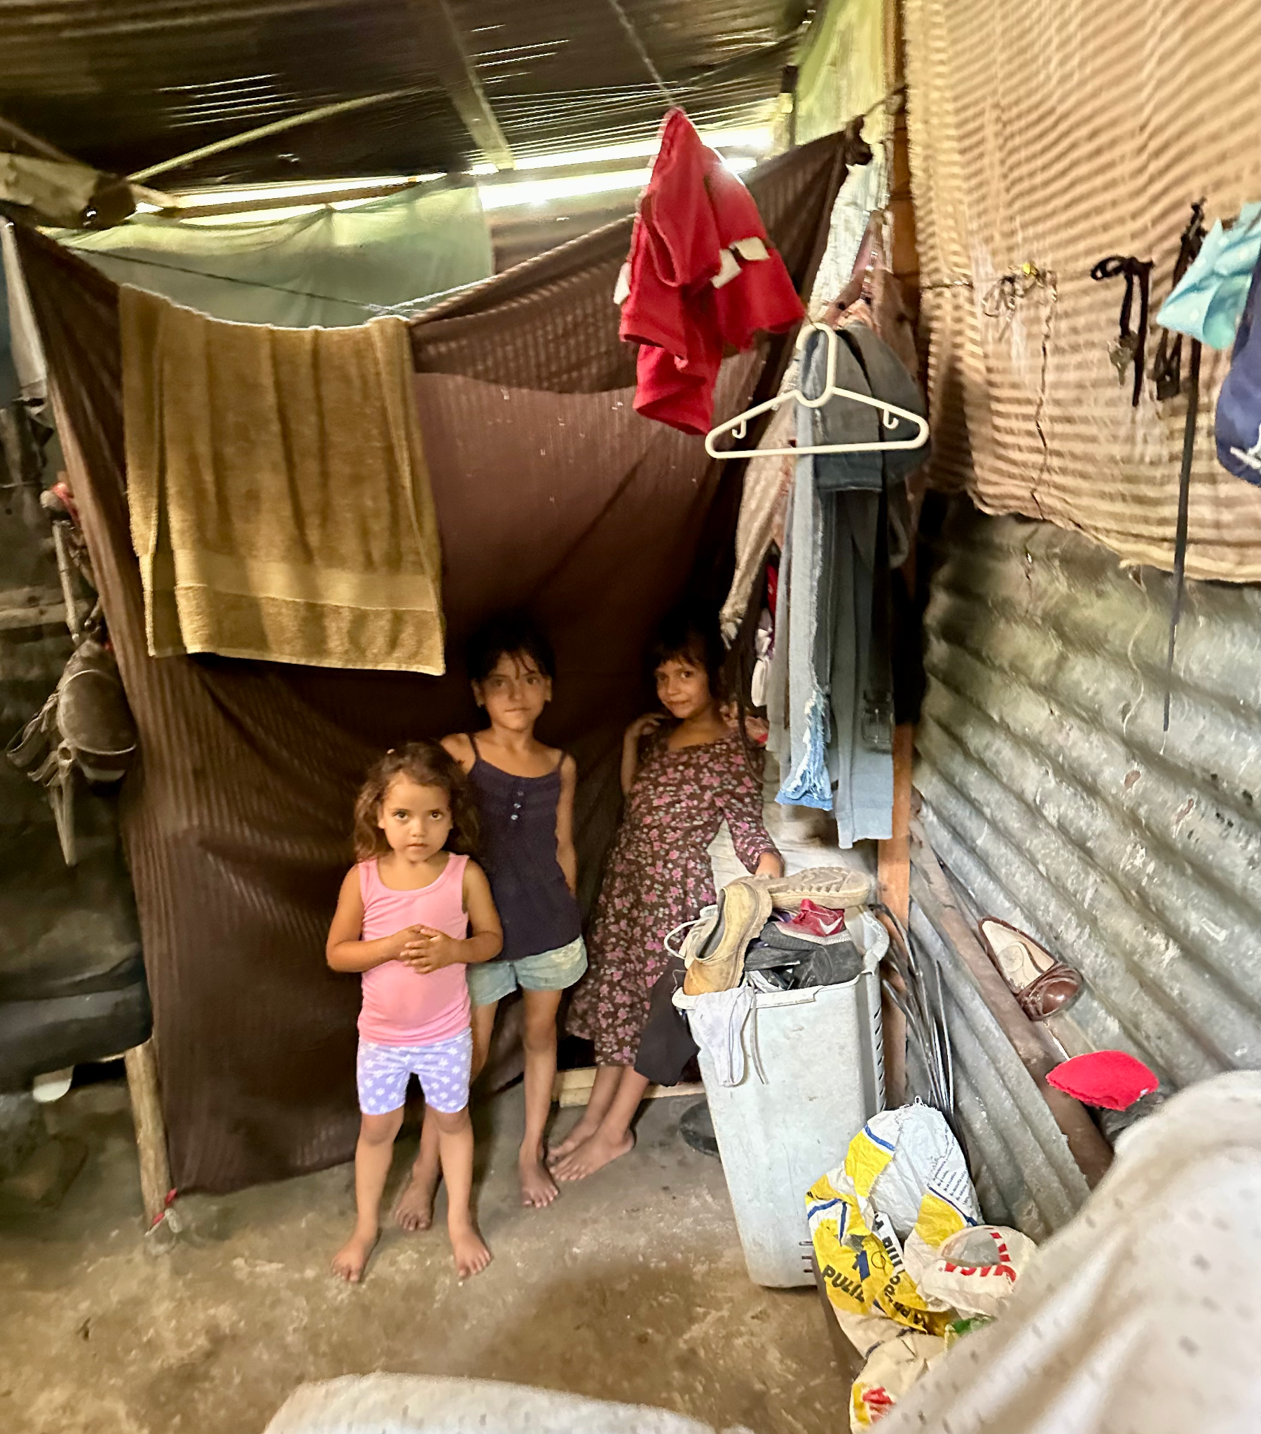

Slide 10
What do we worry about today?
The top common worries we face today
Money and finances. ...
Health and safety of loved ones. ...
Job and career worries. ...
Relationship problems. ...
Appearance worries. ...
world events and politics. ...
Notes:
What do you think the things are we worry about MOST today???

Slide 11
Physiological effects of worry
Increased Heart Rate: Worry can trigger the "fight or flight" response
Muscle Tension
Shallow Breathing
Gastrointestinal Distress
Weakened Immune System
Changes in Appetite
Insomnia
Hormonal Imbalance
Skin Problems
Cognitive Impairments
Cardiovascular Effects
Notes:
Worry is a state of mental distress or agitation….focus on something impending or anticipated

Slide 12
Luke 12: 35-40 Parable of the Expectant Steward
It underscores the importance of living a faithful and prepared life, always expecting Christ's return.
Luke 12:41-48 Parable of the Faithful Steward
It emphasizes that those who have been given much are accountable for their stewardship and will be held to a higher standard.
Notes:
The following provides a great admonition for disciples to be spiritually ready for the coming of the Lord. We know that God will provide for us. Now we must avoid the temptations of evil so that we will not be drawn back into the world….we need to be prepared.
Being a good steward is to: Realize everything belongs to God…be responsible, trustworthy to do good with what God has blessed us with to manage what God has given us
Vs 41 peter asks the question?? Remember vs 1 large number gathered, vs 22 to his disciples
Transition into BE READY because we don’t know when the master returns
If we are so caught up on everything else how will we be ready……I’m not saying we shouldn’t be responsible and live our lives

Slide 13
Luke 13: 22-35
22-30 The Way into the Kingdom
31-35 Christ Mourns over Jerusalem
Luke 14: 25-35
The Cost of Discipleship

Slide 14
Luke 12:23
As Jesus was teaching through the towns and villages on His way to Jerusalem, someone asked Him, “Lord, are only a few people going to be saved?”
What would prompt this question?
Notes:
Jesus’ teachings: often discouraged the half hearted
He even has stated the way is narrow few will enter Mt 7:14
This would contradict the Jewish belief that all Jews..except tax collectors and sinners would be saved
Does this mean very few people will be saved?
I personally see this passage as Jesus speaking to the entire Israelite nation. He was addressing the Jews and Pharisees who believed they were saved because they were God’s chosen people and descendants of Abraham.
Today we may say my parents my grandparents have been christians and I’m a christian…that’s all I’ve ever known…God doesn’t have grand children…personally I’m 7th generation
How many people can fit through a narrow doorway one time? ( we stand before God individually) not a group, not a church
Only one! Jesus is saying that a time is coming, and very soon, that you will no longer be in favor with God or saved simply because you are an Israelite.
Can we fall into the same trap of thinking we are saved because we attend the “right church”?
Josh preached recently it’s about Jesus….Jesus is who saves us…Jesus the narrow door

Slide 15
How did Jesus respond?
Vs 24
“For many, I tell you, will seek to enter and will not be able.
Jesus responds by telling them they will have to make every effort to pass through the narrow door and that many will try to pass through but will not be able to do so.
Notes:
Jesus responds by telling them they will have to make every effort to pass through the narrow door and that many will try to pass through but will not be able to do so.

Slide 16
What did He mean when He used the word STRIVE or EFFORT?
The word strive is borrowed from the word “agonize”
Strive emphasizes intensity in effort
Jesus warns us not to assume that we’ll float into the kingdom with ease….we should expect difficulty!!
Notes:
In Matthew 7:14 Narrow means hard. The way is hard, the gate is narrow, and the people are few.
Strive signifies a struggle against conflict. No one can merit or earn heaven
But entering the narrow gate is nonetheless difficult because of its cost…in terms of pride, fleshly desires, and opposition to truth.
They seek but don’t strive…they don’t do what it takes….to deny self
Possibly look at romans 6:23….the gift is to ACCEPT JESUS

Slide 17
We have many distractions in this life, things constantly trying to pull us away from a relationship with God, especially our adversary, Satan. We are distracted by fear, the pursuit of riches, worry, lust, and our fleshly desires. A life given over to God is a life of full self sacrifice or dying to self, just as Jesus tells us to “count the cost” in Luke 14: 28-35.

Slide 18
Luke chapter 14: 25-35
Christ teaching on Discipleship
Priority of Commitment
Counting the Cost
Plan and Prepare
Be “salty”
Notes:
Salt preserves, considered virtually indispensable
It is symbolic of good

Slide 19
END

