Slide 2
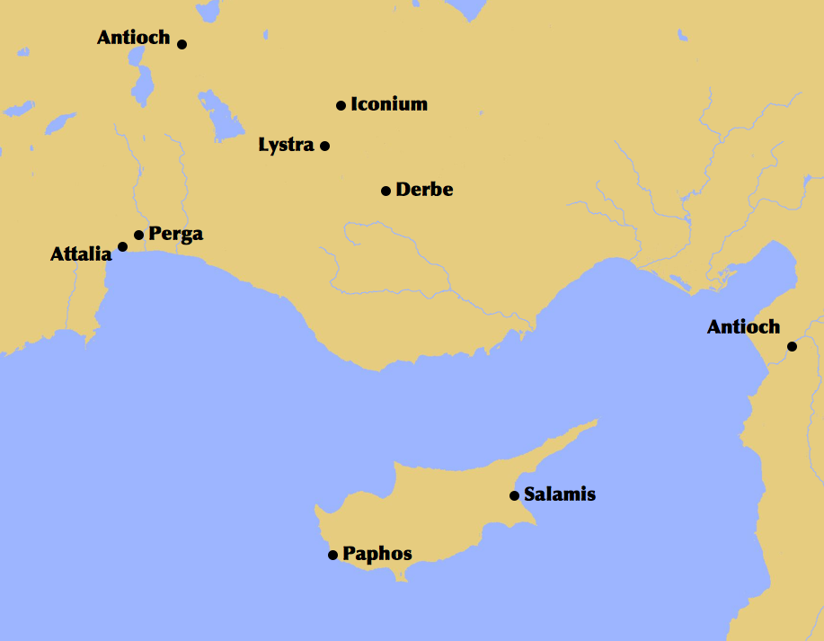
P B
M

Slide 3
P B
M

Slide 4
P B
M

Slide 6
B
P

